Slide 1
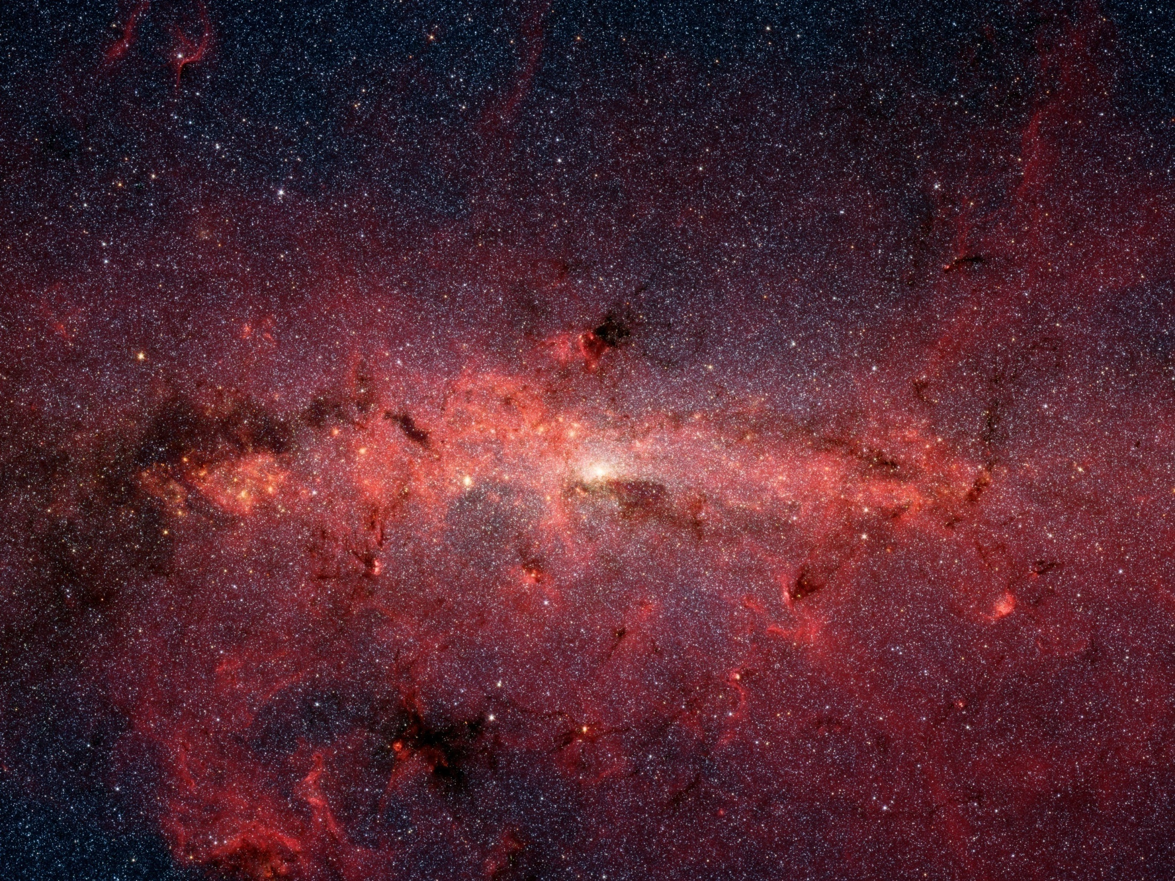
Accessing Particle/Astrophysics Measurements with the NOvA Detector
Designing a Data Driven Triggering & DAQ System for NOvA
Andrew Norman (U. Virginia)
HEP Seminar Argonne National Lab
Aug. 11, 2009
Galactic Center (Spitzer Space Telescope)

Slide 2
Seminar Outline
NOvA’s Core Measurements
Neutrino Osc. Properties
µ₁₃ µ₂₃ ±_{CP} sign(¢m₂₃)
The NOvA Detector
Basic Design as a
¹ range-stack/ EM calorimeter
The DAQ & Triggering
Base Design and Redesign
Advantages &Limitations
Data Driven Triggering Model
Physics Triggering
Core Measurement
Supernova detection
Exotic Topologies
Directional triggers
High E º’s & cosmics

Slide 3
NOvA Core measurements
Neutrino Oscillations and Properties

Slide 4
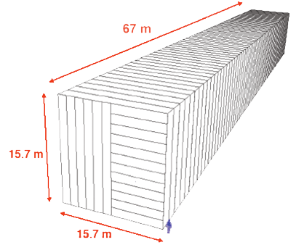
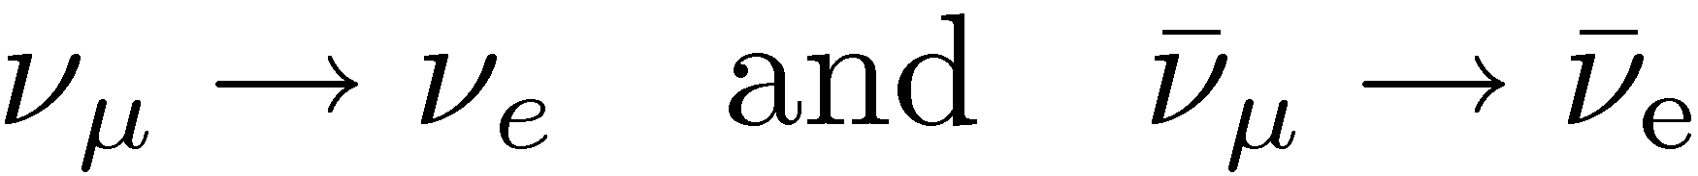
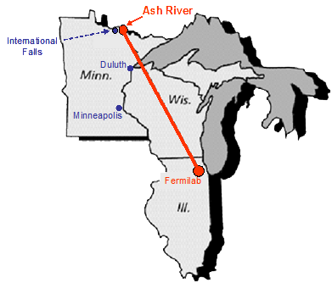
NOvA Overview
NOvA is a second generation accelerator based neutrino oscillation experiment, optimized for detection of the oscillations:
NOvA is:
  A 14 kton, “totally active”, far site detector
  A 222 ton near detector, utilizing an identical detector technology and geometry
  An upgrade of the NuMI beam intensity from 320 kW to 700 kW
Both detectors are “totally active”, highly segmented liquid scintillator calorimeter designs
The detectors are placed 14mrad off the primary beam axis to achieve narrow º_{¹} energy spectrum, peaked at 2GeV.
The far detect sits on a 810km baseline between Chicago and Northern Minnesota at the first oscillation maximum

Slide 5
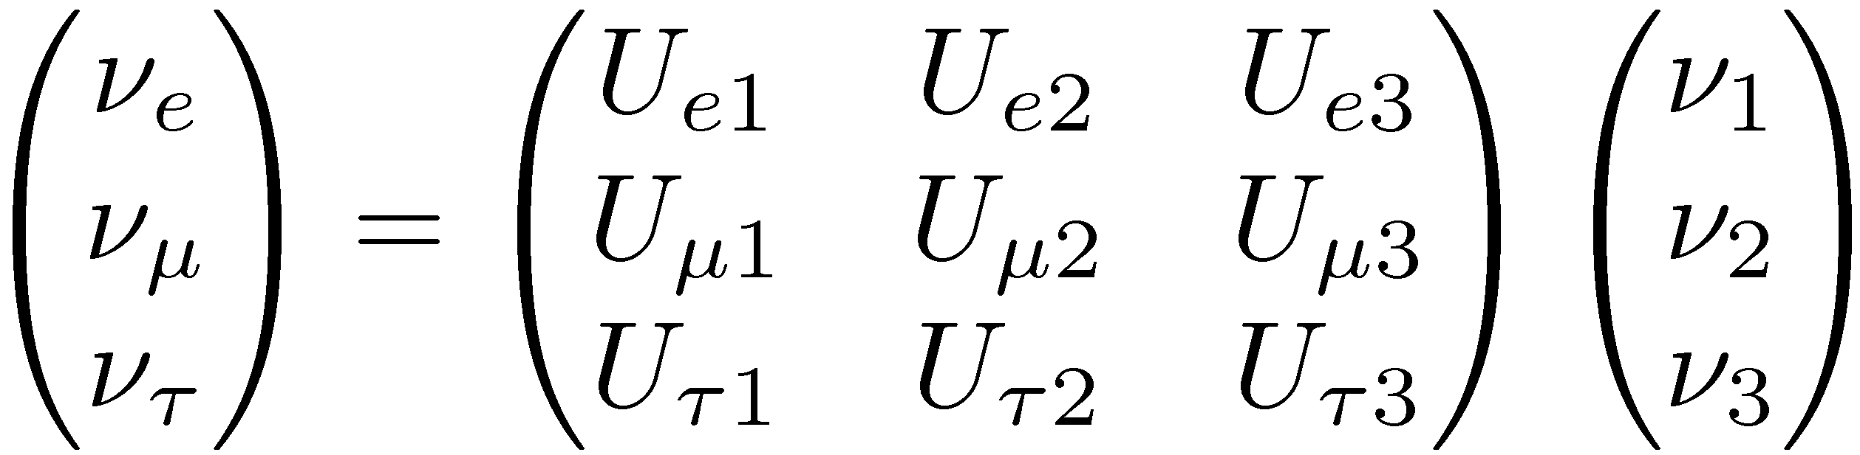
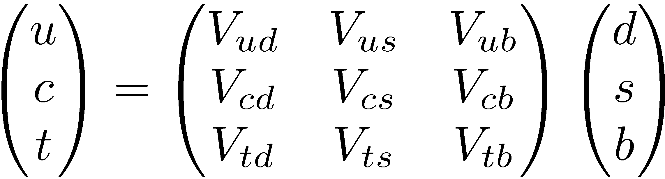
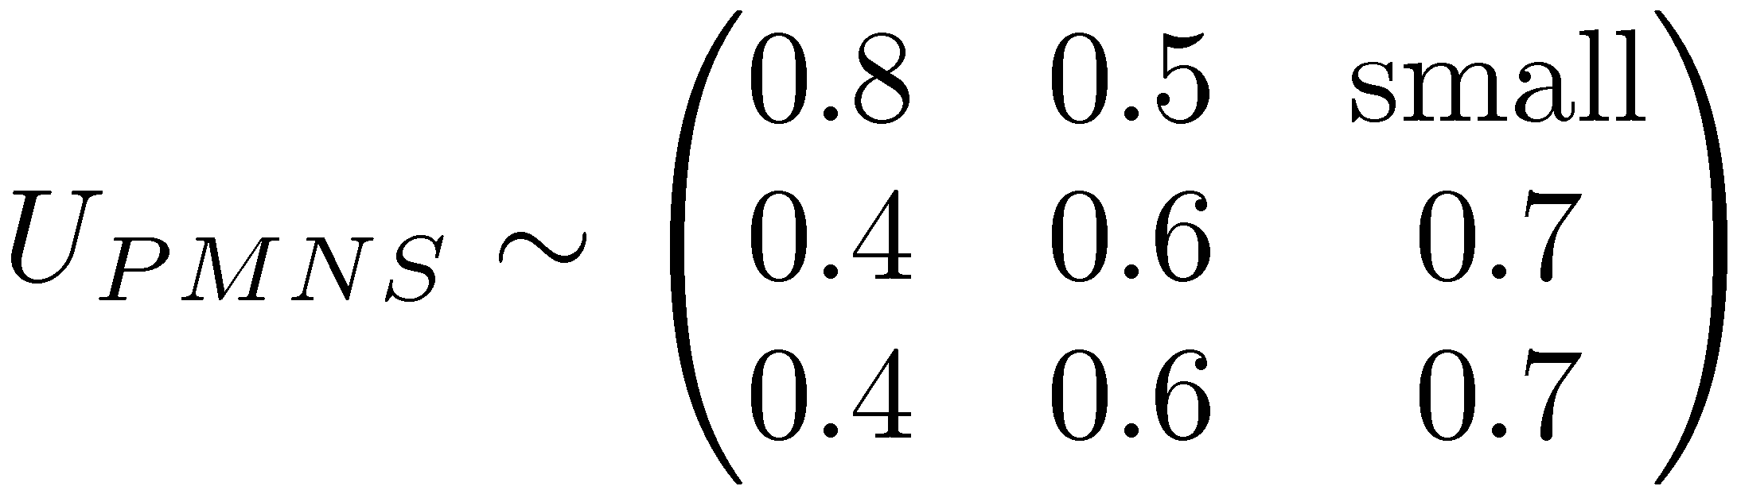
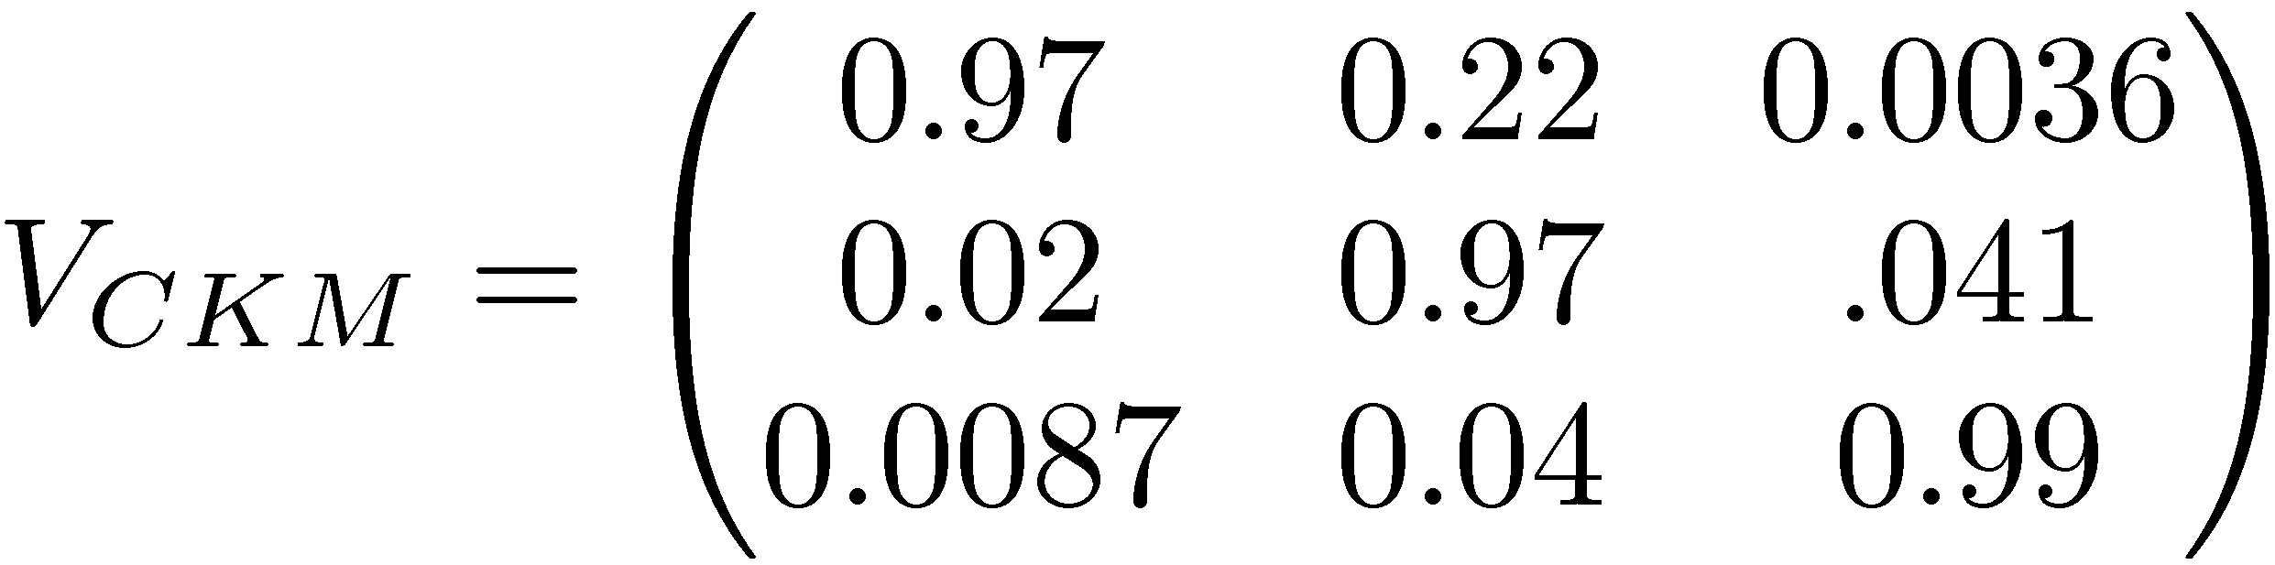
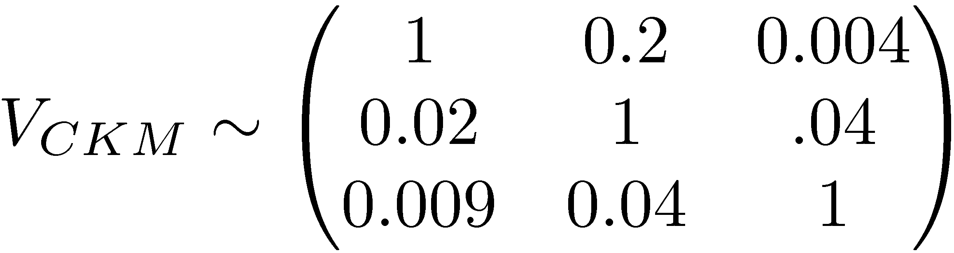
Neutrino Mixing
We know from the Z width that there are three active
(weak coupling) neutrino species
We have observed oscillations between these which implies a mixing through the near degenerate mass eigenstates
In analogy to CKM mixing we setup a mixing structure
Very different structure
Near Unity

Slide 6
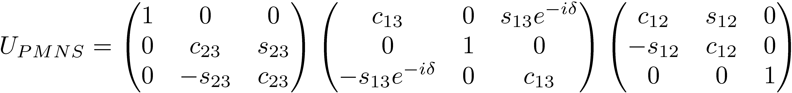
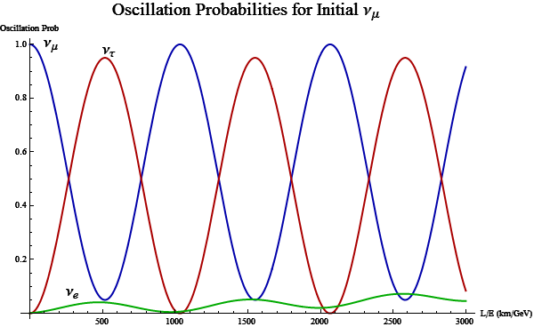



Neutrino Mixing
Re-parameterize as a rotation in 3 angles and a phase
If we examine the oscillation probabilities it becomes clear how to read off PMNS parameters.
NOvA L=810km

Slide 7




Neutrino Mixing
The NOvA Core
measurements
Re-parameterize as a rotation in 3 angles and a phase
Atmospheric/Accelerator
º_{¹} disappearance
Accelerator º_{¹}! º_{e} appearance
Reactor anti-º_{e} disappearance
Solar º_{e} and anti-º_{e}
disappearance
If we examine the oscillation probabilities it becomes clear how to read off PMNS parameters.
This leads to the classification of the mixing angles in terms of the characteristic L/E scale that is needed to view the oscillation
NOvA L=810km

Slide 8

Core Questions for NOvA to Address
  What is the value of µ₁₃ ?
  Is µ₂₃ maximal?
  Do neutrinos violate CP?
  What is the mass structure of the known neutrinos?
  Are neutrinos their own anti-particles?
  What can neutrinos tell us about physics beyond the standard model? Sterile Neutrinos?
  What can we learn from the neutrino burst of a near galactic Supernova?

Slide 9
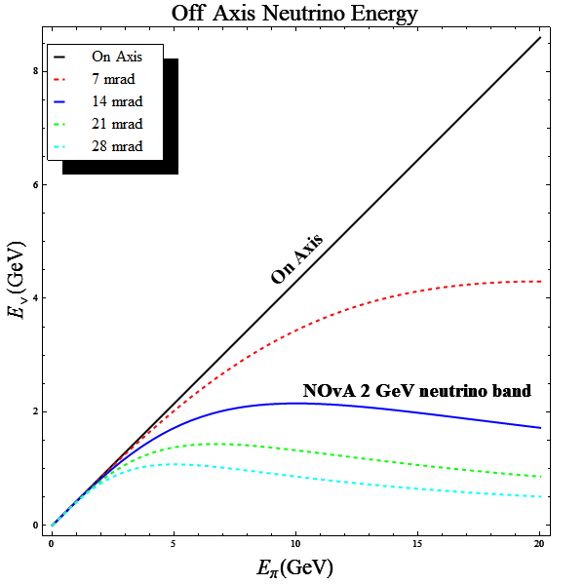
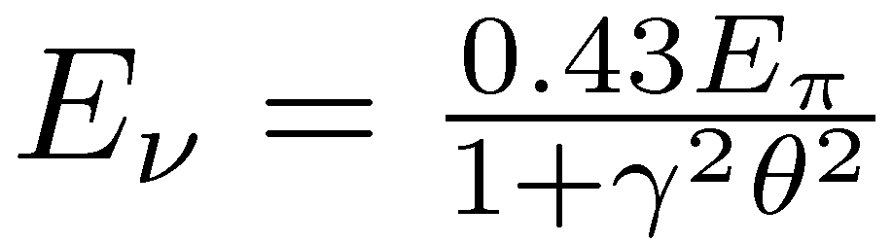
The Off-Axis Beam
The Off-Axis Effect
In the pion rest frame the kinematics are all completely determined for the decay
But when we boost into the lab frame the neutrino’s energy depends on the angle relative to the boost direction.
This ends up projecting the neutrino energy spectrum down to be almost flat.
¹
¼
º
º
Boost °
¼
µ
¹

Slide 10
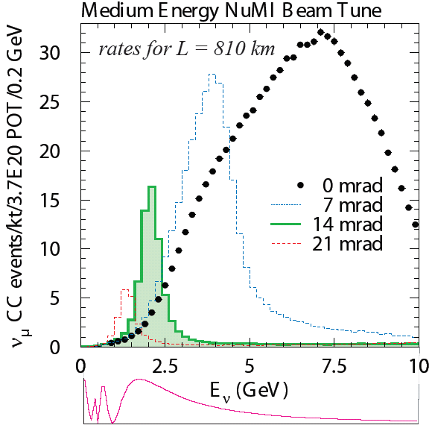
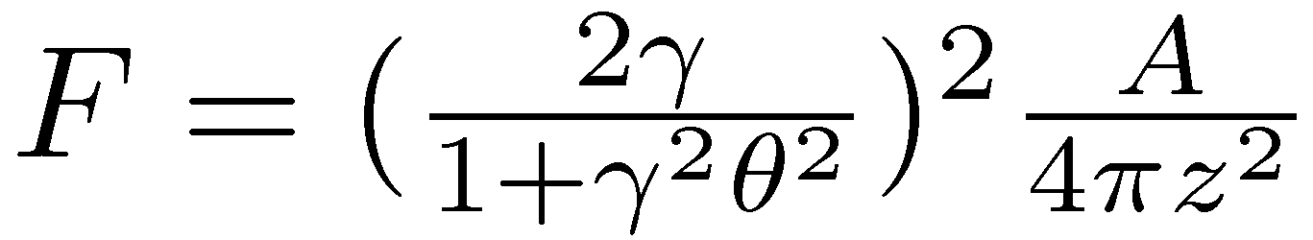
The Effect of Going Off-Axis
By going off-axis, the neutrino flux from ¼ ! ¹ + º is reduced at a distance z to:
But we narrow the º energy spread:
For NOνA, moving 14 mrad off axis makes the NuMI beam energy
  peak at 2 GeV
  E_{º} width narrows to 20%
The detector is matched well to this narrow band beam with an energy resolution » 4% for º_{¹} CC events
L/E Matched to 1st Osc. Max

Slide 11
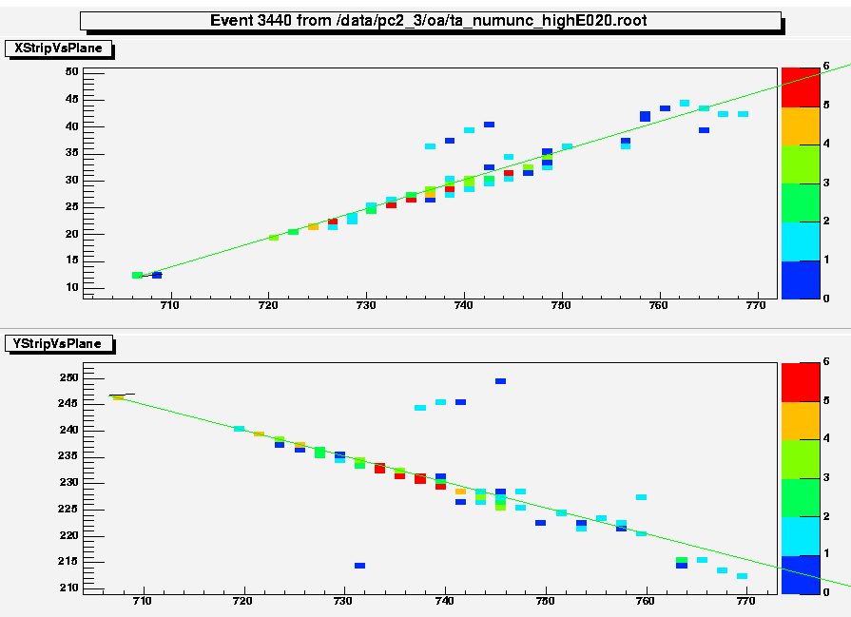
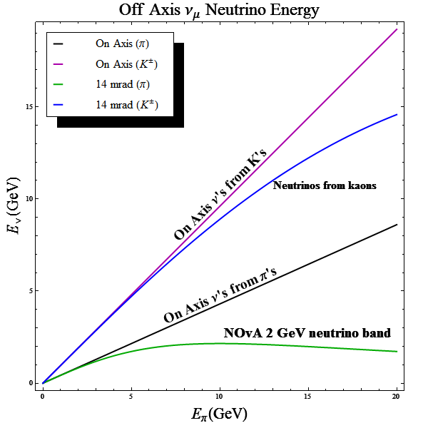

The Advantage of Going
Off-Axis
º _{¹} NC BKG Topology
To Make the º_{e} appearance measurement you need to suppress backgrounds
  Main background for the º _{e} CC event topology is a º _{¹} NC event with a ¼⁰ that is not fully reconstructed
  Off-axis projection (narrow energy band)
  suppresses the high energy º _{¹} NC tail
  Other backgrounds are the intrinsic º_{e} component of the beam (K§ ! ¼⁰ e§ º_{e} ) which are small (but
  so is µ₁₃) which get projected off the energy band.
To improve the µ₂₃ disappearance measurement:
  Significantly reduces the backgrounds from kaons (K§!¹§º) by shifting the neutrino energy to a different band
  Neutrino peak is primarily from π decays
  Energy spectrum in the signal region becomes almost insensitive to the π/K ratio
°
°
¼⁰
°
¼⁰
°

Slide 12
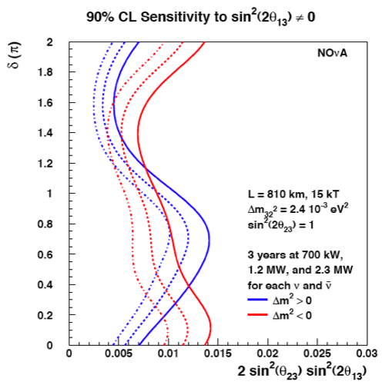
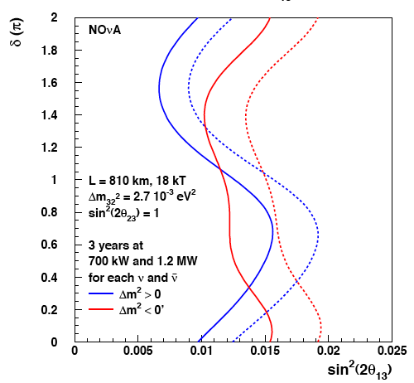
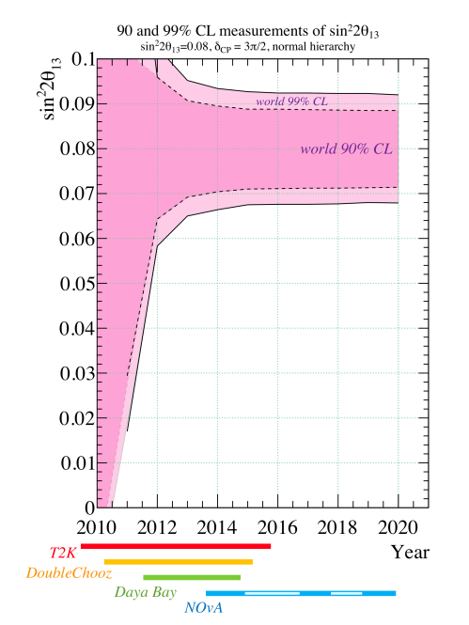
Sensitivity for µ₁₃ from º_{¹} ! º_{e}
Target Nova sensitive to electron neutrino appearance »0.01 at 90% CL
In an kind world µ₁₃ is large
(T2K & DoubleChooz observe µ₁₃ ≠ 0)
This opens up NOvA’s access to measuring
± _{CP} and mass hierarchy resolution
M.Messier

Slide 13
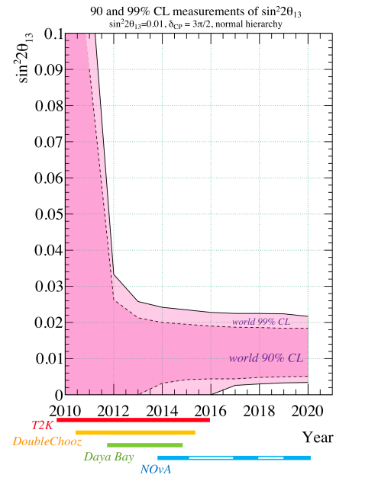
Sensitivity for µ₁₃ from º_{¹} ! º_{e}
Target Nova sensitive to electron neutrino appearance »0.01 at 90% CL
In a cruel world µ₁₃ is small
This greatly reduces NOvA’s access to ±_{CP} and mass hierarchy resolution
M.Messier

Slide 14
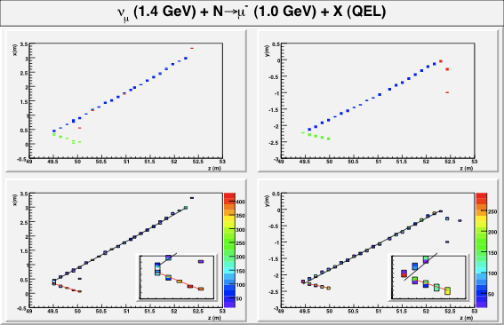
Sensitivity to sin²(2µ₂₃)
The detector’s energy resolution, allows NOºA to perform the disappearance measurement to 1%
Typical 2GeV º_{¹} CC-quasielastic event has »120 hit cells
(dE/dx ¼ 12MeV/plane for MIPP)
If sin²(2µ₂₃)≠1, we can then resolve the quadrant (µ₂₃ > ¼/4 or µ₂₃ < ¼/4, )
Measure if º₃ couples more to º_{¹} or º¿
If sin²(2µ₂₃)=1 then this is also interesting since it could be hint at a basic symmetry

Slide 15
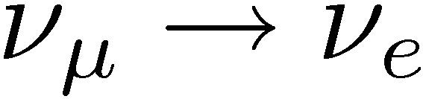
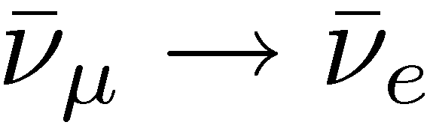
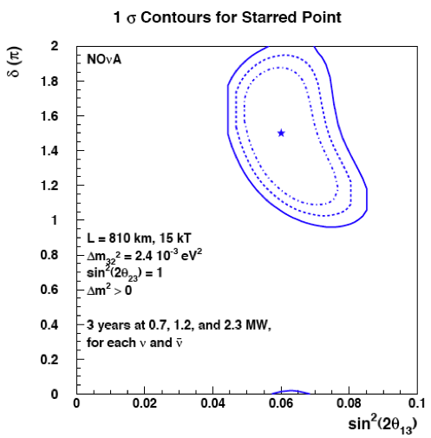
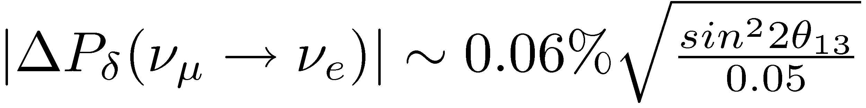
CP Violation
The Large Mixing Angle (LMA) solution gives sensitivity to ±_{CP} in the difference between the and transitions amplitudes.
In vacuum, the transition probability is shifted with ± where at the first oscillation maximum the shift can be simplified to:
For NOvA to measure ±_{CP} we must first observe a (large enough) non-zero º _{¹} ! º _{e} amplitude.
But in matter, the ultimate sensitivity of NOνA for resolving the CP ambiguities depend on both the value of θ₁₃ and ±

Slide 16
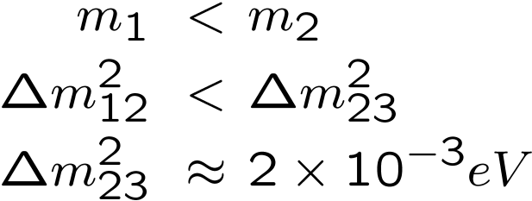
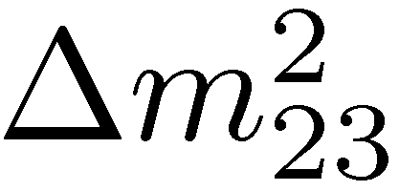
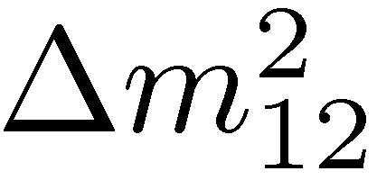
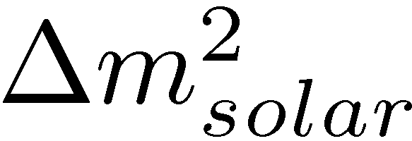
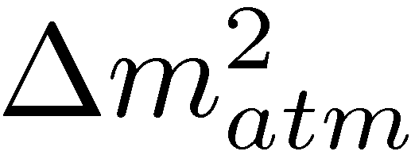
Mass Ordering
From solar and atmospheric data we know:
Normal
This leads to two possible mass hierarchies
  A “normal” order which follows the charged lepton mass ordering
  An “inverted” order where m₃ is actually the lightest
NOºA can solve this by measuring the sign of m₂₃ using the MSW effect over the 810km baseline
Inverted

Slide 17
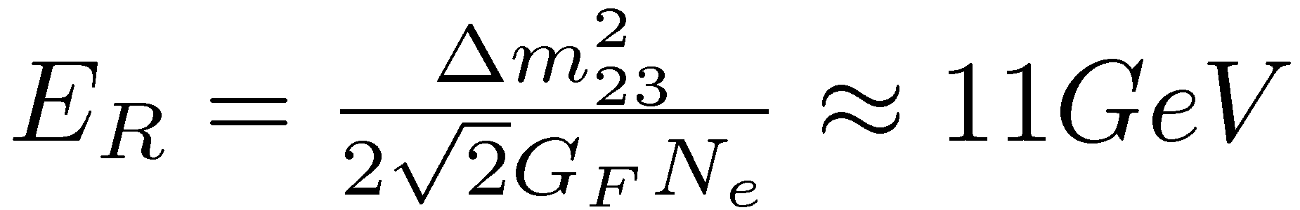
Matter Effect
The forward scattering amplitudes for neutrinos and anti-neutrinos through normal matter differ due to the inclusion of the extra diagram for interactions off electrons
This difference breaks the degeneracy in the neutrino mass spectrum and modify the oscillation probability
If the experiment is performed at the first peak in the oscillation then the matter effects are primarily a function of the beam energy and approximated by:
In the normal hierarchy this matter effect enhances the transition probability for neutrinos and suppresses the probability for antineutrinos transitions
With an inverted hierarchy the effect is reversed
For the 2 GeV neutrino beam used for NOºA, the matter effect gives a 30% enhancement/suppression in the transition probability.

Slide 18
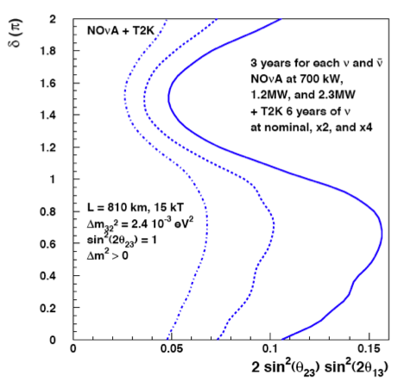
Matter Effect
The forward scattering amplitudes for neutrinos and anti-neutrinos through normal matter differ due to the inclusion of the extra diagram for interactions off electrons
This difference breaks the degeneracy in the neutrino mass spectrum and modify the oscillation probability
If the experiment is performed at the first peak in the oscillation then the matter effects are primarily a function of the beam energy and approximated by:
In the normal hierarchy this matter effect enhances the transition probability for neutrinos and suppresses the probability for antineutrinos transitions
With an inverted hierarchy the effect is reversed
For the 2 GeV neutrino beam used for NOºA, the matter effect gives a 30% enhancement/suppression in the transition probability.
Resolution of the
hierarchy

Slide 19
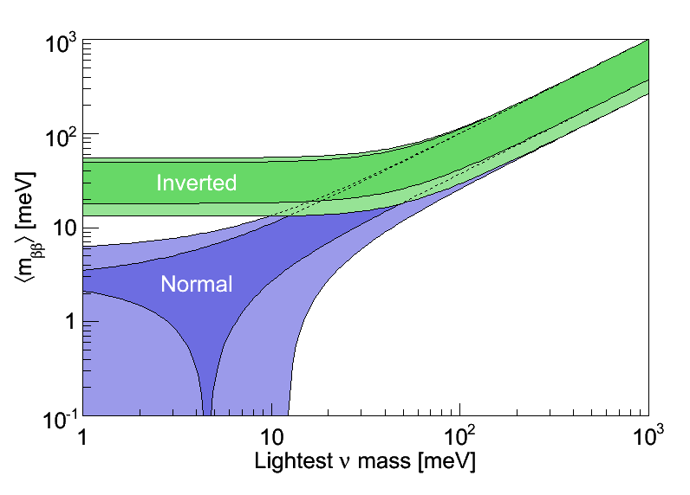
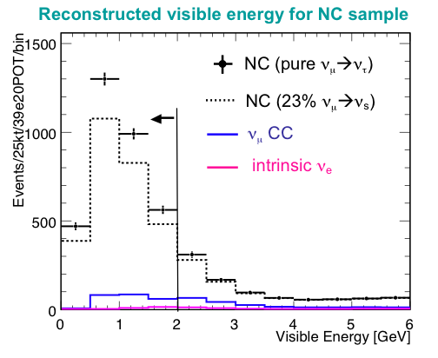
More NOvA Physics
Dirac/Majorana
Sterile Neutrinos
KKCD ⁷⁶Ge Result
Disfavored by current 0º¯¯ Limits
Disfavored by Cosmology
KATRIN expected sensitivity
Expected Next Generation
0º¯¯ Limits (10-100meV)
If NOvA can establish the inverted mass hierarchy, then the next generation of neutrinoless double-¯ decay experiments should see a signal, else it is highly likely that neutrinos are Dirac in nature.
The high granularity of the NOvA detector makes clean measurements of the NC cross sections possible, and allows for Sterile neutrino searches

Slide 20
The NOVA Detector
Design and Physics Parameters

Slide 21
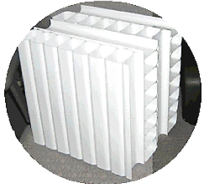
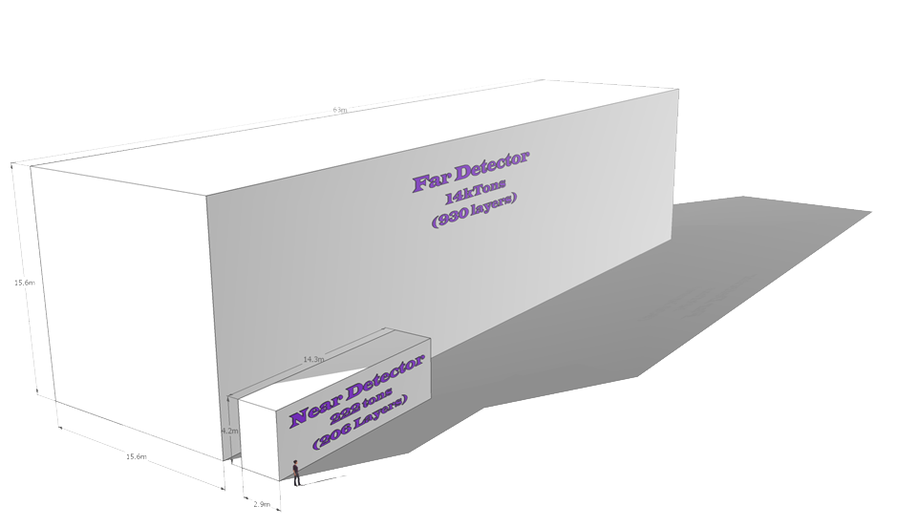
NOvA Detectors
Beam Direction
Far Detector
14kTons – 930 layers
Alternating X/Y measuring planes
Design has 30 modular “blocks” for assembly
Over 357,000 independent measurement cells
> 70% of total mass is active
Located 14mrad off axis
810km baselines
Near Detector
222 Tons – 206 layers
2 modules wide, six blocks deep
Includes muon catcher for ranging out ¹’s
Located 14mrad off axis in NuMI, next to MINOS cavern

Slide 22
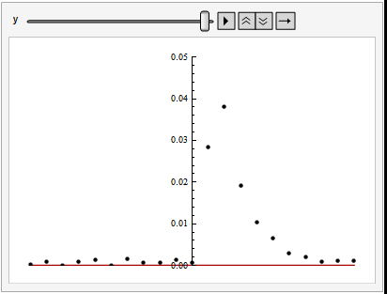
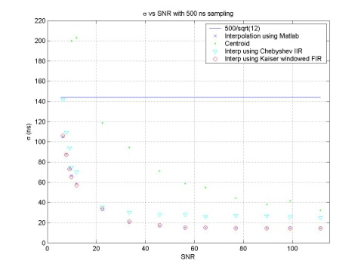
Detector Cell
Single Cell
NOºA Detection Cell
The base detector unit 3.9x6.6cm cell 15.7m long, filled with a mineral oil based liquid scintillator.
Passage of MIPP through the cell (longitudinal to beam) results in dE/dx ¼12.9 MeV across the cell.
  Roughly 10% of energy loss is in the PVC wall
  Yields 10-12MeV of deposition in the scint.
The measured light output is 30-38 p.e. from the far end of the cell into the APD readout
Light yield gives a minimum
Sig/Noise 10:1 (far end)
Zero Suppression
Expected noise (electronic) 300e » 3 p.e.
Continuously digitizes w/ 500ns sampling
Zero suppress (0.5-0.66) MIPP (15-20pe) depending on final light yields
Results in a single cell, lower energy detection threshold of 6-8 MeV (far end)
To APD Readout
Matched Filtering
Scintillation Light
15.5m
Raw data is matched to ideal response function in the FPGA, to extract pulse height and timing edge.
Timing resolution is a function of Sig/Noise (10:1 min) giving a timing resolution of < 30ns
Particle Trajectory
Waveshifting
Fiber Loop
3.9cm
6.6cm
There are 357,120
cells in NOνA

Slide 23
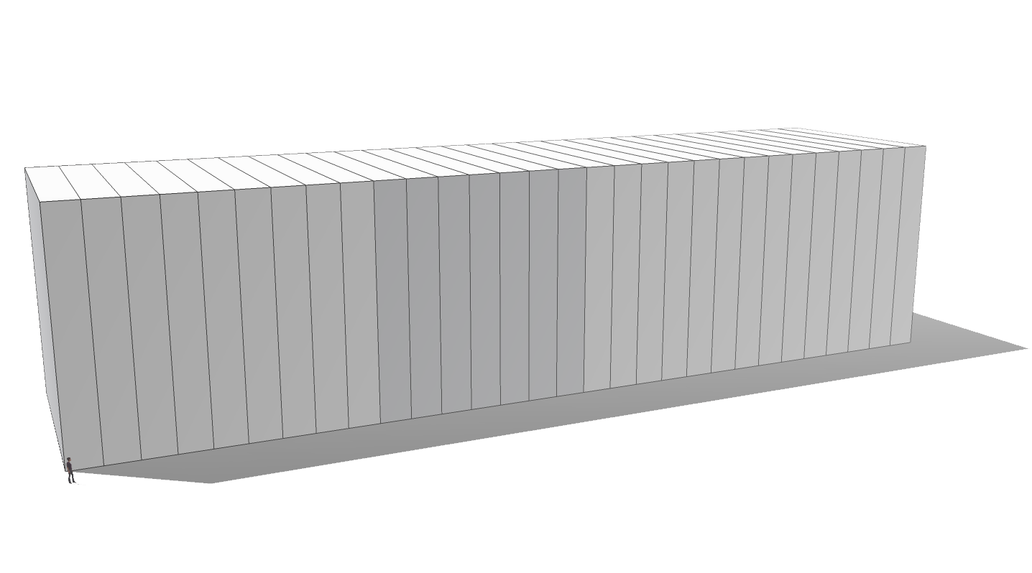
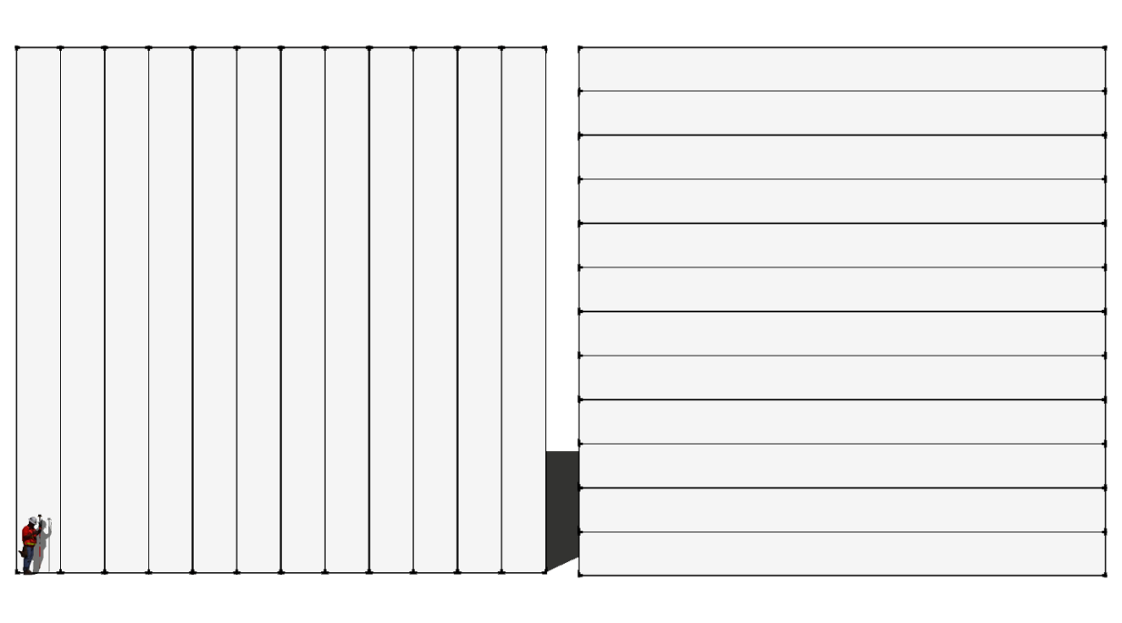
Muon Range Stack
930 X/Y Planes
¢E = 12 GeV
(¢E = 400 MeV/Block)
The detector can be though in the longitudinal direction as a 12GeV high segmented, low Z range stack. In the transverse direction a crossing ¼ 3GeV range with up to 384 sampling points
¢t = 52 ns
¢E = 2.9 GeV
34 X₀

Slide 24
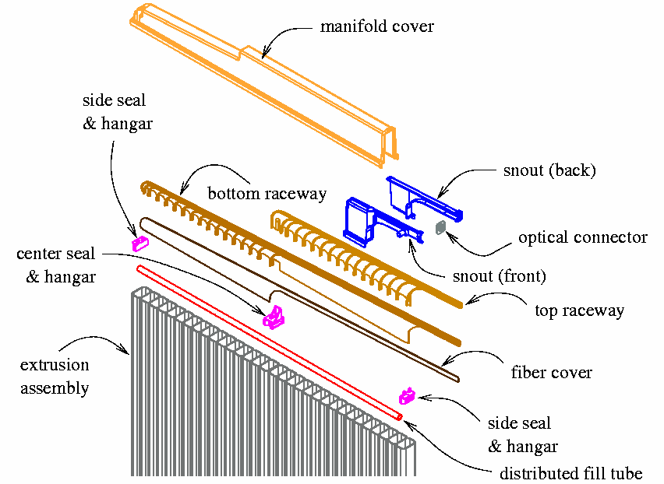
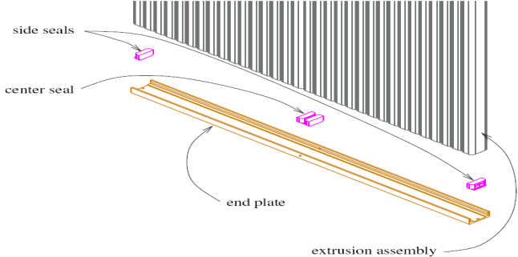
Detector Modules
NOνA Modules
The NOνA detector module forms the base unit for the detector.
Each module is made from two 16 cell high reflectivity PVC extrusions bonded into a single 32 cell module
Includes readout manifold for fiber routing and APD housing
Combined 12 module wide X or Y measuring planes.
Each module is capped, and filled with the liquid scintillator.
These are the primary containment vessel for the 3 million gallons of scintillator material.
There are 11,160 detector modules with a total of 357,120 separate detection cells in the NOνA Far Detector.
Two 16 cell extrusions
PVC Extrusions
Each extrusion is a single 15.7m (51.5ft) long set of 6x3.9cm cells. Two extrusions are joined to form a single 1.3m wide module
Single Cell
15.7m
One Module
6cm
1.3m
3.9cm

Slide 25
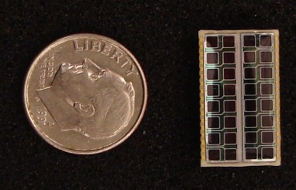
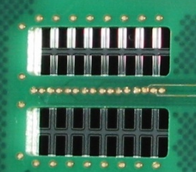
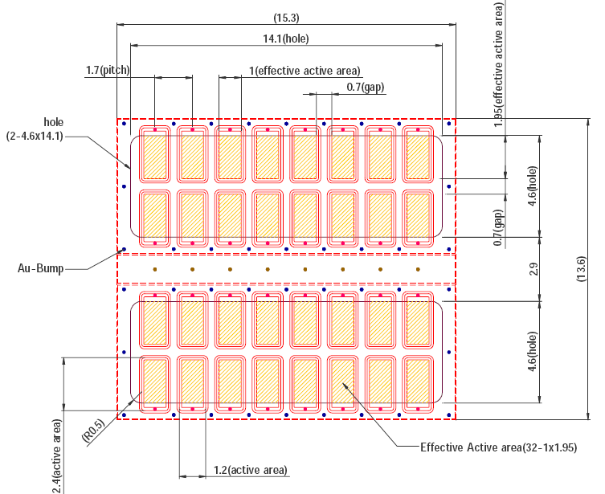
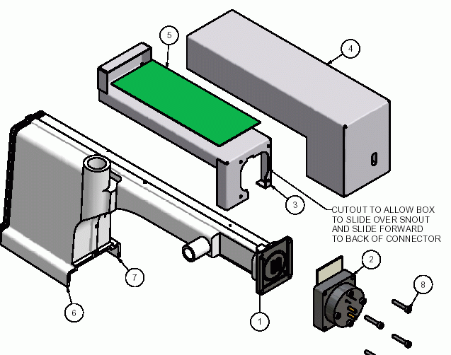
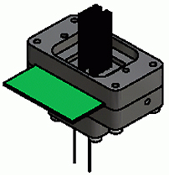
Avalanche Photodiodes ̶ APDs
0.15mm
Pixel Geometry
Each pixel is designed to have an active area 1.0mm by 1.9mm to
accommodate the aspect ratio of the two 0.7mm fiber ends from a single cell
The NOνA Readout
Require 357,120 optical readout channels
Custom designed 32 channel APD (Hamamatsu)
High 85% Q.E. above 525nm
Cooled to -15° to achieve noise rate < 300 electrons
Operated at gain of 100 for detection of 30-39 photon signal from far end readout
Signal to noise at far end 10:1
0.25mm
1.9mm
0.7mm
1.0mm
The bare APD is bonded to the carrier board to provide the optical mask and electrical interface
The 32 pixel APD array for the NOνA Readout System
APD Module
64 fiber
bundle
“Clam Shell”
Optical Housing
FEB
Carrier Board
w/ APD chip
32 Module
Fiber Feed (64 ends)
APD
Module
Heat Sink
Interface

Slide 26
Physics Triggering
DAQ & Trigger

Slide 27
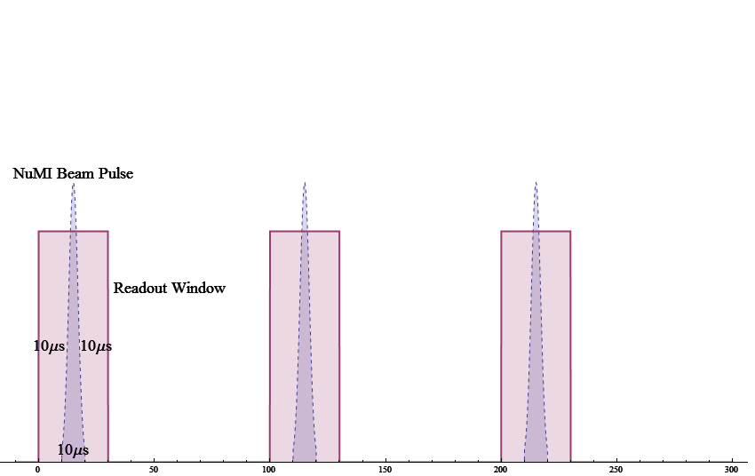
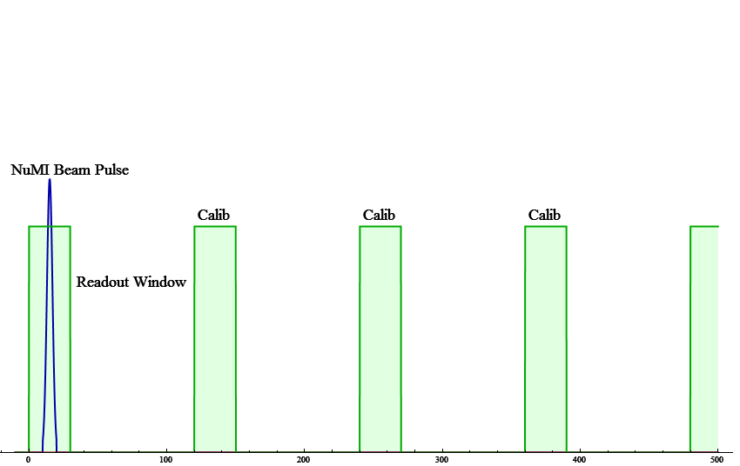
NOvA Core Measurements
For all of the core NOvA physics topics—
{µ₁₃, µ₂₃, ±_{CP} , ¢m² } the only triggers you need are:
  Beam spill
  Calibration pulser
Both of these are completely open zero bias triggers. They impose no restrictions on the data and do not examine the event topologies.
Beam Spill Trig
  30 \mu s window centered on GPS time of NuMI spill at FNAL
¢t=2s, 1.1s
Calibration Pulser
  Random sampling of 30 ¹ s windows at 100£beam period

Slide 28
Data & Noise Rates
Front End
To Tape
Raw single channel hit rate » 100 Hz (noise + cosmics ¹’s)
But < 30 Hz average noise hit rate per channel
Rate into each DCM » 2 MB/s
Rate into buffer farm » 360 MB/s (738 MB/s peak)
All 200,000 time windows in a beam spill cycle are extracted to the buffer/trigger farm.
We write 303 of the 200,000 time windows per cycle to tape
  The rest are lost
Spill Trigger Data
  \approx 12-23 kB/s
  Only \sim 250 Gb/yr
  12 kB/s peak rate to storage
Calibration Data
  Manditory “Zero Bias” sample
  100x the spill window (3ms)
  1.1-2.3 MB/spill
  12-24 TB/yr

Slide 29
DAQ Data Flow and Triggering
FEB
FEB
FEB
FEB
11,160 Front End Boards
FEB
FEB
FEB
FEB
FEB
FEB
Data
Ring
5ms data
blocks
FEB
FEB
Data Driven Triggers System
FEB
FEB
DCM 1
Trigger
Processor
Trigger
Processor
….
Trigger
Processor
DCM 1
Zero Suppressed
at <2/3-1/2 MIPP
(6-8MeV/cell)
DCM 1
DCM 1
180 Data Concentrator Modules
DCM 1
DCMs
Minimum Bias
0.75MB/S Stream
Data Driven
Trig. Decisions
Event builder
COtS Ethernet 1Gb/s
Grand
Trigger OR
Trigger Reception
Triggered
Data Output
Data Slice Pointer Table
Data
Data Time Window Search
»140 Buffer Node Computers
Buffer Nodes
Data
Buffer Nodes
Trigger Broadcast
Buffer Nodes
Buffer Nodes
Buffer Nodes
Buffer Nodes
Data Logger
Buffer Nodes
Global Trigger Processor
Beam Spill Indicator
(Async from FNAL @ .5-.9Hz)
Calib. Pulser ( 50-91Hz)

Slide 30

Buffer Farm (Trigger Farm)
NOvA Uses ¼ 140 commodity class compute nodes as a long duration “buffer” for the raw data
Number of buffer nodes is network I/O driven
  With un-buffered switches need almost 1:1 mapping of DCM→BufferNode to handle total data throughput
  Leads to 3-layer switch array and Round-Robin Data pattern
Buffer depth is driven by latency for the “spill signal” to transit over the open Internet up to Ashriver
  MINOS Lore:
  Latency <t>¼600ms, where 99% arrive within 5s (but there’s a long tail)
  Baseline NOvA design assumes maximum latency of 20s
Moore’s Law Note:
When the DAQ buffer farm was first spec’d (2005) the first dual core chip was not yet introduced.
The buffer farm was not envisioned to be able to handle the I/O requirements & derive topology based triggers
Today the machines that are being bought for 2009/2010 are Dual 6 Core Boxes
(12 processor cores per node)
Projection for 2012 DAQ purchase are 16 core chips (Intel & AMD timelines)
Moore’s Law makes NOvA
Data Driven Triggers possible

Slide 31
Data Driven Triggering
Motivation:
  Spill length is only 10¹s with a 2s (1.33s) rep. rate.
    Beam trigger is forced readout without prescale of
    30 ¹s window (beam spill § 10 ¹s buffer)
  Means the detector is idle almost constantly
  Total live time/yr ¼ 2.6 min
  Total “beam spill” data rate is only 12-23kb/spill (250Gb/year max)

Slide 32

NOvA Event Buffer
Each buffer node contains a single circular “Event Buffer”
The buffer holds raw hit data from the entire detector, grouped in 5ms slices
Buffer Size ¼ 30 slices deep (0.15s per node)
  Gives system wide buffering of 20s of data
  Actual size is roughly 115MB (30£3.8MB)

Slide 33

NOvA Event Buffer
Each buffer node contains a single circular “Event Buffer”
The buffer holds raw hit data from the entire detector, grouped in 5ms slices
Buffer Size ¼ 30 slices deep (0.15s per node)
  Gives system wide buffering of 20s of data
  Actual size is roughly 115MB (30£3.8MB)

Slide 34
Network Data Routing
The Goal is to get the full data stream from the entire detector, for a given 5ms time slice out of the 180 data concentrator modules and into a single “buffer node” computer in the counting house.
But this is a continuous streamed readout, so there can be no network latency.
A “three layer” switch array is employed that maps equal number of input/output ports across switch layers forming a dedicated path between all start and end points
DCM-1
1
Switch
Switch
Switch
Buffer Node-1
DCM-2
2
Buffer Node-2
DCM-3
3
Buffer Node-3
DCM-4
4
Buffer Node-4
DCM-5
5
Switch
Switch
Switch
Buffer Node-5
DCM-6
6
Buffer Node-6
…
Buffer Node-…
DCM-…
N
DCM-N
Buffer Node-N
Notes:
Simplified sketch of a switch array.
In this drawing, DCMs are connected on the left, and Buffer Nodes are on the right.
All DCMs can connect to all Buffer nodes in turn.
Writes to buffer nodes are timed to prevent blocking in the switch.
Like colored balls represent data from same time period.
At startup DCMs wait their turn before outputting
Once the system is running, all DCMs can transmit data to different buffer nodes at the same time.
Allows for high bandwidth from the DCMs to the buffer nodes.

Slide 35
Data Routing
But what really happened:
  and collided at the output of the 3rd layer switch,
  causing retransmission of
  Actually all had potential collisions at the third layer
  Additionally & , & , & , & collide on the second layer
Each collision causes a delay (random with exponential backoff) and retransmission.
This has the potential to break the DAQ stream
1
2
2
3
4
5
6
…
N
1
5
2
6
3
…
4
N
7 collision
DCM-1
1
Switch
Switch
1 collision
Switch
Buffer Node-1
DCM-2
2
1 collision
Buffer Node-2
DCM-3
3
Buffer Node-3
DCM-4
4
1 collision
Buffer Node-4
1 collision
DCM-5
5
Switch
Switch
Switch
Buffer Node-5
DCM-6
6
Buffer Node-6
…
Buffer Node-…
DCM-…
N
DCM-N
Buffer Node-N
Notes:
Simplified sketch of a switch array.
In this drawing, DCMs are connected on the left, and Buffer Nodes are on the right.
All DCMs can connect to all Buffer nodes in turn.
Writes to buffer nodes are timed to prevent blocking in the switch.
Like colored balls represent data from same time period.
At startup DCMs wait their turn before outputting
Once the system is running, all DCMs can transmit data to different buffer nodes at the same time.
Allows for high bandwidth from the DCMs to the buffer nodes.

Slide 36
Ethernet Switch Array (Startup)
One solution is to “stagger” the transmission of packets out of the Data Concentrators and force each successive time window into a different Buffer Node.
This results in data pattern that is free of collisions and utilizes the full aggregated bandwidth of the three layers.
But….if the staggering becomes de-synchronized, the system is prone to collisions and the time to fill a single node is N_{buffer} £ t_{slice}
1
1
1
1
1
1
1
1
1
1
Switch
Switch
Switch
DCM-1
Buffer Node-1
2
2
2
2
2
2
2
2
2
2
DCM-2
Buffer Node-2
3
3
3
3
3
3
3
3
3
3
DCM-3
Buffer Node-3
4
4
4
4
4
4
4
4
4
4
DCM-4
Buffer Node-4
5
5
5
5
5
5
5
Switch
Switch
Switch
5
5
5
DCM-5
Buffer Node-5
6
6
6
6
6
6
6
6
6
6
DCM-6
Buffer Node-6
7
7
7
7
7
7
7
7
7
7
Buffer Node-…
DCM-…
8
8
8
8
8
8
8
8
8
8
DCM-N
Buffer Node-N
Notes:
Simplified sketch of a switch array.
In this drawing, DCMs are connected on the left, and Buffer Nodes are on the right.
All DCMs can connect to all Buffer nodes in turn.
Writes to buffer nodes are timed to prevent blocking in the switch.
Like colored balls represent data from same time period.
At startup DCMs wait their turn before outputting
Once the system is running, all DCMs can transmit data to different buffer nodes at the same time.
Allows for high bandwidth from the DCMs to the buffer nodes.

Slide 37

“Round Robin” Buffering
NOvA Round Robin Event Buffer
(138 Buffer Node Model)
Why Round Robin?
In 2005, commercial off the self network switch technology didn’t provide the buffered throughput to accommodate the streaming NOvA data rate out of the Data Concentrator Modules. The solution was to distribute the bandwidth across multiple physical switch/buffer nodes paths. This results in the Round Robin pattern.
Adjacent time windows are offset by the size of the buffer farm
For 140 node farm this means a 0.7s offset between adjacent slices
Limitation:
Time correlations across MilliSlice windows are difficult. ¢t_{ave} ¼ 2.5ms.

Slide 38

“Round Robin” Buffering
5ms time slice
(¼ 3.8MB)
Next time slice at
¢t= 5ms£NBuffers
= +0.69s
Average thoughput into each node ¼ 5.4 MB/s
Total farm wide throughput ¼ 0.75 GB/s (6 Gbit/s)
Awkward data topology – Adjacent slices are spread across physically different machines
Correlations are almost impossible – Buffer nodes don’t have a map of the data distribution
(system partitioning and resource management)
Additional Information passing defeats the original purpose of load balancing by Round Robin

Slide 39
TRIGGER TYPES

Slide 40



SuperNOºA Detection
Primary SuperNOºA Detection Signal is the inverse beta decay reaction:
For a supernova at 10kpc the total signal is expected to contain:
  5000 total interactions over a time span of ¼ 10s
  Half the interactions in the first second
  Energy peaks at 20MeV and falls off to » 60MeV
Challenge is triggering in real time
  Need data driven open triggering
  Long event buffering (» 20sec)
  Time window correlation, merging
On successful trigger requires a 300 fold spike in rate to tape to dump the entire buffer
Cosmics Background
Suppress trig level with ¹ track rejection
Signal: » 5000 event excess
Sig. to Noise: 1:3 (first second)
Expected Energy Spectrum (10Kpc SN)
Signal+Bkg
Cosmic Bkg
(25kHz)
Signal

Slide 41



Supernova Detection & Triggering
Round Robin Buffer Farm Topology (138 nodes)
Background Rate Fluctuation cause some buffer time slices to appear “normal” even during the leading part of the SN.
SN
¢t=2.76s
10s SN Duration
Simulated buffer occupancies assuming SN leading edge at buffer occurred at t=6.9s. Integrated single to noise is assumed at 1:3 in the first 1s.
Buffers with: coded red.
Buffer Farm Snap Shot
SN Data extends over all buffer nodes (138 different computers)

Slide 42

Serial Buffering
How?
In 2009, serial buffering is possible because network traffic shaping switches are now available with large aggregated bandwidths and deep port buffers.
T_{start}=13.8s
50ms continuous
Advantages:
Time correlations across MilliSlice windows are easy. ¢t_{max} ¼ 150ms.
Certain physics triggers are more “natural” in this topology, less prone to false positives
No synchronized offsetting of DCM transmission times is required
The a prob of having a spill window straddle buffer nodes drops from »1.2% to 0.04% for 150ms grouping.
T_{start} = 6.9s
50ms continuous
T_{start} = 0s
50ms continuous
Adjacent data blocks are now continuous in time,

Slide 43

Serial Buffering
How?
In 2009, serial buffering is possible because network traffic shaping switches are now available with large aggregated bandwidths and deep port buffers.
Advantages:
Time correlations across MilliSlice windows are easy. ¢t_{max} ¼ 150ms.
Certain physics triggers are more “natural” in this topology, less prone to false positives
No synchronized offsetting of DCM transmission times is required
The a prob of having a spill window straddle buffer nodes drops from »1.2% to 0.04% for 150ms grouping.
150ms
MacroSlice-1
Adjacent data blocks are now continuous in time, and MacroSlice can, extend the entire buffer depth

Slide 44
Buffered Data Routing
NOvA Buffered
Burst out all detector data to a single
buffer node for an extended period
Collisions prevented by switch buffer
Efficient high bandwidth “stream” to
node with beneficial data topology
Modern Buffered Switches
Designed to handle and shape
“burst data patterns”
Internal 510mb-1Gb data buffer
Aggregated bandwidths > 320Gbs
Matches a 0.15s NOvA data buffer,
With overhead to scale events buffers comfortably by a factor of 3-4
1
1
Switch
Switch
Switch
DCM-1
Buffer Node-1
2
2
DCM-2
Buffer Node-2
3
3
DCM-3
Buffer Node-3
4
4
DCM-4
Buffer Node-4
“Round Robin” the switch the pattern to balance the bandwidth
5
Switch
Switch
Switch
DCM-5
5
Buffer Node-5
6
DCM-6
6
Buffer Node-6
…
Buffer Node-…
DCM-…
…
N
DCM-N
N
Buffer Node-N
Notes:
Simplified sketch of a switch array.
In this drawing, DCMs are connected on the left, and Buffer Nodes are on the right.
All DCMs can connect to all Buffer nodes in turn.
Writes to buffer nodes are timed to prevent blocking in the switch.
Like colored balls represent data from same time period.
At startup DCMs wait their turn before outputting
Once the system is running, all DCMs can transmit data to different buffer nodes at the same time.
Allows for high bandwidth from the DCMs to the buffer nodes.

Slide 45


Supernova Detection & Triggering
Serial Buffer Farm Topology (138 nodes)
SN Leading Edge
Transition to
Buffer Node-2
Simulated buffer occupancies assuming SN leading edge at buffer occurred at t=0.05s. Integrated single to noise is assumed at 1:3 in the first 1s.
Buffers with: coded red.
Buffer Farm Snap Shot
SN Data extends over 68 sequential nodes.
Strong triggering signal is first 3rd

Slide 46

Exotic Topologies:
Magnetic Monopoles
Properties
Upper Limits
Natural result of grand unified gauge theories
GUTs predictions for:
  Super-massive point like objects m»10¹⁷ GeV/c²
Wide Velocity range
  Galactic Bound v ' 10⁻³ c
  Solar Bound v ' 10⁻⁵ c
  Earth Bound v ' 10⁻⁶ c
Parker Bound
  Required so that MM do not “short circuit” galactic field faster than galactic dynamo-regeneration mechanism
  O(10⁻¹⁵) cm⁻² s⁻¹ sr⁻¹
Extended Parker Bound
  1.2 £ 10⁻¹⁶ cm⁻² s⁻¹ sr⁻¹
Current Limit from MACRO
  1.4 £ 10⁻¹⁶ cm⁻² s⁻¹ sr⁻¹
  Mass/Velocity Dependent

Slide 47


Magnetic Monopole Signature
¹
¹
¹
¹
¹
¹
Extremely slow, highly ionizing,
highly penetrating track,
traversing the detector volume.
Leave distinct signature in
either ? or k orientation
Transit times:
  Transverse
    ¯ = 10⁻³c, ¢ t ¼ 52¹ s
    ¯ = 10⁻⁴c, ¢ t ¼ 520¹ s
    ¯ = 10⁻⁵c, ¢ t ¼ 5 ms
  Longitudinal
    ¯ = 10⁻³c, ¢ t ¼ 225¹ s
    ¯ = 10⁻⁴c, ¢ t ¼ 2.2 ms
    ¯ = 10⁻⁵c, ¢ t ¼ 22 ms
These times are well matched to NOvA’s detector geometry and readout
  Even with a ¯ = 10⁻¹ you would expect a transverse transit of
  >500 ns across 350+ cells each with 30ns timing resolution

Slide 48
Magnetic Monopole Signature
Extremely slow, highly ionizing,
highly penetrating track,
traversing the detector volume.
Leave distinct signature in
either ? or k orientation
Transit times:
  Transverse
    ¯ = 10⁻³c, ¢ t ¼ 52¹ s
    ¯ = 10⁻⁴c, ¢ t ¼ 520¹ s
    ¯ = 10⁻⁵c, ¢ t ¼ 5 ms
  Longitudinal
    ¯ = 10⁻³c, ¢ t ¼ 225¹ s
    ¯ = 10⁻⁴c, ¢ t ¼ 2.2 ms
    ¯ = 10⁻⁵c, ¢ t ¼ 22 ms
These times are well matched to NOvA’s detector geometry and readout
  Even with a ¯ = 10⁻¹ you would expect a transverse transit of
  >500 ns across 350+ cells each with 30ns timing resolution
Large Pulse Heights
Linear Trajectory
Time correlated (long ¢t)
¢ t = 52¹s – 5ms
Single view »384 cells

Slide 49
Monopole Triggering
The “rare” nature of having a monopole cross the detector requires a data driven trigger
Without a trigger NOvA’s sensitivity reaches at most » 2.3£10⁻¹⁴ cm⁻² s⁻¹ sr⁻¹
But…with a simple trigger –
linear tracking, ¢ timing, dE/dx
  NOvA can push below the Extended Parker Bound
  And can cover a wider range in
  MM ¯ = (10⁻¹ – 10⁻⁵) than previous results
A 100% efficient NOvA detector would reach 1.5£ 10⁻¹⁷ cm⁻² s⁻¹ sr⁻¹ over six years of running

Slide 50

Magnetic Monopole Sensitivities
NOvA Sensitivity extends below
the Extended Parker Bound
MACRO –Ref: M.Ambrosio et al. (2002)
Eur.Phys.J. C25, 511-522 (2002)

Slide 51





WIMP Detection
WIMP Candidate
¡(capture)
¡(annihilation)
¾(scatter)
º interactions
Results in ejection of a high energy neutrino
º_{¹}
º_{e}
NOvA
E_{º} >> E_{º-solar}
Detect CC Interaction
Correlated to Solar Position
(for upward and horiz. evts)
Solar Gravity Well

Slide 52


WIMP Detection
NOvA is all but insensitive to the Solar º flux
Simple energy threshold is enough to completely suppress the ⁸B º‘s
Solar WIMP search looks for º _{¹} CC events pointing to the Sun with
Energy >> E_{low}
Triggering is done in Buffer farm which has knowledge of event time and solar position/trajectory
Only Upward going or horizontal flux are considered to suppress Atmospheric muons
General acceptance is from 1GeV-10GeV (¹’s ranged out) to many TeV (muon E via dE/dx)
Horizontal ¹
º_{¹}
¹§
(Conversion in Det)
º_{¹}
Upward going ¹
(Conversion in Rock)
Large Number of sampling point and full event reconstruction give pointing to source.
º_{¹}

Slide 53
NOvA WIMP Triggers
Solar Tracking – º_{¹}
Solar Tracking – º_{e}
º_{¹} Requires:
  Reconstructed º _{¹} CC muon track
  (upward or horizontal)
    Allows conversion in the rock or atmosphere while keeping cosmic ray background to a minimum
  Track pointing requirement
  (§ 5 degrees to solar)
  Track Energy >> E_{solar}
º_{e} Requires:
  Reconstructed º_{e} CC EM shower shape (upward or horizontal)
    Interaction point required within the detector
    Pre-veto of ranged muon in shower origination area
  Shower pointing requirement
  Total shower energy >> E_{solar}

Slide 54

WIMPS and High Energy º’s
ATM º’s & Galactic WIMP
Energy Range
Doubles as High E ATM º trigger
Requires:
  Reconstructed º_{¹} or º_{e} CC event
  (upward or horizontal)
  ¢t (bottom/top)
    Timing resolution 30ns
  Higher E threshold to suppress false positives from atm cosmics
Sky survey and source correlation is done offline
For upward/horizontal º_{¹} the available range is from sub-GeV to >> TeV with E_{¹} from dE/dx
Below Threshold
Range in
Detector
(? and k )
dE/dx

Slide 55









Delayed Coincidence Triggering
Many processes of interest have a signature which includes a delayed component
  Muon decay (ordinary Michel spectrum, for calibration)
  Low energy Neutrino/Anti-neutrino CC events (Supernova Source)

Slide 56
Triggering on Delayed Coincidences
Easy if the coincidence is short
(i.e. less than buffer window)
  And if the signal is also well localized
Hard if time window is long
  Singles rate limits purity of trigger
    Base singles rate » 100 Hz (noise + cosmic ¹’s)
    Reduced singles rate » 30 Hz (elec. noise only)
Not possible without pre-rejection of cosmics

Slide 57
Summary & Conclusions
NOvA is unique:
  It accesses a set of fundamental measurements that are vital to understanding neutrinos
  But the detector that has been designed is much more versatile due to its size and fine sementation
  There are opportunities to explore topics in cosmic ray & astrophysics over wide energy ranges and at sensitivities that make NOvA very complimentary to other experiments
All that is required is some creativity and a trigger!

Slide 58
Backup SLIDES

Slide 59



Front End Electronics
Data Concentrators (DCM)
The digitized data streams from 64 front end boards are broadcast over 8B/10B serial links to an associated data concentrator module which orders, filters and buffers the data stream, then repackages the data into an efficient network packet and rebroadcasts it to a specific buffer node for trigger decisions.
Use a continuous digitization and readout scheme
APDs are sampled at a 2MHz and a dual correlated sampling procedure is used for signal recognition/zero suppresion
Done real time on the FPGA, the signals are then dispatched to Collector nodes as “time slices”
Data Concentrator Modules assemble/order the data and dispatch macro time windows to a “buffer farm” of 180 compute nodes
Provides minimum 30sec full data buffer for trigger decision
Dead-timeless system with software based micro/macro event triggering
FEB ASIC
The custom designed ASIC is an integrator/shaper with multiplexer running at 16MHz. The channels are Muxed at 8:1 and sent to a 40MHz quad ADC for digitization. For the higher rate near detector the channels are muxed at 2:1 and sent to 4 quad ADCs. ASIC is a low noise device with expected noise < 200 e. rms.
ASIC
ADC
FPGA
I/O
NOνA Front End Board
Power

Slide 60



Supernova Neutrinos
Neutrinos and Antineutrinos are produced via:
The neutrinos are trapped in core collapse, reach thermal equilibrium and then escape in a burst
Duration of the neutrino burst: 1-10s
The neutrino luminosity is upwards of 100 times greater than the optical luminosity
Neutrino flash proceeds primary photons by 5-24 hours.
Each flavor takes away the same energy fraction
Different neutrino temperatures are due to allowed reaction channels

Slide 61

Reactor anti-º _{e} detection

Slide 62

Serial Buffering
How?
In 2009, serial buffering is possible because network traffic shaping switches are now available with large aggregated bandwidths and deep port buffers.
MacroSlice-3
Advantages:
Time correlations across MilliSlice windows are easy. ¢t_{max} ¼ 150ms.
Certain physics triggers are more “natural” in this topology, less prone to false positives
No synchronized offsetting of DCM transmission times is required
The a prob of having a spill window straddle buffer nodes drops from »1.2% to 0.04% for 150ms grouping.
MacroSlice-2
MacroSlice-1
Adjacent data blocks are now continuous in time, and MacroSlice can be defined

Slide 63

NOvA Event Buffer
Each buffer node contains a single circular “Event Buffer”
The buffer holds raw hit data from the entire detector, grouped in 5ms slices
Buffer Size ¼ 30 slices deep (0.15s per node)
  Gives system wide buffering of 20s of data
  Actual size is roughly 115MB (30£3.8MB)

Slide 64
My Involvement & Bias
UVA Became involved with NOvA in the fall of 2005
  We concentrated on the CD-1/2/3 designs for:
    Power Distribution Systems
    Detector Controls & Monitoring (slow controls)
From 2005-Present, NOvA has become the primary focus of our group (and my time) – Our involvement has evolved substantially
Currently I serve as the L3 manager for two task trees
  Detector Control Systems (x.7.4)
  DAQ Software Integration (x.7.3) (part of 2009 DAQ reorganization)
Additional responsibilities in:
  DAQ Hardware!Software Interfaces (DCM embedded software/cntrl)
  DAQ Software & triggering design
  Detector Infrastructure (power distribution, mechanical support, routing, etc…)
General Philosophy
It’s important to understand where the data comes from in order to understand what you can do with it.
DAQ, Triggering & Electronics

Slide 65
KKCD ⁷⁶Ge Result
Disfavored by current 0º¯¯ Limits
Disfavored by Cosmology
KATRIN expected sensitivity
Expected Next Generation
0º¯¯ Limits (10-100meV)
Klapdor-Kleingrothaus, Krivosheina, Dietz and Chkvorets, Phys. Lett. B 586 198 (2004).

Slide 66
Muon Detection
MeV to TeV ¹‘s
Below Threshold
Range in
Detector
(? and k )
dE/dx?
dE/dx
Range k only

Slide 67
Motivation for this talk:
I get this question (a lot recently):
“Can NOvA……”
“Can NOvA…. µ₁₃ µ₂₃ ±_{CP} sign(¢ m₃₁)”
see a Supernova?
detect dark mater?
find sources of (very)
high energy neutrinos?
measure (high E) cosmic fluxes?
measure ¾_{NC} from the beam?
from the atm?
see monopoles?

Slide 68
And I answer:
“Well…..”
“Maybe…..”
“It depends on the trigger.”
“We’re working on redesigning
the triggers.”

Slide 70




Mixing Matrices

