Slide 1
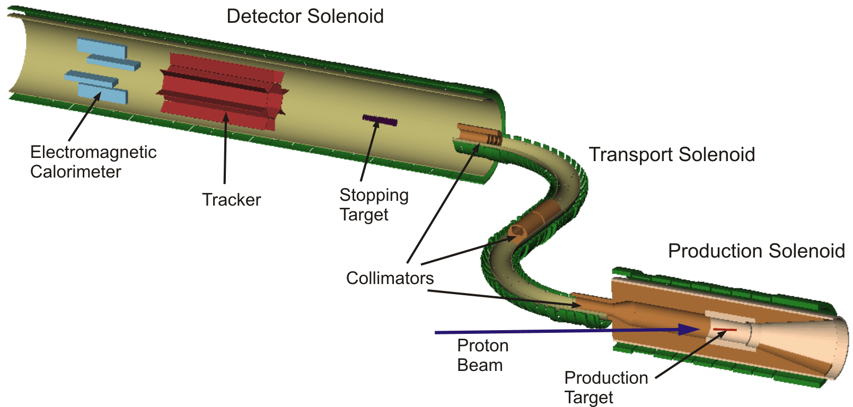
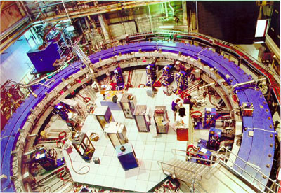
The Mu2e and Muon g-2 Experiments
Precision windows into physics beyond the standard model
Andrew Norman
University of Virginia
For the Mu2e & g-2 Collaborations

Slide 2

Introduction
The world is poised for the LHC to turn on give us direct access to physics at the Terascale….
But there are other windows into new physics that can reach far beyond the energies of the world’s largest colliders
Two of these windows are here at Fermilab
Mu2e and g-2 will probe:
new physics,
new models
new energy scales
with ultra-rare searches
and precision measurements

Slide 3
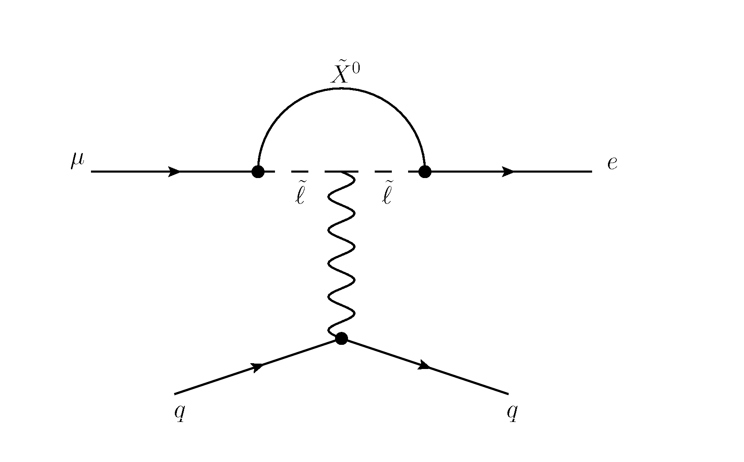
Why Precision Measurements & Ultra-Rare Processes?
We want to access physics beyond the standard model
  This means access to High and Ultra-High Energy interactions
  We get to these energies through loops
  Getting at Loops means making precision measurements
  and looking for ultra-rare decays
Ideally we start with processes that are forbidden or highly suppressed in the standard model
  Any observation becomes proof of non-SM physics
Flavor Changing Neutral Currents
  FCNC in quark sector
    B_{s} ! ¹ ¹ , b ! s ° , K ! ¼ º º
    Allowed but HIGHLY suppressed in Standard Model
    Can receive LARGE enhancements in SUSY and other beyond-SM physics
  FCNC in charged lepton sector
    ¹ ! e ° , ¹ ! e e e , ¹ N ! e N (Lepton Flavor Violating)
    No SM amplitudes (except via º loops)
    Permitted in beyond-SM models, and have extreme reach in energy

Slide 4
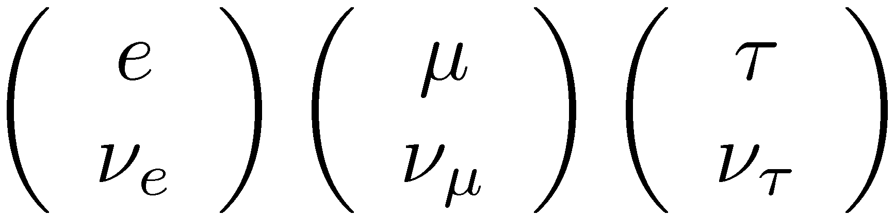
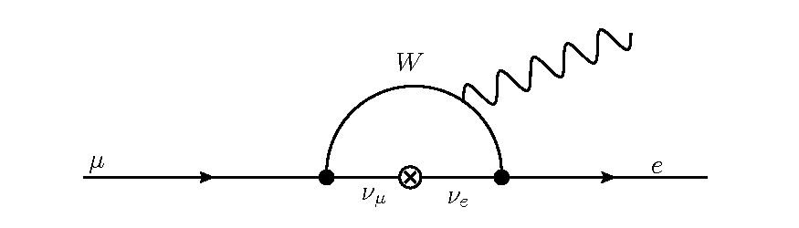
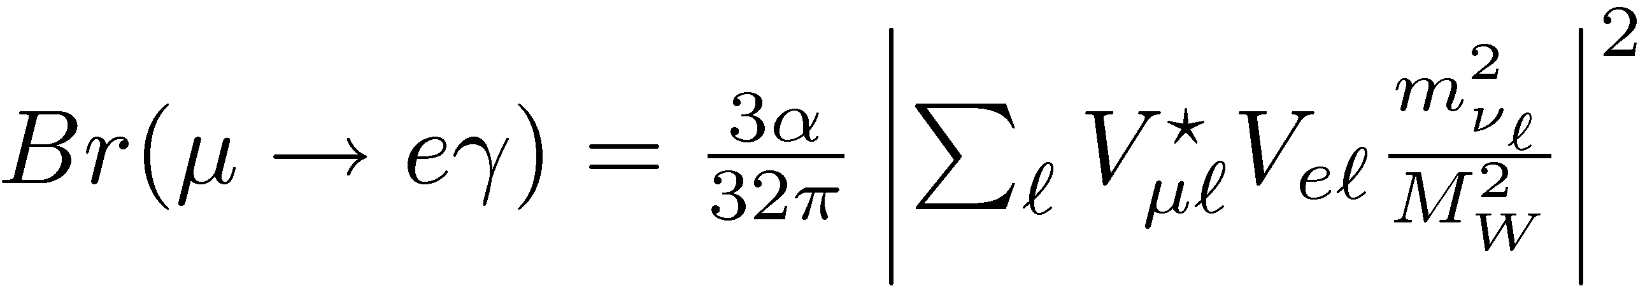
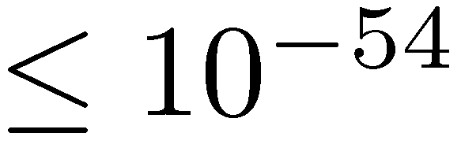
Lepton Mixing in the Standard Model
We have three generations of leptons:
In the standard model Lagrangian there is no coupling to mixing between generations
But we have explicitly observed neutrino oscillations
Thus charged lepton flavor is not conserved.
Charged leptons must mix through neutrino loops
But the mixing is so small, it’s effectively forbidden
No SM couplings between generation!

Slide 5
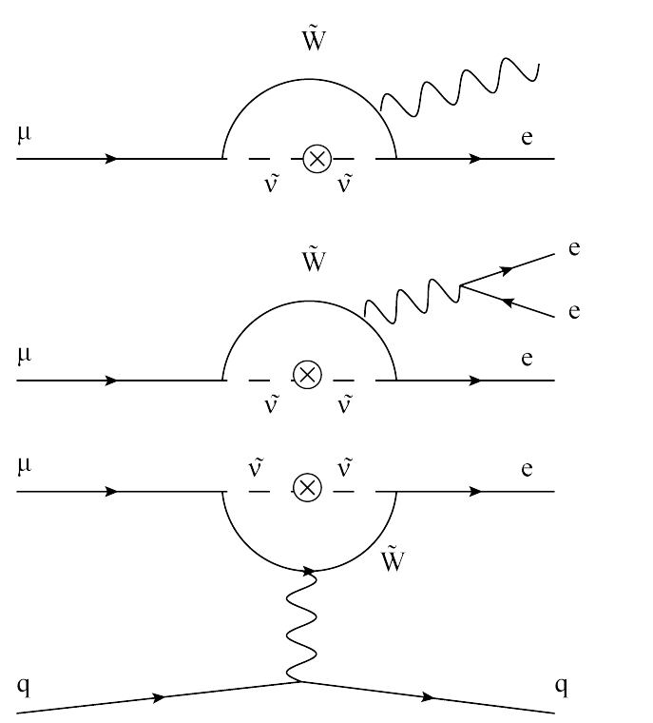
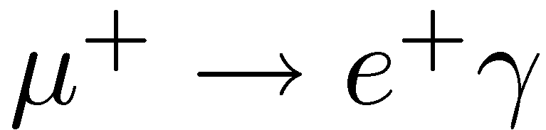
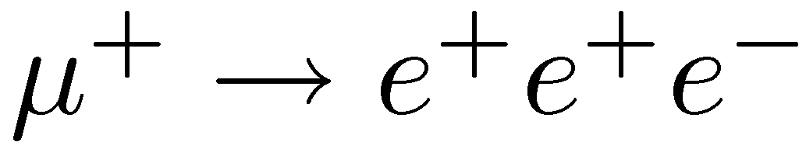
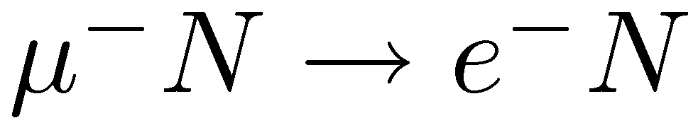
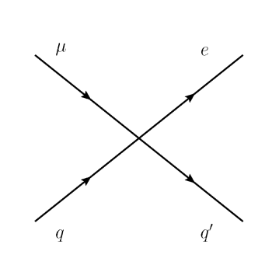
Charged Lepton Flavor Violation (CLFV) Processes with ¹’s
There are three basic channels to search for
¹-CLFV in:
If loop like interactions dominate we expect a ratio of rates:
  ¼ 400 to 2 to 1
If contact terms dominate then ¹N!eN can have rates 200 times that of ¹!e°
New physics for these channels can come from loop level
For ¹ N ! e N and ¹ ! eee we also can have contact terms
Note: ¹ !e° and ¹ !eee have experimental limitations (resolution, overlap, accidentals)
Ultimately Limits the measurement of:
Br(¹ ! e °)»10⁻¹⁴
No such limits on ¹N!eN channel

Slide 6
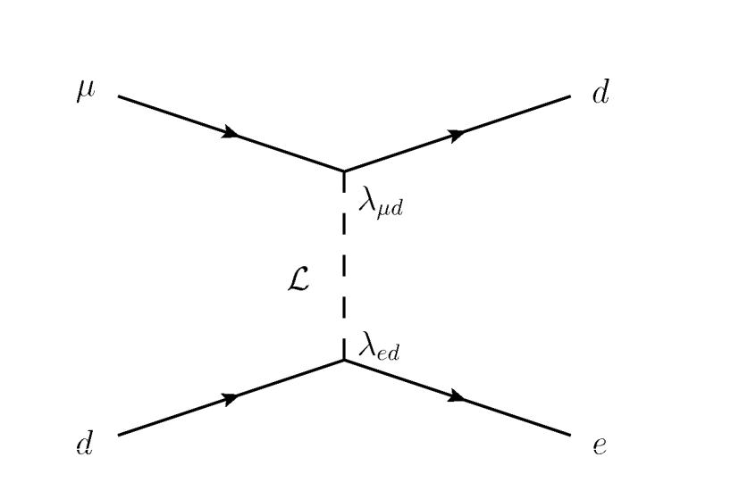
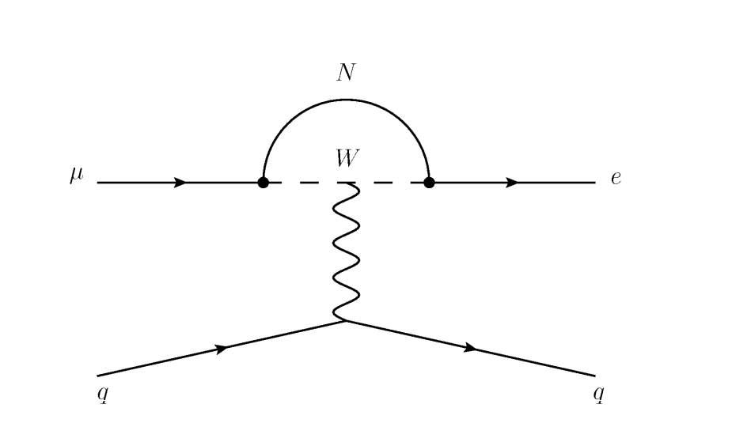
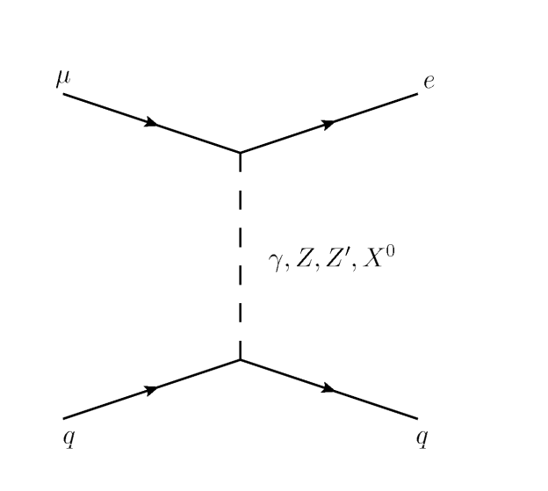
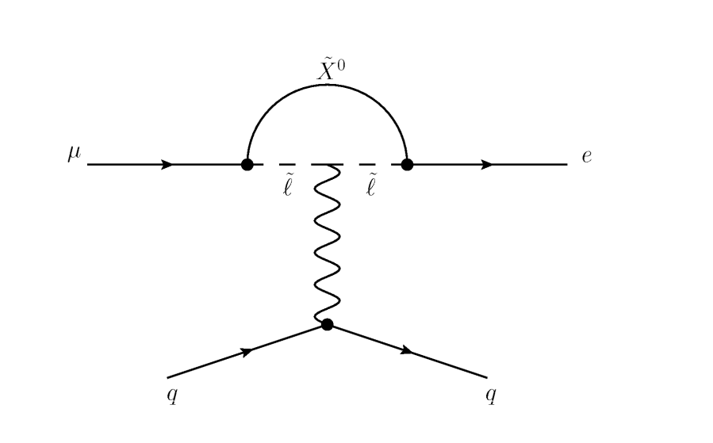

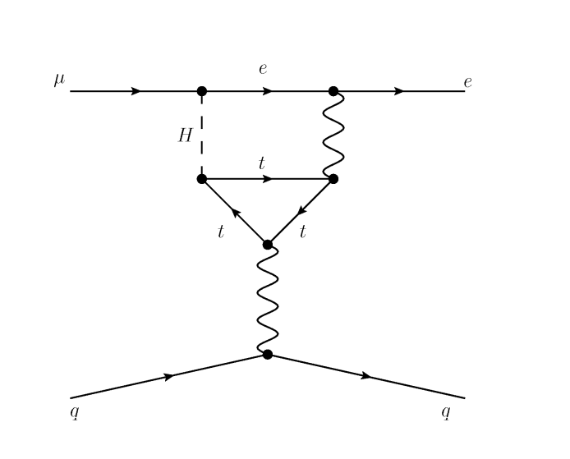
Beyond the Standard Model
The CLFV process can manifest in the ¹N!eN channel in many models with large branching fractions:
Contact Terms
Loops
Leptoquarks
SUSY
Compositeness
Heavy Neutrinos
Second Higgs Doublet
Anomalous Heavy Couplings

Slide 7
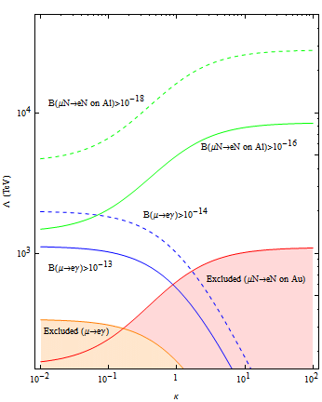
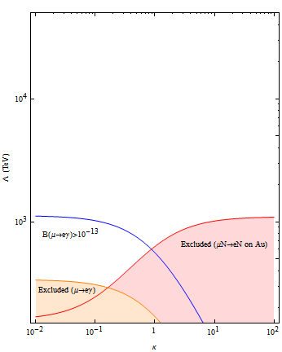
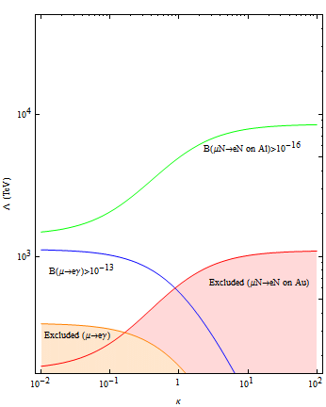
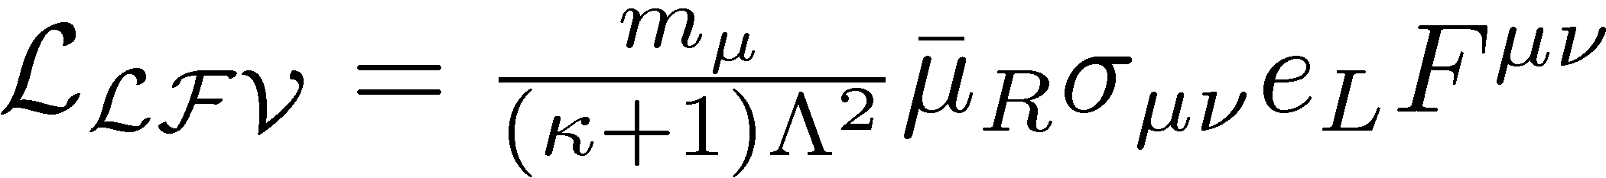
General CLFV Lagrangian
Recharacterize these all these interactions together in a model independent framework:
  Splits CLFV sensitivity into
    Loop terms
    Contact terms
  Shows dipole, vector and scalar interactions
  Allows us to parameterize the effective mass scale ¤ in terms of the dominant interactions
  The balance in effective reach shifts between favoring ¹N!eN and ¹!e° measurements .
  For contact term dominated interaction
  (large κ) the sensitivity in Λ, reaches upwards of 10⁴ TeV for the coherent conversion process
Loops
Mu2e Project-X
Contact Interactions
Mu2e
Gives the same dipole structure as g-2
¤ (TeV)
MEG
Sindrum II
MEGA
κ

Slide 8
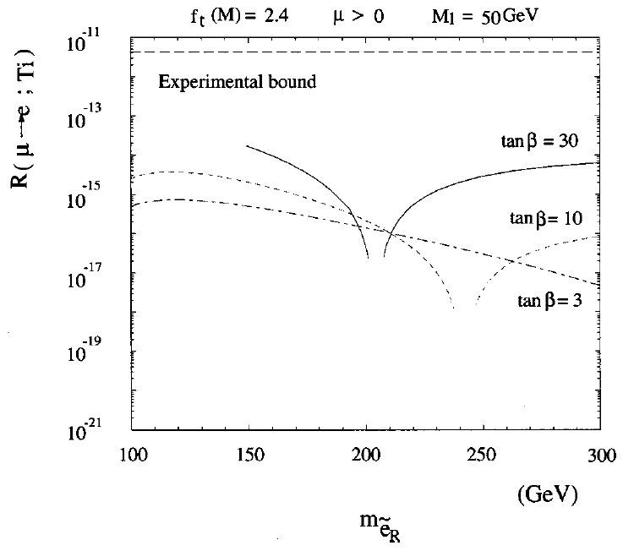
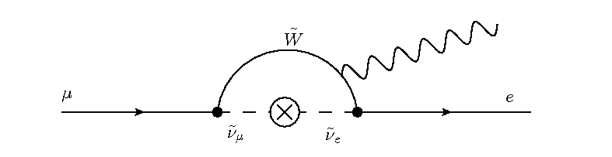
¹N!eN Sensitivity to SUSY
Rates are not small because they are set by the SUSY mass scale
For low energy SUSY like we would see at the LHC:
Br(¹ N ! e N) ~10⁻¹⁵
Makes ¹N!eN compelling, since for Mu2e this would mean observation of
¼O(40) events [0.5 bkg]
R(¹ N ! e N ) vs Slepton Mass
Sindrum II Bound
Exclude
Mu2e Phase-1
Mu2e Phase-2 (Project X)
A 2x10⁻¹⁷ single event sensitivity,can
exclude large portions of the available
SUSY parameter spaces
Hisano et al. 1997

Slide 9
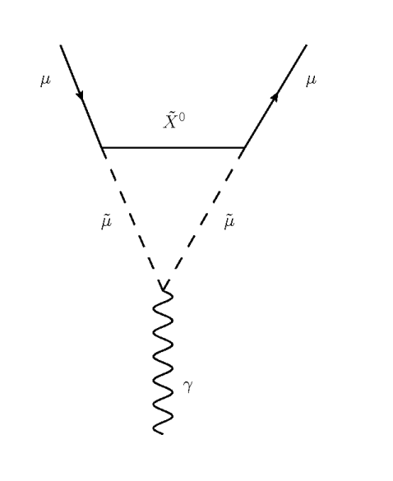
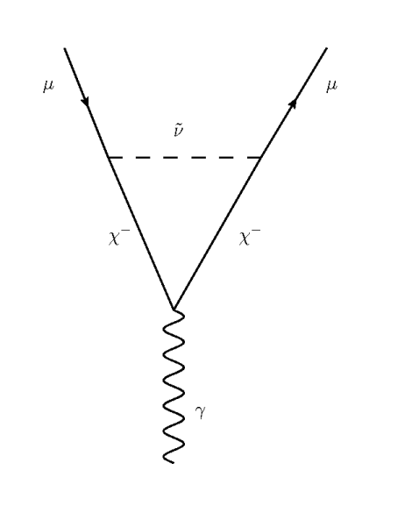
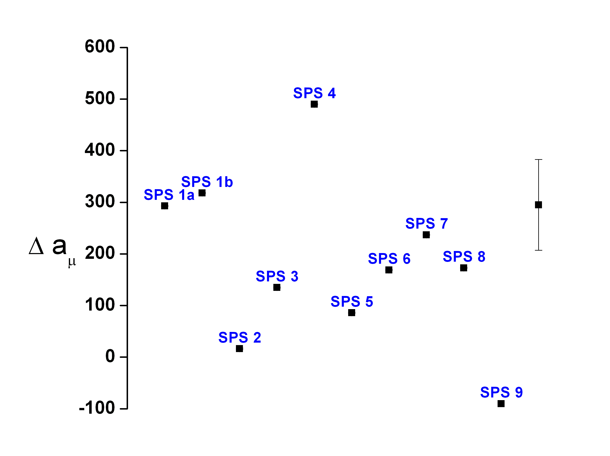
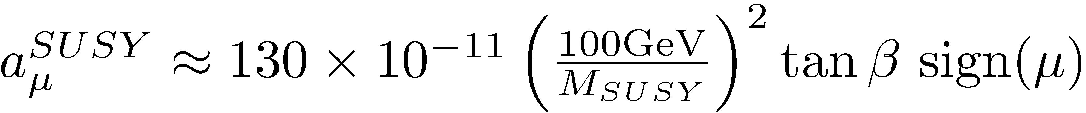
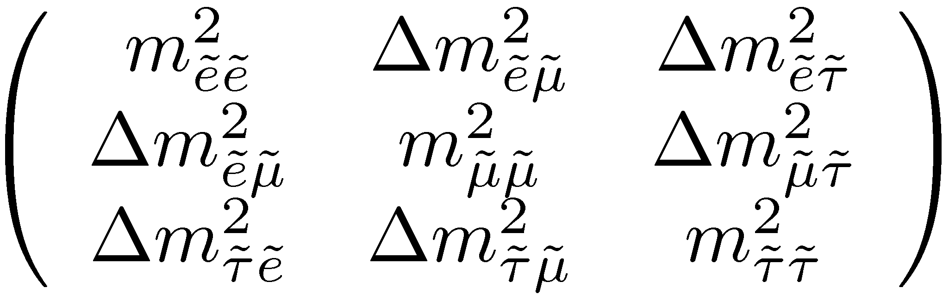
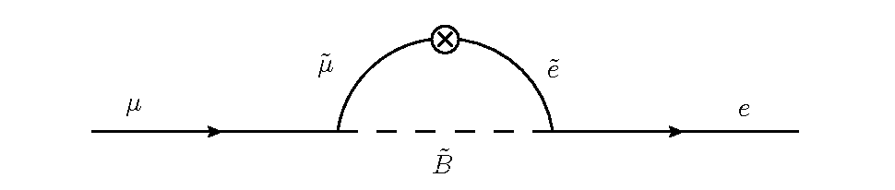
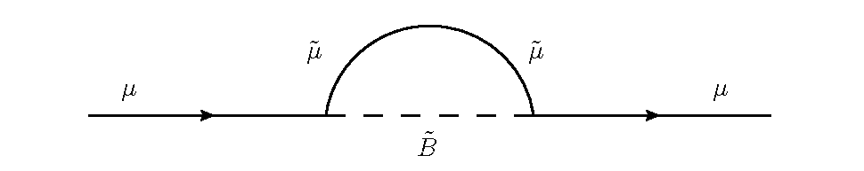
g-2 Sensitivity to SUSY
SUSY contributes to a_{¹}= (g-2)/2:
  Gives direct access to tan¯ and sign(¹)
  g-2 result rules out large classes of models
a_{¹}’s sensitivity to SUSY is through
the same loop interactions as
CFLV channels
Gives us access to
Slepton Mixing
Snowmass Points & Slopes w/ g-2
Current Exp
Future?
Slepton Mixing Matrix
¹ ! e
g-2

Slide 10
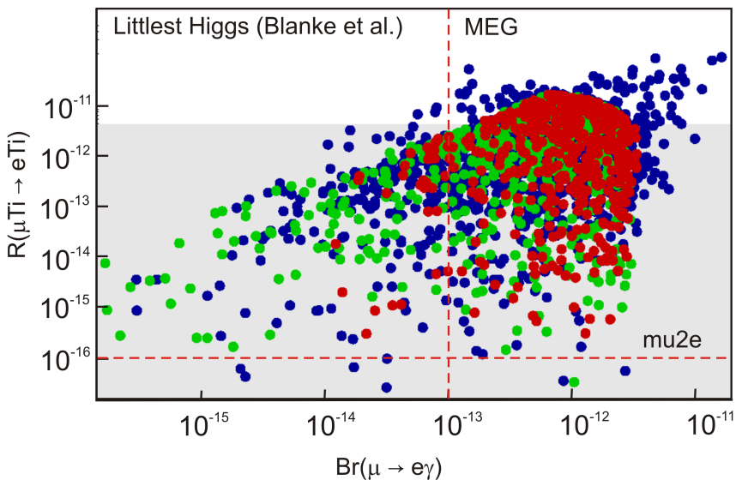
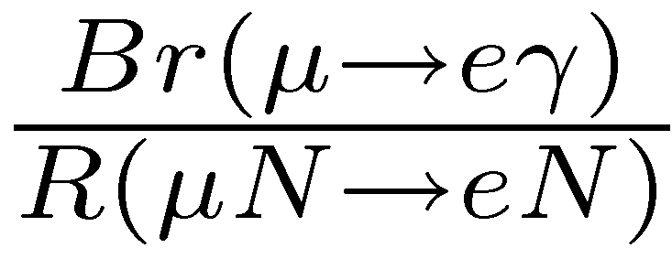
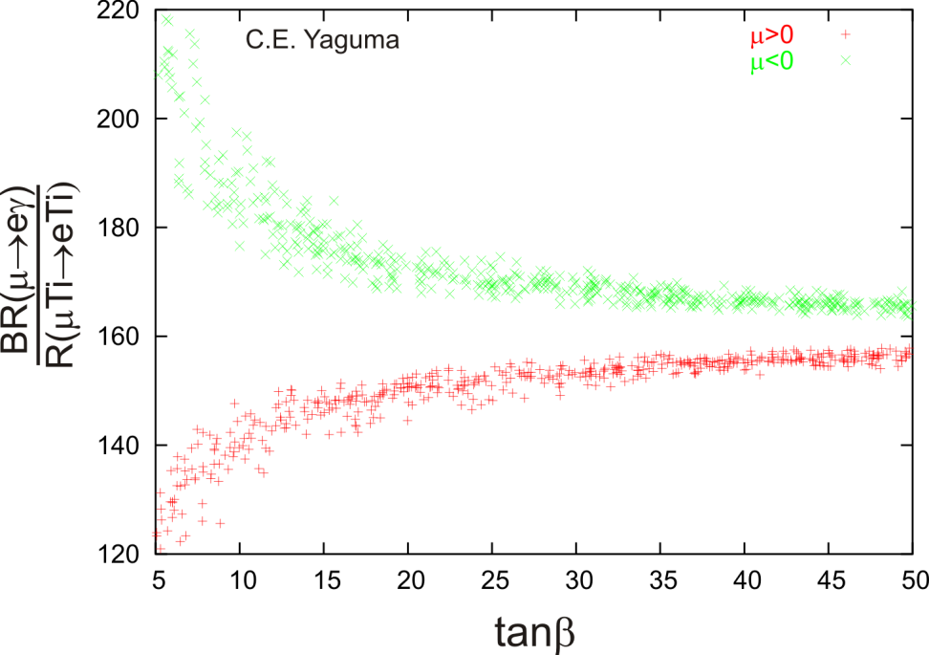
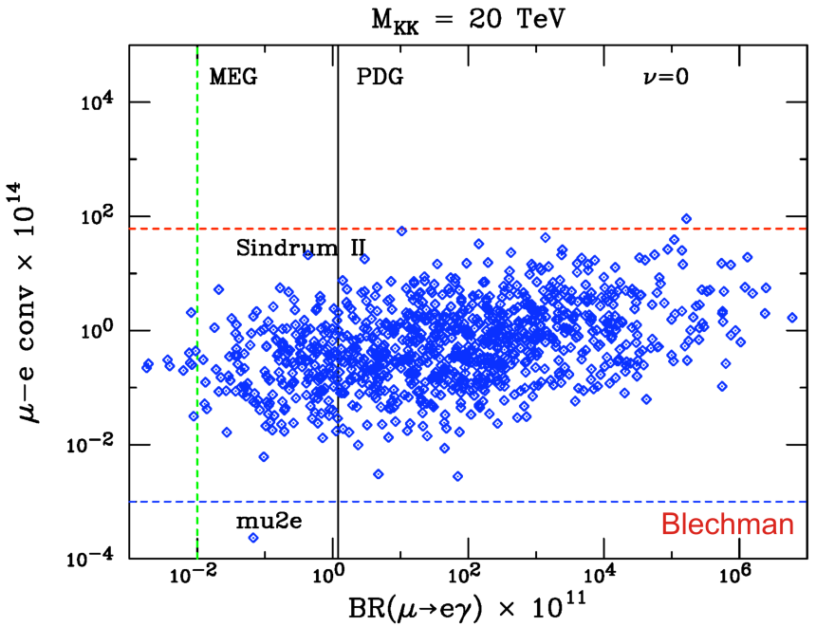
¹N!eN, ¹!e°, g-2 Work Together
Example:
From LHC we have the SUSY masses
From g-2 we know tan¯
From g-2 we know also know ¹>0
Combining these we get an a priori PREDICTION for:
under MSSM/MSUGRA
Mu2e sensitivity can exclude the available phase space
Knowing ¹N!eN, ¹!e° allow us to exclude SUSY phase space
Also knowing the g-2 results allows us to then over constrain SUSY models
In some cases this permits us to make strong, testable predictions for our models in terms of Br(¹!e°) & R(¹N!eN)
Exclude
g-2 selects which curve we should be on, and gives us the value of tan¯
We measure R(¹ N ! e N) and take the ratio to the MEG result.
We use this match to prediction as a way to disentangle, or validate, or interpret manifestations of SUSY
Exclude
MSSM/msugra/seesaw
Randall-Sundrum

Slide 11
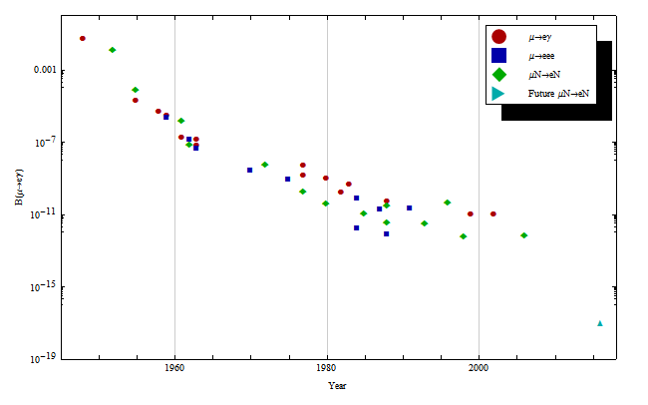
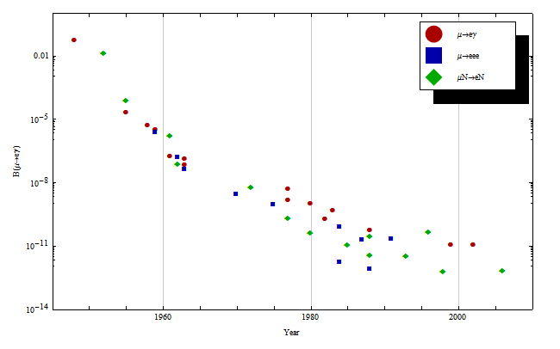
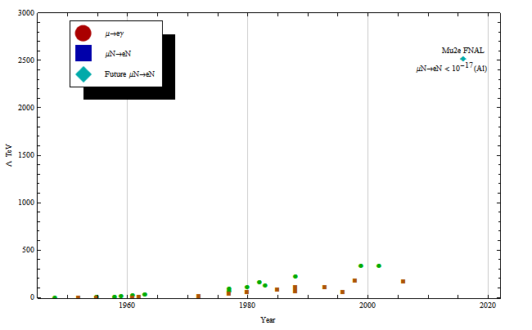
A Brief History of ¹-cLFV
¹-LVF Effective Mass Reach
¹-LVF Branching Fractions
First Measurement (Pontecorvo)
6£10⁻² in 1948
Effective Mass Reach 1.2 TeV!!
Mu2e’s effective mass reach for SUSY is 1000’s of TeV
Low energy SUSY Predictions for CLFV via ¹N ! e N
Mu2e will push the ¹N!eN limit down four orders of magnitude.
Below the SUSY prediction
Current Limits:
1.2£10⁻¹¹ (MEGA ¹!e°)
7£10⁻¹³ (Sindrum II on Au)

Slide 12
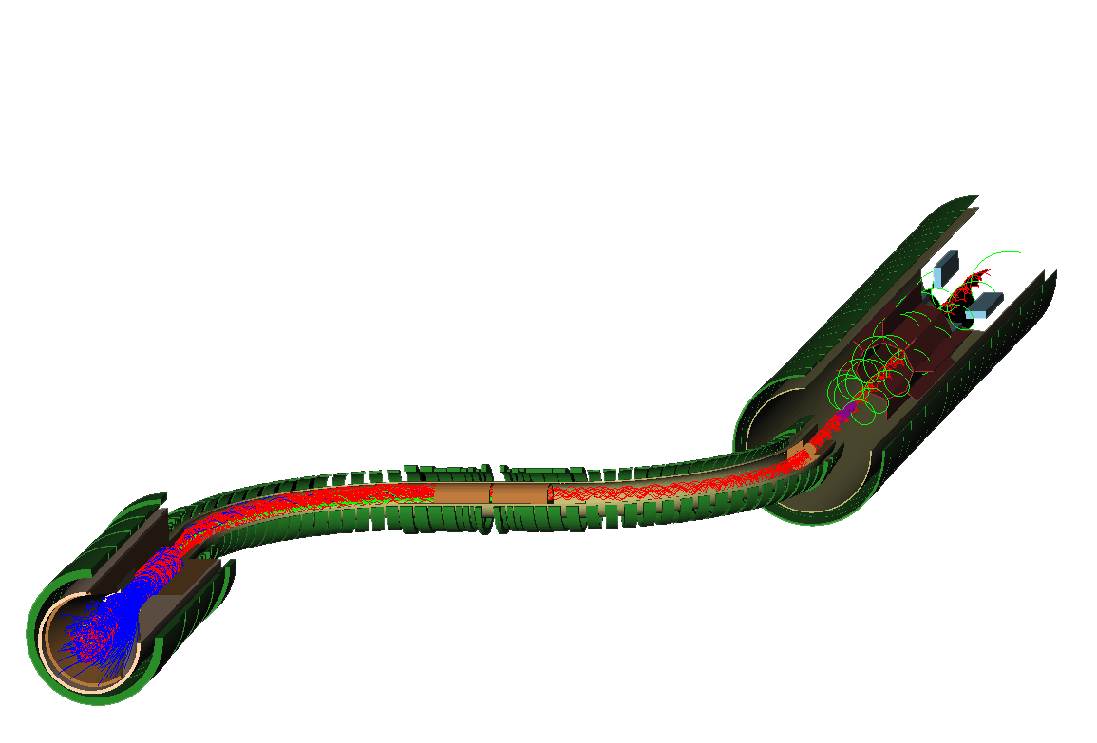
Mu2E at FNAL

Slide 13
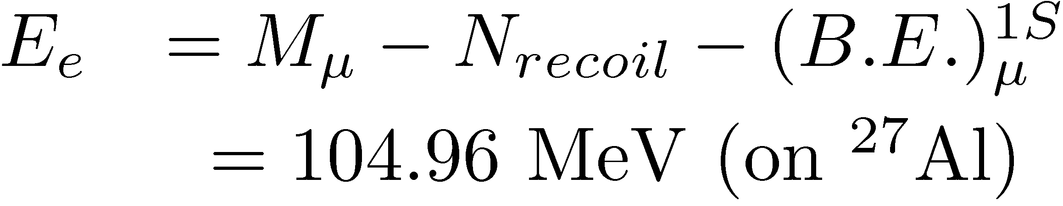
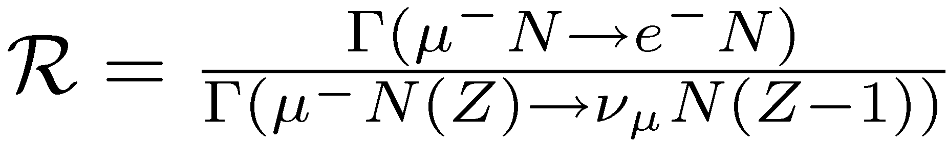
The ¹N!eN measurement at Br(10⁻¹⁷)
(in a nutshell)
Stop »O(5£10¹⁰) ¹⁻ per pulse on a target (Al, Ti, Au)
Wait 700ns (to let prompt backgrounds clear)
Look for the coherent conversion of a muon to a mono-energetic electron:
Report the rate relative to nuclear capture
If we see a signal, it’s compelling evidence for physics beyond the standard model!

Slide 14

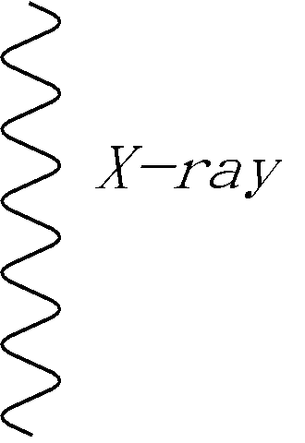
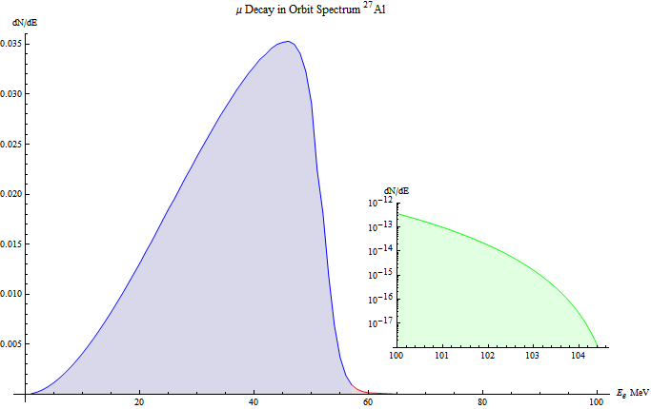
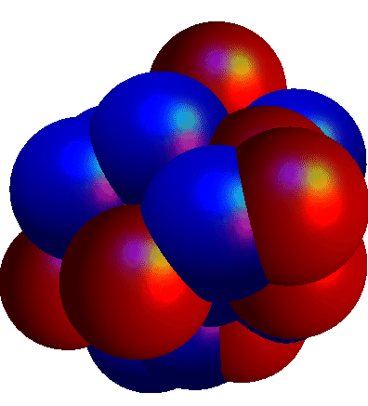





Muonic Atom
¹N!eN in Detail
We use the cascade of muonic x-rays and the well known spectrum to normalize the experiment.
(i.e. We measure N_{stop} in real time)
1S Muonic Aluminum
Start with a series of target foils
  For Mu2E these are Al or Ti
Bring in the low energy muon beam
  We stop ¼ 50% of ¹ ‘s
  Stopped muons fall into the atomic potential
  As they do they emit x-rays
Muons fall down to the 1S state and a captured in the orbit
  Muonic Bohr Radius
  Nuclear Size
  Provides large overlap in the muon’s wavefunction with the nucleous’s
  For Z > 25 the muon is “inside” the nucleous
Once captured 3 things can happen
  Decay in Orbit:
¼ 50% stop in target
Conversion & DIO
Endpoint 104.96MeV
Michel Peak
¼ 4 fm
Falls as δ⁵
Al Target Foils
Decay In Orbit
Recoil Tail
Nuclear Recoil
¼ 20 fm
Target
200 μm, circular foils (²⁷Al)
Radius tapers from 10 cm to 6.5 cm
5cm spacing between foils
e⁻
ν
ν
Lifetime: 864ns
DIO Fraction: 39.3%
Capture Fraction: 60.7%

Slide 15
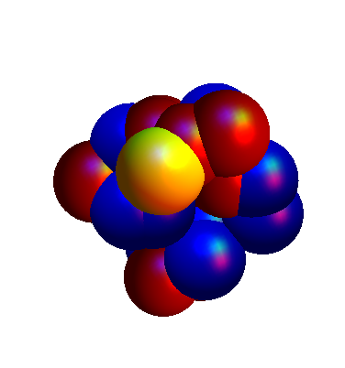
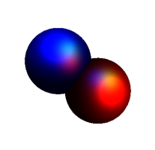
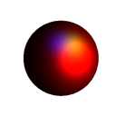
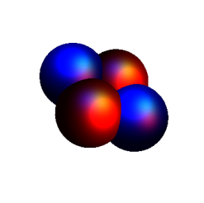
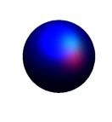


Muonic Atom
1S Muonic Aluminum
Ordinary Muon Capture (OMC)
Start with a series of target foils
  We stop ¼ 50% of ¹ ‘s
Bring in the low energy muon beam
  We stop ¼ 50% of ¹ ‘s
  Stopped muons fall into the atomic potential
  As they do they emit x-rays
Muons fall down to the 1S state and a captured in the orbit
  Muonic Bohr Radius
  Nuclear Size
  Provides large overlap in the muon’s wavefunction with the nucleous’s
  For Z > 25 the muon is “inside” the nucleous
Once captured 3 things can happen
  Decay in Orbit:
  Nuclear Capture:
2009 Measurements
Mu2E Collaboration will measure the spectra for muon capture induced nucleon emission this summer at the PSI test beam.
Contact: Peter Kammel (U. of Illinois)
pkammel@illinois.edu for details
Nuclear Breakup w/
Proton & Neutron Ejection
Problem
These protons and neutrons constitute the largest source of rate in the detector (» 1.2 per ¹)
The energy spectra for these ejected particles is not well known.
²⁷Al →²⁷Mg
¼ 4 fm
W
Capture is a contact like interaction, scales as: |Á_{¹} (0)|² N_{protons} » Z⁴
¼ 20 fm
ν
Lifetime: 864ns
DIO Fraction: 39.3%
Capture Fraction: 60.7%

Slide 16
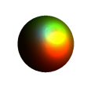

Muonic Atom
1S Muonic Aluminum
Coherent Conversion (μ→e)
Start with a series of target foils
  We stop ¼ 50% of ¹ ‘s
Bring in the low energy muon beam
  We stop ¼ 50% of ¹ ‘s
  Stopped muons fall into the atomic potential
  As they do they emit x-rays
Muons fall down to the 1S state and a captured in the orbit
  Muonic Bohr Radius
  Nuclear Size
  Provides large overlap in the muon’s wavefunction with the nucleus's
  For Z > 25 the muon is “inside” the nucleus
Once captured 3 things can happen
  Decay in Orbit:
  Nuclear Capture:
  New Physics! i.e. ¹ N ! e N
Nucleus Is Left Unchanged
¼ 4 fm
X
Muon
Converts
¼ 20 fm
Coherent Conversion to the ground state scales as » Z⁵.
Rates: (μN→eN)/(OMC)
rises as Z. Moving to high Z buys you sensitivity
e⁻
E_{e} ¼ 105 MeV

Slide 17
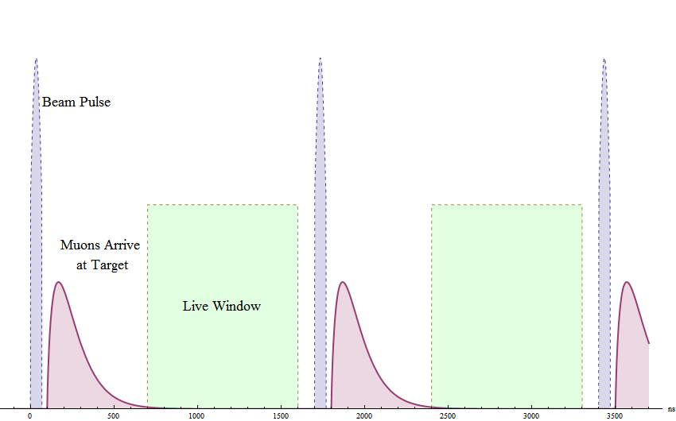




Beam Structure
¹’s are accompanied by “prompt” e, ¼, ….
These cause real background
Must limit our beam extinction, and detector live window
Prompt Backgrounds
Radiative Pion Capture (RPC) presents the single most dangerous potential background to the Mu2e experiment.
The gamma can convert asymmetrically
giving e⁻ with energy up to m_{¼}
We MUST suppress this with beam extinction
Extinction of 10^{-7} demonstrated at BNL AGS
3£10⁷ protons
Extinction < 10⁻⁹
Allow Prompts to die out (must wait »700ns)

Slide 18
Total Backgrounds
Background | Evts (2×10⁻¹⁷)
μ Decay in Orbit (DIO) Tail | 0.225
μ Decay in flight w/ scatter | 0.036
Beam Electrons | 0.036
Cosmic Ray | 0.016
μ Decay in flight (no scatter) | < 0.027
Anti-proton | 0.006
Radiative μ capture | <0.002
Radiative π capture | 0.072
π Decay in flight | <0.001
Pat. Recognition Errors | <0.002
Total | 0.415
Background | Evts (2×10⁻¹⁷)
μ Decay in Orbit (DIO) Tail | 0.225
μ Decay in flight w/ scatter | 0.036
Beam Electrons | 0.036
Cosmic Ray | 0.016
μ Decay in flight (no scatter) | < 0.027
Anti-proton | 0.006
Radiative μ capture | <0.002
Radiative π capture | 0.072
π Decay in flight | <0.001
Pat. Recognition Errors | <0.002
Total | 0.415
Largest Background
  Decay in Orbit (DIO)
  Rad ¼ Capture (RPC)
Limiting Backgrounds
  Can limit prompt backgrounds w/ extinction
  In particular, Rad π Cap. drives the extinction requirement
  Current Background Estimates require 10⁻⁹ extinction
  BNL AGS already has demonstrated extinction of 10⁻⁷ with out using all the available tools
Background | Evts (2×10⁻¹⁷)
μ Decay in Orbit (DIO) Tail | 0.225
Radiative pion capture | 0.072
Beam Electrons | 0.036

Slide 19


Signal to All Backgrounds
Signal significance
  If we assume SUSY accessible at the LHC:
    Mu2e may see »O(40) events
    On 0.5 event background
  At R_{¹e}=10⁻¹⁶ (limit of sensitivity)
    Mu2e sees » 4 events
    on 0.5 event background
  This is a Strong Signature
R_{¹e}=10⁻¹⁶

Slide 20


The Mu2e Detector in Detail

Slide 21

Production Solenoid
Magnetic
Mirror Effect
8GeV Incident Proton Flux
3×10⁷ p/pulse (34ns width)
5T
Gradient Solenoid Field
p
2.5T
Primary π production
off gold target
μ
π
π
¹
π decays to μ
μ is captured into the transport solenoid and proceeds to the stopping targets

Slide 22

Transport Solenoid
Designed to sign select the muon beam
  Collimator blocks the positives after the first bend
  Negatives are brought back on axis by the second bend
Sign Selecting
Collimator

Slide 23

The Detector
Graded Field for
Magnetic Mirror Effect
1.0T
Beam
1T Solenoidal Field
1.2T
The detector is specifically design to look for the helical trajectories of 105 MeV electrons
Each component is optimized to resolve signal from the Decay in Orbit Backgrounds

Slide 24



Straw Tracker (In Vacuum)
Octagonal+Vanes geometry is optimized for reconstruction of 105MeV helical trajectories
Extremely low mass
Acceptance for DIO tracks < 10⁻¹³
Trajectories
P_{t} > 90MeV
Vane
Barrel
Electron
track
Low Energy
DIO Trajectories
Target Foils
DIO Tail
> 57MeV
R=57MeV

Slide 25



Crystal Calorimeter
Original Design:
5% energy measure for trigger decision (1kHz rate)
Timing edge for event reconstruction
Spatial match to tracker trajectory
Low acceptance to Michel Peak
<5%
Tracker Trajectory must project to cal cluster hit

Slide 26
Cost and Schedule
Total Project Cost Est. $200M (fully loaded, escalated, appropriate contingencies)
Received Stage-1 Approval and DOE’s CD-0 anticipated shortly
Technically Driven Schedule (wholly magnet driven) results in 2016 start of data taking
Opportunities for Significant R&D, Test Beam, and Auxiliary Measurement work for students and university groups
Mu2e Experiment Technically Driven Schedule
2009 |  |  |  | 2010 |  |  |  |  | 2011 |  |  |  | 2012 |  |  |  | 2013 |  |  |  | 2014 |  |  |  | 2015 |  |  |  | 2016 |  |  |  | 2017 |  |  |  | 2018
Q1 | Q2 | Q3 | Q4 | Q1 | Q2 | Q3 |  | Q4 | Q1 | Q2 | Q3 | Q4 | Q1 | Q2 | Q3 | Q4 | Q1 | Q2 | Q3 | Q4 | Q1 | Q2 | Q3 | Q4 | Q1 | Q2 | Q3 | Q4 | Q1 | Q2 | Q3 | Q4 | Q1 | Q2 | Q3 | Q4 | Q1 | Q2 | Q3 | Q4
Mag. CDR
 |  |  |  | Final Magnet Design
 | PSI Test Beam |  |  |  |  |  |  |  |  |  | Magnet Construction, Installation, Commissioning
 |  |  |  |  |  |  |  |  |  |  |  |  |  |  |  |  |  |  |  |  |  |  |  |  |  |  |  |  |  | First Physics Run 2E-17 SES

Slide 27
g-2 at FNAL

Slide 28




Intro & Theory
Remember that we can express the muon’s magnetic moment
Gives us the standard QED prediction:
The deviation of g from 2
is the anomalous magnetic moment:
The purpose of g-2 is to measure with extreme precision the anomalous magnetic moment and compare it to the corrections that arise in the SM and Beyond SM physics

Slide 29



Current g-2 Numbers & Theory
BNL E821 a_{¹}
Experiment: 0.54 ppm (0.46 stat, 0.31 syst.)
Theory: 0.48 ppm
Lopez Castro (Photon ’09)
Points of Reference
SUSY (SPS1A)
Extra Dimensions

Slide 30



The g-2 Measurement
Inject 100% longitudinally Polarized ¹’s
The muon is self analyzing, from the decay distribution of elections
The precession frequency is directly obtained from the electron rates in the detectors
¹’s spin precesses
e⁻
e⁻ decay depends on spin of the muon
ω_{a}
Momentum
Spin
This method requires extremely precise knowledge of the B field

Slide 31
g-2 Goals
Collect 21£ the current BNL data set
Statistical & Systematic Error each 0.1ppm
Achieve 4£ the precision of the current a_{¹}
Would result in the current deviation from theory moving from 3.8¾ ! 7¾ significance (including theory error)
Possible at FNAL because we can have:
  More ¹’s
  Less background

Slide 32
Conclusions
In an era where, we are poised to see our first direct evidence of physics beyond the standard model:
We must pay special attention to precision measurements
Mu2e and g-2 have the ability, not only guide us as we begin to interpret and understand signs of new physics,
But they naturally combine to:
  Make elegant predictions
  Probe large parameter spaces
  and access physics beyond the Terascale
Consider the possibilities and join us!
  Mu2e: http://www-mu2e.fnal.gov
  g-2: Lee Roberts (roberts@bu.edu) and
  Dave Hertzog (hertzog@illinois.edu)

Slide 33
Backup Slides

Slide 34
Mu2e Collaboration
Boston University
J.Miller, R.Carey, K.Lynch, B. L.Roberts
Brookhaven National Laboratory
P.Yamin, W.Marciano, Y.Semertzidis
University of California, Berkeley
Y.Kolomensky
University of Calivornia, Irvine
W.Molzon
City University of New York
J.Popp
Fermi National Accelerator Laboratory
C.Ankenbrandt, R.Bernstein, D.Bogert, S.Brice, D.Broemmelsiek, R.Coleman, D.DeJongh, S.Geer, D.Glenzinski, D.Johnson, R.Kutschke, M.Lamm, P.Limon, M.Martens, S.Nagaitsev, D.Neuffer, M.Popovic, E.Prebys, R.Ray, V.Rusu, P.Shanahan, M.Syphers, H.White,B.Tschirhart, K.Yonehara,C.Yoshikawa
Idaho State University
K.Keeter, E.Tatar
University of Illinois, Urbana-Champaign
P.Kammel, G.Gollin, P.Debevec, D.Hertzog
Institute for Nuclear Research, Moscow, Russia
V.Lobashev
University of Massachusetts, Amherst
K.Kumar, D.Kawall
Muons, Inc.
T.Roberts, R.Abrams, M.Cummings
R.Johnson, S.Kahn, S.Korenev, R.Sah
Northwestern University
A.De Gouvea
Instituto Nazionale di Fisica Nucleare Pisa, Universita Di Pisa, Pisa, Italy
L.Ristori, R.Carosi, F.Cervelli, T.Lomtadze, M.Incagli, F.Scuri, C.Vannini
Rice University
M.Corcoran
Syracuse University
P.Souder, R.Holmes
University of Virginia
E.C.Dukes, M.Bychkov, E.Frlez, R.Hirosky, A.Norman, K.Paschke, D.Pocanic
College of William and Mary
J.Kane
17 Institutions
Over 70 physicists

Slide 35



Mu2E & NOνA/NuMI
How do we deliver O(10¹⁸) bunched ¹’s?
Mu2e
Detector Hall
To NuMI
Use NuMI cycles in the Main injector to slow spill to Mu2e.
No Impact on NOvA
Results in:
6 batches x 4x10¹² /1.33 s x 2x10⁷ s/yr
= 3.6 x10²⁰protons/yr

Slide 36

Crystal Calorimeter
Original Design:
5% energy measure for trigger decision (1Hz rate)
Timing edge for event reconstruction
Spatial match to tracker trajectory
Immune to DIO rates
DIO Radius
PbWO₄
Crystal Geometry
Calorimeter Properties
Resolution | 5%
Material | PbWO₄
Readout | Dual APD
Blocks | 500 per fin, 4 fins
Segmentation | 30£30£120mm³
Trigger Rate | 1kHz
Light yield | 20-30p.e./MeV
50 blocks
13.6X₀
<5%
30mm
120mm
Tracker Trajectory must project to cal cluster hit
30mm
10 blocks
Single Crystal
Calorimeter Fin

Slide 37

Straw Tracker
Fast Gas
Longitudinal Tracker Features:
  2800 straw tubes in vacuum
  Utilize 17,000 pad readouts
  50% Geometric acceptance to signal (90° § 30°)
  Intrinsic resolution 200keV
  Virtually Immune to DIO
Pad Readout
1 Atm
Vacuum
1-10MΩ
1 Atm
25 ¹m
Diameter Swell > 1%

Slide 38

Sensitivity to SUSY
Rates are not small because they are set by the SUSY mass scale
For SUSY like we would see at the LHC:
Br(¹ N ! e N) ~10⁻¹⁵
Makes ¹N!eN compelling, since for Mu2e this would mean observation of
¼O(40) events
Mu2e can exclude over the full range of slepton mass
Sindrum II Bound
Exclude
Mu2e Phase-1
Mu2e Phase-2 (Project X)
Access to ultra high mass scales via quantum corrections.
Can access possibly access ν_{R} and other processes at scales 10¹²-10¹⁴ GeV/c²
Hisano et al. 1997

Slide 39



¹N ! eN & SUSY Models
Assuming we see a signal:
  By changing target, we gain sensitivity to the scalar, vector or dipole nature of the interaction
  Need to go to high Z
  Hard because ¿ small for large Z (¿_{Au} =72ns)
  But DIO backgrounds are suppressed and Conversion/OMC ratio scales as Z
This is a unique feature of the ¹N !eN measurements

Slide 40



Intro & Theory
Remember that we can express the muon’s magnetic moment
Where g is the Lande g-factor, given by the muon-photon vertex form factors F₁ & F₂
Gives us the standard QED prediction:
We can talk now about the deviation
of g from 2 as being the anomalous
magnetic moment:
F₁ is just the charge of the muon (1)
F₂ vanishes at leading order
The purpose of g-2 is to measure with extreme precision the anomaly and compare it to the well known corrections that arise in SM and Beyond SM physics

Slide 41


FNAL Beam for g-2
I
Beam Related Gains for running at FNAL
Stored ¹ per PoT
Beam line setup is almost identical to the 8GeV scheme used for Mu2e
Uses 6 of 20 batches*
  Parasitic to NuMI program
Uses target and lens at the present p-bar program
Modified AP2 line (+ quads)
Need a new beam stub into ring
Detector is in a simple building near cryo services
Goal: Deliver polarized muons and stored in the g-2 ring at the magic momentum, 3.094 GeV/c
*Can use all 20 if MI program is off

Slide 42


upgrade
BNL Storage Ring Flies to Chicago!
FNAL beams offer more \mu
Magnetic Field is improved through shimming and calibration
1 ppm contours

