Slide 1
WBS 2.7.4 Breakout
Detector Controls (DCS)
A.Norman (U.Virginia)
L3 Manager
June 16, 2009

Slide 2
Detector Controls & Monitoring: Overview
What is the “D.C.S”?
  It is the unified collection of detector controls, readout monitoring systems
  It controls all non-DAQ specific configuration parameters for hardware systems
  It controls some DAQ specific configuration parameters, but only for hardware systems
  It monitors all critical operational parameters
  It handles the generation of alarm and logging messages for the system using these parameters
  It interfaces to the main databases
This is the User’s (and Run Control’s) window into controlling NOνA

Slide 3
Detector Controls & Monitoring: Status
Full system design established
  Heavily leveraged off of EPICs libraries
  Designs for specific hardware readout exist where hardware has been established
  Preliminary [generic] designs for hardware readout exist where hardware has not been finalized
  Prototype [standalone] readouts have been developed or leveraged for key systems still being evaluated
  Implementations of some subsystems have been started
    Completion requires final hardware choices
    Completion requires final DAQ interaction specifications
DCS design is approximately 90% complete

Slide 4
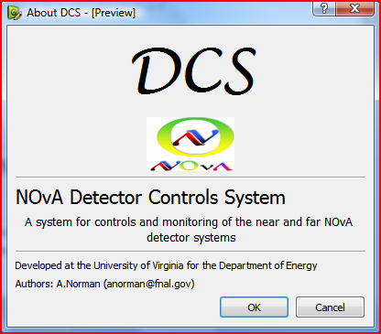
Overview
Scope
Hardware
Computing
Networking
Software Design
Integration

Slide 5
Scope
Detector Controls & Monitoring

Slide 6
Scope: Controls
The DCS is designed to handle the programmable controls, monitoring, alarm handling, and state logging for the major detector subsystems
  Power Control and Distribution
    High Voltage Bias
    Low Voltage power
  Water pumping and cooling
  Data Concentrator Modules (DCM)
  Front End Boards (FEB)
  PVC Stress/strain sensors
  Timing/Sync modules
  Environmental parameters and monitoring
  Rack monitoring
The DCS needs to provide the local state logging as well as interfacing with the primary database server for long term logging and system history
The DCS needs to provide a feedback loop into the DAQ system to handle system faults and run stop conditions

Slide 7
Scope: Far Det. Controls (15kTon Design)
Subsystem | Type | Units | Channels | Total Channels | Interface
High Voltage | Caen SY1527 or Weiner Mpod | 2 | 96 | 180 used | Ethernet
Low Voltage | Wiener PL506 or Caen SY8800 | 60 | 6 | 360 | Ethernet
Water Cooling | Neslabs M150 | 15 | 10 | 150 | Ethernet/RS485
Data Acq. | Custom DCM | 180 | 62(64) | 11,160 | Ethernet
Det. Envir. | N.I. Fieldpoint | 15 | 128 | 1,920 | Ethernet
Front End | Custom FEB | 11,160 | 32 | 357,120 | 8B/10B DCM
Timing/Sync | Custom TDB | 12 | 4 | 48 | Ethernet
Misc. & Rack Mon. | Misc. Sensors | 200 | 1-10 | 2000 | Misc.
Total |  |  |  | 15,818 372,938 w/FEBs
The detector controls system is required to have access to over 11,600 physical devices roughly 370,000 independent programmable channels
Controls interface must present a uniform method of accessing all the devices regardless of controls interface
The system must be modular, scalable and support partitioning into production, installation, and calibration/commissioning variants to accommodate the “physics during build” model.

Slide 8
Far Det. Controls (14kTon)

Slide 9
Scope: Far Detector Monitoring
System | Parameters/Chan | Channels | Total Monitoring
High Voltage | 6 | 180 | 1,080
Low Voltage | 4 | 360 | 1,440
Water Cooling | 4 | 150 | 600
DCM | 24 | 180 | 4,320
Det. Env | 128 | 15 | 1920
Front End | 32 max | 11,160 | 357,120
Timing/Sync | 10 | 12 | 120
Mech Sensors | 1 | 4500 | 4500
Misc. & Rack Mon. | 1-2 | 150 | 300
TOTAL |  |  | 14,280 371,400 w/FEBs
The detector Monitoring system is required to monitor and alarm on over 370,000 system critical run time parameters.
The monitoring frequency must be variable from ~1Hz for pushed data streams to once per minute (or 5minutes) for slower polled readouts.
Client initiated monitoring requests can cause burst spikes in the DCS bandwidth with transfers on the order of 400-600mb per full monitoring dump with protocol and network overhead

Slide 10
Hardware
Detector Controls

Slide 11
DCS Readout Hardware
DCS Readout interfaces fall into two general categories
Ethernet Enabled
Non-Ethernet Enabled
CAEN SY1527High Voltage
Wiener PL508 Low Voltage
Data Concentrator Modules
Compact Fieldpoint Controllers
Remote power protection circuits
Temperature sensors (RTDs)
Pressure and flow sensors
Stress/Strain gages
Local relays
Rack monitoring
Misc sensor packs
RS485 protocol devices
Front End Boards (FEBs)
These we readout directly via network switch connection
These we readout first by a Fieldpoint station, then into the network
FEBs are readout via a DCM pass through method

Slide 12
DCS Readout Hardware
Ethernet enabled devices are connected directly to a second level switch and read through the DCSNet
Sensor packs are readout through a National Instruments Compact Field Point station which is outfitted with an Ethernet control interface
Front End Boards are readout through the DCMs in a pass through fashion that routes the status packets through embedded system handler
  DAQ/Data traffice is routed to Eth0 to DAQNet
  DCS traffic is routed out on Eth1 to DCSNet
The general monitoring stations are arrayed in the detector hall on the upper catwalk spaced by di-block
Fully Partitioned Network Traffic

Slide 13
DCSNet Network Topology
Field Point Unit
Field Point Unit
Field Point Unit
Master
Channel
Server
Env. Chan Serv
ENV. IOC
Field Point Unit
Secondary Switch
Voltage Chan Serv
Voltage IOC
Fiber Connect
Point Sensors
DCSNet
Master DCS Switch
DCSNet
DCSNet
Env. Sensors
Env. Sensors
Env. Sensors
FEB Chan Serv
FEB IOC
Env. Sensors
FEB Chan Serv
FEB IOC
Env. Sensors
FEB Chan Serv
FEB IOC
Secondary Switch
FEB Chan Serv
FEB IOC
FEB Chan Serv
FEB IOC
HV Supply
HV Supply
DCM Chan Serv
LV Supply
LV Supply
DCM IOC
DCSNet
LV Supply
LV Supply
Client Controls and Monitoring Applications
DAQNet
Run
Control
DCM
DCM
FEB
FEB
FEB
FEB
FEB
FEB
FEB
FEB
FEBs
FEBs

Slide 14


DCS Network Overview
DCS Chan. Server/IOC
DCS Master Server 1
(Displays and Controls)
DCS Chan. Server/IOC
DCSNet
DCS User Client
DCS User Client
KVM Switch
Access from the control room is from the master control station or from client stations connected to the DCSNet
DCS Chan. Server/IOC
Error Logger
DCSNet
DCS Local Logger
(4TB storage)
Far site Control Room
Far Site Electronics Room
DCS Master Server 2
(Displays and Controls)
Detector hall access to DCS is through mobile laptop over the DCSNet Wireless access points.
DCSNet
Wireless
DCSNet
Database Server
(FNAL/Feynman CD)
Access from the FNAL control room is via a VPN style secure point to point connection that extends the DCSNet to the second control master, and remote user clients
Remote DCS User Client
Detector Hall Controls Access
FNAL site Control Room

Slide 15
soFTWARE
Detector Controls

Slide 16


DCS Client Software
Based off of QT4 and ROOT 5 with interfaces to EPICS 3.14
Currently working under QT4.2.x and QT-ROOT 5.x
Runs under Sci Linux 4.x and all Microsoft Windows XP/Vista distributions
Provides a platform independent development API for creating the client interfaces.
Client applications are portable and can be deployed on multiple platforms
Everything is standard C++ compatible with standard GCC (linux) and Visual C/mingw (MS Windows)
Results in high performance clients
Visualization is accomplished by direct use of the ROOT histogram and plotting libraries.
Component widgets are standardized and manageable.
Full integration with ROOT 5.x complete under QT4

Slide 17

DCS Server Software
Core system based off of EPICS developed at ANL
Development started under base release R3.14 (Feb 2007 Rel.)
Runs under Sci. Linux 4.x as well as Fedora Core
Provides a Client/Server type architecture and communications protocol
Operates under the concept of distributed Input/Output controllers with universal channel naming and access conventions
Provides the majority of the transaction protocol, local state monitoring and channel history and access models
Currently EPICS drivers exist for some of our hardware
  Caen SY1527
  N.I. Fieldpoints
  Generic Ethernet device (base module)
Need to develop drivers for
  Wiener LV supplies
  RS485 based devices (Standard OPCs will not work since we are using Linux OS)
  DCMs (model off the basic Ethernet device)
  FEBs (via DCM interface)
Overhead and performance based on tests by ANL EPICS group, and from implementations at D0, were extrapolated to determine that NOvA will require 12 PCs to handle the monitoring/controls load (50k records per server).
System is scalable. We can add additional IOCs to support new devices, or add additional servers to support higher loads.

Slide 18
Hardware Interfaces
Interfaces follow vendor specific specs
  Not possible to fully implement hardware/software interface layer till final specs and devices are prototyped/procurred
Currently have samples for testing of:
  Fieldpoint Readout Stations
  Weiner PL508 & Mpod (ISEG HV)
  Caen SY1527 HV and SY8800 LV
  DCM Prototype + Firmware

Slide 19
Control Protocols
DCS
Env. Sensors
HV Systems
HV Systems
HV Systems
HV Systems
LV Systems
Rack Monitoring
TDUs
TDUs
TDUs
Mech. Sensors
HV Systems
DCMs
Water Pumping/Cooling
DCMs
DCMs
DCMs
DCMs
DCMs
DCMs
DCMs
SNMP or
OPC Serv.
FEBs
FEBs
N.I. Fieldpoint API
FEBs
FEBs
FEBs
FEBs
FEBs
FEBs
FEBs
FEBs
FEBs
FEBs
FEBs
FEBs
FEBs
FEBs
FEBs
FEBs
FEBs
FEBs
FEBs
FEBs
FEBs
FEBs
FEBs
Custom Embedded
Linux Kernel
FEBs
FEBs
FEBs
FEBs
FEBs
FEBs
FEBs
FEBs
FEBs
FEBs
FEBs
FEBs
FEBs
FEBs
FEBs
FEBs
FEBs
FEBs
FEBs
FEBs
FEBs
FEBs
FEBs
FEBs
FEBs
FEBs
FEBs
FEBs
FEBs
FEBs
FEBs
FEBs
FEBs
FEBs
FEBs

Slide 20
DCM Embedded Software
DCM runs a PowerPC single board computer
  Standard chip, compilation rules exist
Requires three types of Software development
  Operating System
    Custom Linux
    Network boot, small memory foot print
  Hardware driver
    Custom Kernel module with support for FPGA and buses
  DAQ clients
    FPGA loader, DAQ inits, DAQ Readout, Buffer manager, Network dispatch
    DCS client (readout/monitor/dispatch)

Slide 21
DCM Embedded Software
Boot Loader
Boot Server
Embedded OS
DHCP
TFTP
Ramdisk
NFS
Flash
DCM Software
Single Board PPC
Linux 2.6.22 Kernel
Custom PPC build
28Mb sys-mem
footprint (15mb ramdisk)
DCM Kernel Module
FPGA
FPGA Init.
FPGA Ctrl. Reg.
Data Slice Buffers
Read/Write
Read/Write
1 Per Buffer Node
FPGA Data Seg.
FPGA Status Reg.
Read/Write
Read/Write
LCD
OS Eth0 Network Layer
DAQNet
Data Retrieval interrupt handler
Buffer Handler
Control/Config
Message Handler
FEB Stat.
FEB Conf.
DCM Stat.
DCM Conf.
Det. Ctrl/Mon.
Epics IOC
OS Eth1 Network Layer
DCSNet
FPGA Load/Program Util

Slide 22
Preliminary Design
Some systems have not been fully prototyped or demo models are not available
We still design the preliminary readouts
  Allows for modular design and integration with the EPIC IOC structure
  Created state level diagrams for hardware/driver interaction
  Implementation of the state machines can be tested and debugged using other control systems (e.g. Labview)
  Allows for development of lightweight “test” clients which do not rely on full EPICs infrastructure

Slide 23
NOvA– Wiener MPOD-ISEG HV (SNMP)
Controls and Monitoring—State Transitions (IPND Software Design)
SNMP
Init
Network
Init
Modules
Init
Data Storage
Init
Channel State Query
Fail
Read Channel
Process Channel
Alarm
Alarm
Channel
Reset
Read
Critical Condition
User Interrupt
Set
Alarm
Log
Halt
Program
Channel
Graph
Channel
Readout Protocol
Specific States
Wait
State
Shutdown
Cleanup
STOP

Slide 24
NOvA– CAEN SY1527 HV (OPC)
Controls and Monitoring—State Transitions
OPC Client
Init
OPC Connect
Modules
List Query
Modules List
Init
Channel State Query
Channel List
Init
Success
Fail
Read Channel
Process Channel
Alarm
Alarm
Channel
Crit Reprog
Reset
Read
Readout Protocol
Specific States
Critical Condition
Log
User Interrupt
Release
Channel
Alarm
Log
Set
Halt
Program
Channel
Graph
Channel
Write Lock Channel
Shutdown
Cleanup
Wait
State
STOP

Slide 25
Full EPICs design
Modular hardware drivers allow us to integrate with the EPICs structure of
  Input/Output Controllers
  Channel Access Servers
Clients are developed at the top of the design tree and see a generic interface and API for retrieving/monitoring data

Slide 26
DCS Software Design Tree
Master Display Client
(Ash River)
Master Display Client
(FNAL Wilson Hall)
Subsystem Display Client
Alarms Client
Database Logger
FNALNet
User Level Device Control Interface
User Level Device Control Interface
Subsystem Display Client
User Level Device Control Interface
Subsystem Display Client
Run Ctrl.
Comm.
DAQNet
Local Logger
DCSNet
DCSNet
DCSNet
DCSNet
EPICS Master Server
EPICS Server (Physical PC)
EPICS Server (Physical PC)
EPICS Data Handler
EPICS Data Handler
EPICS Data Handler
EPICS Data Handler
EPICS Data Handler
EPICS Data Handler
Input/Output Controller
Input/Output Controller
Input/Output Controller
Input/Output Controller
Input/Output Controller
Input/Output Controller
Hardware Devices
Hardware Devices
Hardware Devices
Hardware Devices
Hardware Devices
Hardware Devices

Slide 27
DCS/DAQ Integration
Det. Controls must interact with the main DAQ system
  Provides access to program devices
  Provides state/fault information
  Acts as a general feed back channel
  for hardware operations
    Not the same as the data quality monitor (DQM)
    Not the same as the DAQ health monitor (DAQmon)

Slide 28
DCS Integration to DAQ & Logging
Client Controls
Voltage
Monitoring
Voltage
Controls
Chan Serv
Master
Env. Chan Serv
ENV. IOC
FNAL
V Chan Serv
Voltage IOC
Env. Sensors
Env. Sensors
UVA
Cooling
Monitoring
Cooling
Controls
Env. Sensors
Env. Sensors
Env. Sensors
DCSNet
DCSNet
DCSNet
Etc.
FEB
Monitoring
FEB Chan Serv
FEB IOC
HV Supply
HV Supply
DCM
Monitoring
DCM Chan Serv
DCM IOC
Alarm
Server
LV Supply
LV Supply
LV Supply
LV Supply
DAQNet
Local
Logger
Run
Control
DCM
DCM
Error
Logger
FEB
FEB
DB
Logger
FEB
FEB
FEB
FEB
FEB
FEB
FEBs
FEBs

Slide 29
DCS/DAQ Integration
Many subsystems share development paths between DCS and DAQ
Primary system is the DCM
  Kernel module developed to support both data stacks and monitoring data stacks
  Client apps are being developed for both data path and dcs path in tandem
  This inherits down to the FEB level since the DCM is the transport mechanism for talking to the FEBs

Slide 30
BACKUP SLIDES
Detector Mass Based

Slide 31
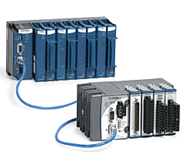
DCS Fieldpoint Readouts
The detector hall monitoring, rack monitoring, the water cooling/pumping system controls, and misc sensors & systems are accessed through a common National Instruments Compact Fieldpoint station for each detector di-block.
Stations backplanes are instrumented with 8 pods yielding 96-120 channels of controls or monitoring
The break down of instrumentation types is:
Pod Type | Slot | Units | Chan | Total Chan. | System
8 slot back plane | - | - | - | - | Base
Ethernet Control Interface module | 0 | 1 | - | - | Comm.
24 VDC, 120W rail mount supply (PS-5) | Rack | 1 | - | - | Sensor Power
3 wire RTD input 16bit | 1 | 1 | 8 | 8 | Cooling/Env.
10-30V Digital In/Out Module | 2 | 1 | 8 (4/4) | 8 | Cooling
12-24V Digital Counter Module | 3 | 1 | 8 | 8 | Cooling
24V sinking Digital Input | 4 | 1 | 32 | 32 | Env/Cooling
16bit Analog Input (0-10V) | 5 | 1 | 16 | 16 | Env/Cooling
8 Chan Strain Gage Input | 6/7 | 2 | 8 | 16 | Block Stress
Open | 8 | 1 | 32max | 32 | Misc
Total: |  |  |  | 120/96

Slide 32
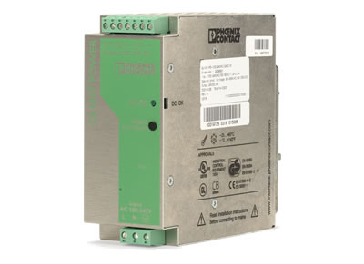
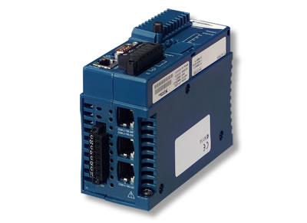
DCS Fieldpoint Readouts
PS-5 24V power supply (external) used to power sensors, providing up to 120W for additional instrumentation on water cooling plant and optionally for timing/sync units.
Provides integrated RS485 controller/bus
Failsafe and disconnected operation permitted through onboard program cycle
  Ensures network outage does not crash all readouts
  Buffered readouts permit level-0 filtering of data and short term storage of some parameters
Labview and OPC server options for local maintenance and hardware debugging.
Product support lifetime 10+ years
Includes RS485/232 controllers

Slide 33
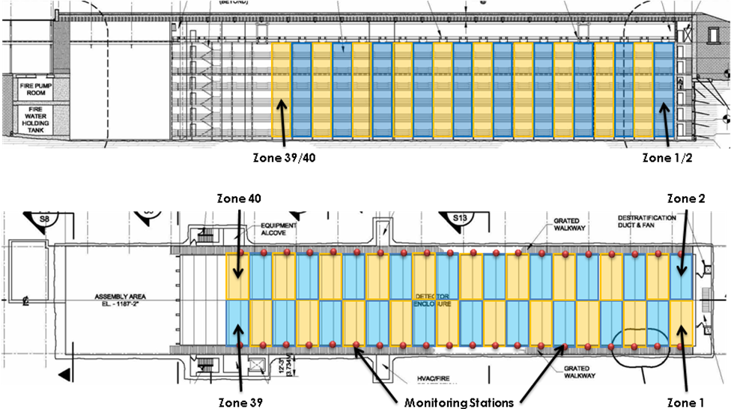
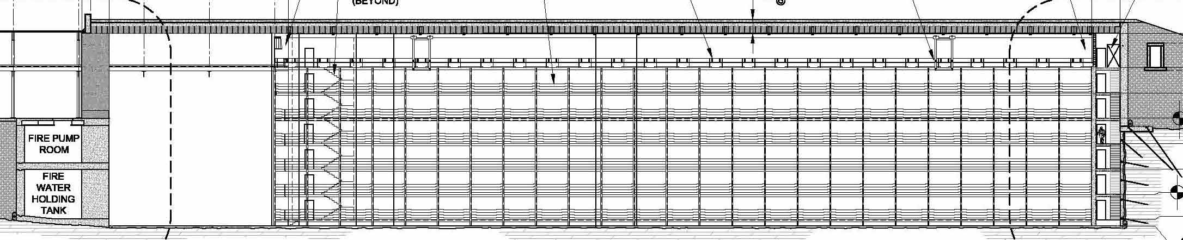
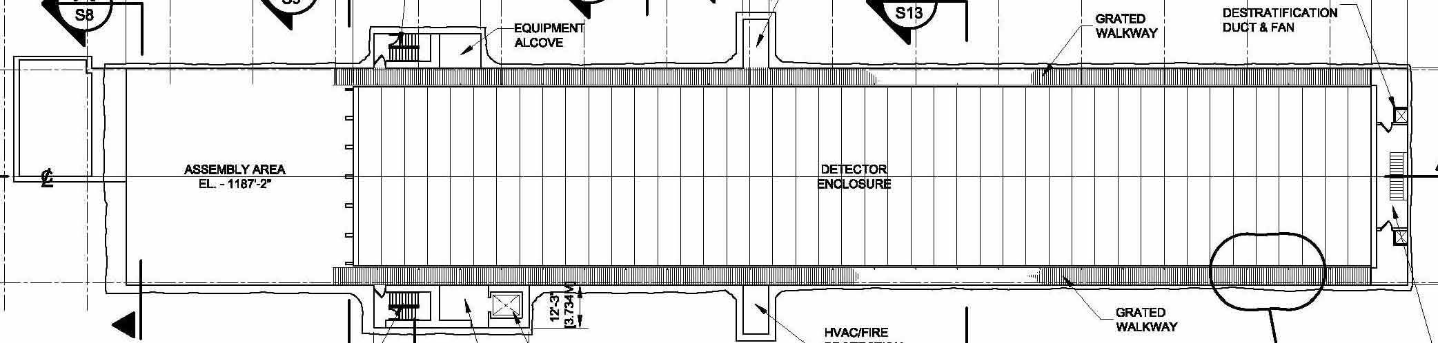
Monitoring Station Placement
Zone 17
Zone 1
Zone 40
Zone 2
Zone 17
Monitoring Stations
Zone 1

Slide 34

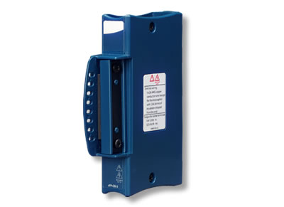
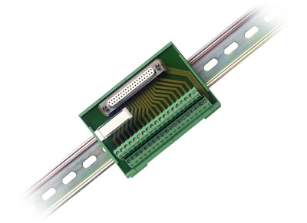
DCS Readout Rack
Front |  |  | Back
Position | Equipment |  | Position | Equipment
U-1 | DAQ Switch |  | U-1 | OPEN
U-2 |  |  | U-2 | Aux. Terminal Block
U-3 | DCS Switch |  | U-3 | DIN mounted
U-4 |  |  | U-4 | (DB37 Cable routing)
U-5 | Air Gap |  | U-5 | Air Gap
U-6 | Field Point |  | U-6 | 24V Power supplies
U-7 |  |  | U-7 | (Fieldpoint)
U-8 |  |  | U-8 | Power Distribution Block
U-9 | Exaust Fans |  | U-9 | (Fieldpoint)
U-10 | (3x 70mm muffin) |  | U-10 | Air Gap
U-11 |  |  | U-11 | Air Gap
U-12 | Wiener PL508 |  | U-12 | Wiener PL508
U-13 |  |  | U-13
U-14 |  |  | U-14
U-15 |  |  | U-15
U-16 |  |  | U-16
U-17 |  |  | U-17
U-18 | Exaust Fans |  | U-18 | Air Gap
U-19 | (3x 70mm muffin) |  | U-19 | Air Gap
U-20 |  |  | U-20 | Air Gap
U-21 | Wiener PL508 |  | U-21 | Wiener PL508
U-22 |  |  | U-22
U-23 |  |  | U-23
U-24 |  |  | U-24
U-25 |  |  | U-25
U-26 |  |  | U-26
U-27 | Exaust Fans |  | U-27 | Air Gap
U-28 | (3x 70mm muffin) |  | U-28 | Air Gap
U-29 |  |  | U-29 | Air Gap
U-30 | Wiener PL508 |  | U-30 | Wiener PL508
U-31 |  |  | U-31
U-32 |  |  | U-32
U-33 |  |  | U-33
U-34 |  |  | U-34
U-35 |  |  | U-35
U-36 | Exaust Fans |  | U-36 | Air Gap
U-37 | (3x 70mm muffin) |  | U-37 | Air Gap
U-38 |  |  | U-38 | Air Gap
U-39 | Wiener PL508 |  | U-39 | Wiener PL508
U-40 |  |  | U-40
U-41 |  |  | U-41
U-42 |  |  | U-42
U-43 |  |  | U-43
U-44 |  |  | U-44
DCS readout hardware is housed in the di-block electronics racks
Simple sensor inputs to the field point stations are located on the front of the racks (integrated connection blocks)
Complex/Aux sensor inputs are routed through terminal block/board assemblies on the back side of the rack. Integration through DB37 cable to the backside inputs on the field points
RS485 devices are handled by Field point controller.
Readout of Wiener/CAEN devices is provided by connection to the local DCS network switch
Gbit Fiber (to Master)
100Mb Ethernet

Slide 35
DCS Configuration
Need to be able to configure production and test configurations
Typical controls configuration for a particular “detector” version can be broken down into a tree structure from the block level down to the individual configuration parameters (FEB parameters, voltages, etc…
Branches are independent
“Detectors” become collections of branches
Easy partitioning and resource resolution
Block
X Planes
X-1
X-2
Y Planes
Y-1
X-15
Y-2
Y-16
FEB-1
FEB-2
FEB-12
…
…
TEC
T set
V set
V trip
FPGA
Fit Param.
C1
C2
…
Block 2
…
Block N
Det. Config Ver. N

Slide 36
DCS Configuration
<detector>
<block blockname=“nova01”>
<highvoltage zone=“nova01-hv01”>450V</highvoltage>
<highvoltage zone=“nova01-hv02”>450V</highvoltage>
….
<lowvoltage zone=“nova01-lv01” epicID=“lvmainframe-01”>
<lv_chan epicID=“lv01-01” type=“3.3V”>
<lv_vset epicID=“lv01-01-vset”>3.20V</lv_vset>
<lv_ilimit epicID=“lv01-01-ilimit”>1.2A</lv_ilimit>
</lv_chan>
</lowvoltage>
<module modulename=“nova01-x01” type=“X”>
<FEB FEBname=“nova01-x01-f01” FEB_UNI_ID=“1”>
<TEC tecname=“nova01-x01-t01”>
<TEC_calibration>1.2</TEC_calibration>
<TEC_setpoint>-15.0</TEC_setpoint>
</TEC>
</FEB>
</module>
<module modulename=“nova01-y02” type=“Y”>
….
</module>
</block>
<block blockname=“nova02”>
</block>
…
</detector>
This tree structure relates well to the Document Object Model (DOM) implementation of XML.
Each detector object becomes a “node” with parent and child objects
Values parameters become “leaf nodes”
Full description of the detector component relationships
Node Definitions
Leaf Values

Slide 37
DOM/XML Advantages
Provides a natural hierarchy with inheritance of parent/child relationships that mirrors the physical detector layout
  Allows for identification and configuration of a “detector region” instead of a discrete set of channels
  Allows for alarm association and correlations
Allows us to embed the EPICs channel information into the description file so that it’s abstracted from the operator
Parsing is done through nodes lists allowing us to extract subsets of data (i.e. all low voltage channels in Block02, or all detector active TECs)
  Allows client applications to use the general config file instead of requiring each application to have a separate list of components
Human readable/editable configuration files
  But with a configuration interface for generating base configs
Relies on standard APIs for file parsing/writing
Has natural translation modules into SQL tables
  Ease database integration
  Provides a natural mapping from central DB to runtime config
Industry standard for document markup

Slide 38
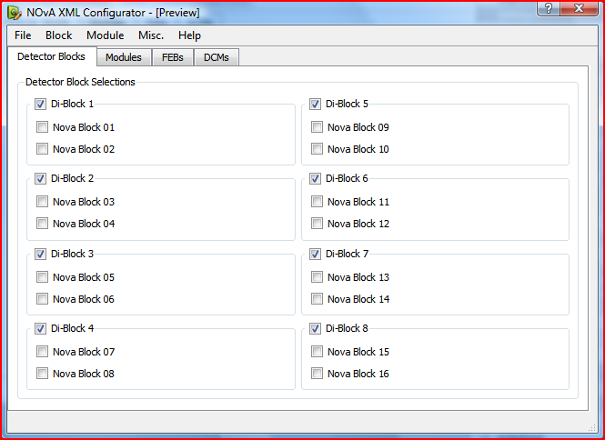
Configurator
Loads baseline values
  Either from central DB
  Or XML file
Allows for detector configuration on any level of granularity
  Block, Module, FEB
Output is DOM style XML to file or back to DB
Used to create client UI’s on the fly with only the relevant detector elements
All UI’s use the same config file and only parse out what they need (i.e. HV or LV channels, DCM parameters etc…)

Slide 39
Client Building
DCS clients are “built” at run time by parsing the config file and instantiating control widgets into display arrays
Involves no static assumptions about the current detector
  Allows for detector growth
  Allows for small “test” clients
  Allows multiple clients to run in parallel
Channel maps are automatically propagated to clients without rebuilds
EPICs layers are completely abstracted
Requires a central resource manager to resolve resource allocation conflicts

Slide 40
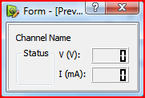
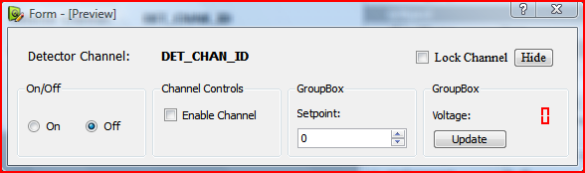
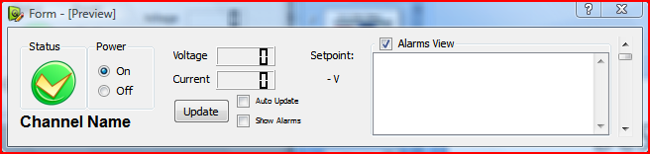
Widget Examples: Voltage
Compact Voltage display widget which shows only voltage and current for a generic channel (“Channel Name” is replaced on instance init, with the EPICS channel name)
Simple control widget for a single voltage channel. The widget allows for the on/off toggle, channel enable/disable, and modification of the setpoint.
An update field is included with a readback voltage and update.
The “detailed” voltage monitoring widget which includes a nice graphic status display, power indicator (not a control), a readback for both voltage and current, and a window showing a simple alarm history

Slide 41
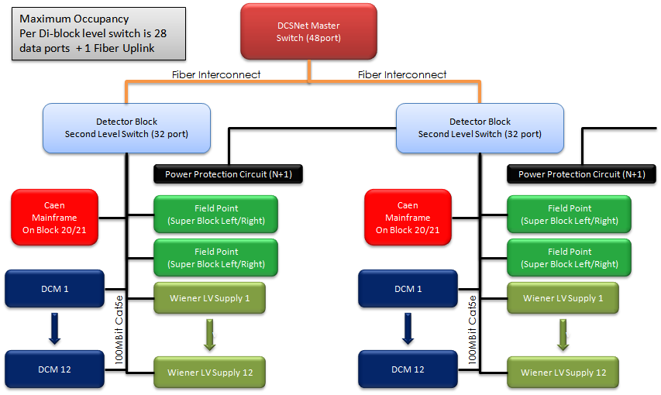
Second Level Switch Occupancy
20 second level switches
Gbit bandwidth per switch
Fiber uplink to master switch in electronics room
Aligned by detector di-blocks on detector Left/Right.
Mounted in catwalk elec. racks
Each switch handles minimum load of 12 Wiener LV supplies, 2 Fieldpoint control stations, rack power control (for rack N+1)
Full DCS traffic partitioning include the DCM’s 2nd Ethernet port on the switch
Total Occupancy: 28 ports

Slide 42
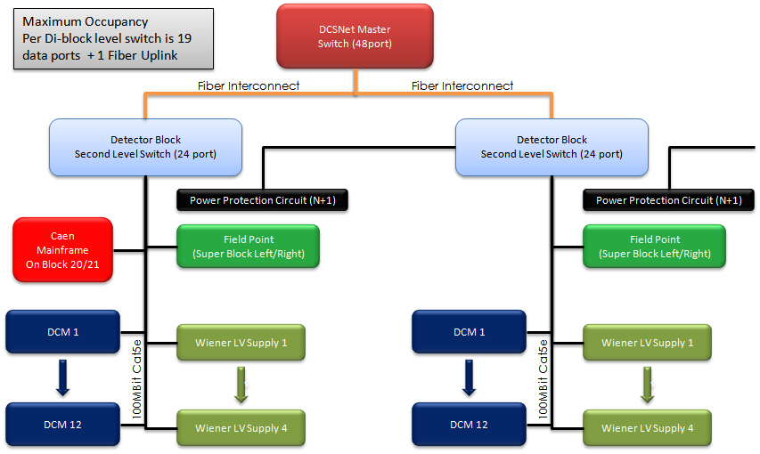
Second Level Switch Occupancy
17 second level switches
Gbit bandwidth per switch
Fiber uplink to master switch in electronics room
Aligned by detector di-blocks on.
Mounted in catwalk elec. racks
Each switch handles minimum load of 4 Wiener LV supplies, 1 Fieldpoint control stations, rack power control (for rack N+1)
Full DCS traffic partitioning include the DCM’s 2nd Ethernet port on the switch
Total Occupancy: 19 ports
  Means we need a 24port switch

Slide 43
Scope: Far Detector Controls (20kT)
Subsystem | Type | Units | Channels | Total Channels | Interface
High Voltage | Caen SY1527 | 2 | 96 | 192(114 used) | Ethernet
Low Voltage | Wiener | 76 | 6 | 456 | Ethernet
Water Cooling | Neslabs M150 | 38 | 10 | 380 | Ethernet/RS485
Data Acq. | Custom DCM | 228 | 62(64) | 14,136 | Ethernet
Det. Envir. | N.I. Fieldpoint | 38 | 128 | 4,864 | Ethernet
Front End | Custom FEB | 14136 | 32 | 452,352 | 8B/10B DCM
Timing/Sync | Custom TDB | 11 | 4 | 44 | Ethernet
Misc. & Safety | Misc. Sensors | 200 | 1-10 | 2000 | Misc.
Total |  |  |  | 22,072 474,424 w/FEBs
The detector controls system is required to have access to over 15,000 physical devices and 475,000 independent programmable channels
Controls interface must present a uniform method of accessing all the devices regardless of controls interface
The system must be modular, scalable and support partitioning into production, installation, and calibration/commissioning variants to accommodate the “physics during build” model.

Slide 44
Scope: Far Detector Monitoring (20kT)
System | Parameters/Chan | Channels | Total Monitoring
High Voltage | 6 | 80 | 486
Low Voltage | 4 | 456 | 1,824
Water Cooling | 2 | 380 | 760
DCM | 24 | 228 | 5,472
Det. Env | 128 | 38 | 4,864
Front End | 20-25 | 14136 | 353,400
Timing/Sync | 10-15 | 11 | 165
Misc. & Safety | 1-2 | 2000 | 4000
TOTAL |  |  | 17,571 370,971 w/FEBs
The detector Monitoring system is required to monitor and alarm on over 370,000 system critical run time parameters.
The monitoring frequency must be variable from ~1Hz for pushed data streams to once per minute (or 5minutes) for slower polled readouts.
Client initiated monitoring requests can cause burst spikes in the DCS bandwidth with transfers on the order of 400-600mb per full monitoring dump with protocol and network overhead

