Slide 1
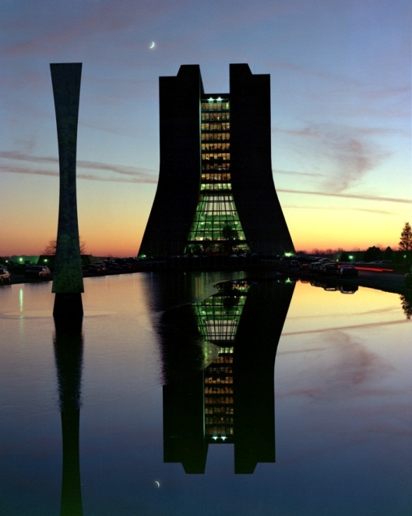
Accelerator Based Neutrino Physics at Fermilab
E. Craig Dukes
University of Virginia
BCVSPIN 2011
July 27, 2011

Slide 2

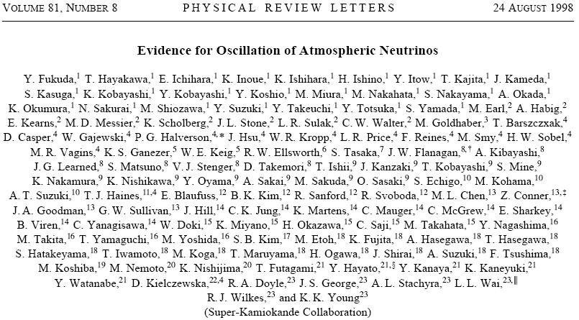
The Past Decade Neutrino Physics Really Got Interesting

Slide 3
A Brief neutrino primer

Slide 4
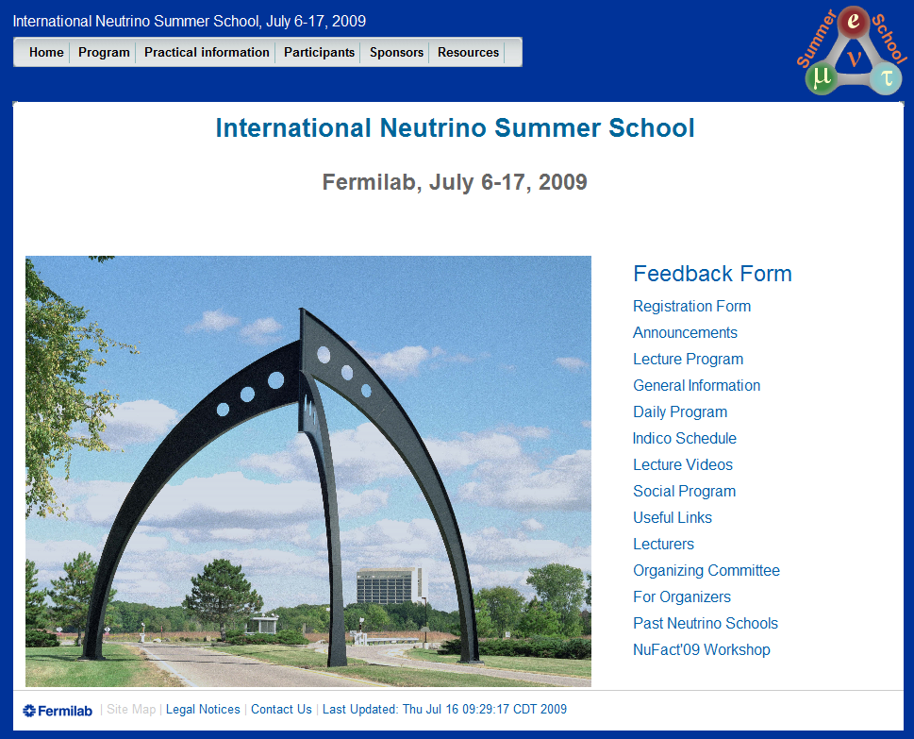
A Great Reference for Neutrino Physics
http://vms-db-srv.fnal.gov/fmi/xsl/search/r_nuss2009.xsl
Slides and video available!

Slide 5
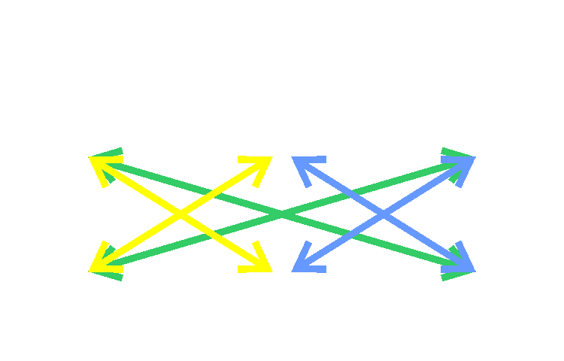
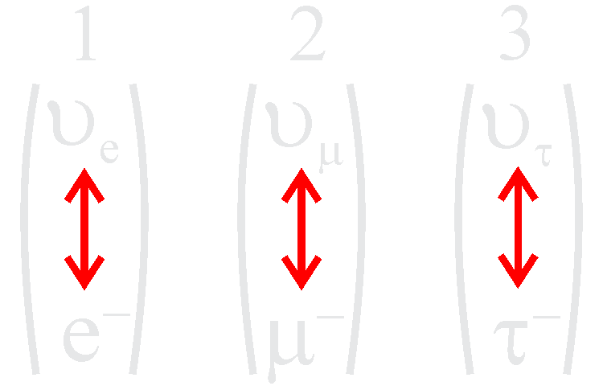
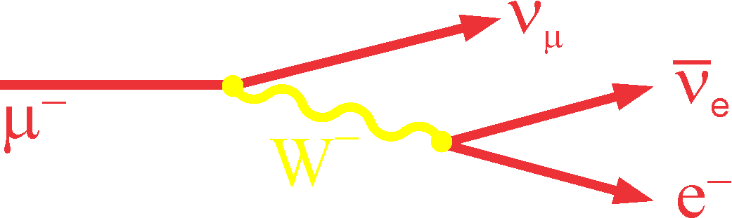
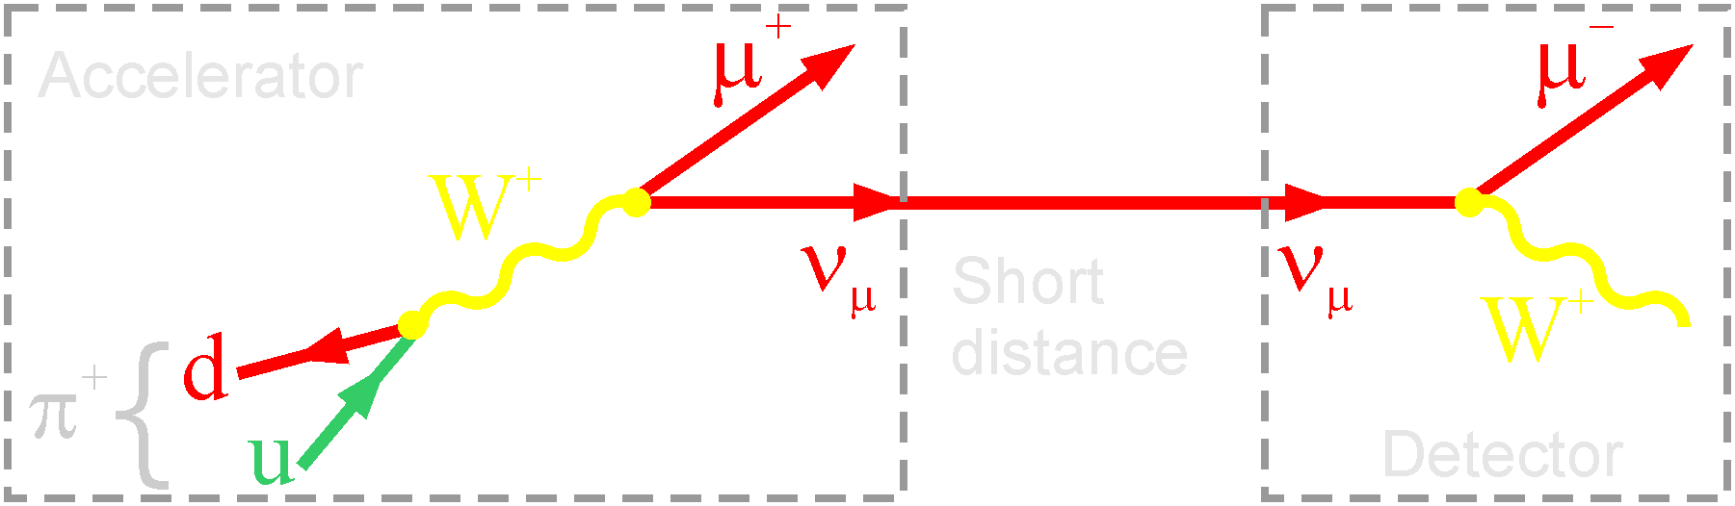
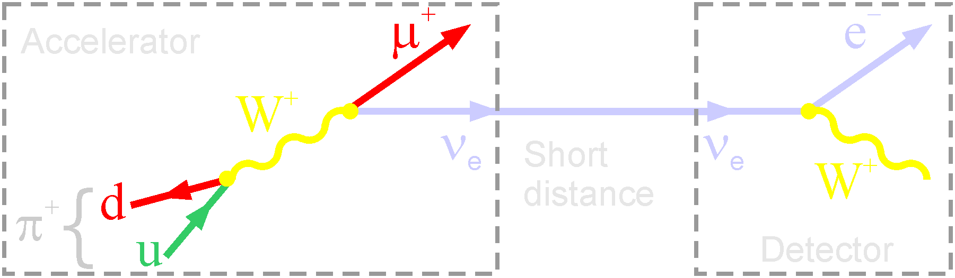
Lepton Mixing
Leptons
Cross generational transitions do not occur in the lepton sector!
Charged weak interaction changes one type of lepton into another

Slide 6
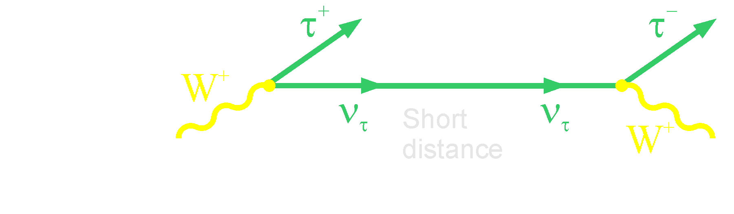
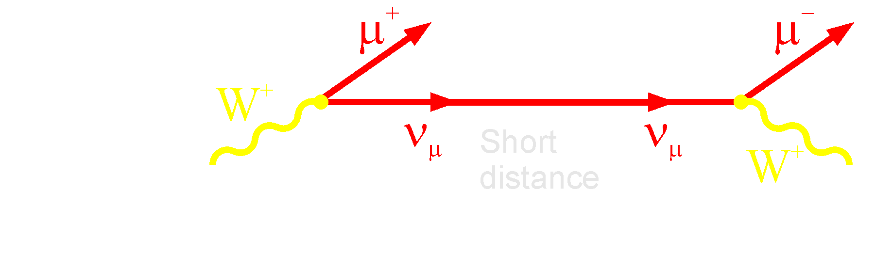
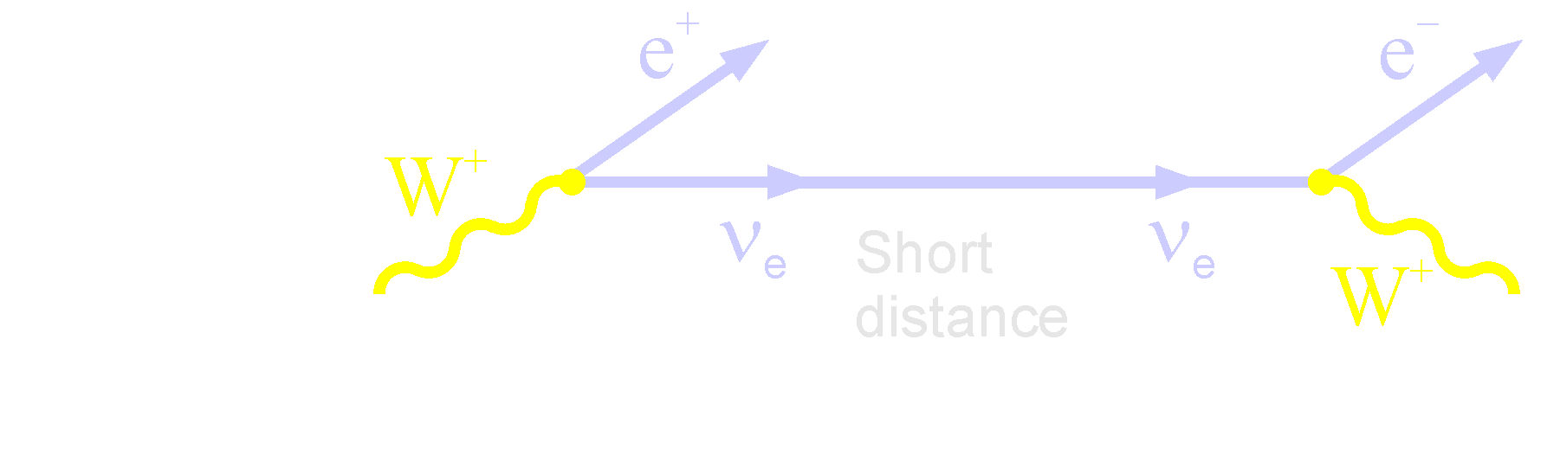
Production and Detection of Neutrinos
Note: Flavor of charged lepton gives neutrino flavor, charge tells you if it is a neutrino or anti-neutrino
Leptons

Slide 7
How Neutrinos Interact: Cross Sections
N(E)_{events} = Φ_{ν}(E) x σ_{ν}(E) x N_{target}
Number of neutrino-induced events
Flux of neutrinos
(# per cm⁻²s⁻¹)
Neutrino cross section (cm²)
Number of targets
Cross section σ depends on:
neutrino type
interaction type: Z⁰, W±
target type: p, n, e
energy: σ_{tot} ∝ E_{ν}
@1 GeV
νp ~10⁻³⁸ cm²
pp ~10⁻²⁶ cm²
Tiny due to large W,Z masses

Slide 8
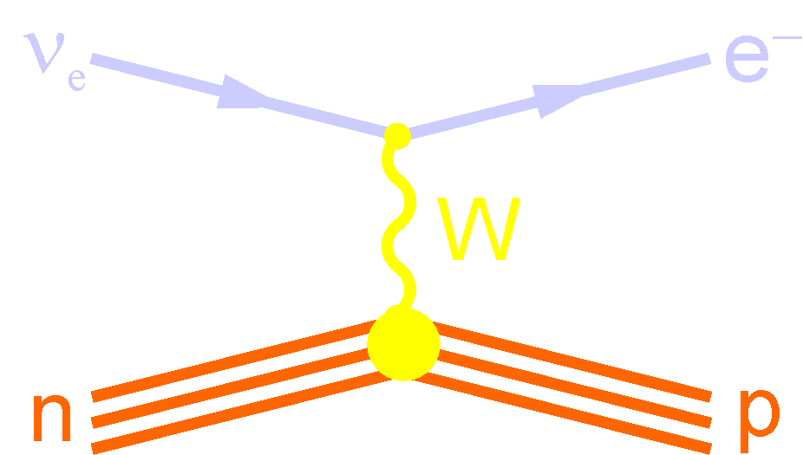
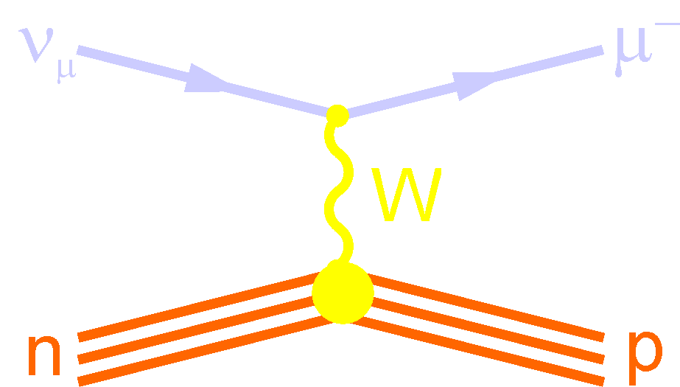
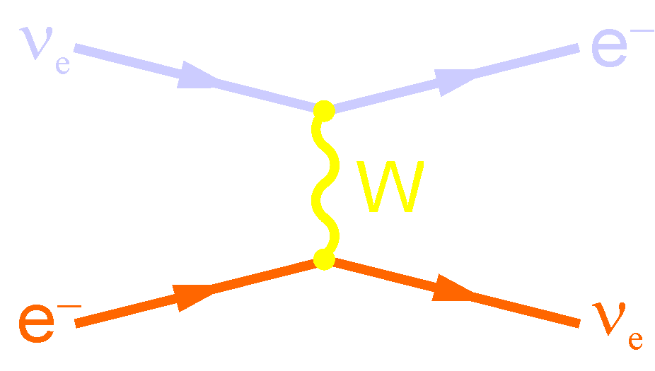

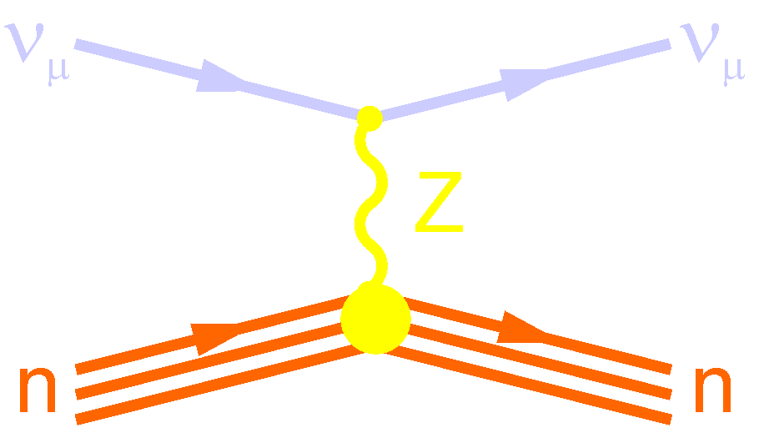
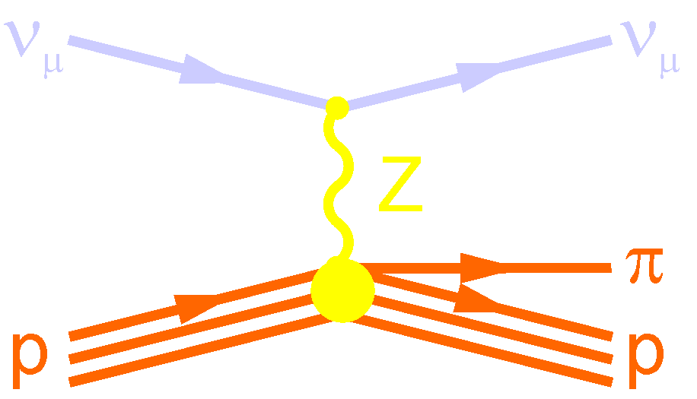
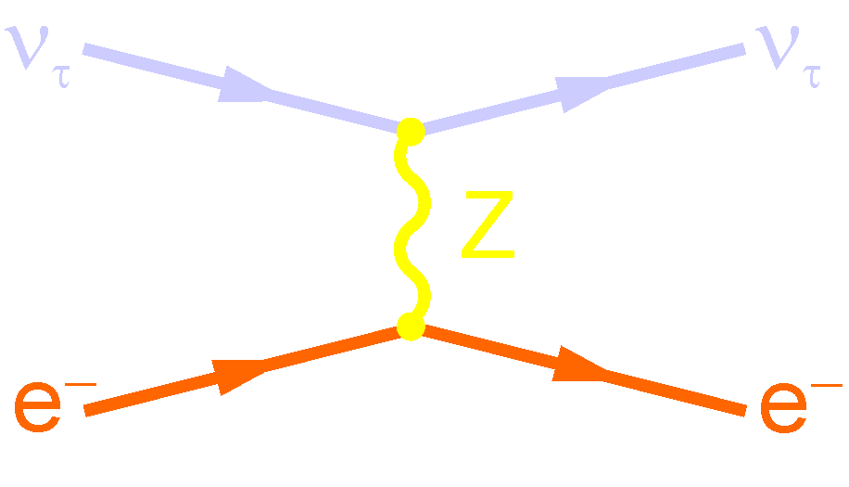
Aside: How Neutrinos Interact
Charged Current (CC) Interactions (mediated by W± boson)
Quasi-elastic
Quasi-elastic
Quasi-elastic
Neutral Current (NC) Interactions (mediated by Z⁰ boson)
Small for kinematic reasons
Elastic
Inelastic
Elastic

Slide 9
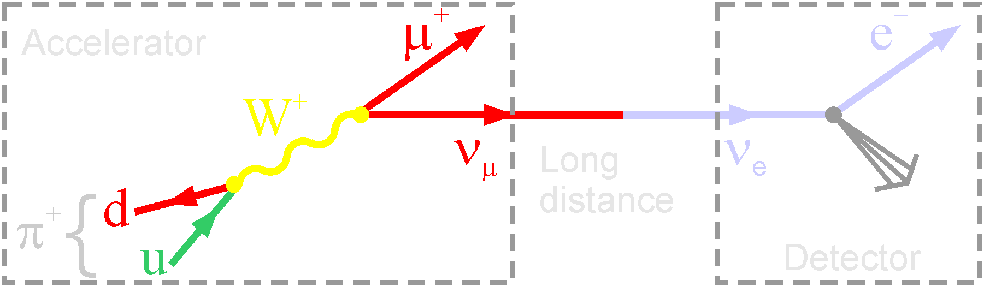
Neutrinos Oscillate!
Neutrinos propagate in mass eigenstates: ν₁ ν₂ ν₃
There’s a lot of subtle fundamental QM here!
Neutrinos produced and detected in flavor eigenstates: ν_{e} ν_{μ} ν_{τ}
Mass difference
Two component mixing
Mixing Angle between mass and flavor states

Slide 10
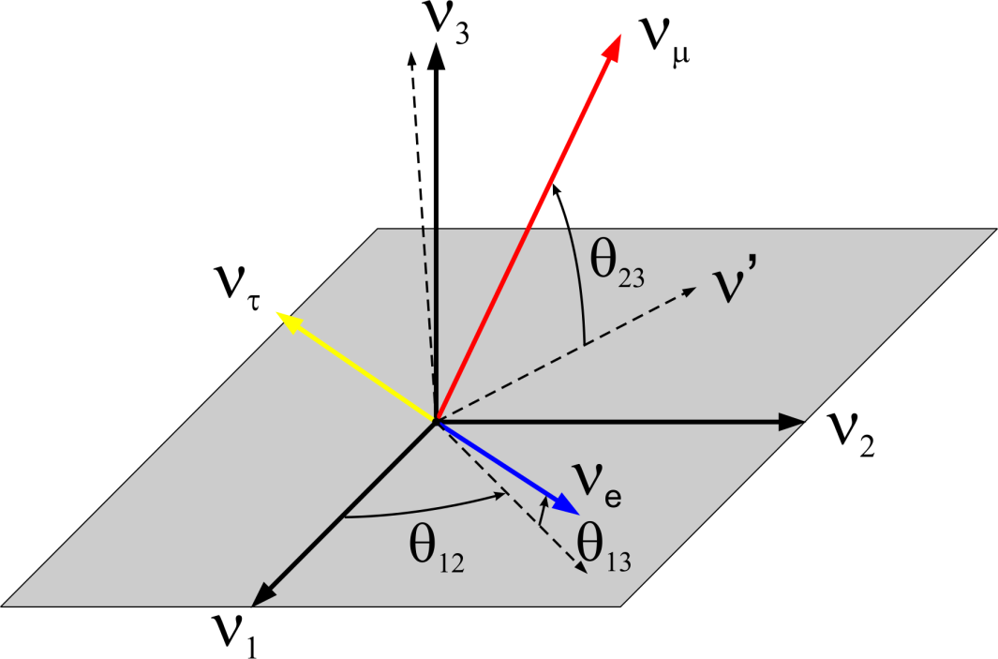
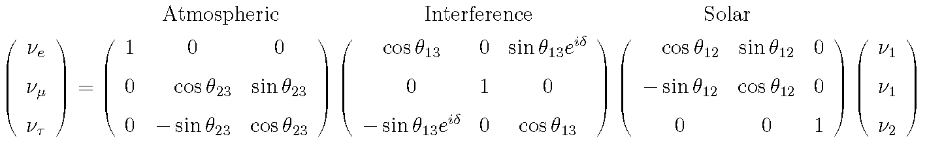
Implications of Neutrino Oscillations
Neutrinos have mass
Neutrinos have non-zero mixing angles
3 Flavor states: ν_{e} ν_{μ} ν_{τ}
3 Mass states: ν₁ ν₂ ν₃
Three mixing angles: θ₁ θ₂ θ₃
One CP phase: δ
PMNS Matrix

Slide 11
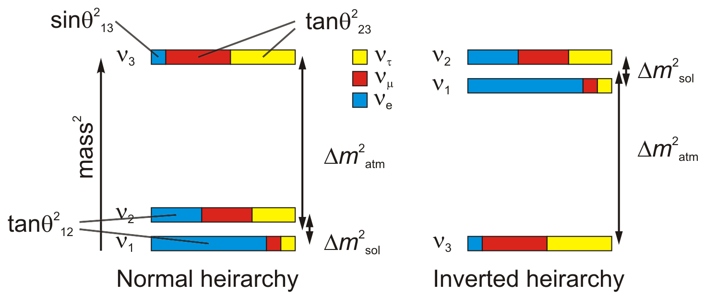
A Huge Amount has been Learned in the Past Decade
ν_{e}
ν_{μ}
ν_{e}
Appearance Experiments
Disappearance Experiments
Known
Unknown
PMNS Matrix

Slide 12
Appearance Rate: ν_{μ}→ν_{e}
P_{atm} depends on θ₁₃
P_{sol} independent of θ₁₃ and typically small
P_{int} depends on θ₁₃, CP phase, and neutrino or antineutrino
- neutrino
+ antineutrino
CP phase

Slide 13
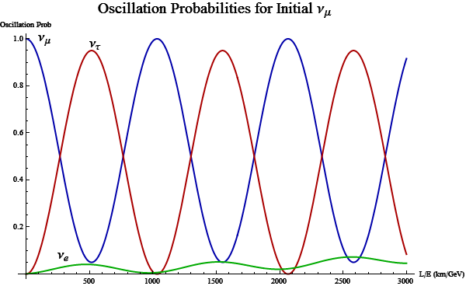



Appearance Rates
OPERA
NOvA L=810km
0.041
MINOS, NOvA, T2K, etc

Slide 14
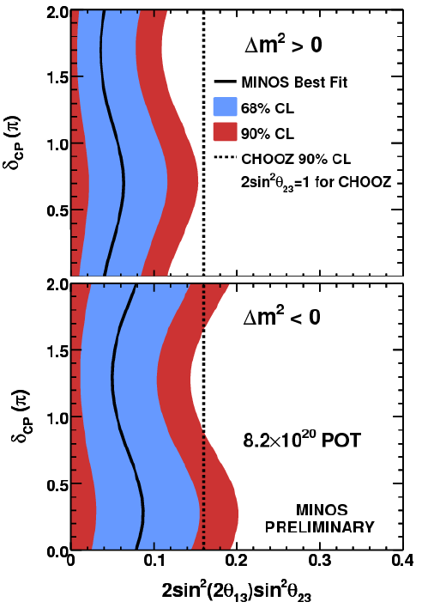
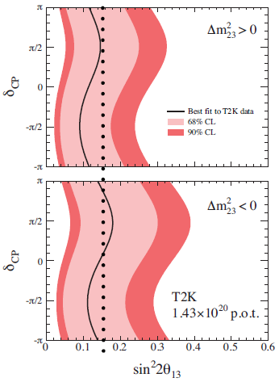
Hot Off the Press News on θ₁₃!
MINOS: observe 62, expect 50 evts
exclude sin²2θ = 0 @ 89%CL
T2K: observe 6, expect 1.5 evts
Note: Neutrino physics is not a data-rich field!

Slide 15
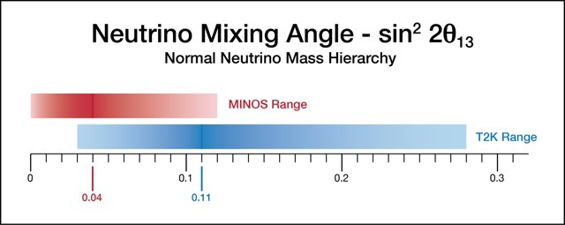
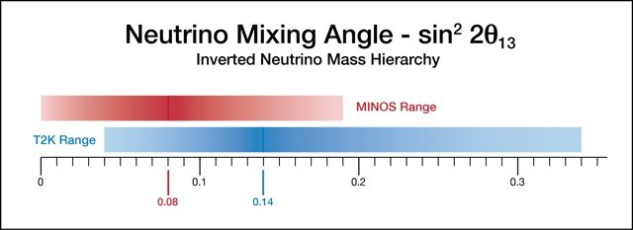
Hot Off the Press News on θ₁₃!

Slide 16

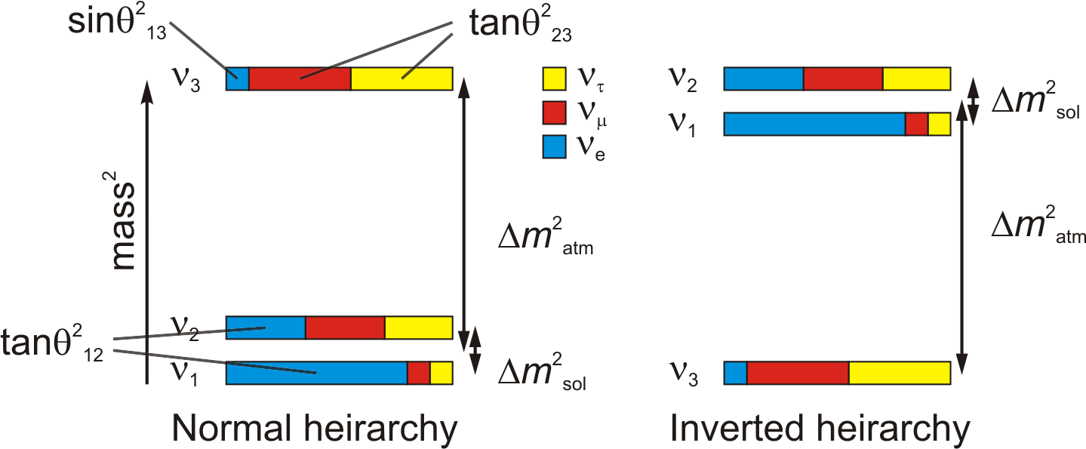
What Remains to be Learned?
What is the value of θ₁₃, the amount of ν_{e} in ν₃?
  Impacts mass hierarchy measurement
  Impacts CP-violation search
Is the mass hierarchy normal or inverted?
Is θ₂₃ maximal (45 degrees)? if so, why?
Are neutrinos and anti-neutrinos different?
Do neutrinos respect CP? If not, is CP violation in the neutrino sector responsible for the matter-antimatter asymmetry in the universe?
What is the neutrino mass?

Slide 17
The Past

Slide 18
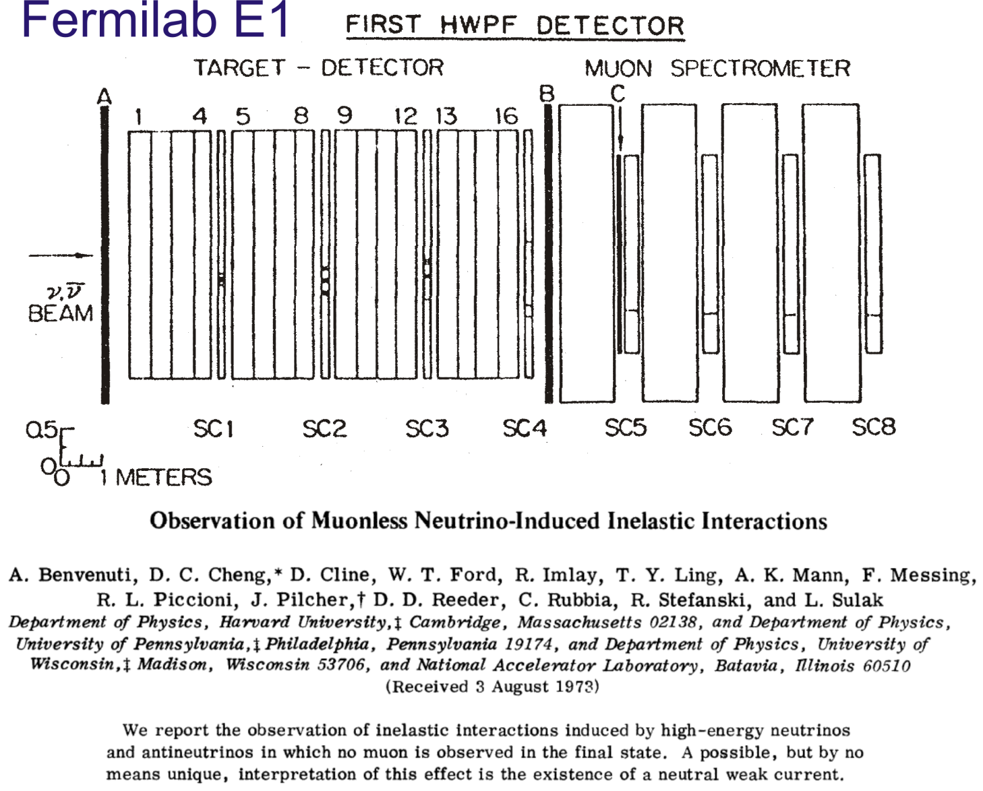
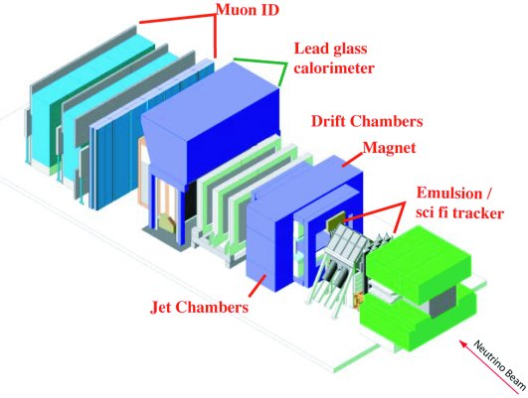
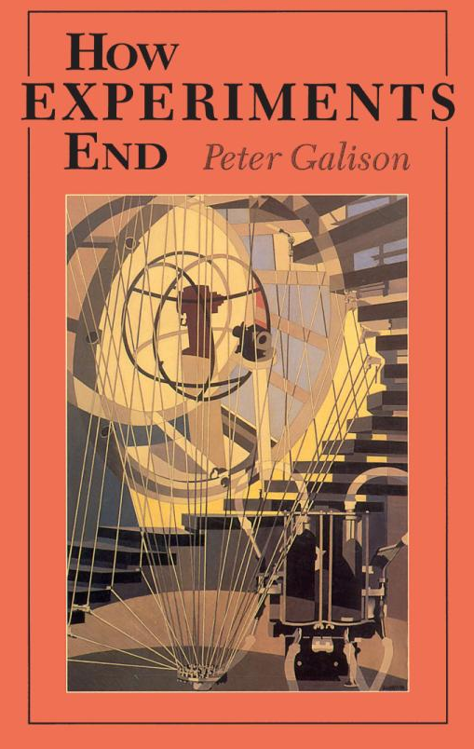
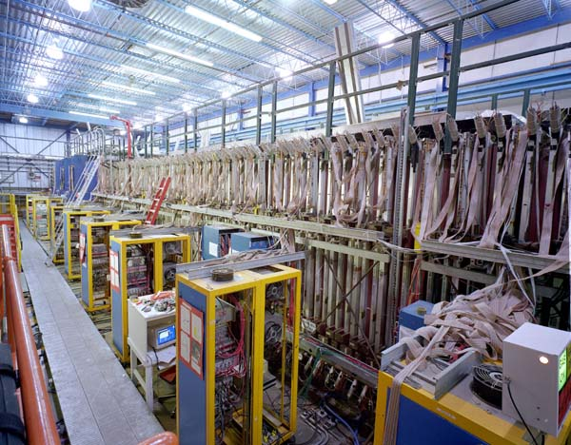
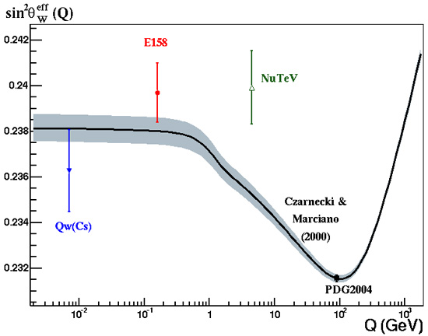
Fermilab has Long History of ν Physics
Last fixed target run (1997) two neutrino experiments: DONUT and NuTeV
DONUT: ν_{τ} discovery
NuTeV: sin²θ_{W} anomaly
DONUT

Slide 19
The Present

Slide 20
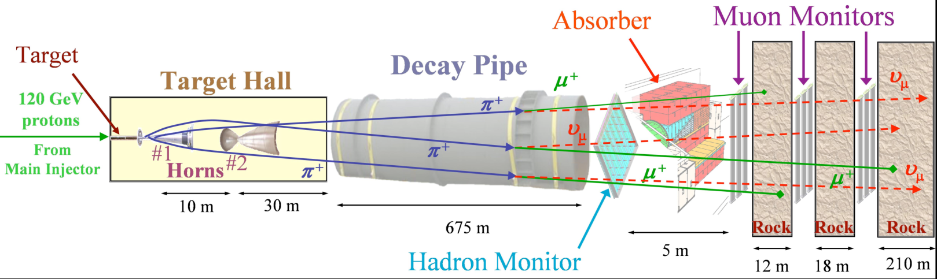
Fermilab has built two new Neutrino Beams
Main Injector Beam (NUMI)
  Beam
    120 GeV protons
    4.5 x 10¹³ p/2.2 s (0.320 MW)
  Experiments:
    MINOS (running)
    ArgoNeuT (running)
    MINERvA (running)
    NOvA (construction)
    LAr5 at SOUDAN (?)
Booster Beam
  Beam:
    8 GeV protons
    4 x 10¹² p/0.20 s
  Experiments:
    MiniBooNE (running)
    SciBooNE (just completed)
    MicroBooNE (approved)
We use beam power because σ(ν) ∝ E
NUMI Beamline

Slide 21
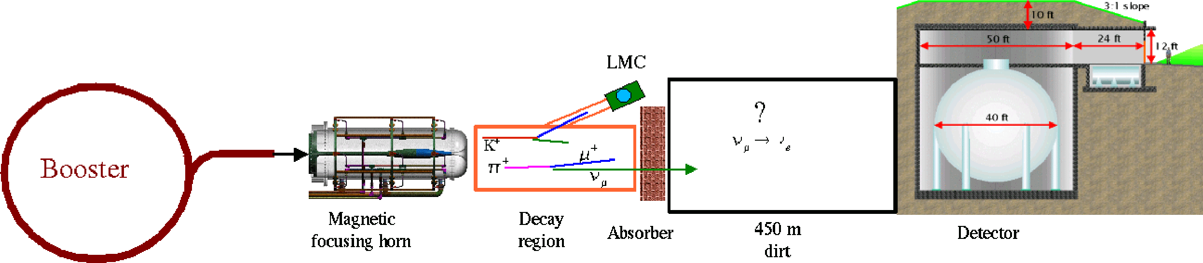
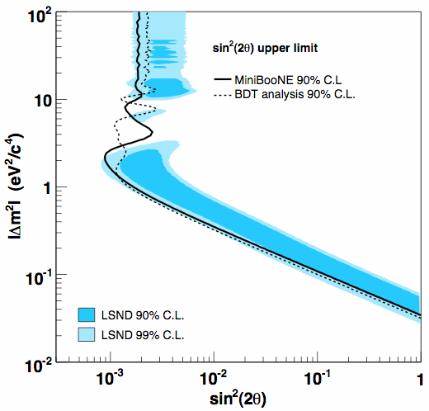
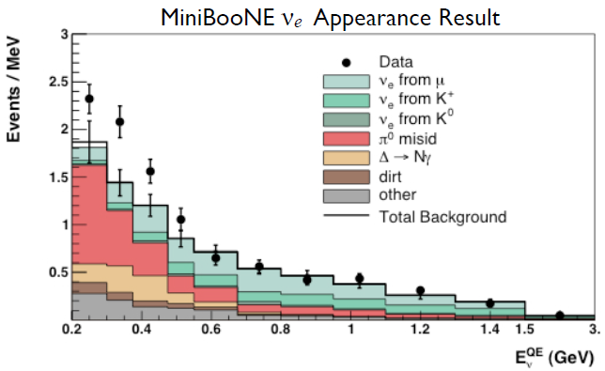
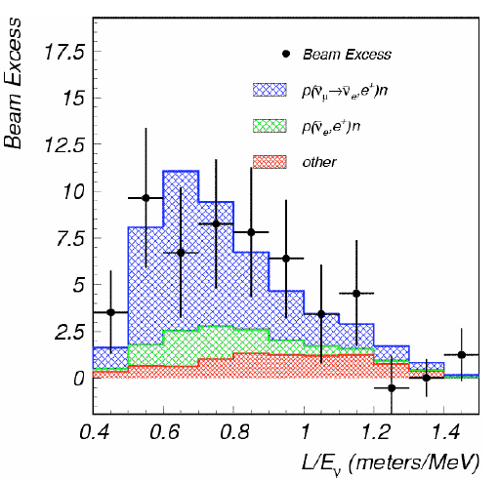
MiniBooNE
Appearance Experiment: ν_{μ}→ν_{e} (ν_{μ}→ν_{e})
Running through 2011
Find low-energy excess
Oscillated signal
Rule out LSND result
LSND Result
Designed to confirm or refute the LSND oscillation result
LSND result is not compatible with standard neutrino oscillation model: Requires exotic new physics
Sterile neutrinos
Neutrino decay
Lorentz/CPT violation
Extra dimensions

Slide 22
Do We Know the Low Energy σ_{ν}?
M.C. Martinez et al., arXiv:0805.2344 [nucl-th] (2008) - K.S. Kim, L.E. Wright, nucl-th/0705.0049 (2007)
O. Benhar, AIP Conf. Proc. 967, 111 (2007) - A. Butkevich, S. Kulagin, nucl-th/0705.1051 (2007)
A.V. Butkevich, arXiv:0804.4102 [nucl-th] (2008) - J.E. Amaro et al., PRC 75, 034613 (2007)
M.J. Vincente Vacas et al., arXiv:802.1128 [nucl-th] (2008) - A. Bodek et al., arXiv: 0708.1827 [hep-ex] (2007)
A. Bodek et al., Eur. Phys. J. C53, 349 (2008) - P. Lava et al., PRC 73, 064605 (2006)
A.M. Ankowski et al., AIP Conf. Proc. 967, 106 (2007) - O. Benhar et al., nucl-ex/0603029 (2006)
A.V. Butkevich, S.A. Kulagin, arXiv:0711.3223 [nucl-th] (2007) - R. Bradford et al., hep-ex/0602017 (2006)
J.E. Amaro et al., arXiv:0710.5884 [nucl-th] (2007) - K.S. Kuzmin et al., Acta Phys. Polon. B37, 2337 (2006)
A.N. Anatov et al., Phys. Rev. C75, 064617 (2007) - J. Nieves et al., Phys. Rev. C73, 025504 (2006)
T.W. Donnelly, Eur. Phys. J. A21, 409 (2007) - M.C. Martinez et al., PRC 73, 024607 (2006)
T. Nasu et al., AIP Conf. Proc. 967, 187 (2007) - A. Meucci et al., Acta Phys. Polon, B27, 2279 (2006)
N. Jacjowicz et al., AIP Conf. Proc. 967, 292 (2007) - C. Giusti et al., nucl-th/0607037 (2006)
K.S. Kim et al., J. Phys. G34, 2643 (2007) - N. Jachowicz et al., NP. Proc. Suppl. 155, 260 (2006)
J.A. Caballero et al., nucl-th/0705.1429 (2007) - G. Co, ActaPhys.Polon.B37, 2235 (2006)
M. Martini et al., Phys. Rev. C75, 034604 (2007) - M. Valverde et al., Phys. Lett. B642, 218 (2006
E. Hernandez et al., Phys. Lett. B647, 452 (2007) - M. Valverde et al., Phys. Lett. B638, 325 (2006)
A. Bodek et al., arXiv: 0709.3538 [hep-ex] (2007)
M.V. Ivanov et al., Phys. Rev. C77, 034612 (2008) - H. Nakamura et al., hep-ph/0705.3884 (2007)
E. Hernandez et al., arXiv:0802.1627 [hep-ph] (2008) - E.A. Paschos et al., hep-ph/0704.1991 (2007)
S.K. Singh et al., arXiv:0710.4467 [nucl-th] (2007) - M. Sajjad et al., Phys. Rev. D75, 093003 (2007)
M. Barbaro et al., arXiv:0710.4089 [nucl-th] (2007) - T.-S. H. Lee, AIP Conf. Proc. 967, 238 (2007)
C. Praet et al., arXiv:0710.0312 [nucl-th] (2007) - M. Sajjad et al., Nucl. Phys. A782, 179 (2007)
L. Alvarez-Ruso et al., arXiv:0709.3019 [nucl-th] (2007) - L. Alvarez-Ruso et al., Phys. Rev. C75, 055501 (2007)
L. Alvarez-Ruso et al., arXiv:0709.0728[nucl-th] (2007) - D. Rein, L.M. Sehgal, Phys. Lett. B657, 207 (2007)
T. Leitner et al., arXiv:0709.0244 [nucl-ex] (2007) - O.Benhar, D. Meloni, Phys. Rev. Lett. 97, 192301 (2006)
O. Lalakulich et al., AIP Conf. Proc. 967, 243 (2007) - O. Buss et al., Phys. Rev. C74, 044610 (2006)
O. Buss et al., Phys. Rev. C76, 035502 (2007) - E.A. Paschos, A. Kartavtsev, Phys. Rev. D74, 054007 (2006)
L. Alvarez-Ruso et al., Phys. Rev. C76, 68501 (2007) - O. Lalakulich et al., Phys. Rev D74,014009 (2006)
K. Graczyk, J. Sobczyk, AIP Conf. Proc. 967, 205 (2007) - O. Buss et al., Eur. Phys. J. A29, 189 (2006)
E.A. Paschos, AIP Conf. Proc. 967, 162 (2007) - S.K. Singh et al., Phys. Rev. Lett. 96, 241802 (2006)
L.M. Sehgal, AIP Conf. Proc. 967, 166 (2007) - B.Z. Kopeliovich, Nucl. Phys. Proc. Suppl. 139, 219 (2006)
Ch. Berger, L.M. Sehgal, Phys. Rev. D76, 113004 (2007) - S. Ahmad et al., Phys. Rev. D74, 073008 (2006)
I. Schienbein et al., Phys. Rev. D77, 054013 (2008) - O. Lalakulich et al., PRC 75, 015202 (2007)
A. Cooper-Sarkar et al., JHEP 0801, 075 (2008) - S.A. Kulagin, R. Petti, hep-ph/0703033 (2007)
S.A. Kulagin et al., arXiv:0711.3956 [nucl-th] (2007) - T. Leitner et al., Int.J.Mod.Phys. A22, 416 (2007)
A. Psaker, arXiv:0708.0926 [hep-ph] (2007) - K.S. Kuzmin et al., Phys. Atom. Nucl. 69, 1857 (2006)
S. Alekhin et al., AIP Conf. Proc. 967, 215 (2007) - T. Leitner et al., PRC 73, 065502 (2006), PRC 74, 065502 (2006),
W. Melnitchouk, AIP. Conf. Proc. 967, 225 (2007) - O. Benhar, D. Meloni, hep-ph/0610403 (2006)
New σ_{ν} calculations: 2006-2008 (Sam Zeller)
QE
Single π production
DIS

Slide 23
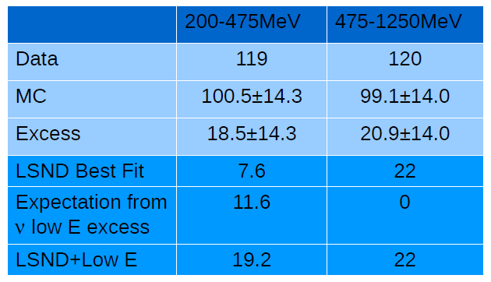
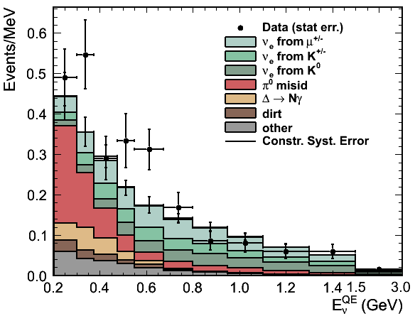
MiniBooNE: anti-ν_{e} Appearance
Both low and energy excess!
Fluctuation?: 1.6% 3.0%
No good explanation of excess has been given

Slide 24
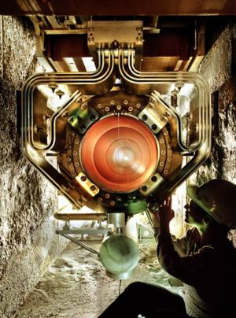
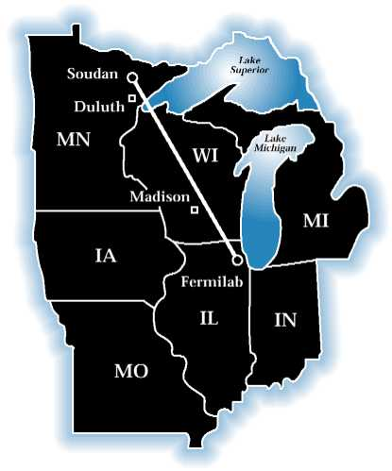
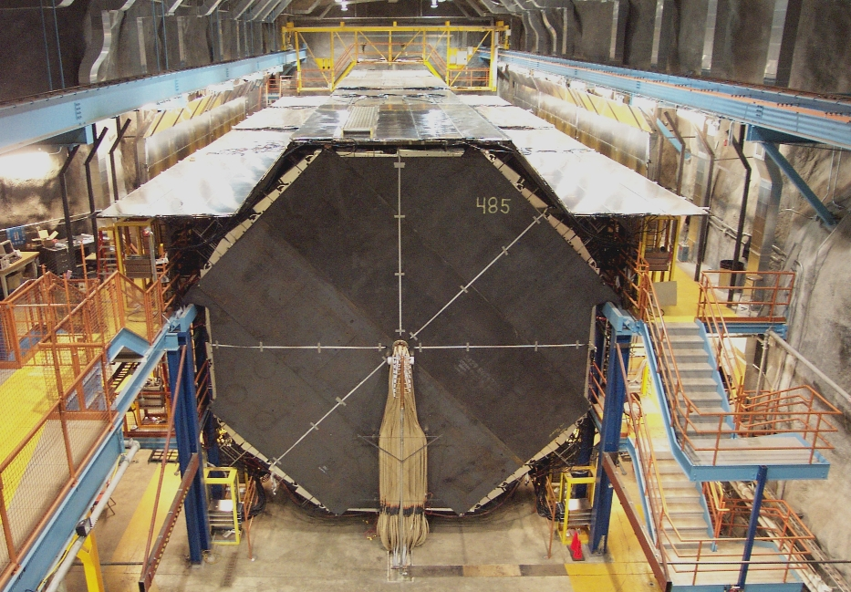

MINOS (Main Injector Neutrino Oscillation Search)
Detector:
NUMI beam
Long baseline: 735 km
5.4 kt far detector, 1kt near
Optimized for ν_{μ} disappearance
Sampling 2.54 cm Fe / 1.0 cm scint.
Magnetic field: sign of charge
Goals:
Make precision measurements of Δm²₃₂ and sin²2θ₂₃
Confirm oscillations vs decay/decoherence
Compare ν vs anti-ν oscillations

Slide 25
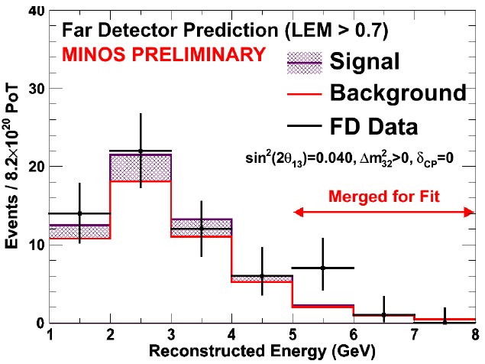
MINOS: ν_{μ}→ ν_{e}
8.2x10²⁰ POT
Observe 62 events after cuts
Expect 49.5±7(stat)±2.8(sys) background events
1.7σ excess
Best fit normal (inverted): sin²2θ₁₃ = 0.04 (0.08)

Slide 26
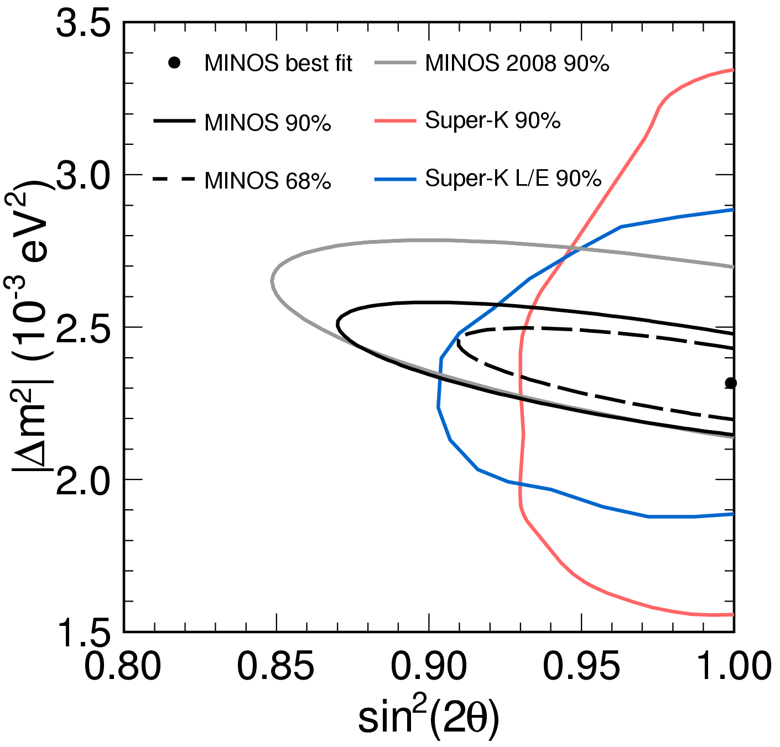
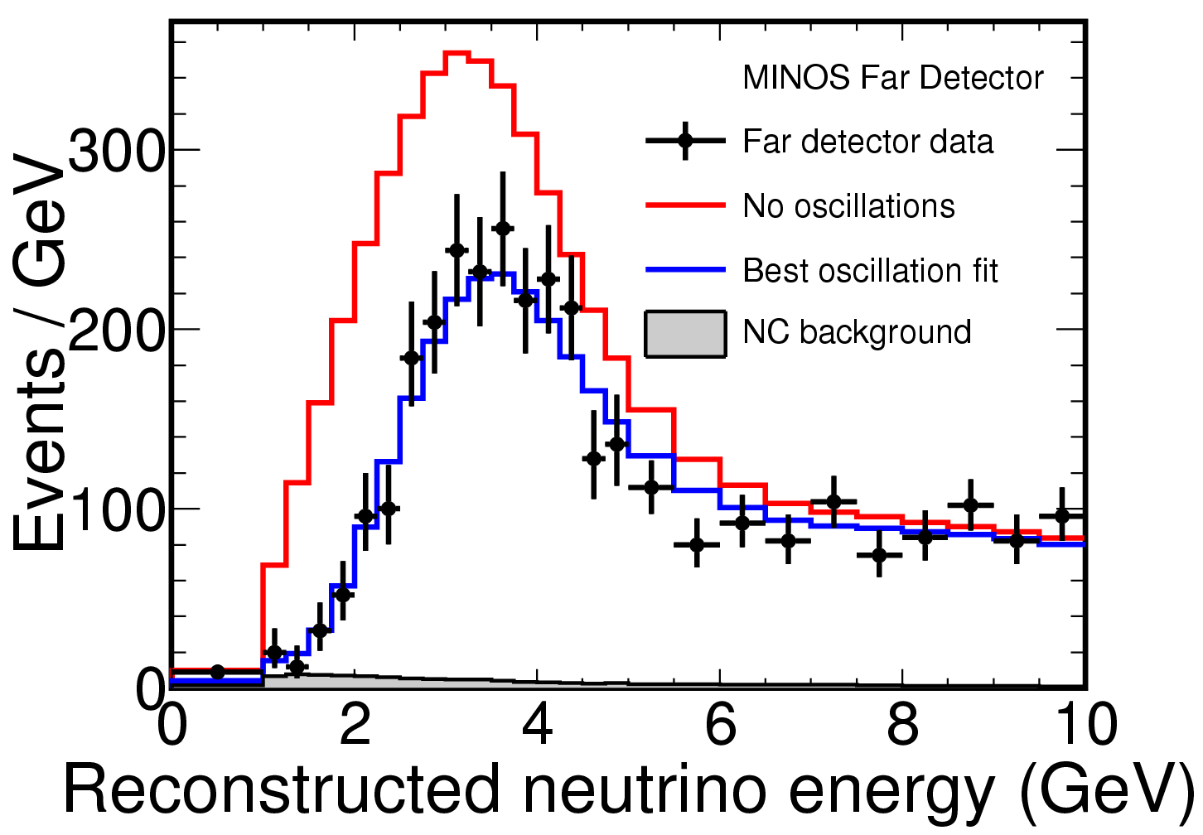
MINOS: ν_{μ} Disappearance
Decoherence disfavored at 8.8σ
Decay disfavored at 6.8σ
Most precise measurement: 5% error

Slide 27
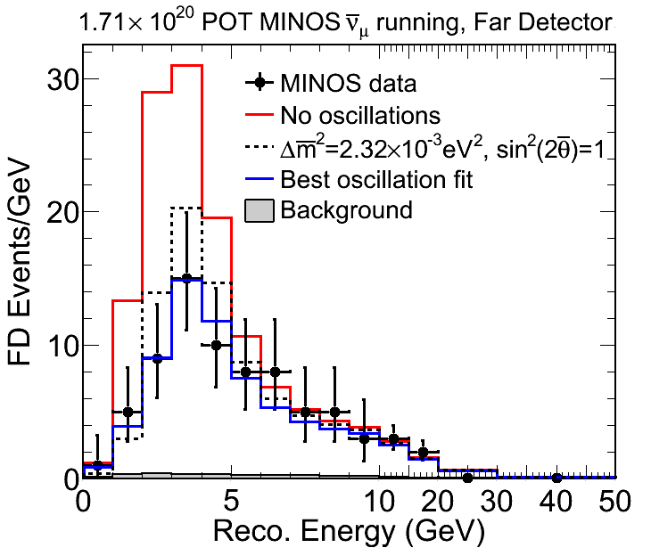
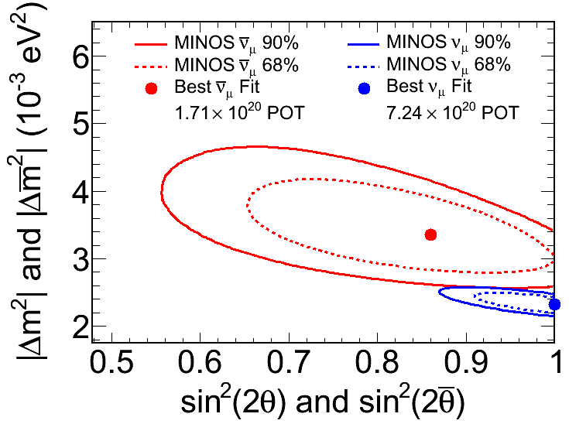
MINOS: anti-ν_{μ} Disappearance
What is happening here!
5% chance they are consistent!

Slide 28
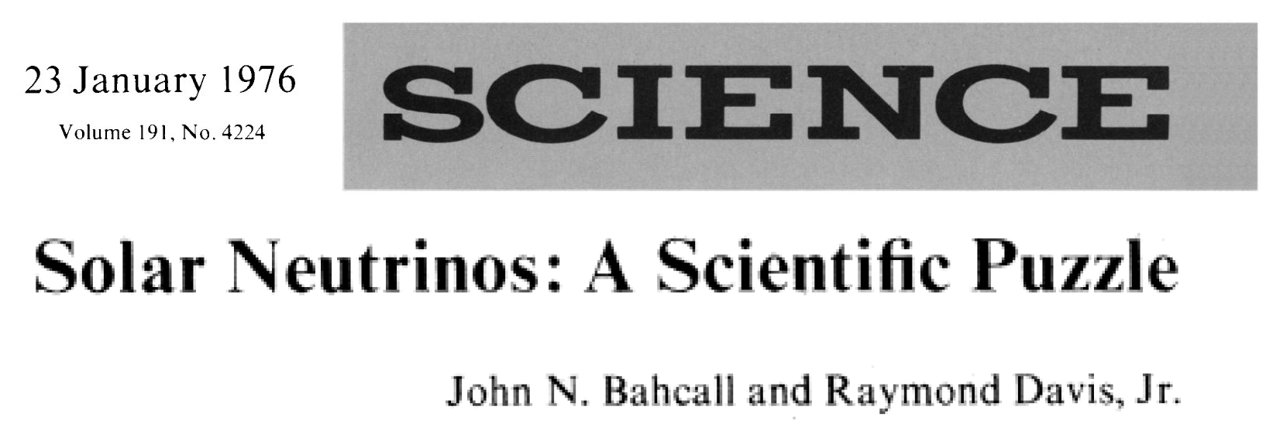
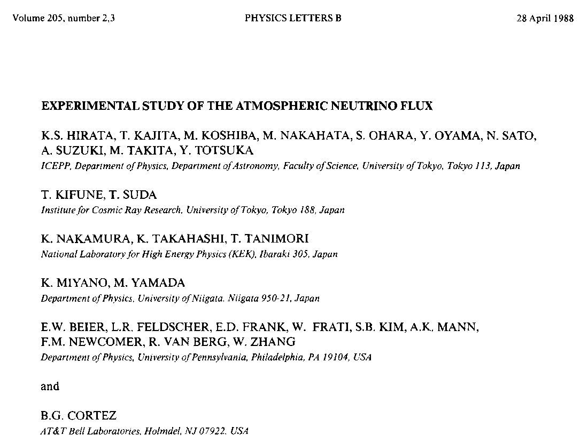
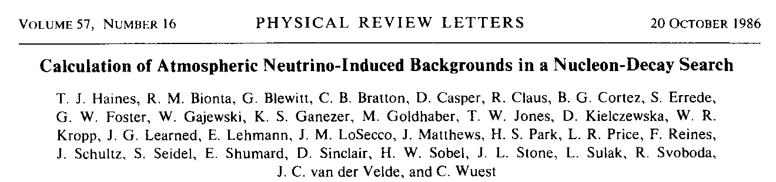
Beware: Neutrino Anomalies can be Important!
Beta-decay anomaly
J. Chadwick, Verh. d. Deutsch. Phys. Ges. 16, 383, 1914.
Solar neutrino anomaly
Atmospheric ν_{μ}/ν_{e} anomaly in proton decay experiments

Slide 29
The Immediate Future

Slide 30


MINERνA: Physics Goals
All accelerator long-baseline experiments need energies from ~0.5 GeV to several GeV
Neutrino cross sections poorly known at low energies
  mostly old bubble-chamber data
  NC cross sections known to ~50% at best
Neutral current π⁰ is a major background to ne appearance experiments
MINERνA plans to measure neutrino nucleus cross sections with unprecedented statistics from 1 – 20 GeV
  5% on CC
  10% on NC
Main Injector Experiment for ν-A
Note: MiniBooNE, SciBooNE (K2K, NOvA) making these measurements as well!
Current knowledge of CC cross sections
ν_{μ}N → μ⁻p
5% flux error not included

Slide 31



MINERvA: Detector
Fully active segmented scintillator detector: 5.87 tons
Nuclear targets: He, C, Fe and Pb
MINOS Near Detector as muon catcher
Installed and taking data!

Slide 32



NOνA
Second generation experiment in the NUMI beamline
Fully active detector optimized for detection of ν_{μ} → ν_{e} oscillations
Goals:
  Observe ν_{μ} → ν_{e} oscillations
  Measure θ₁₃
  Measure θ₂₃
  Determine mass hierarchy
  Make first probe of δ_{CP}

Slide 33

The NOνA Collaboration
180 Scientists & Engineers from 26 Institutions
Argonne National Laboratory
University of Athens
California Institute of Technology
University of California, Los Angeles
Fermi National Accelerator Laboratory
Harvard University
Indiana University
Lebedev Physical Institute
Michigan State University
University of Minnesota, Duluth
University of Minnesota, Minneapolis
The Institute of Nuclear Research, Moscow
Technische Universitat Munchen
State University of New York, Stony Brook
Northwestern University
University of South Carolina
Southern Methodist University
Stanford University
University of Tennessee
Texas A&M University
University of Texas, Austin
University of Texas, Dallas
Tufts University
University of Virginia
College of William & Mary
Wichita State University
Notes:
33

Slide 34



Three Parts to NOνA
Far Detector
Neutrino Beam
Upgrades
Near Detector

Slide 35


Neutrino Beam Upgrades: ANU
Turn Recycler from an anti-proton storage ring into a proton storage ring/pre-injector for the Main Injector
Need a new injection and a new extraction lines from Recylcer to Main Injector with Fast kickers
Shorten MI cycle from 2.2 s to 1.33 with RF upgrades
Upgrade NUMI target horn to handle more beam power and faster cycle time
Doubles present NUMI beam power!
 | NOvA TDR | Slip stacking in MI | Slip stacking in Recycler
8 GeV Intensity (p/batch) | 4.3-4.5 x 10¹² | 4.3 x 10¹² | 4.3 x 10¹²
Number of 8 GeV batches | 7 | 11 | 12
MI Cycle Time | 2.4 s | 2.2 s | 1.3 s
MI Intensity (ppp) | 3.3 x 10¹³ | 4.5 x 10¹³ | 4.9 x 10¹³
NUMI Beam Power (kW) | 192 | 320 | 700
NUMI Protons per Year | 2 x 10²⁰ | 4 x 10²⁰ | 6 x 10²⁰

Slide 36

NOνA Far Detector
15 kTons
Fine-grained sampling EM calorimeter: 73% liquid scintillator, 27% PVC
  Fine-grained sampling: 4 cm x 4cm x 0.15 X₀
  σ(E)/E ~ 10%/√E for ν_{e} CC events
  ν_{e} efficiency: ~35%
930 planes: alternating vertical and horizontal cells
368,640 cells
16 x 16 x 63 m³

Slide 37




NOνA Far Detector Siting: Longitudinal Distance
Mass ordering sensitivity (matter effect) dictates placing the detector as far as practical from Fermilab: Ash River, Minnesota, 810 km baseline
Redirecting the NUMI beam not an option: too $$$
Furthest point north
in US accessible by road.
Note: just 35 km less baseline would require 40% more statistics!
Far Detector: June 26, 2011
Beam center about 4 km in air at Ash River!
1.5 miles
south of Voyageurs
National park
NOvA site

Slide 38



NOνA: Far Detector Building
Building completed
471’(350’) long x 63’ wide x 71’ high (below grade)
Sized for 18 kt detector
$15.8 less than baseline!
This fall: start installing the detector

Slide 39




NOνA Far Detector Siting: Off-Axis Distance
Advantages of going Off-Axis
Allows the central energy to be tuned to the desired value
Reduces high-energy tail, which feeds down neutral current and τ backgrounds
Reduces ν_{e} background from K decays
Off axis angle, φ, is a compromise between optimizing measurements of:
  θ₁₃: θ small
  mass hierarchy: L/E large, θ large
First oscillation maximum

Slide 40

NOνA Far Detector Siting: Vertical Distance
NOvA is the first surface long-baseline oscillation experiment
All previous long-baseline oscillation experiments have been deep underground: MINOS, Opera, SuperK, T2K, Kamland, SNO, etc.
1.2 x 10⁷ spills/year
10 μs spill
120 s live time/year
Only cosmic-ray gammas present a potential background to the ν_{μ}→ν_{e} signal
  12X₀ of overburden: concrete and barite
  40’ deep in solid granite
  granite berm

Slide 41


NOνA: Detector Element
3.8 cm x 5.9 cm x 15.5 m cell (walls 2 – 4.5 mm thick)
368,640 total cells
Material:
  PVC loaded with 15% titanium dioxide ⇨ highly reflective
Liquid scintillator:
  Mineral oil: 3.9 million gallons, 70% of mass
  4.1% pseudocumene
  Waveshifters: PPO, bis-MSB
Fiber:
  Single fiber for each cell, looped around: both ends read out
  0.7 mm, double-clad, 300 ppm K-27 waveshifter
  12,133 km
  Typically light takes 50 cm to find the fiber, with ~8 reflections
  10X attenuation for longest path length
1% change in reflectivity
⇨ 8% change in light output
Longest thing you can put in an 18-wheeler

Slide 42



NOνA: Front-End Electronics
Photodetector:
32-pixel APD (Hamamatsu)
2 fibers per pixel
Gain: 100X (@ ~400V)
Cooling: -15C (thermoelectric cooler)
Signal-to-noise: 10:1 (muon at far end)
11,160 needed (Far Detector)
Snout
TEC
FEB
Fiber ends
APD
32 Module
Fiber Feed (64 ends)

Slide 43

Front-end Electronics Block Diagram
Analog front end: 10 mV/fC
DC coupled, 32-channel
2,4,8 : 1 multiplexing
16 MHz: 125 – 500 ns sampling
Digitize
12 bits, 2 MSPS per channel
1:FD, 4:ND
Data & timestamp extraction
Data packets to DCMs
Slow-Control I/O
APD
Module
DAQ
32
ASIC
Quad
ADC
FPGA
HV
Reg
TE Cooler
Controller
Shunt HV regulator
Controls cooling of APD (-15C)
TEC
TEC
Controller
ASIC
ADC
FPGA
APD
Notes:
43

Slide 44

NOνA: Data Acquisition System
Font-end electronics run in continuous digitization mode
Data time-stamped at the FEB
Data Concentrator Module (DCM) takes serial data from up to 64 FEBs and combines and packages it to be sent to the Buffer Nodes
Off-the-shelf gigabit Ethernet network + switches used to build the events
Triggers:
  Delayed beam spill from Fermilab
  Software data-driven trigger for exotics
All hits in a 30 μs window centered on the 10 μs NUMI spill time stored

Slide 45



NOνA: Detector Fabrication
Largest plastic structure ever built
Modules are glued to each other in 32-plane blocks: 30 total for 15 kT detector
“Bookends” at either end
Huge amount of engineering done to assure it will stand: estimate 20 years (without bookends).
Creep Curve

Slide 46



Block Fabrication at Ash River Site
Modules shipped from Minnesota factory
Glued together to form 12-module wide planes
32-planes glued together to form blocks
Block pivoter moves blocks to detector
After positioning at detector blocks are filled with scintillator

Slide 47

Block Pivoter at CDF

Slide 48


NOνA Near Detector
Same technology as Far Detector
222 Ton mass
Fabrication completed of surface prototype, which is currently taking data

Slide 49



Near Detector: First Events
Cosmic Ray Shower
First Neutrino

Slide 50




NOνA: Detector Performance, Typical Events
2.2 GeV ν_{e} QE CC
Signal
Backgrounds
Electrons: fuzzy, short, dense tracks
1.4 GeV ν_{μ} QE CC
12.3 GeV ν_{μ} NC (1.3 GeV π⁰)
Muons: sharp, long, sparse tracks

Slide 51


NOvA: θ₁₃ Reach
NOvA designed for good electron appearance sensitivity down to sin²(2θ₁₃) ~ 0.01 or θ₁₃=2.9°
Note: best fit sin²(2θ₁₃) ~ 0.08 or θ₁₃=8.2°
An abundance of theoretical guidance

Slide 52


Mass Heirarchy: ν_{μ}→ν_{e} Rate – Matter Important
Extra CC term for ν_{e} in matter important!
Increases ν_{μ} → ν_{e} rate for normal hierarchy: effect reversed for inverted hierarchy and for antineutrinos
Energy dependent: 30% effect for NOvA

Slide 53


CP Violation Mucks Things Up
CP violation can confuse the effect → regions of inherent ambiguity
Can be resolved by another measurement at a different baseline

Slide 54




NOvA: Mass Hierarchy Sensitivity
NOvA + T2K
NOvA Alone
NOvA alone:

Slide 55


NOνA: Mass Heirarchy
If NOνA establishes the inverted mass hierarchy and the next generation of 0νββ experiments see nothing then neutrinos will almost certainly be Dirac particles
Current 0νββ limit
Expected next generation 0νββ limits
KATRIN senstivity

Slide 56

NOνA: ν_{μ} Disappearance. Is θ₂₃ Maximal?
We know θ₂₃ is close to 45°: Is the mixing maximal: θ₂₃ = 45°?
Because of NOvA’s good energy resolution, it will make a ~1% measurement of θ₂₃ through muon neutrino disappearance

Slide 57

Resolving the Ambiguity in Determining θ₂₃
Dominant term in P(ν_{μ}→?) is proportional to: sin²(2θ₂₃)
Dominant term in P(ν_{μ}→ν_{e}) is proportional to: sin²(θ₂₃)sin²(2θ₁₃)
Reactor experiments are sensitive to sin²(2θ₁₃) alone
Comparison of P(ν_{μ}→ν_{e}) with Reactor experiments can resolve ambiguity

Slide 58

95% CL Resolution of θ₂₃ Ambiguity
Average over mass hierarchy, CP phase δ, and sign of θ₂₃ ambiguity
At the central value of T2K result, NOvA resolves the ambiguity for sin²(2θ₂₃) < 0.96

Slide 59
NOvA: CP violation sensitivity
NOvA will provide the first look into CP conservation
Will be the only look for some time!
Nature must be kind: θ₁₃ must be large!
Mass hierarchy not resolved

Slide 60
Long-Range Future

Slide 61






Fermilab Pushing Forward on Intensity Frontier
Strategic Plan for the Next Ten Years:
“The panel recommends an R&D program in the immediate future to design a multi-megawatt proton source at Fermilab…”
LHC
Fermilab
“The panel recommends a world-class neutrino program as a core component of the US program, with the long-term vision of a large detector in the proposed DUSEL and a high-intensity neutrino source at Fermilab.”
Notes:
Last year a special panel was convened to chart the course of particle physics over the next decade. In this figure, from their report, they separated the field into three frontiers, the Energy Frontier, the Intensity Frontier, and the non-accelerator based Cosmic Frontier. There is much overlap between the three frontiers: the big questions are the same: the orgiin of the universe, the unification of the forces, and new physics beyond the standard model.
The energy frontier is about to move from Fermilab, where it has been for the last two decades, to CERN. The panel recommended that Fermilab push forward on the intensity frontier with the design of a multi-megawatt proton acclerator. This intensity upgrade of Fermilab is called Project X. For the rest of my talk I will focus on what Project X might do in the realm of rare paritcle decays and precision physics.

Slide 62





Fermilab’s Project X: the Path to the Intensity Frontier
Neutrino
program and rare
decay/precision physics
program can be run
simultaneously!
3-GeV, 3 MW, continuous wave superconducting H- linac
3-8 GeV, 200 kW, pulsed linac w ILC-style RF
120 GeV, 2 MW
Fermilab Accelerator Complex:
1 400 MeV linear accelerator
3 circular accelerators (8, 150, 1,000 GeV)
3 8 GeV storage rings
The Project X linear accelerator would feed a high-intensity neutrino and rare decay/high precision physics program
Replace 40-year old Booster with high intensity linear accelerator
Project X linear accelerator could eventually feed a very high-intensity muon-decay neutrino source: neutrino factory
Notes:
Here is a figure showing the present Fermilab accelerator complex. There is a low-energy linear accelerator, three circular accelerators, and three circular storage rings. It all starts in the linear accelerator, then booster, where the beam is accelerated to 8 billion electron volts, and then the main injector, which can accelerate it up to150 billion electron volts. The beam from the main injector can be extracted to produce neutrinos which currently go to northern Minnesota, or to the antiproton source. They then get into the Tevatron where they accelerated to 1,000 billion electron volts and collided with protons.

Slide 63




Project X Beam Rates Enormous
Beam Power
= particles/s x energy
Upgrade path
to 4 MW
8 GeV: ~20X increase
120 GeV: ~10X increase
Don’t lose
the beam!
Each beam pulse has energy of Lamborghini Gallardo going 140 mph (226 km/h), with only 1.7 x 10⁻¹⁶ the Gallardo’s mass!
Notes:
The beam rates that Project X will provide are enormous. What I have here is a plot of beam power vs beam energy for various accelerators around the world. By beam power we mean the rate, in particles per second, times the energy. The red curve shows the present beam power at Fermilab. J-PARC-1 is a new acclerators that is being commissioned in Japan, the SNS is the Spallation Neutron Source at Oak Ridge, that has just come online.

Slide 64


Consensus in the Neutrino Community Forming
U.S. Long Baseline Neutrino Experiment Study (arXiv:0705:4396)
NUSAG Report, July 13, 2007
Long Baseline Neutrino Experiment (LBNE)
New deep underground detector site: DUSEL
  Longer baseline than NOvA
New multi-purpose detector possible
  Neutrino and proton decay physics
New beamline from Fermilab
  Wide band beam is best: can fit oscillation parameters using energy spectrum
  Considerable upgrade to the current Fermilab intensity needed
U.S. Long Baseline Neutrino Experiment Study (arXiv:0705:4396)
NUSAG Report, July 13, 2007

Slide 65






Next Generation Detectors Being Designed
LENA 50kT
Glacier 10-100kT
MEMPHIS 215kT /shaft
UNO 500kT
LANND 122kT (8x8)
LArTPC 50kT

Slide 66
Two Detector Technologies Favored
U.S. Long Baseline Neutrino Experiment Study (arXiv:0705:4396)
 | Pro | Con
Water Cerenkov | Well understood technology New background rejection techniques available Scale-up factor < 10 ~10% energy resolution Multipurpose (proton decay) | Must be underground Cavern stability must be assured NC background depends on spectrum and comparable to intrinsic background Low v_{e} efficiency (15-20%)
Liquid Argon TPC | Promise of high efficiency Promise of high background rejection Potential to operate on (or near) surface | Technology not proven Scale up by 300X needed Accurate cost estimate impossible Safety issues underground

Slide 67

LBNE Water Cherenkov vs LArTPC
100 kt WC equivlant to 17 kt LArTPC detector

Slide 68

Fermilab Pursuing Aggressive Liquid Argon Program
Bonnie Fleming
Similar program underway in Europe
Staged program for R&D with physics increasing with each step

Slide 69




ArgoNeuT
NSF/DOE Liquid Argon TPC R&D program
175 liter detector in NUMI beam
Goals:
Demonstrate effectiveness of liquid argon purification techniques
Measure gamma vs electron discrimination
Measure low energy neutrino cross sections
May 2009: first event

Slide 70


MicroBooNE
70/170 ton mass
In 8 GeV Fermilab neutrino line
R&D (stage 2 of LArTPC program):
  Test purity in a non-evacuated vessel
  Full systems test of low-noise electronics
  TPC and vessel design
Physics:
  Study surface running issues
  Investigate MiniBooNE low energy excess
  Measure neutrino cross sections
  BNB: 100K events, NuMI: 60K events
Schedule:
  Construction: 2009
  Data: 2011
6 x 10²⁰ POT

Slide 71

Ultimate Reach: Neutrino Factory
Advantages:
Large neutrino fluxes
Little uncertainty in neutrino flux
Little background if sign of lepton can be determined
All ν parameters measured from ν_{e} →ν_{μ} and anti-ν_{e} → anti-ν_{μ}
Δm² sensitivity so good that hierarchy may be measurable with θ₁₃ = 0! 0!
Disadvantages:
Need to measure muon sign → magnetic detector needed
Technology unproven: lots of R&D needed that will take time
Neutrinos from Muon Decay
International Design Study: ZDR by ~2010, RDR by ~2012
Neutrino Factory

Slide 72



4 GeV Neutrino Factory
CPV
Mass Hierarchy
Geer, Mena, & Pascoli, Phys. Rev. D75, 093001, (2007).
Bross, Ellis, Geer, Mena,& Pascoli, hep-ph arXiv:0709.3889
Bands indicate running time and background uncertainties
Magnetic cavern with two parallel solenoids (0.5T x 34,000 m³).
Superconducting transmission line designed for VLHC
ν

Slide 73


Getting Back to the Energy Frontier
3 TeV Muon Collider
Muon Collider
Notes:
Finally, I should add that Project could get Fermilab back to the energy frontier through
plans for a 3 trillion electron volt muon collider.

Slide 74
The Future is Very Exciting
A large θ₁₃ is good news for everyone in the field!
  It makes it much easier to resolve the mass hierarchy
  Gives us a chance to observe CP violation, although the next generation experiments, such as LBNE, will be needed
The era of precision neutrino physics is upon us: by the end of the decade θ₁₃ will be well measured, and the mass hierarchy should be resolved
There are some strange anomalies reported by MINOS and MiniBooNE → are there yet more surprises that neutrino physics has for us?
The ultimate neutrino experiment isn’t going to come cheap!
DUSEL/LBNE: $2,250M-$2,750M
Neutrino factory: $2,100M-$2,700M
  Note: NOvA (+beam upgrade): $270M
  Note: US LHC: $500M over a decade
It is clear that an international effort is needed

