Slide 1
Neutron flux measurement for beam polarization study at FnPB of SNS
Hitesh Rahangdale
University of Tennessee
Nab Collaboration
The work presented is in part supported by U.S. D.O.E award number DE-FG02-03ER41258

Slide 2
Neutron beta Decay and N_{ab}
Neutrino-Electron-Correlation
$$a=\frac{1−{\left|λ\right|}^{2}}{1+3{\left|λ\right|}^{2}}$$
$$\text{Beta}\text{−}\text{Asymmetry}$$
$$A=−2\frac{{\left|λ\right|}^{2}+\operatorname{Re}{λ}}{1+3{\left|λ\right|}^{2}}$$
$$λ=\frac{g_{A}}{g_{V}}$$
Neutron lifetime $Γ=τ_{n}^{−1}=\frac{2π}{ℏ}G_{F}^{2}V_{ud}^{2}\left(1+3{\left|λ\right|}^{2}\right)∫ρ\left(E_{e}\right)dE_{e}$,
Fierz interference term $b=0$
Current PDG values
Nab Goal:
$$a=−0.1049±0.0007$$
$${∆a}/a=0.1\%$$
$$b=0.017±0.020$$
$$∆b=3×{10}^{−3}$$

Slide 3
Uncertainty budget
Experimental Parameter | $${\left({Δa}/a\right)}_{syst}$$
Magnetic Field | 6.0 · 10⁻⁴
Electric Potential Inhomogeneity | 5.5 · 10⁻⁴
Adiabaticity of Proton Motion | 1 · 10⁻⁴
Detector Effects | 7.1 · 10⁻⁴
Electron TOF | small
Residual Gas | 3.8 ·10⁻⁴
TOF in Acceleration Region | 3 · 10⁻⁴
Background/Accidental Coincidences | < 1 · 10⁻⁴
Neutron Beam | 3.2 · 10⁻⁴
… position | 1.7 · 10⁻⁴
…profile | 2.5 · 10⁻⁴
…Doppler Effect | small
…Unwanted beam polarization | 1 · 10⁻⁴
Total | 1.2 · 10⁻³
Discussed in this session
This Talk

Slide 4
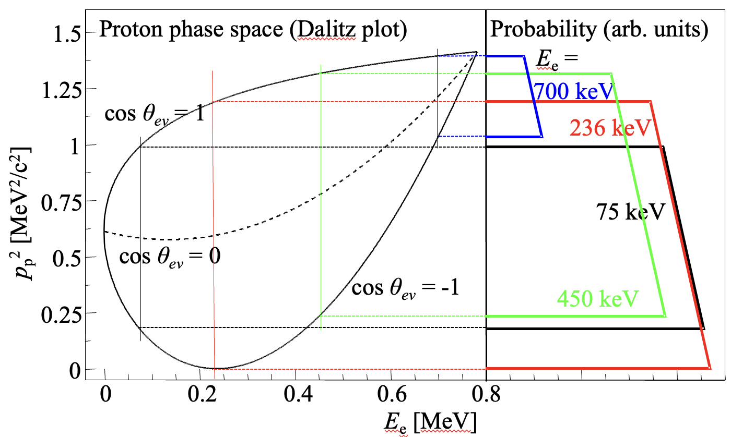
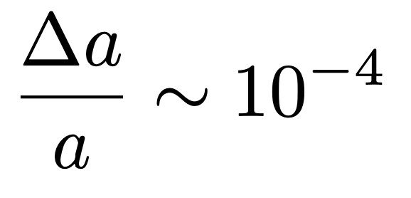
Effect of Neutron Polarization
For Unpolarized Target
If net polarization in the beam
EPJ WoC 219, 04002 (2019)

Slide 5
Neutron beam polarization measurement
The capture Cross section for reaction 3He + n → p + 3H highly spin dependent.
It is minimum when the spins are aligned and maximum with spins anti-aligned.
Transmission of Neutrons:
For unpolarized He cell.
For polarized cell. aligned spin
For polarized cell. opposite spin
$$T_{0}=Ne^{−κ} κ=nlσ_{0}\frac{λ}{λ_{0}}$$
$$T_{up}=\left(1−P_{n}\tanh\left(κP_{He}\right)\right)e^{−κ}\cosh\left(κP_{He}\right)$$
$$T_{dn}=\left(1+P_{n}\tanh\left(κP_{He}\right)\right)e^{−κ}\cosh\left(κP_{He}\right)$$
$$P_{n}=\frac{R_{dn}−R_{up}}{\sqrt{{\left(R_{up}+R_{dn}\right)}^{2}−4}}$$
Assuming perfect spin flip of He,
$$R_{up}= \frac{T_{up}}{T_{0}} , R_{dn}=\frac{T_{dn}}{T_{0}}$$
Although very efficient, Polarization of He is lost when spin is flipped
$P_{n}=\frac{R_{down}−R_{up}}{\sqrt{{\left(R_{up}+R_{down}\right)}^{2}−4}}+\frac{κP_{He}}{2}{\overline{ε}}_{AFP}+\text{higher} \text{orders}$

Slide 6
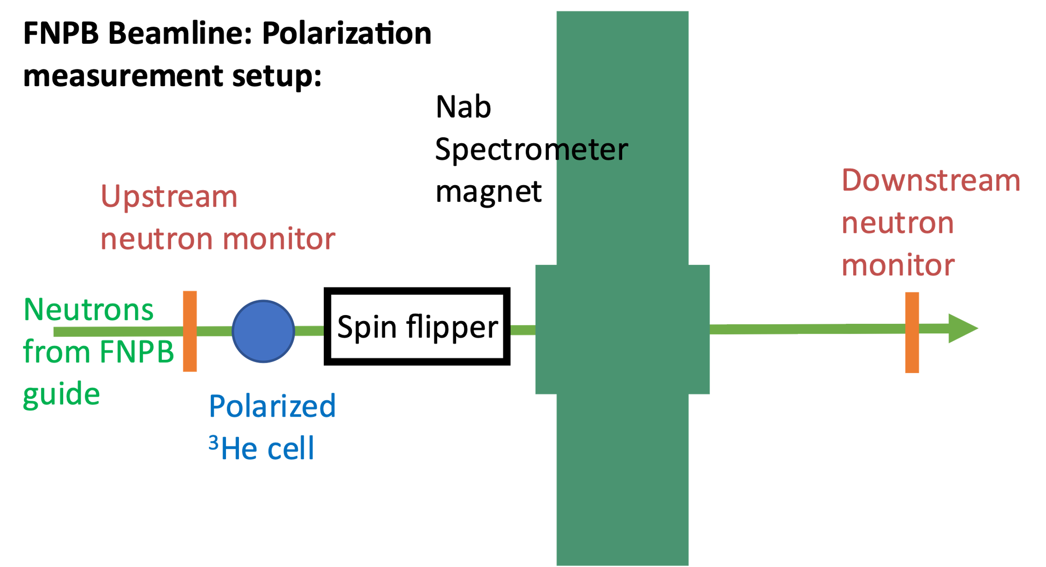
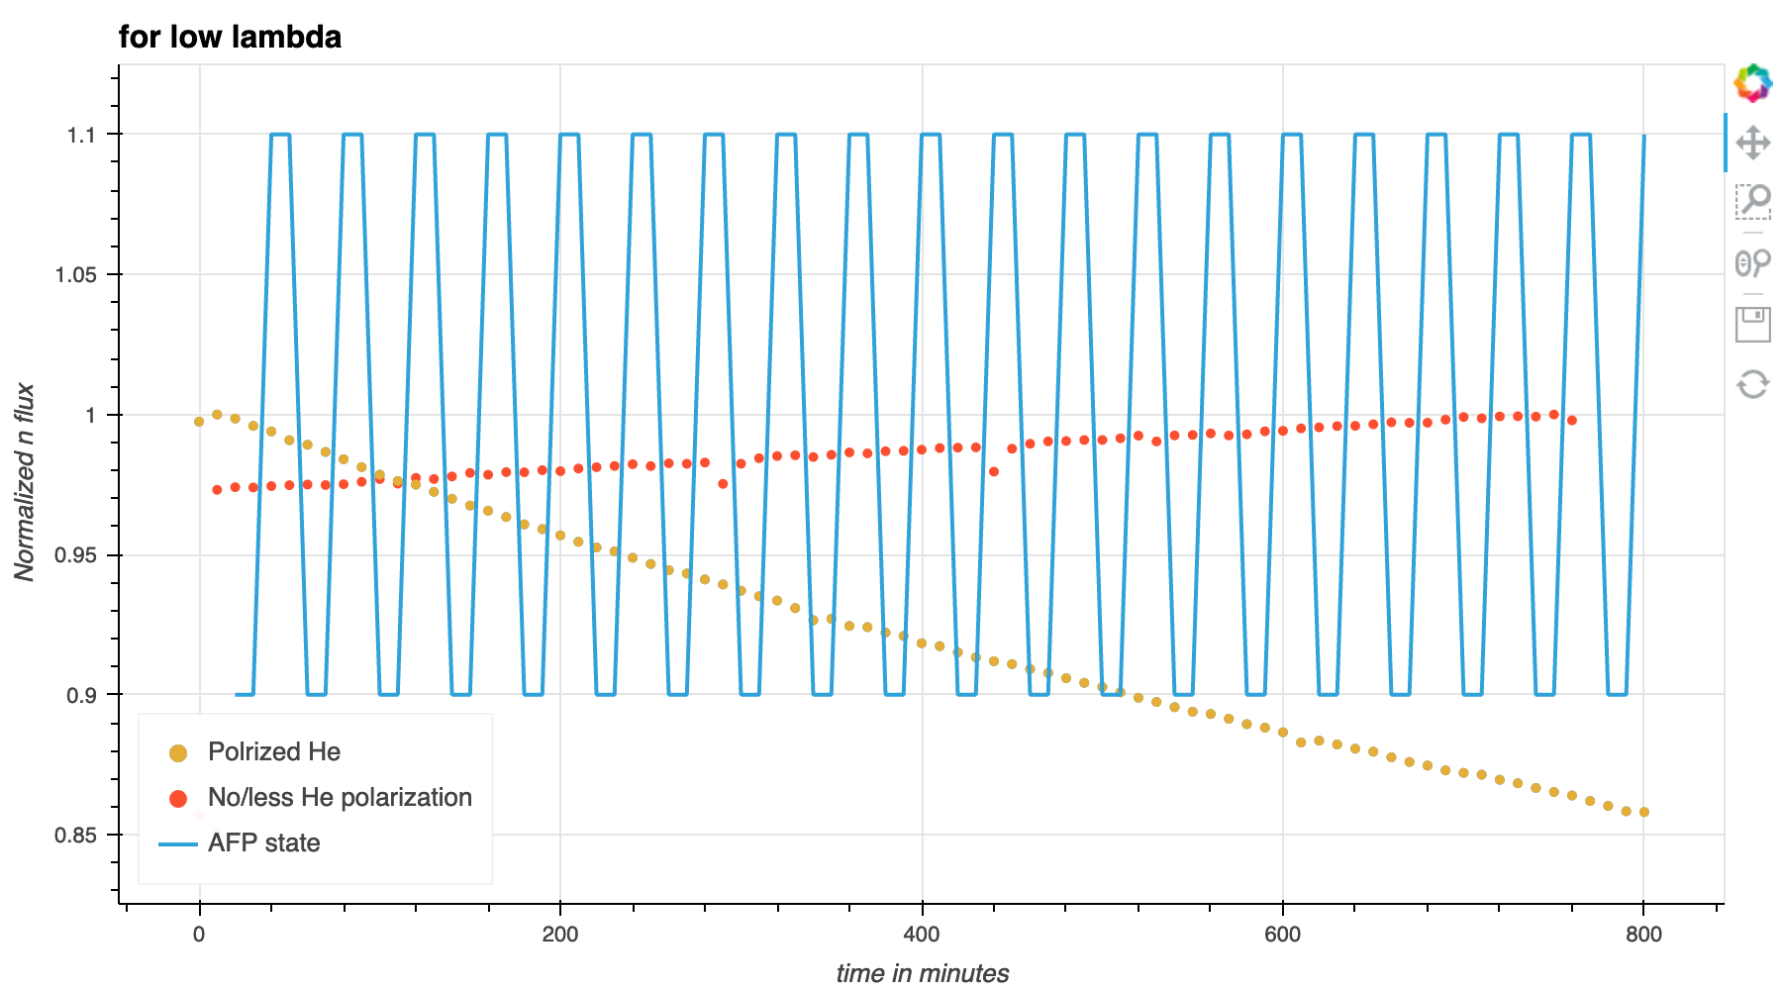
Neutron beam polarization measurement
Beam flux measured in the upstream monitor for normalization.
The neutron beam passes through the polarized 3He cell.
Spin flipper is not used in this setup.
Beam intensity is measured in the downstream monitor.
During experiment the He spin is flipped
Data from all detectors is collected in the
Multi-channel voltage ADC.
Notes:
What is the intensity of neutron beam?

Slide 7
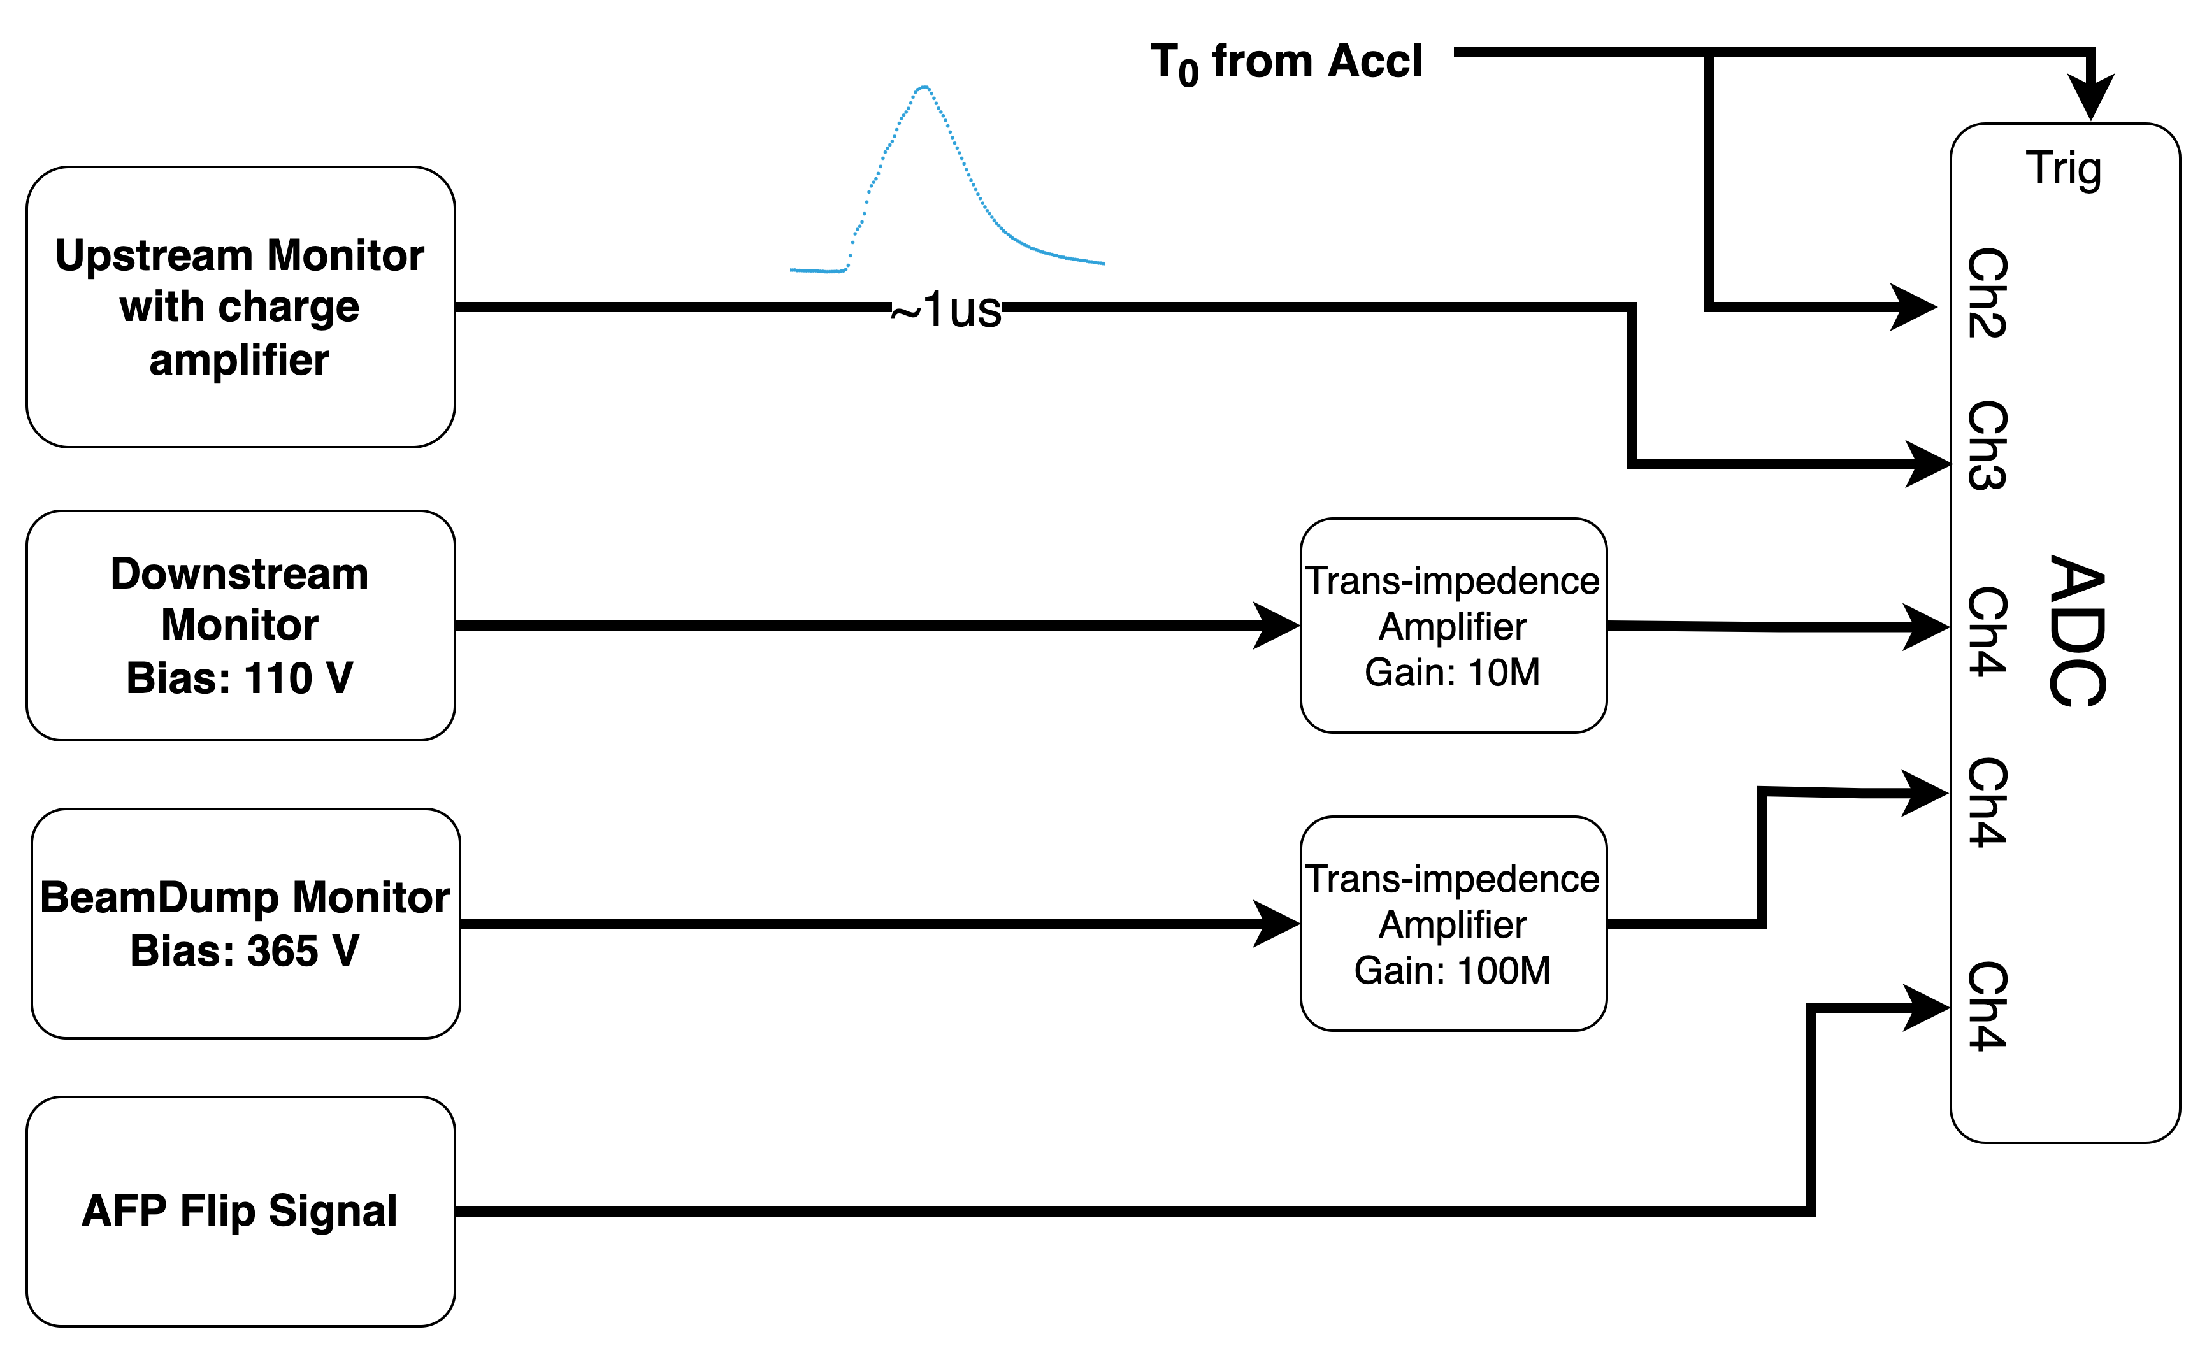
Beam Flux measurement
Upstream Monitor
Counting type detector with ¹⁴N + CF₄ gas mixture
Able to detect individual neutrons.
Used with preamp to get single neutron event.
Produces narrow signals. ~500ns width
Downstream Monitor:
Thick Monitor filled with ³He.
Does not detect individual neutrons and needs high flux.
Produces current proportional to neutron flux.
DAQ:
Our DAQ contains voltage ADC, with 48 channels.
It works in triggered mode
Triggered by signal form SNS at 60Hz.
For each trigger, data is sampled at 400us, for ~16ms, i.e, 40 time bins

Slide 8
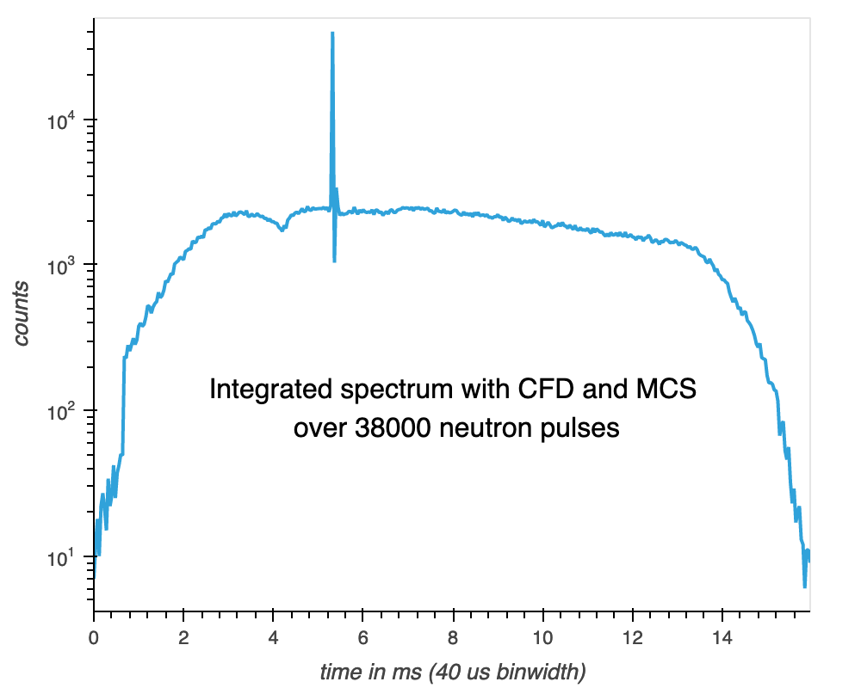
Beam Flux Measurement
Can’t directly incorporate, current upstream monitor in DAQ
dynamic range
Large integration time

Slide 9
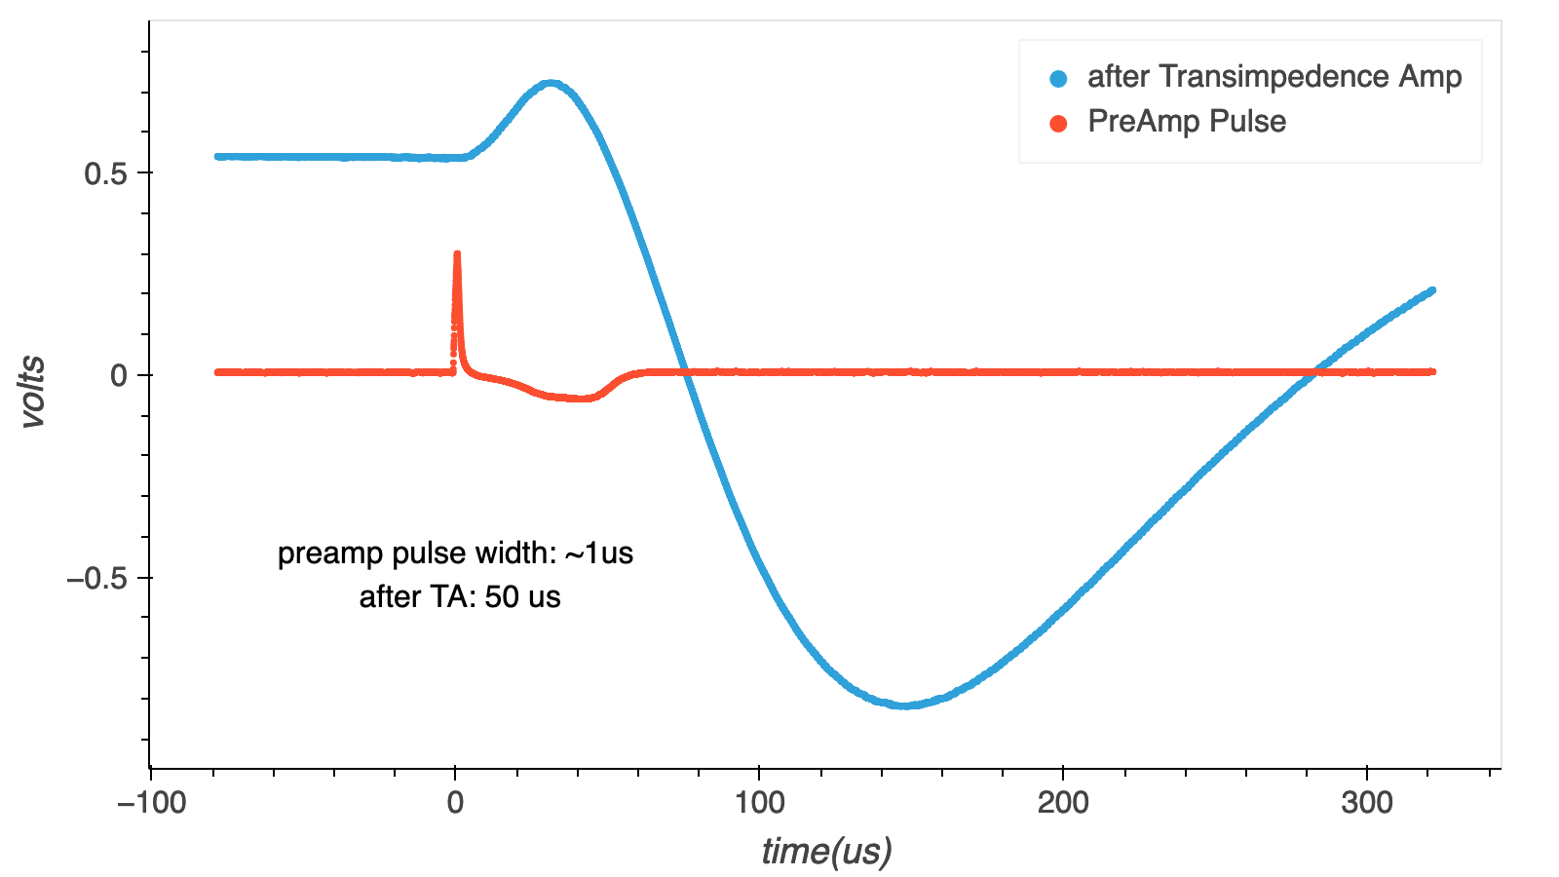
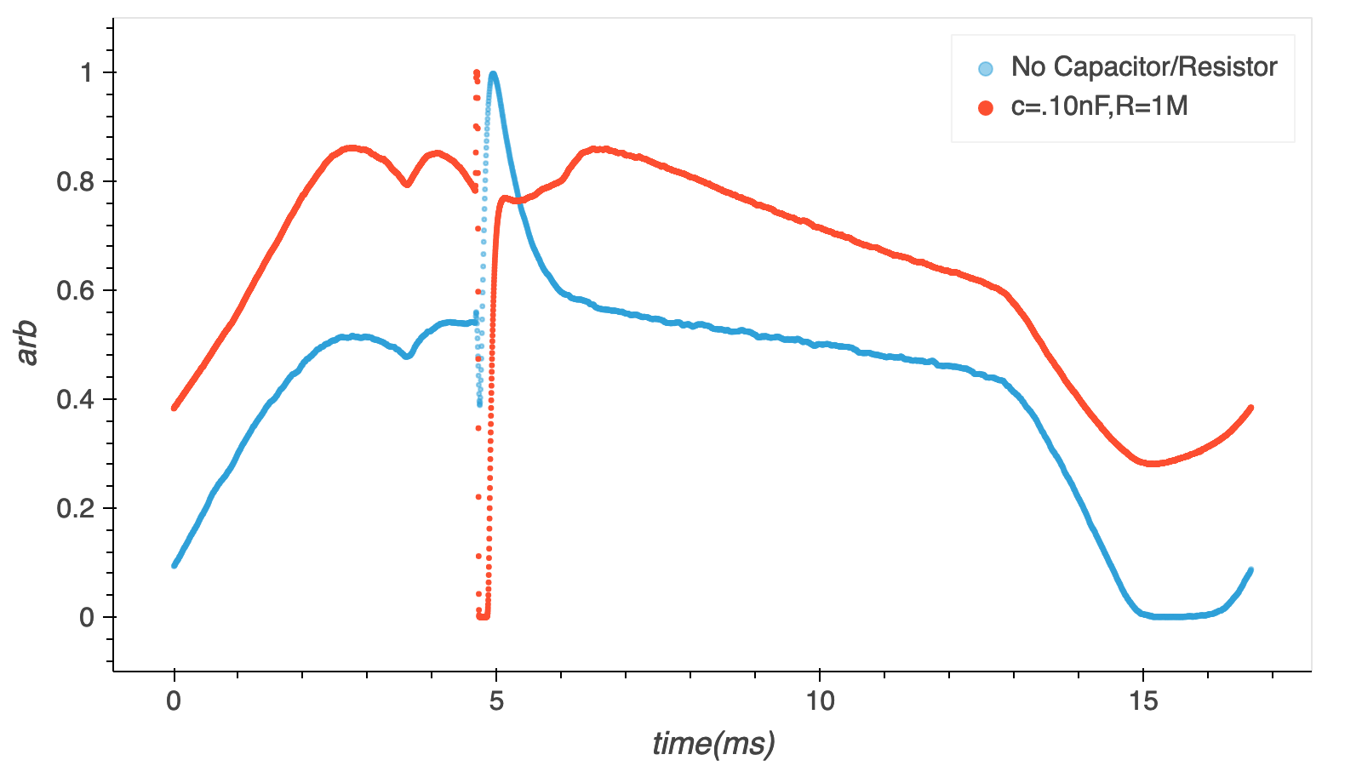
Beam Flux Measurement

Slide 10
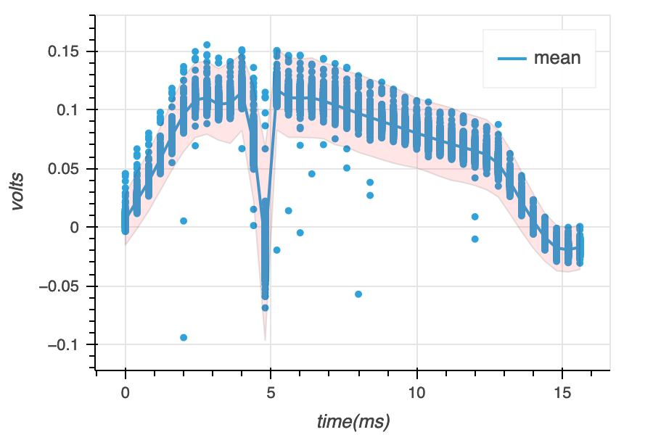
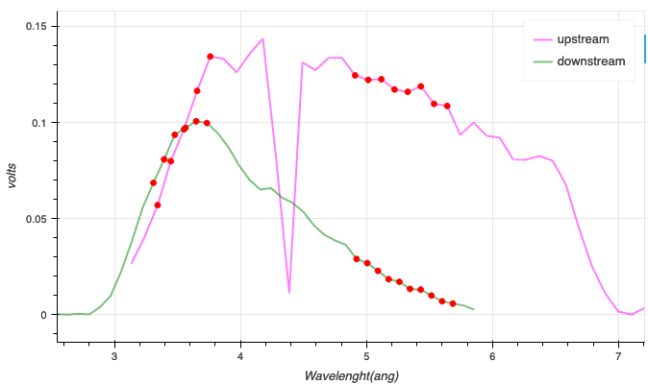
Beam Flux Measurement
Upstream Monitor
Downstream Monitor
Wavelength calibrated

Slide 11
Summary & Outlook
Different types of Upstream and Downstream Monitors.
Used TA to convert pulses into the instantaneous current.
Fluctuations in upstream monitor is higher than downstream.
Used the setup to do the beam polarization measurement.
Increase the efficiency of upstream monitor.
Change the DAQ system/downstream monitor.

Slide 12
Thanks!!
Prof. Nadia Fomin
Prof. Stefan Baeßler
Dr. Seppo Penttilä
Sepehr Samiei

Slide 13
The Nab Collaboration
Main project funding:

