Slide 1
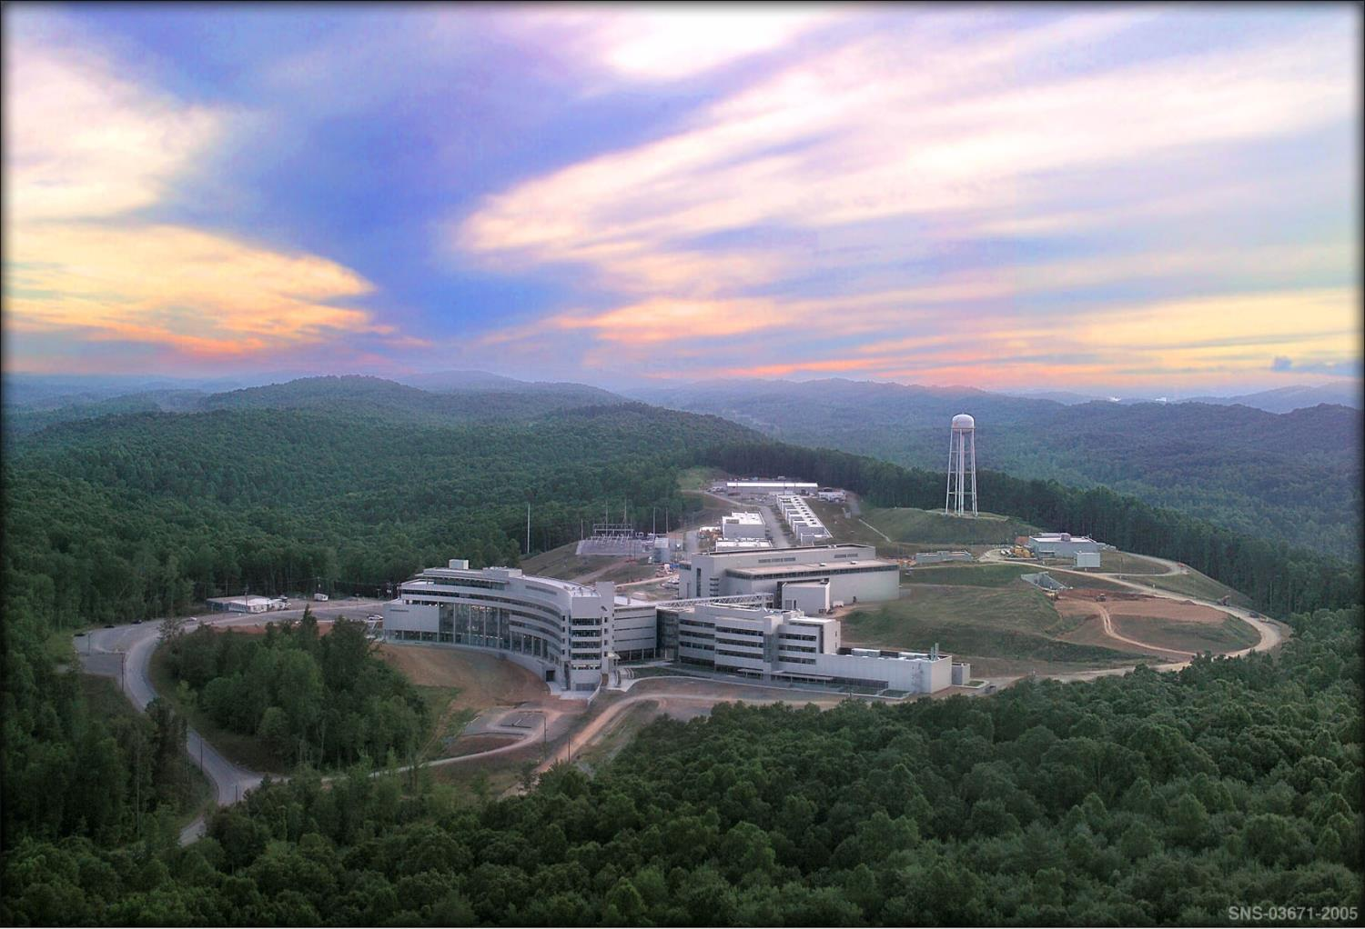


The measurement of neutron beta decay observables with the Nab spectrometer
Stefan Baeβler
Inst. Nucl. Part. Phys.

Slide 2




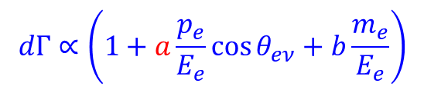

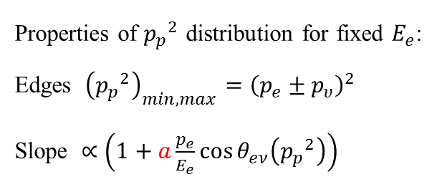
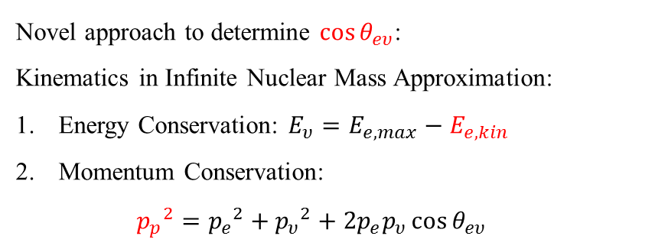

The neutrino electron correlation coefficient $a$
e⁻
Novel approach to determine $\cos{θ_{eυ}}$:
Kinematics in Infinite Nuclear Mass Approximation:
Energy Conservation: $E_{υ}=E_{e,max}−E_{e,kin}$
Momentum Conservation:
    ${p_{p}}^{2}={p_{e}}^{2}+{p_{υ}}^{2}+2p_{e}p_{υ}\cos{θ_{eυ}}$
p
$$θ_{eν}$$
n
$$\overline{ν_{e}}$$
$$dΓ∝\left(1+a\frac{p_{e}}{E_{e}}\cos{θ_{eν}}+b\frac{m_{e}}{E_{e}}\right)$$
Properties of ${p_{p}}^{2}$ distribution for fixed $E_{e}$:
Edges ${\left({p_{p}}^{2}\right)}_{min, max}={\left(p_{e}±p_{υ}\right)}^{2}$
Slope $∝\left(1+a\frac{p_{e}}{E_{e}}\cos{θ_{eν}\left({p_{p}}^{2}\right)}\right)$
$$1+a\frac{p_{e}}{E_{e}}\cos{θ_{eν}\left({p_{p}}^{2}\right)}$$
p_{p}² distribution
$$\cos{θ_{eν}\left({p_{p}}^{2}\right)}=−1$$
$$\cos{θ_{eν}\left({p_{p}}^{2}\right)}=+1$$
$E_{e,kin}=450$ keV
J.D. Bowman, Journ. Res. NIST 110, 40 (2005)
0.0
0.5
1.0
1.5
p_{p}² [MeV²/c²]

Slide 3
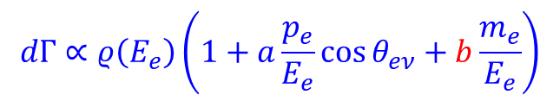

The Fierz Interference Term $b$
e⁻
p
$$dΓ∝ρ\left(E_{e}\right)\left(1+a\frac{p_{e}}{E_{e}}\cos{θ_{eν}}+b\frac{m_{e}}{E_{e}}\right)$$
n
$$θ_{eν}$$
$$\overline{ν_{e}}$$
)
s
t
i
n
u
.
b
Electron spectrum:
r
a
(
d
l
b
= +0.1
e
i
SM
Y
0
2
0
0
4
0
0
6
0
0
8
0
0
$E_{e,kin}$ (keV)

Slide 4



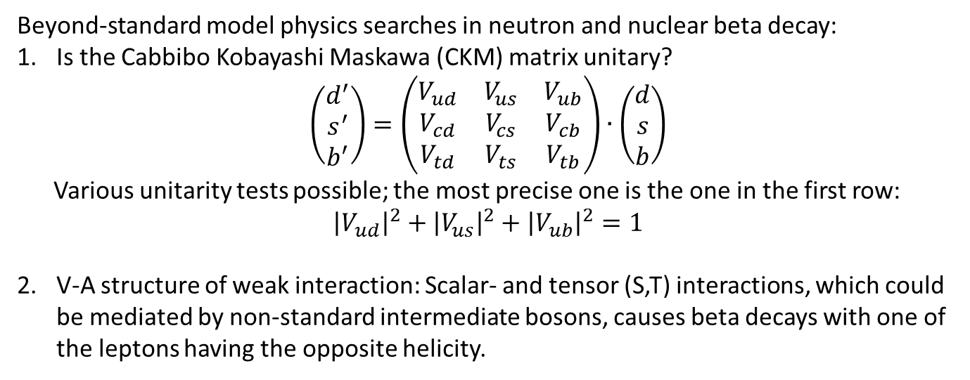




Motivation
Beyond-standard model physics searches in neutron and nuclear beta decay:
Is the Cabbibo Kobayashi Maskawa (CKM) matrix unitary?
$$\left(\begin{matrix}d^{′} \\ s^{′} \\ b^{′}\end{matrix}\right)=\left(\begin{matrix}V_{ud} & V_{us} & V_{ub} \\ V_{cd} & V_{cs} & V_{cb} \\ V_{td} & V_{ts} & V_{tb}\end{matrix}\right)∙\left(\begin{matrix}d \\ s \\ b\end{matrix}\right)$$
Various unitarity tests possible; the most precise one is the one in the first row:
${\left|V_{ud}\right|}^{2}+{\left|V_{us}\right|}^{2}+{\left|V_{ub}\right|}^{2}=1$
V-A structure of weak interaction: Scalar- and tensor (S,T) interactions, which could be mediated by non-standard intermediate bosons, causes beta decays with one of the leptons having the opposite helicity.
$${\vec{σ}}_{n}$$
$${\vec{σ}}_{e}$$
e⁻
e⁻
$${\vec{σ}}_{e}$$
p
n
$${\vec{σ}}_{ν}$$
$${\vec{σ}}_{ν}$$
$$\overline{ν_{e}}$$
$$\overline{ν_{e}}$$

Slide 5
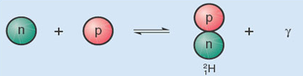
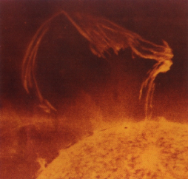
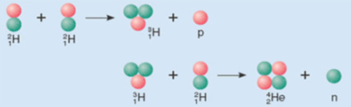
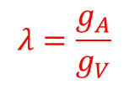


Coupling Constants of the Weak Interaction
g_{A} = G_{F}·V_{ud}·λ
$$τ_{n}^{−1}∝\left(g_{V}^{2}+3g_{A}^{2}\right)$$
Coupling Constants in Neutron Decay
p = (udu)
u
e⁻
W±
ν_{e}
g_{V} , g_{A}
g_{V} = G_{F}·V_{ud}·1
d
n = (ddu)
$$λ=\frac{g_{A}}{g_{V}}$$
$$n→p+e^{−}+{\overline{ν}}_{e}$$
Primordial Nucleosynthesis
Solar cycle
p
e⁻
²H⁺
e⁺
W±
W±
ν_{e}
n
ν_{e}
p + p
n + ν_{e} ↔ p + e⁻
p + p → ²H⁺ + e⁺ + ν_{e}
Start of Big Bang Nucleosynthesis, Primordial ⁴He abundance
Start of Solar Cycle, determines amount of Solar Neutrinos
Notes:
5

Slide 6
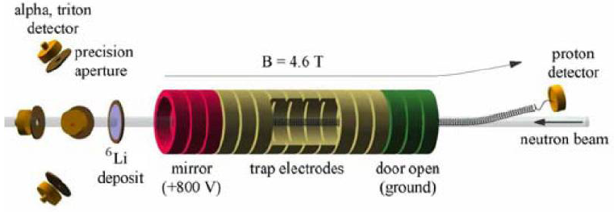
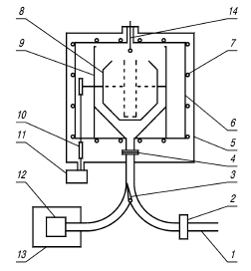
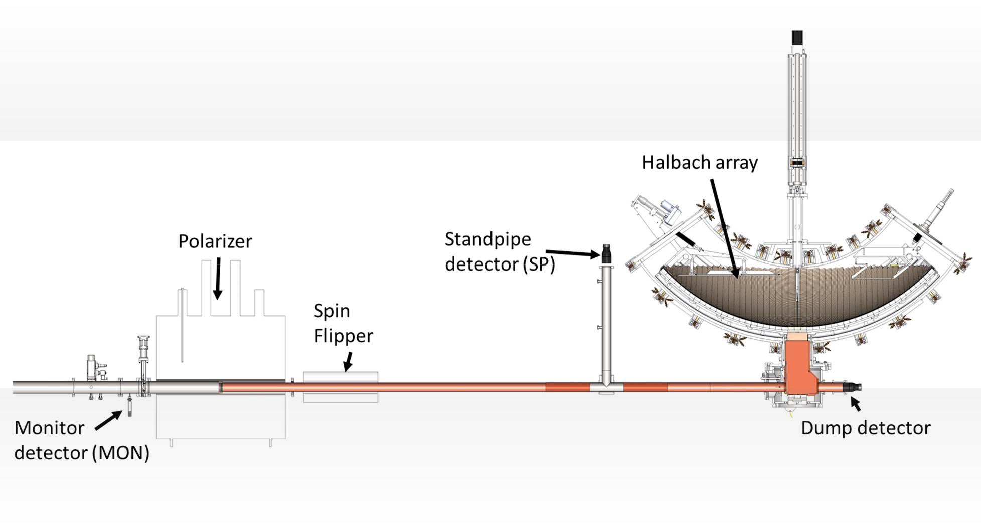
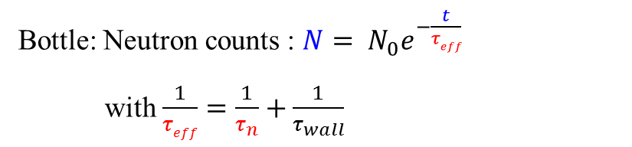
Neutron Lifetime Measurements
Beam: Decay rate: $\frac{dN}{dt}=\frac{N}{τ_{n}}$
Bottle: Neutron counts : $N= N_{0}e^{−\frac{t}{τeff}}$
with $\frac{1}{τeff}=\frac{1}{τ_{n}}+\frac{1}{τ_{wall}}$
UCNtau
UCN Storage bottle(s)
UCN
detector
Shutter
UCN from source
6

Slide 7
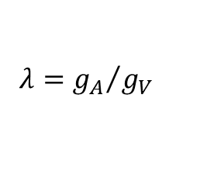



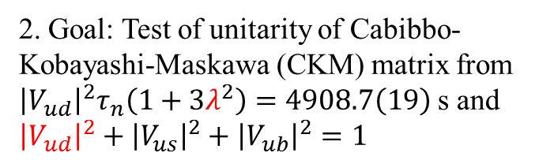
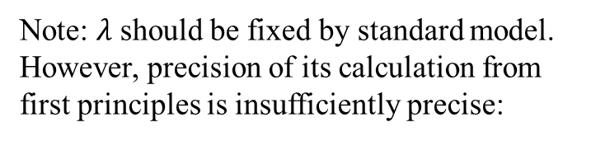

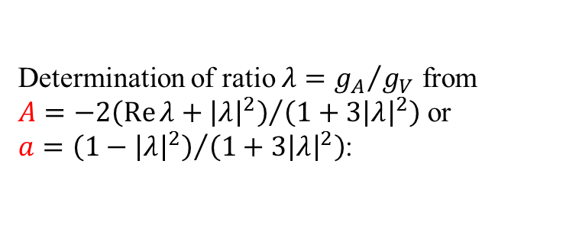

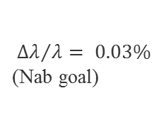


Motivation for Nab
Determination of ratio $λ={g_{A}}/{g_{V}}$ from $A={−2\left(\operatorname{Re}{λ}+{\left|λ\right|}^{2}\right)}/{\left(1+3{\left|λ\right|}^{2}\right)}$ or $a={\left(1−{\left|λ\right|}^{2}\right)}/{\left(1+3{\left|λ\right|}^{2}\right)}$:
Note: $λ$ should be fixed by standard model. However, precision of its calculation from first principles is insufficiently precise:
2. Goal: Test of unitarity of Cabibbo-Kobayashi-Maskawa (CKM) matrix from ${\left|V_{ud}\right|}^{2}τ_{n}\left(1+3λ^{2}\right)=4908.7\left(19\right)$s and ${\left|V_{ud}\right|}^{2}+{\left|V_{us}\right|}^{2}+{\left|V_{ub}\right|}^{2}=1$
$$\left|λ\right|=\left|g_{A}/g_{V}\right|$$
UCNA (2017)
${Δλ}/λ= 0.03\%$
(Nab goal)
1.00
1.25
1.50
1.75
$$N_{f}=$$
$$2+1+1$$
aCORN (2017)
PNDME’16
PERKEO II (2013)
UCNA (2013) ( )
LHPC’12
UCNA (2010) ( )
LHPC’10
Byrne (2002)
$$N_{f}=2+1$$
RBC/UKQCD’08
( ) PERKEO II (2002)
My average:
$$λ=−1.2756(11)$$
Mostovoi (2001)
Lin/Orginos’07
PERKEO II (1997) ( )
Yerozolimskii (1997)
RQCD’14
Liaud (1997)
QCDSF/UKQCD’13
PERKEO I (1986)
$$N_{f}=2$$
ETMC’15
Stratowa (1978)
CLS’12
$$−1.30$$
$$−1.28$$
$$−1.26$$
$$−1.24$$
RBC’08
For neutron data to be competitive, want:
$${Δτ_{n}}/{τ_{n}}\sim 0.3 \text{s}$$
$${Δλ}/λ\sim 0.03\text{\%}$$
$$λ = gA/gV$$
Most recent 2+1+1 flavor Lattice-QCD result from PNDME: T. Bhattacharya et al., PRD 94, 054508 (2016)

Slide 8
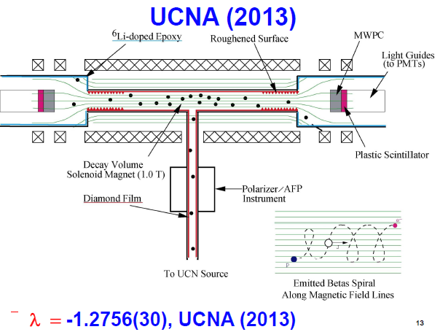
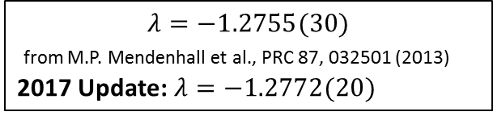


The Beta Asymmetry
$${\vec{σ}}_{n}$$
e⁻
p
n
$$\overline{ν_{e}}$$
Electron Detector (Plastic Scintillator)
NEW
Decay Electrons
$$λ=−1.2755(30)$$
from M.P. Mendenhall et al., PRC 87, 032501 (2013)
2017 Update: $λ=−1.2772(20)$
Polarized Neutrons
Major improvement planned in PERKEO III and PERC
Split Pair Magnet
PERKEO II
Magnetic Field
$λ=−1.2748(+13/−14)$ from D. Mund et al., PRL 110, 172502 (2013)

Slide 9
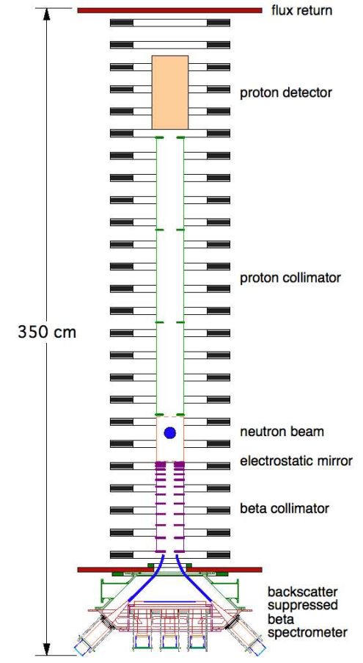
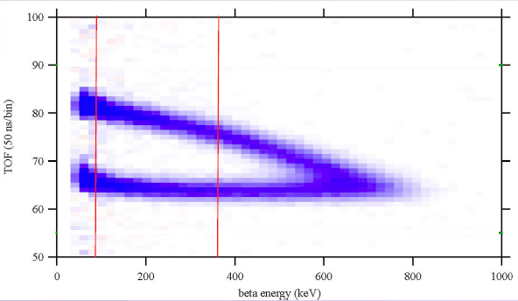
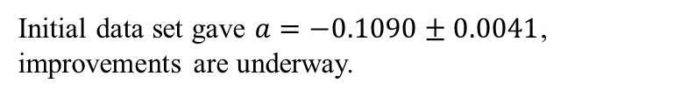
aCORN
e⁻
p
n
fit range
Magnetic
field
NEW
PDG: a = -0.103:
“p_{υ} up” more likely
Initial data set gave $a=−0.1090±0.0041$, improvements are underway.
(NIST, Tulane, Indiana, Hamilton Coll., DePauw U.)
Notes:
9

Slide 10

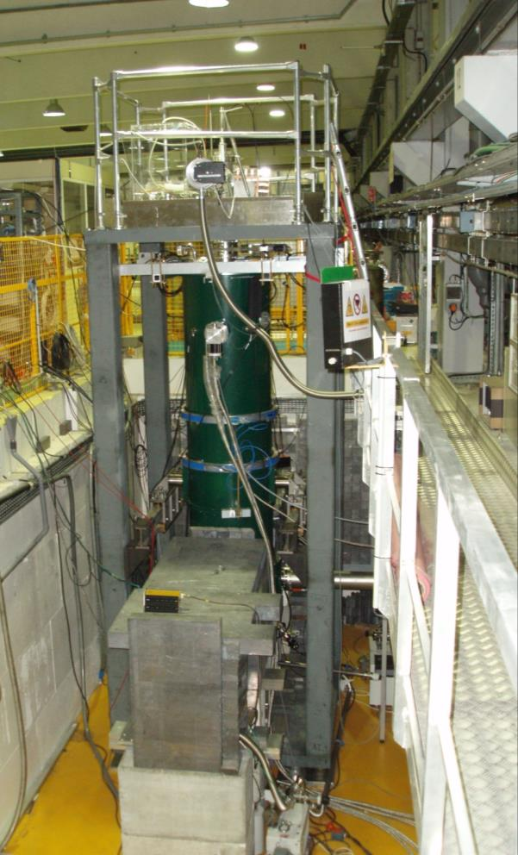
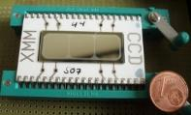
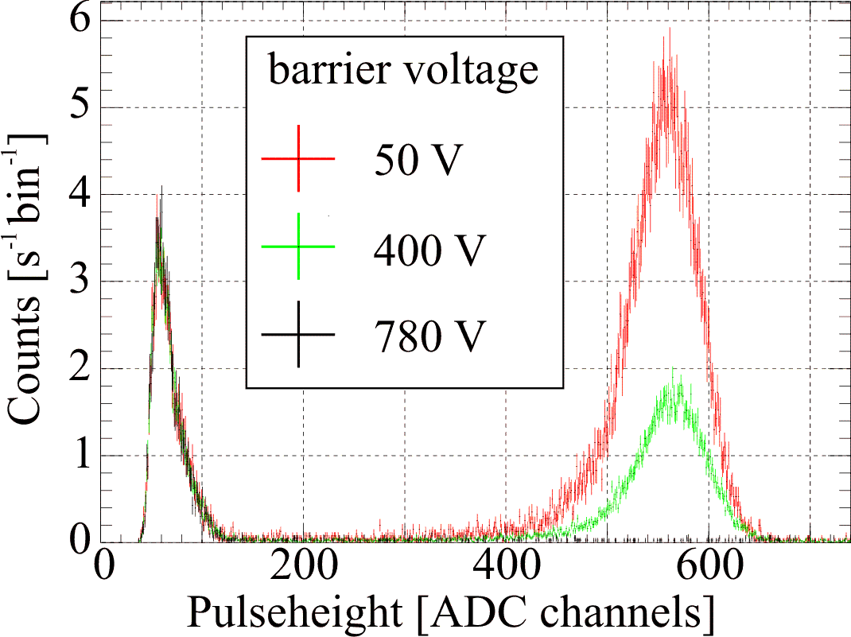

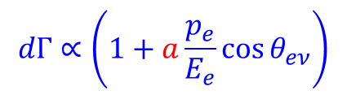
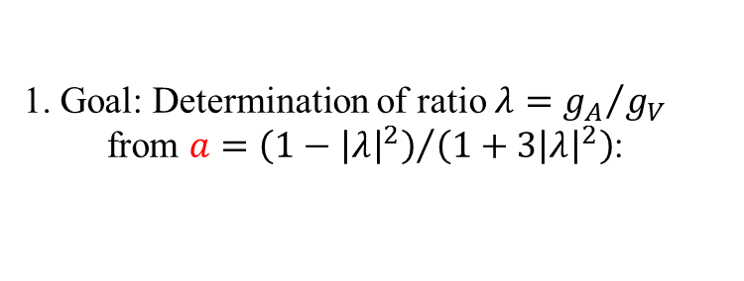
aSPECT Setup @ ILL Grenoble
n
e⁻
p
$$dΓ∝\left(1+a\frac{p_{e}}{E_{e}}\cos{θ_{eν}}\right)$$
$$θ_{eν}$$
$$\overline{ν_{e}}$$
Proton Detector
Magnetic
field
Decay rate w(E)
Spectrum for a = +0.3
… for a = -0.103 [PDG2016]
0
200
400
600
Analyzing Plane
Electrode
Proton kinetic energy E [eV]
Protons
Protons
Neutron Decay
Present best experiments: Δa/a = 5%
Last beamtime: Summer 2013, currently being analyzed

Slide 11
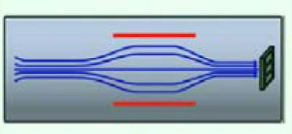
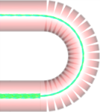
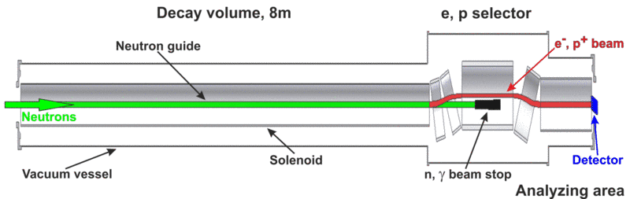


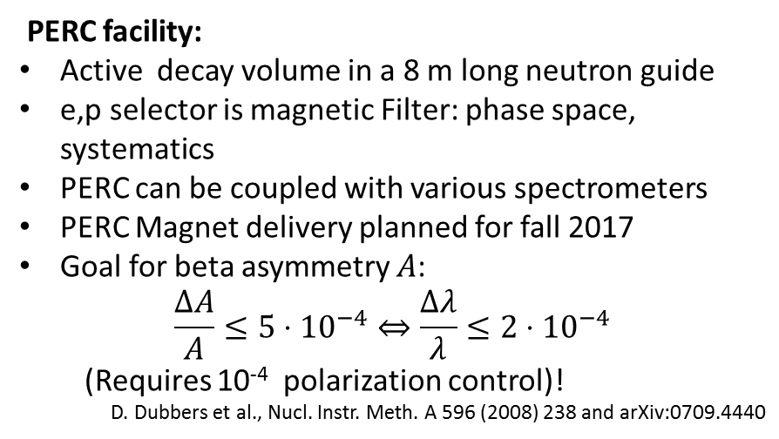

The PERC facility @ FRM II
PERC facility:
Active decay volume in a 8 m long neutron guide
e,p selector is magnetic Filter: phase space, systematics
PERC can be coupled with various spectrometers
PERC Magnet delivery planned for fall 2017
Goal for beta asymmetry $A$:
$$\frac{ΔA}{A}≤5⋅{10}^{−4}⇔\frac{Δλ}{λ}≤2⋅{10}^{−4}$$
(Requires 10⁻⁴ polarization control)!
D. Dubbers et al., Nucl. Instr. Meth. A 596 (2008) 238 and arXiv:0709.4440
Electron or proton detector
Scintillator (e-),
Silicon, …
MAC-E filter (“aSPECT”)
R×B spectrometer
$$…$$
G. Konrad, SMI
$$B1 = 6 \text{T}$$
$$B0 = 1.5 \text{T}$$
User
System
Cryostat

Slide 12
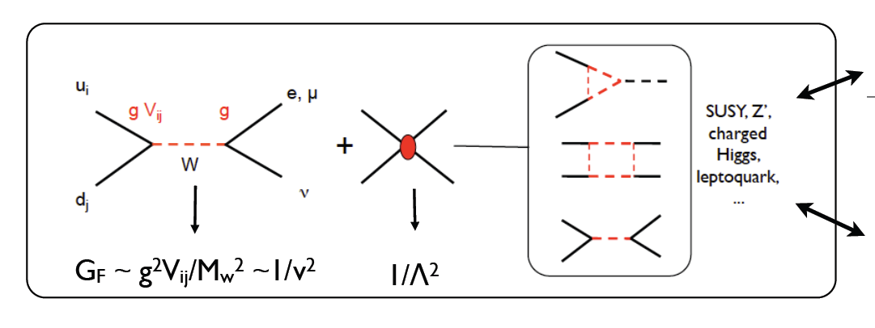
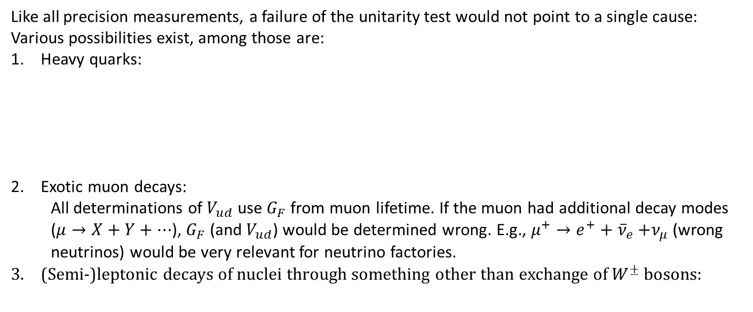
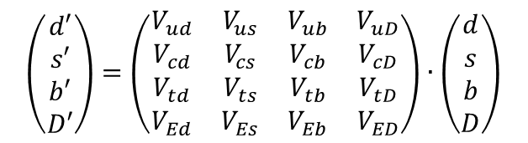
What if the test of CKM unitarity fails?
Like all precision measurements, a failure of the unitarity test would not point to a single cause:
Various possibilities exist, among those are:
Heavy quarks:
Exotic muon decays:
  All determinations of $V_{ud}$ use $G_{F}$ from muon lifetime. If the muon had additional decay modes ($μ→X+Y+…$), $G_{F}$ (and $V_{ud}$) would be determined wrong. E.g., $μ^{+}→e^{+}+{\overline{ν}}_{e}{+ν}_{μ}$ (wrong neutrinos) would be very relevant for neutrino factories.
(Semi-)leptonic decays of nuclei through something other than exchange of $W^{±}$ bosons:
$$\left(\begin{matrix}d′ \\ s′ \\ b′ \\ D′\end{matrix}\right)=\left(\begin{matrix}V_{ud} & V_{us} & V_{ub} & V_{uD} \\ V_{cd} & V_{cs} & V_{cb} & V_{cD} \\ V_{td} & V_{ts} & V_{tb} & V_{tD} \\ V_{Ed} & V_{Es} & V_{Eb} & V_{ED}\end{matrix}\right)∙\left(\begin{matrix}d \\ s \\ b \\ D\end{matrix}\right)$$
$${\left|V_{uD}\right|}^{2}=1−{\left|V_{ub}\right|}^{2}{−\left|V_{us}\right|}^{2}−{\left|V_{ud}\right|}^{2}$$
W. Marciano, A. Sirlin, PRL 56, 22 (1986)
P. Langacker, D. London, PRD 38, 886 (1988)
K.S. Babu and S. Pakvasa, hep-ph/0204236
Specific models: E.g.
W. Marciano, A. Sirlin, PRD 35, 1672 (1987).
R. Barbieri et al., PLB 156, 348 (1985)
K. Hagiwara et al., PRL 75, 3605 (1995)
A. Kurylov, M. Ramsey-Musolf, PRL 88, 071804 (2000)
Energy scale of new physics: $Λ≥11$ TeV V. Cirigliano et al., NPB 830, 95 (2010)

Slide 13
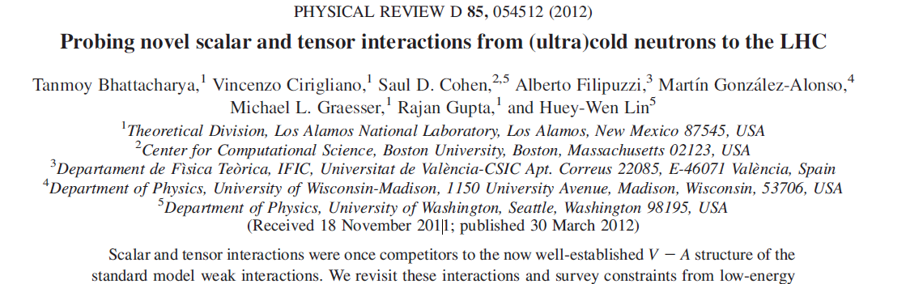
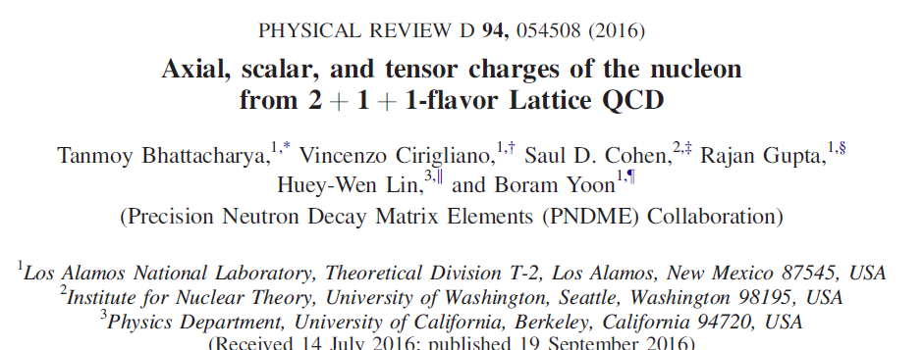
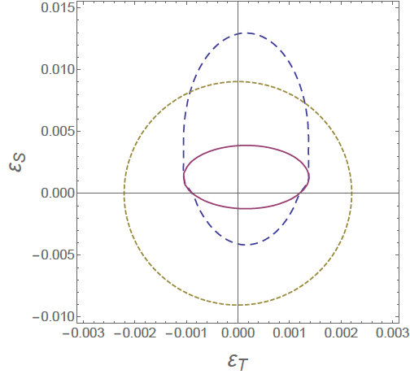
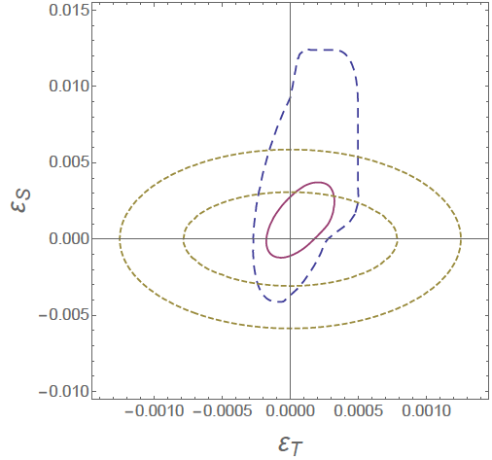




Scalar(S) and tensor(T) interactions in beta decay
Other searches for Beyond Standard Model Physics: S,T interactions (fermions with “wrong” helicity), e.g. through W’ bosons; weak magnetism; second class currents; …
Low-energy experiments (mostly $0^{+}→0^{+}$, $π→eνγ$); $g_{S,T}$ from quark model
Low-energy experiments (add $\left|b\right|<{10}^{−3}$ in n, ⁶He); $g_{S,T}$ from quark model
Low-energy experiments,
$g_{S,T}$ from Lattice QCD
Low-energy experiments,
$g_{S,T}$ from Lattice QCD
LHC:
8 TeV, 20 fb⁻¹
LHC:
14 TeV, 10,300 fb⁻¹
LHC-Search for $pp→e+ν+$ other stuff and $pp→e+e+$ other stuff

Slide 14
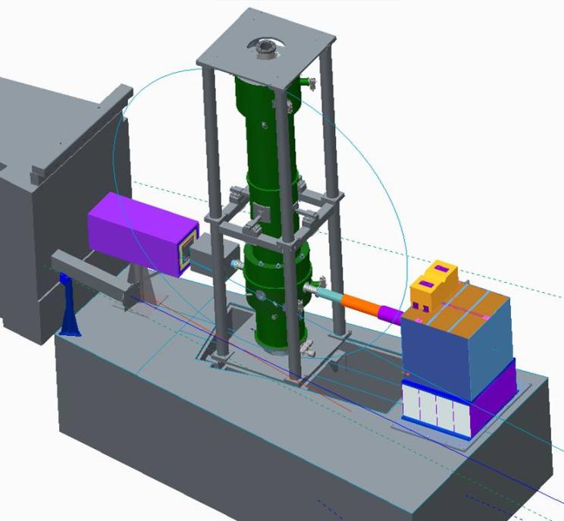
Nab spectrometer @ FNPB @ SNS
- 30 kV
TOF region
(low field)
8 meters
4 m flight path skipped
magnetic filter
region (field maximum)
decay volume
0 kV
Neutron
beam
1 m flight path skipped
Cold Neutron Beam
0-1 kV
Fundamental Neutron Physics Beamline (FNPB) @ Spallation Neutron Source (SNS)

Slide 15
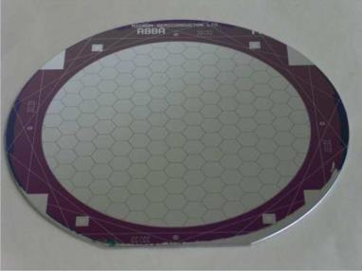
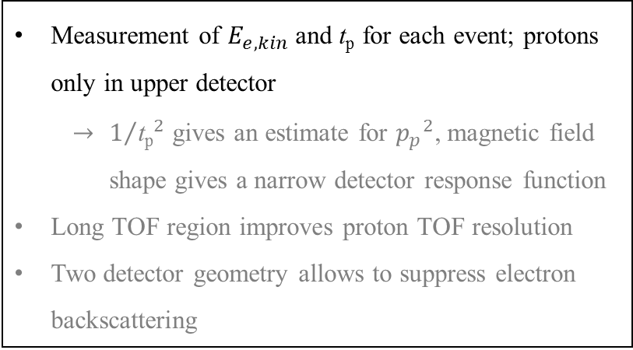
Nab spectrometer operation
- 30 kV
Segmented
Si detector
Ø 81 mm
TOF region
(low field)
4 m flight path skipped
magnetic filter
region (field maximum)
Measurement of $E_{e,kin}$ and $\text{t}\text{p}$ for each event; protons only in upper detector
    $1/{{\text{t}\text{p}}_{}^{2}}$ gives an estimate for ${p_{p}}^{2}$, magnetic field shape gives a narrow detector response function
Long TOF region improves proton TOF resolution
Two detector geometry allows to suppress electron backscattering
decay volume
0 kV
Neutron
beam
1 m flight path skipped
0-1 kV
Original configuration: D. Počanić, S. Baeßler, D. Bowman, V. Cianciolo, G. Greene, S. Penttilä et al., NIM A 611, 211 (2009)
Asymmetric configuration: S. Baeßler, D. Počanić, D. Bowman, S. Penttilä et al., arXiv:1209.4663

Slide 16
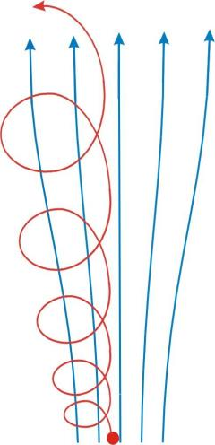

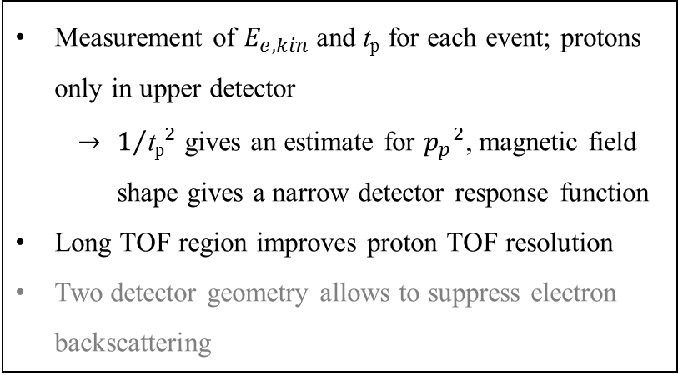



Nab spectrometer principle: measurement of E_{e} and t_{p}
- 30 kV
$$p_{∥}$$
$$p_{⊥}$$
Magnetic Field
TOF region
(low field)
Adiabatic conversion
4 m flight path skipped
magnetic filter
region (field maximum)
Proton Trajectory
$$p_{∥}$$
decay volume
$$p_{⊥}$$
0 kV
Measurement of $E_{e,kin}$ and $\text{t}\text{p}$ for each event; protons only in upper detector
    $1/{{\text{t}\text{p}}_{}^{2}}$ gives an estimate for ${p_{p}}^{2}$, magnetic field shape gives a narrow detector response function
Long TOF region improves proton TOF resolution
Two detector geometry allows to suppress electron backscattering
Neutron
beam
1 m flight path skipped
0-1 kV

Slide 17
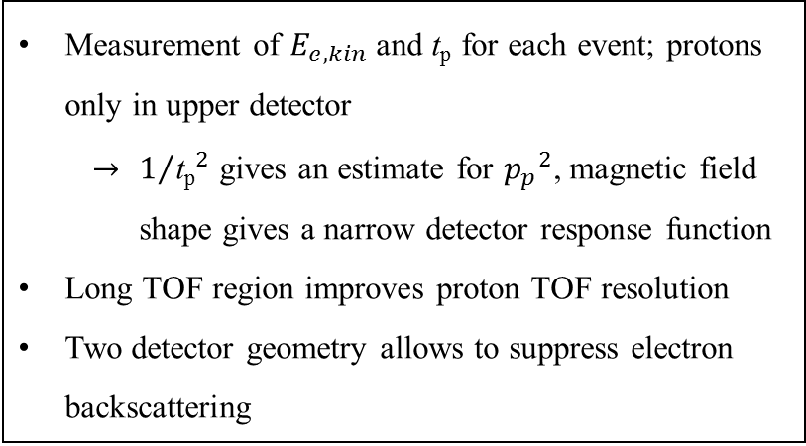
Electron energy measurement with backscattering suppression
5
- 30 kV
10
detected E_{e} for e⁻ in lower detector
4
detected E_{e} with only lower detector
10
Detector response for
incoming E_{e} = 300 keV
3
10
Yield
TOF region
(low field)
2
10
4 m flight path skipped
magnetic filter
region (field maximum)
1
10
1
decay volume
0
50
100
150
200
250
300
detected E_{e} [keV]
0 kV
Measurement of $E_{e,kin}$ and $\text{t}\text{p}$ for each event; protons only in upper detector
    $1/{{\text{t}\text{p}}_{}^{2}}$ gives an estimate for ${p_{p}}^{2}$, magnetic field shape gives a narrow detector response function
Long TOF region improves proton TOF resolution
Two detector geometry allows to suppress electron backscattering
Neutron
beam
1 m flight path skipped
0-1 kV

Slide 18





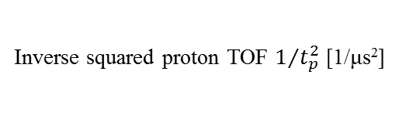

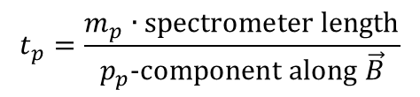



Nab data analysis
$$1+a\frac{p_{e}}{E_{e}}\cos{θ_{eν}\left({p_{p}}^{2}\right)}$$
Full GEANT4 spectrometer simulation:
p_{p}² distribution
$$\cos{θ_{eν}\left({p_{p}}^{2}\right)}=−1$$
$E_{e,kin}=150$ keV
$$\cos{θ_{eν}\left({p_{p}}^{2}\right)}=+1$$
$E_{e,kin}=300$ keV
12000
$E_{e,kin}=450$ keV
$E_{e,kin}=450$ keV
8000
Yield
0.0
0.5
1.0
1.5
4000
$E_{e,kin}=600$ keV
p_{p}² [MeV²/c²]
$E_{e,kin}=750$ keV
0
0
0.002
0.004
0.006
$$t_{p}=\frac{m_{p}∙\text{spectrometer} \text{length}}{p_{p}\text{−}\text{component} \text{along} \vec{B}}$$
Inverse squared proton TOF $1/{t_{p}^{2}}$ [1/μs²]
Data analysis: Use edge to determine or verify the spectrometer TOF response function.
Then, use central part to determine slope and correlation coefficient a.

Slide 19
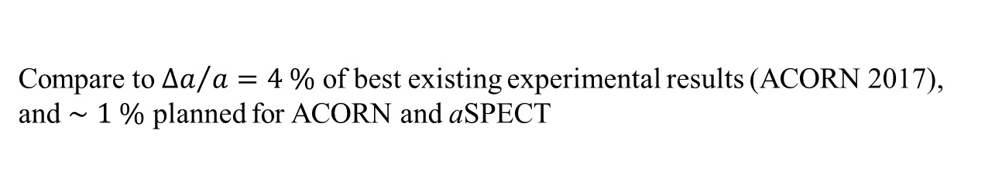


Statistical uncertainty budget for $a$ coefficient
Planned statistical uncertainty budget:
lower $E_{e,kin}$ cutoff | none | 100 keV | 100 keV | 100 keV
upper $t_{p}$ cutoff | none | none | 40 μs | 30 μs
$Δa$ ($N$, $a$, $b$ variable) | 2.4/√N | 2.5/√N | 2.7/√N | 3.0/√N
$Δa$ ($N$, $a$, $b$, $E_{cal}$, $L$ variable) | 2.6/√N | 2.7/√N | 2.9/√N | 3.2/√N
$Δa$ ($N$, $a$, $b$, $E_{cal}$, $L$ variable, inner 75% of data) | 3.4/√N | 3.5/√N | 3.8/√N | 4.3/√N
As above, 10% bg | 4.2/√N | 4.4/√N | 4.6/√N | 5.0/√N
3.6×10⁸ events can be detected in 6 weeks (Decay volume V = 246 cm³, 12.7% of decay protons go to upper detector, 50% efficiency in use of beam time, 1600 decays/s), corresponding to ${\left(\frac{Δa}{a}\right)}_{stat}∼2.4⋅10^{−3}$for this period.
→ ${\left(\frac{Δa}{a}\right)}_{stat}∼7⋅10^{−4}$ can be reached, but it requires 70 weeks of data taking.
Compare to ${Δa}/a=4 \%$ of best existing experimental results (ACORN 2017), and $∼1 \%$ planned for ACORN and aSPECT

Slide 20

Systematic uncertainty budget for $a$ coefficient
Experimental parameter | Main specification | Systematic uncertainty Δa/a
Magnetic field
... curvature at pinch | $Δγ/γ=2\%$ with $γ=d^{2} B_{z}(z)/dz^{2}/B_{z}(0)$ | 5.3·10⁻⁴
… ratio r_{B} = B_{TOF}/B₀ | $$(Δr_{B})/r_{B} =1\%$$ | 2.2·10⁻⁴
… ratio r_{B,DV} = B_{DV}/B₀ | $$(Δr_{B,DV})/r_{B,DV} =1\%$$ | 1.8·10⁻⁴
Length of the TOF region |  | none
Electrical potential inhomogeneity:
… in decay volume / filter region | $$\left|U_{F}−U_{DV}\right|<10 \text{mV}$$ | 5·10⁻⁴
… in TOF region | $$\left|U_{F}−U_{TOF}\right|<200 \text{mV}$$ | 2.2·10⁻⁴
Neutron Beam:
… position | $$Δ\overline{z_{DV}}<2 \text{mm}$$ | 1.7·10⁻⁴
… profile (including edge effect) | Slope at edges < 10%/cm | 2.5·10⁻⁴
… Doppler effect |  | small
… Unwanted beam polarization | $$\left|\overline{P_{n}}\right|≪{10}^{−4}$$ | can be small
Adiabaticity of proton motion |  | 1·10⁻⁴
Detector effects:
… Electron energy calibration | $ΔE_{e,kin}<0.2$ keV | 2·10⁻⁴
… Shape of electron energy response | fraction of events in tail to 1% | 5.7·10⁻⁴
… Proton trigger efficiency | $$ε_{p}<100 \text{ppm}\text{/}\text{keV}$$ | 3.4·10⁻⁴
… TOF shift due to detector/electronics | $$Δt_{p}<0.3 \text{ns}$$ | 3·10⁻⁴
Residual gas | $$p<2⋅{10}^{−9} \text{torr}$$ | 3.8·10⁻⁴
Background / Accidental coincidences |  | small
Sum |  | 1.2·10⁻³

Slide 21




The measurement of the Fierz Interference Term $b$
e⁻
$$dΓ∝ρ\left(E_{e}\right)\left(1+a\frac{p_{e}}{E_{e}}\cos{θ_{eν}}+b\frac{m_{e}}{E_{e}}\right)$$
p
$$θ_{eν}$$
n
$$\overline{ν_{e}}$$
Systematic uncertainties:
Electron energy determination
Most stringent requirement: Non-linearity of 0.01%
Background
0 V
5
10
Detector response to decay
electron with $E_{e}=300$ keV
4
10
TOF region
(low field)
3
10
)
4 m flight path skipped
s
d
t
l
i
e
magnetic filter
region (field maximum)
n
i
u
Y
2
.
10
b
Electron spectrum:
r
a
1
(
10
2% of events in tail
(deadlayer, bremsstrahlung)
d
decay volume
l
b
= +0.1
e
i
SM
1
Y
0
50
100
150
200
250
300
0 kV
detected E_{e} [keV]
+1 kV
Neutron
beam
1 m flight path skipped
0
2
0
0
4
0
0
6
0
0
8
0
0
-30 kV
- 30 kV
$$E_{e,kin} \text{(}\text{keV}\text{)}$$
Goal: $Δb≤3⋅10^{−3}$

Slide 22








Status of Nab experiment
Fundamental Neutron Physics Beamline
@ Spallation Neutron Source
Magnet system tested successfully at manufacturer, is expected to arrive at ORNL this Friday.
neutrons
4
$$\left|B\right|/T$$
3
2
$\left|B\right|$ measured
1
$\left|B\right|$ calculated
-200
-100
0
100
200
300
400
500
600
$$z/\text{cm}$$

Slide 23





Nab (and UCNB) detector properties
DAQ system (A. Sprow, C. Crawford et al.): All waveforms recorded. Risetime $∼ 40$ ns, fall time $∼4$ µs.
Energy resolution a few keV, threshold $≤10$ keV
Noise low enough to detect protons (average deposited energy: 18 keV)
Bad pixels need investigation
Ø 81 mm
Back side
Ce-139 source
Electron, ~ 100 keV, followed by
Proton, ~18 keV, in neighboring pixel
γ: 33 keV
β: 127 keV
β: 27 keV
β: 160 keV
LabVIEW controller
C++ coincidence logic
LabVIEW FPGA low-threshold trapezoid trigger on ADC
Optical fiber bus, clock & sync
LANL test run with Ce-139 source, Analysis H. Li

Slide 24



Main electrode system: Simulation of the effect of openings
Symmetry axis
Electric potential [V]
z
x
Neutron beam
Assumption for simulation: Potential of bore tube different by 1 V from electrodes

Slide 25


Main electrode system: Fabrication
Top and bottom part of electrode system, before coating:
Symmetry axis
Neutron beam
Parts are in hand, and are awaiting cleaning and coating.

Slide 26
Electrode surface coating: What is the issue?
...and I have no objection if the conductor is homogenous.
However, if not:
Most undergraduate textbooks: No electric field in empty hole inside conductor…
-
+
E field
Material 1
Material 2
Material 1
Material 2
V
Φ₂
V_{C}
Φ₁
E_{F,2}
Φ₁
Φ₂
E_{F,1}
E_{F,1}
E_{F,2}
_
+
_
+
_
+
Consequence: Need to establish that electric field is known, or known to be absent, in flight path.

Slide 27



Work function measurements
Work Function [meV]
40
4900
35
30
4950
25
PRELIMINARY
20
Height [mm]
5000
15
10
5050
5
0
5100
0
50
100
150
200
250
300
350
Angle [°]
In collaboration with Prof. I. Baikie, KP Technologies

Slide 28
Main Electrode system in decay volume and filter
Goal: Variation of voltage at position of proton beam less than 10 mV
Issue: Can only measure voltage variation on electrode surface (work function)
Work function map:
Work Function [meV]
4900
5000
12
10
5100
8
Y (2 mm)
6
4
2
X axis (4 mm)
2
4
6
8
10
12
X (2 mm)
Past result with platinum-coated copper electrode
New coating with copper/silver-coated stainless steel electrode
→ Self-made spray coating with either a graphite or copper/silver spray are as good as best metal coatings. Coatings can be made, and repaired in-house.

Slide 29

Main electrode system
We previously identified two coating methods that provide good homogeneity of the work function, and are compatible with UHV conditions. A copper/silver spray (which was good always when the coating looked good eye) and a graphite spray (which was mostly good when the coating looked good by eye). We decided to go with copper/silver.
WF / meV
But: Manufacturer changed recipe:
4600
NEW
OLD AND GOOD
2.5
4640
4680
2.0
4720
4760
Y [cm]
1.5
4800
1.0
0.5
0.0
0.0
0.5
1.0
1.5
2.0
2.5
Present status of testing:
New spray seems to be equally good in terms of work function uniformity ($σ<10$ meV)
Vacuum test so far inconclusive
Cryogenic testing not yet done
Next step: Align main electrode substrates, do coating, characterize
X [cm]

Slide 30



The Nab collaboration
Active and recent collaborators:
R. Alarconª, S.B.^{b,c} (Project Manager), S. Balascutaª, L. Barrón Palos^{n}, K. Bass^{i}, N. Birge^{i}, A. Blose^{f}, D. Borissenko^{b}, J.D. Bowman^{c} (Co-Spokesperson), L. Broussard^{c}, A.T. Bryant^{b}, J. Byrne^{d}, J.R. Calarco^{c,i}, T. Chuppº, T.V. Cianciolo^{c}, J.N. Clement^{b}, C. Crawford^{f}, W. Fan^{b}, W. Farrar^{b}, N. Fomin^{i}, E. Frlež^{b}, J. Fry^{b}, M.T. Gericke^{g}, M. Gervais^{f}, F. Glück^{h}, G.L. Greene^{c,i}, R.K. Grzywacz^{i}, V. Gudkov^{j}, J. Hamblen^{e}, C. Hayes^{m}, C. Hendrusº, T. Ito^{k}, H. Li^{b}, C.C. Lu^{b}, M. Makela^{k}, R. Mammei^{g}, J. Martin^{l}, M. Martinezª, D.G. Matthews^{f}, P. McGaughey^{k}, C.D. McLaughlin^{b}, P. Mueller^{c}, D. van Petten^{b}, S.I. Penttilä^{c} (On-site Manager), D. Počanić^{c} (Co-Spokesperson), G. Randallª, N. Roane^{b}, C.A. Royse^{m}, K.P. Rykaczewski^{c}, A. Salas-Bacci^{b}, E.M. Scott^{i}, S.K. Sjue^{k}, A. Smith^{b}, E. Smith^{k}, A. Sprow^{f}, E. Stevens^{b}, J. Wexler^{m}, R. Whitehead^{i}, W.S. Wilburn^{k}, A.Young^{m}, B.Zeck^{m}
ª Department of Physics, Arizona State University, Tempe, AZ 85287-1504 ^{b} Department of Physics, University of Virginia, Charlottesville, VA 22904-4714 ^{c} Physics Division, Oak Ridge National Laboratory, Oak Ridge, TN 37831 ^{d} Department of Physics and Astronomy, University of Sussex, Brighton BN19RH, UK ^{e} Department of Chemistry and Physics, University of Tennessee at Chattanooga, Chattanooga, TN 37403 ^{f} Department of Physics and Astronomy, University of Kentucky, Lexington, KY 40506 ^{g} Department of Physics, University of Manitoba, Winnipeg, Manitoba, R3T 2N2, Canada | ^{h} KIT, Universität Karlsruhe (TH), Kaiserstraße 12, 76131 Karlsruhe, Germany ^{i} Department of Physics and Astronomy, University of Tennessee, Knoxville, TN 37996 ^{j} Department of Physics and Astronomy, University of South Carolina, Columbia, SC 29208 ^{k} Los Alamos National Laboratory, Los Alamos, NM 87545 ^{l} Department of Physics, University of Winnipeg, Winnipeg, Manitoba R3B2E9, Canada ^{m} Department of Physics, North Carolina State University, Raleigh, NC 27695-8202 ^{n} Universidad Nacional Autónoma de México, México, D.F. 04510, México º University of Michigan, Ann Arbor, MI 48109
Main project funding:

Slide 31

The determination of the Fierz Interference term $b$
e⁻
$$dΓ∝ρ\left(E_{e}\right)\left(1+a\frac{p_{e}}{E_{e}}\cos{θ_{eν}}+b\frac{m_{e}}{E_{e}}\right)$$
p
$$θ_{eν}$$
n
$$\overline{ν_{e}}$$
0 V
Systematic uncertainties:
Electron energy determination
Background
5
10
Detector response to decay
electron with $E_{e}=300$ keV
TOF region
(low field)
4
10
4 m flight path skipped
3
)
10
magnetic filter
region (field maximum)
s
d
t
l
i
e
n
i
u
Y
2
.
10
b
Electron spectrum:
r
a
1
(
10
decay volume
d
2% of events in tail
(deadlayer, bremsstrahlung)
l
b
= +0.1
e
i
SM
1
Y
0 kV
0
50
100
150
+1 kV
200
250
300
Neutron
beam
detected E_{e} [keV]
1 m flight path skipped
Goal: $Δb<3⋅10^{−3}$
-30 kV
0
2
0
0
4
0
0
6
0
0
8
0
0
- 30 kV
E
(
k
e
V
e
)
,
k
i
n

Slide 32










Planned continuation (SNS or NIST): Polarized neutrons
Beta asymmetry (to extract $A$) : reflect all protons to bottom detector, use top detector for electrons
Proton asymmetry (to extract $B$): detect protons at top
Segmented
Si detector
TOF region
(field
r
B
·
B
0
)
Polarizer:
Supermirror
or Helium-3
AFP
Spin
Polarimetry with Helium-3
Flipper
magnetic filter
region (field maximum)
Main uncertainties in previous best experiment (PERKEO II): statistics, detector, background, polarization
Superior detector energy resolution, good enough time resolution
Keep coincidences to improve background
Statistics @ SNS or NIST is an issue for $A$
Polarization measurement seems manageable (XSM or He-3)

Slide 33


Summary
The Nab collaboration is setting up the Nab spectrometer at the Spallation Neutron Source. Start of commissioning planned in summer 2018. Until tomorrow, the big reason for the delay has been the magnet.
Goal: Δa/a ≤ 10⁻³ and Δb ≤ 3·10⁻³. This is in line with the requirements for standard model tests:
  Compare renormalization constant $λ=g_{A}/g_{V}$ to direct determination on lattice.
  Unitarity test of Cabbibo-Kobayashi-Maskawa matrix in first row.
  Search for new physics at above the TeV scale that manifests itself as S,T interaction.
Thank you for the attention!
Notes:
Größer

