Slide 1



Modifications to the Nab Detector Electronics System
Andrew Hagemeier
University of Virginia
ACNS Conference, June 26, 2024

Slide 2
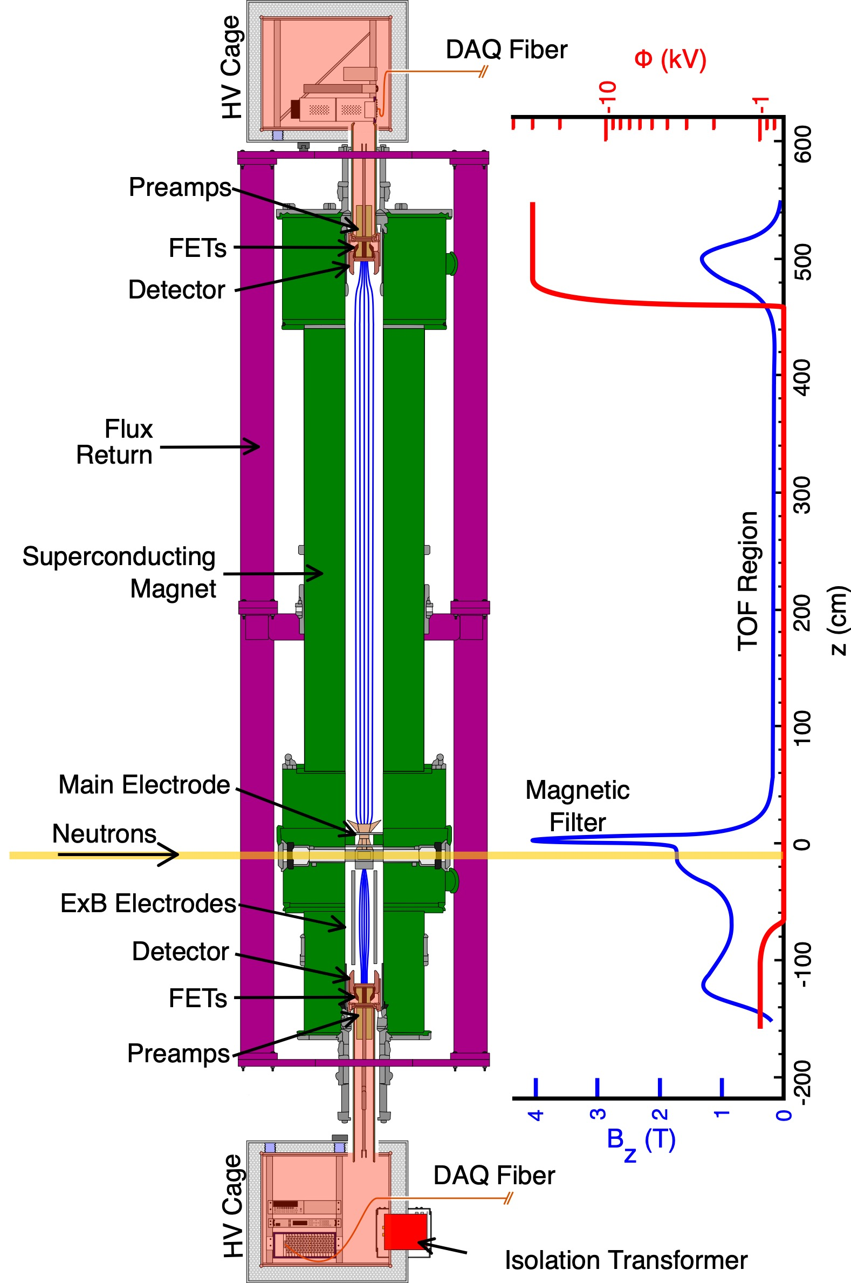
Nab Experiment Detector System

Slide 3
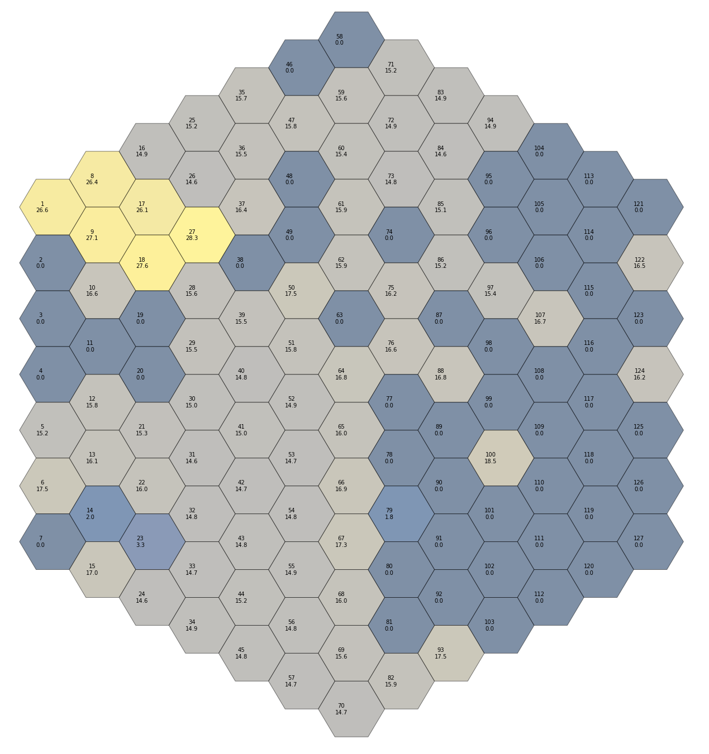
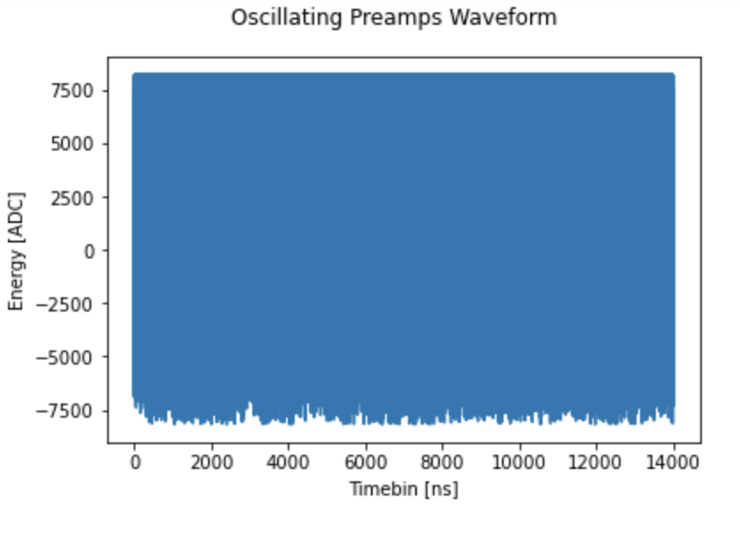
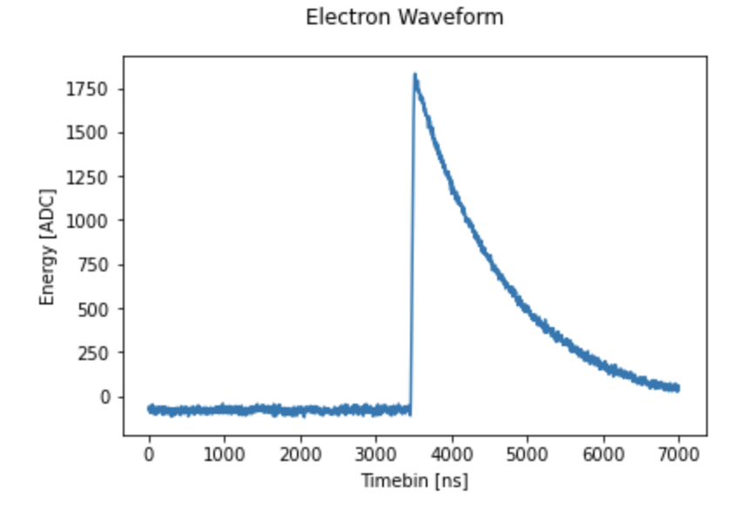
Nab Electronics
Stability
  Too many preamps plugged in leads to system oscillations
  Preamps too cold leads to oscillations
  Damage can lead to loss of pixel or instability
Upper Detector Pixel Gain Summer 2023

Slide 4
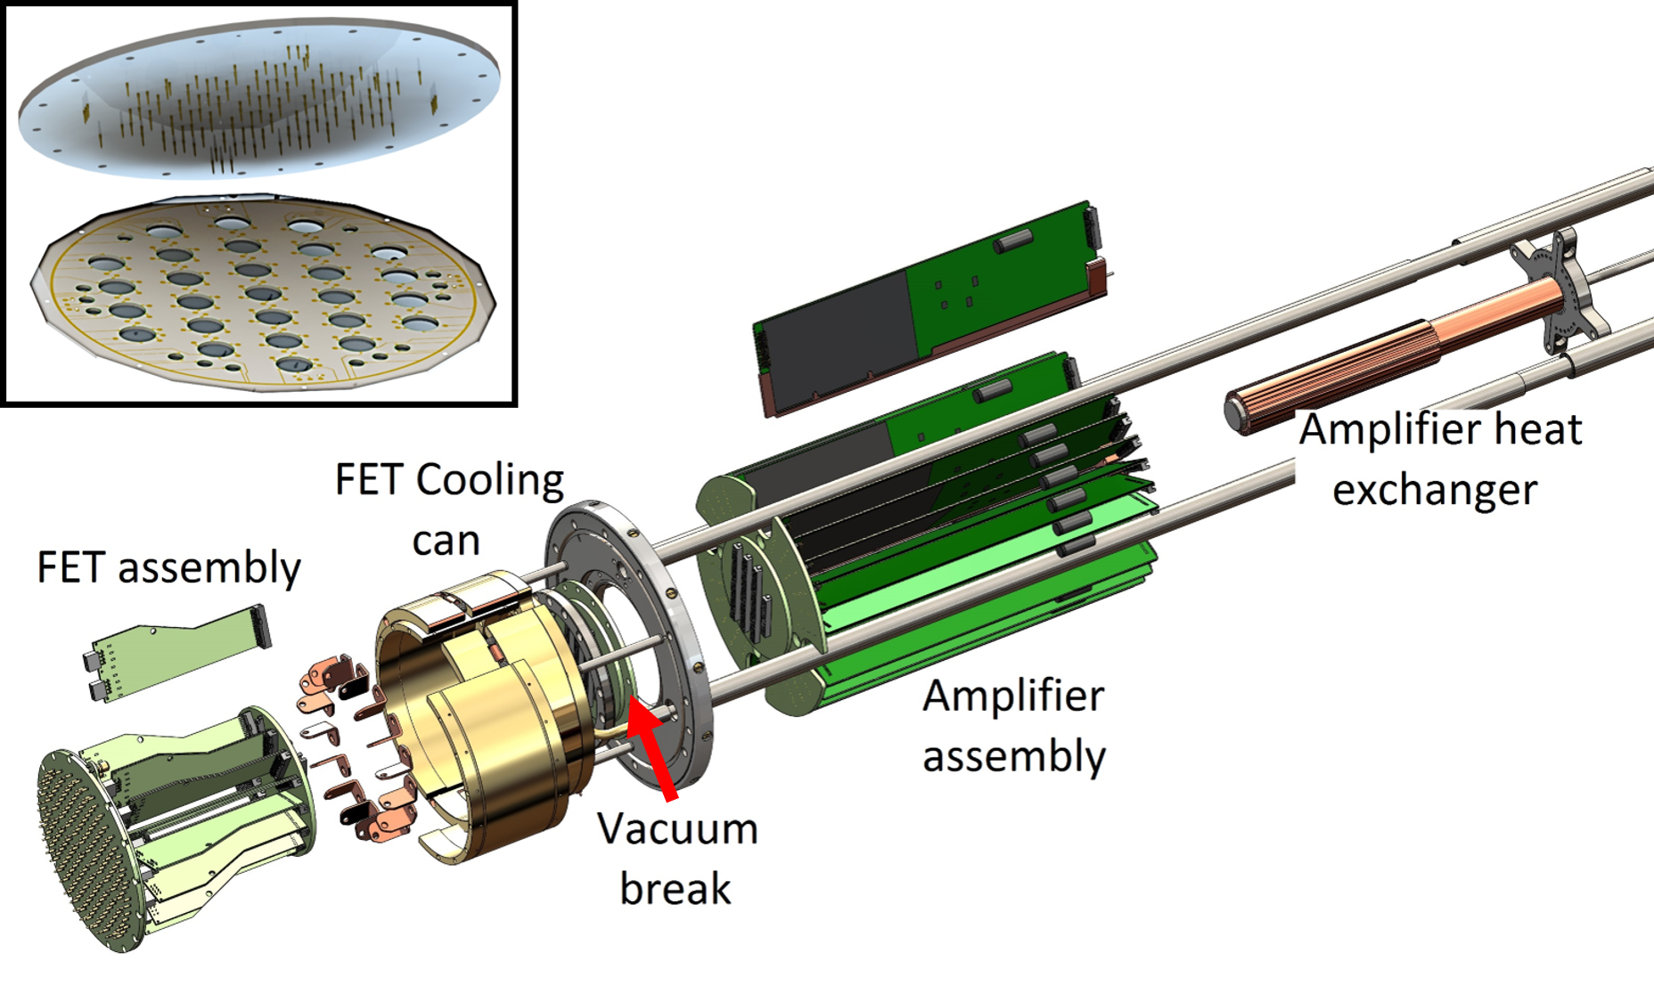
Nab Electronics
FET Pogo Pin Board
Transition Boards

Slide 5
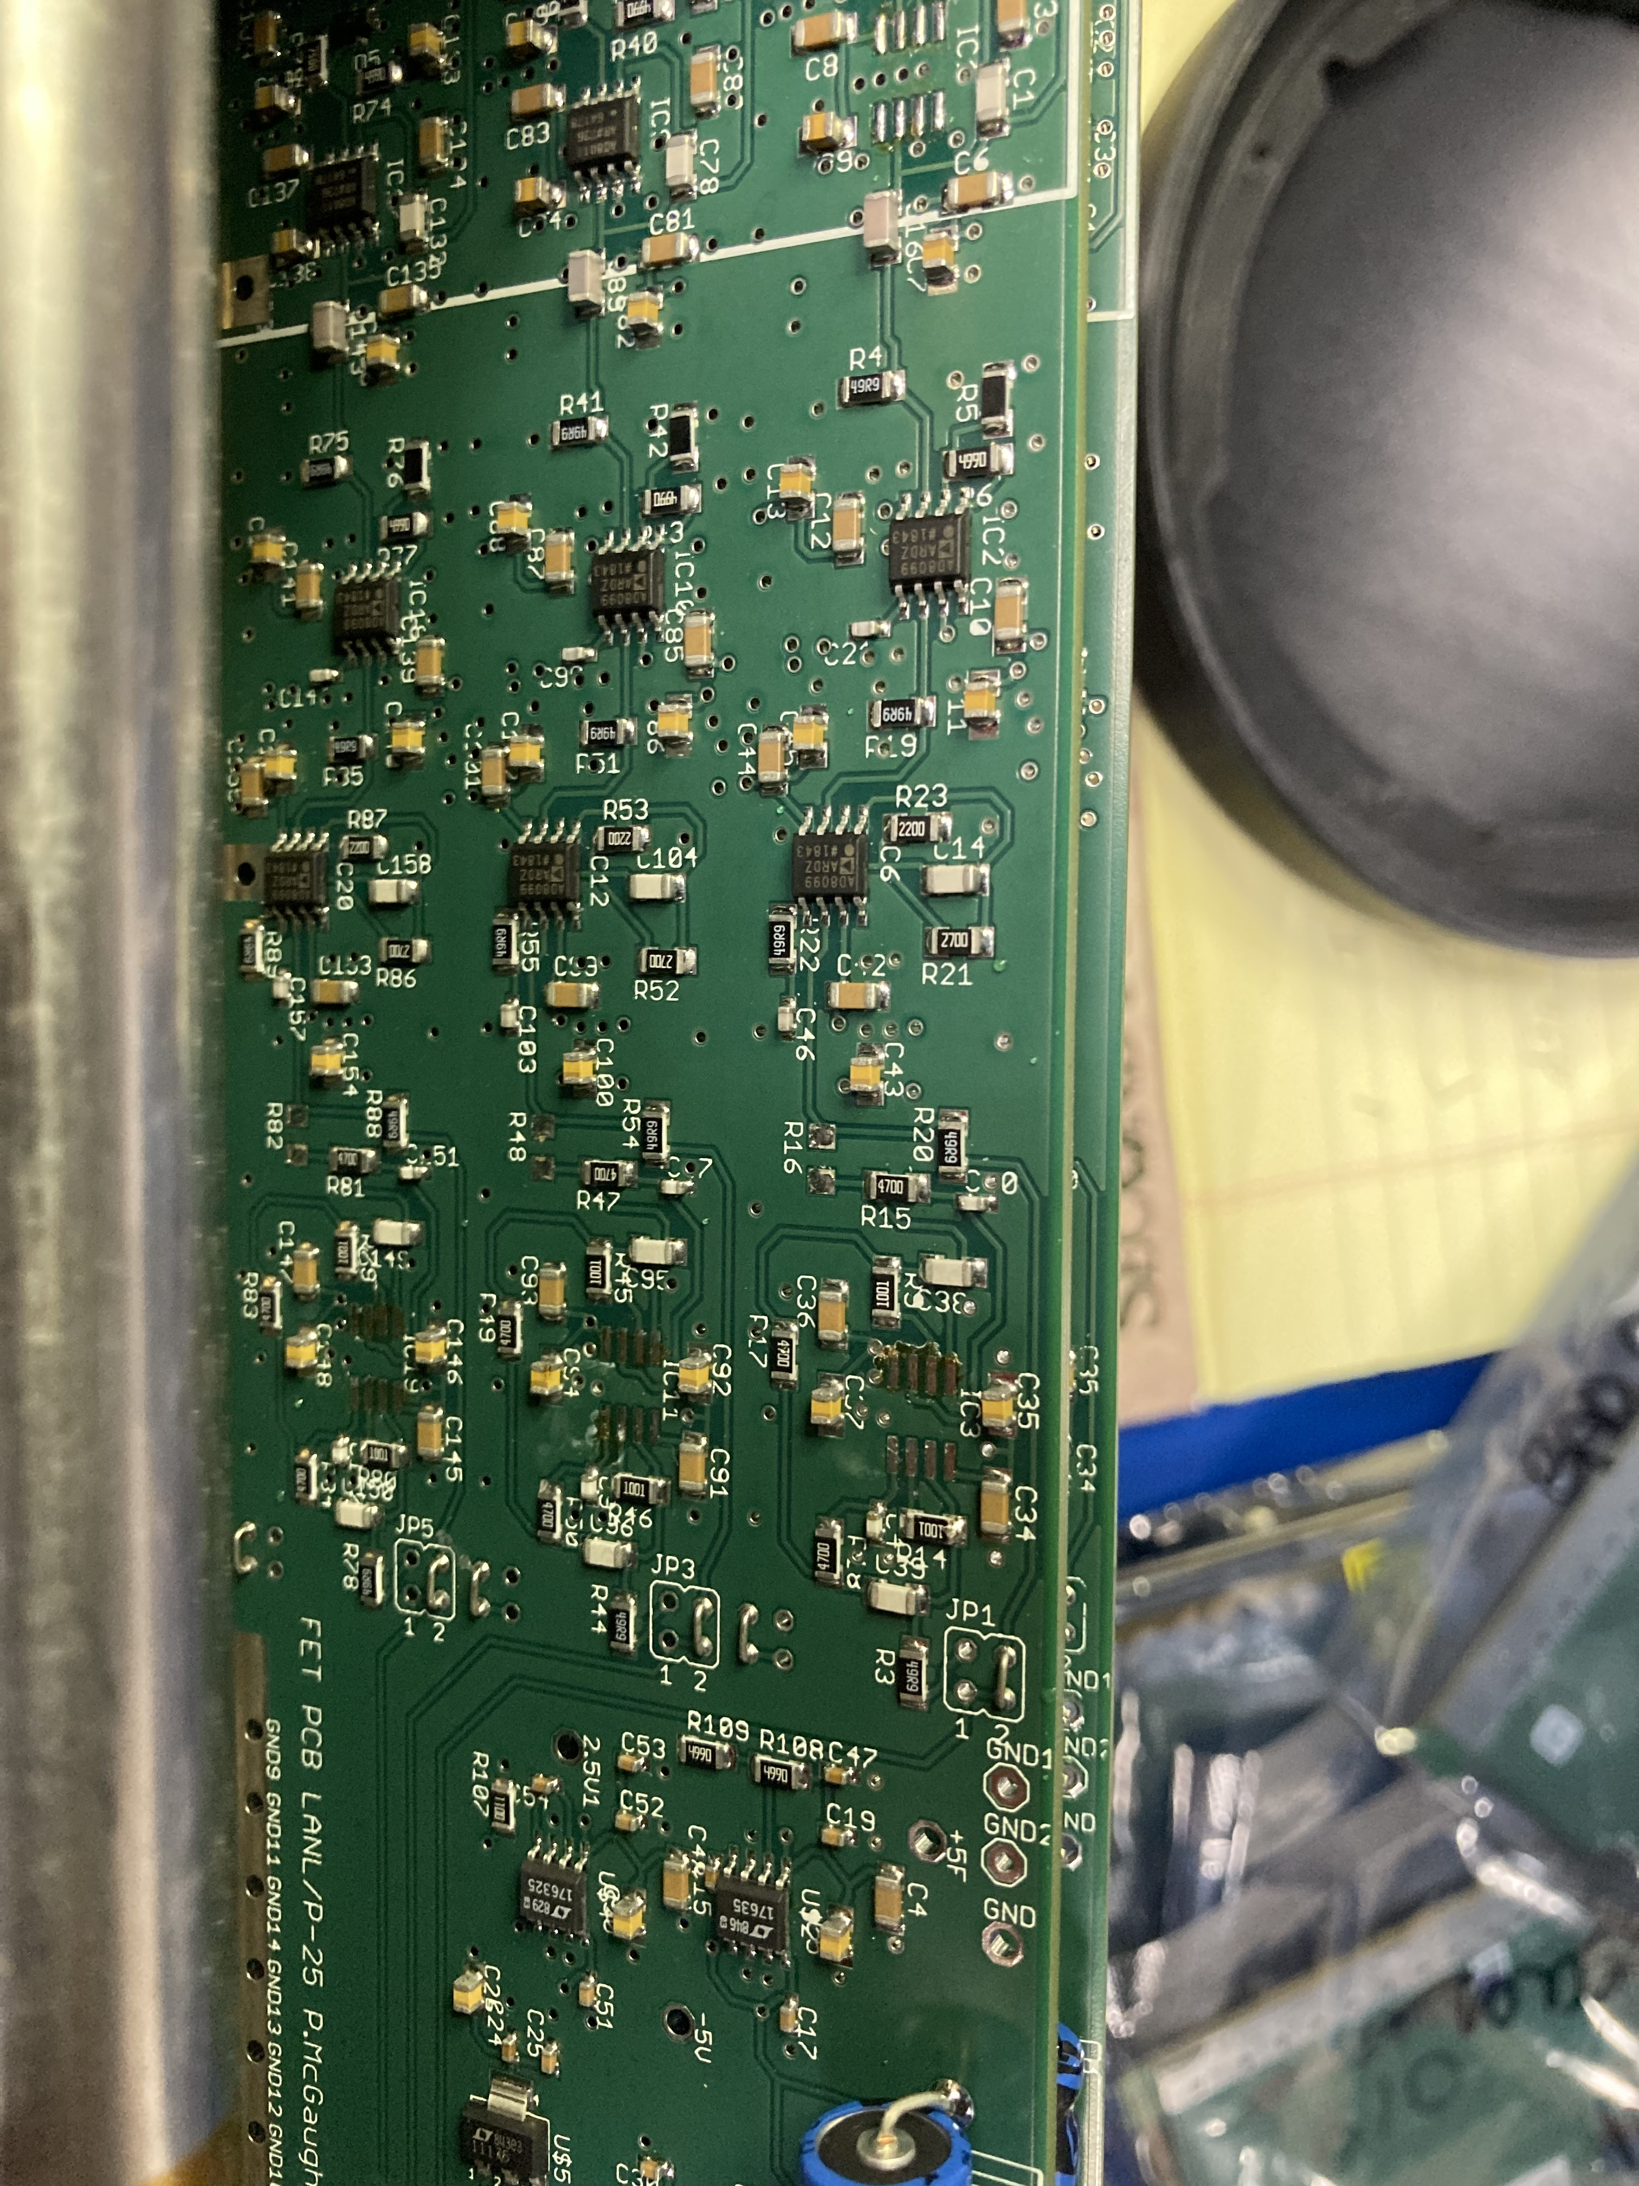
Shaper Circuit Removed
Shaper Circuit Removed
  Not in currently used
  Preamplifier board power draw reduced by 1/3
    Before
      +7V : 295 mA
      -7V : 271 mA
    After
      +7V : 211 mA
      -7V : 186 mA
  Stability Test
    All preamps powered, system did not oscillate on bench for 2 hours

Slide 6
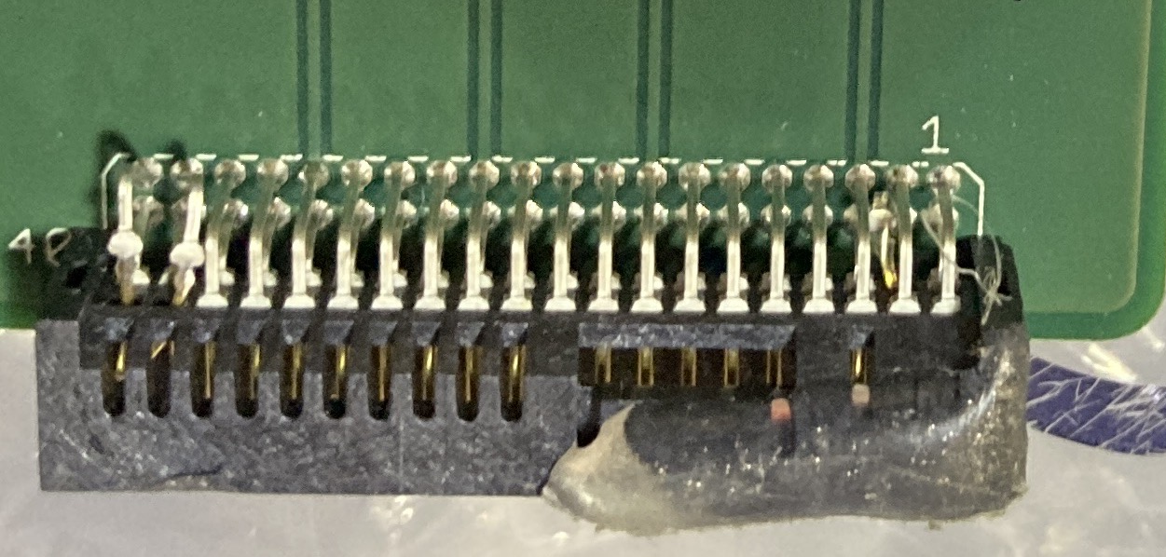
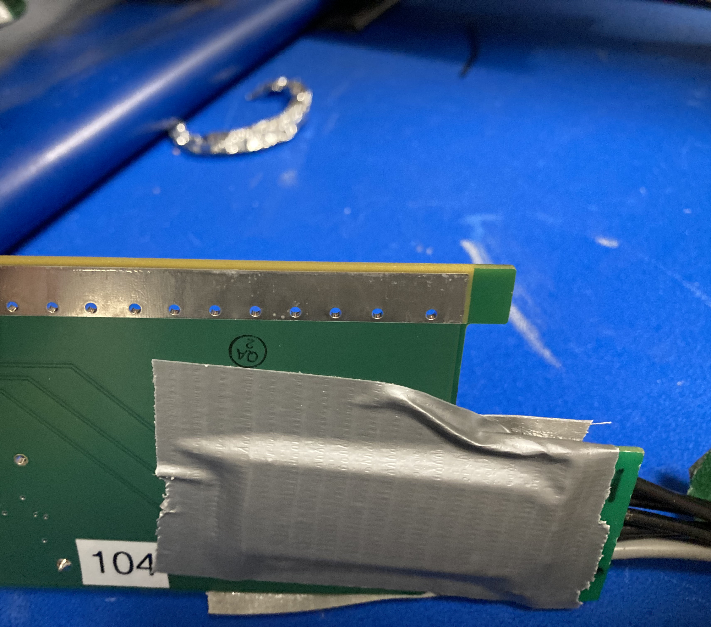
Connector Issues
Connector Damage
  Movement of Pins
    Touching other Pins, not Pushed in
  Connectors disengage easily
    Tabs taped to connectors, holding them together
  Repair Difficulty
    No thermals on ground pins makes replacement effectively impossible

Slide 8
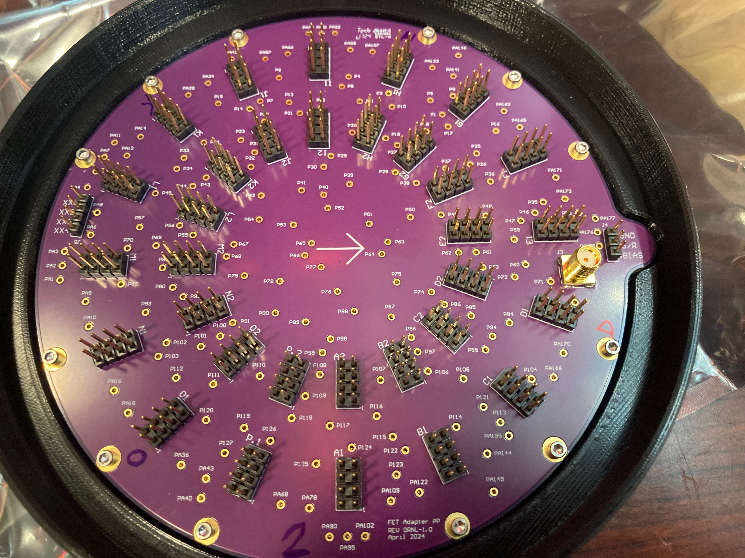
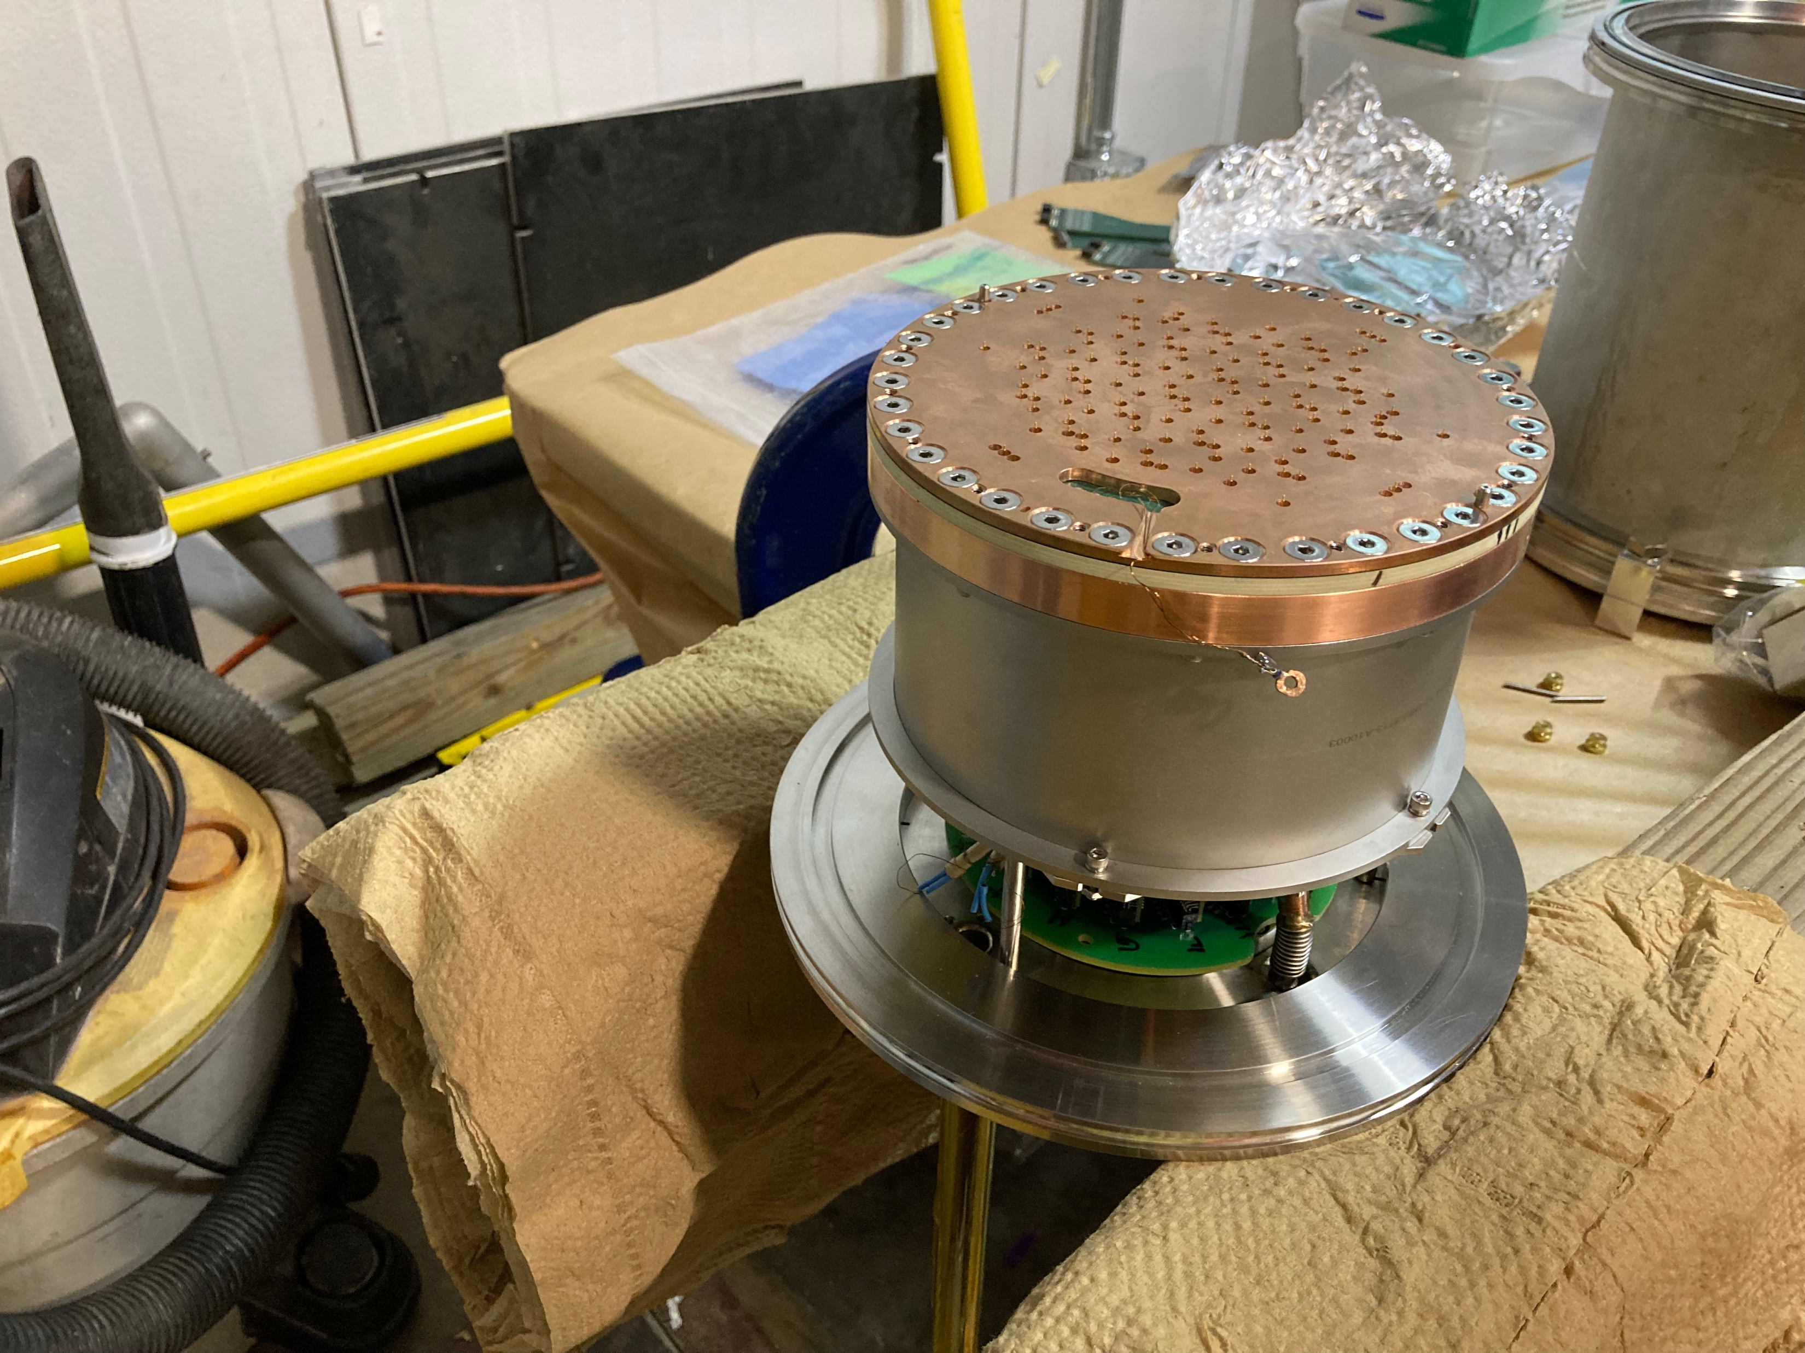
Cold Tests of New FET Pogo Pin Board

Slide 9
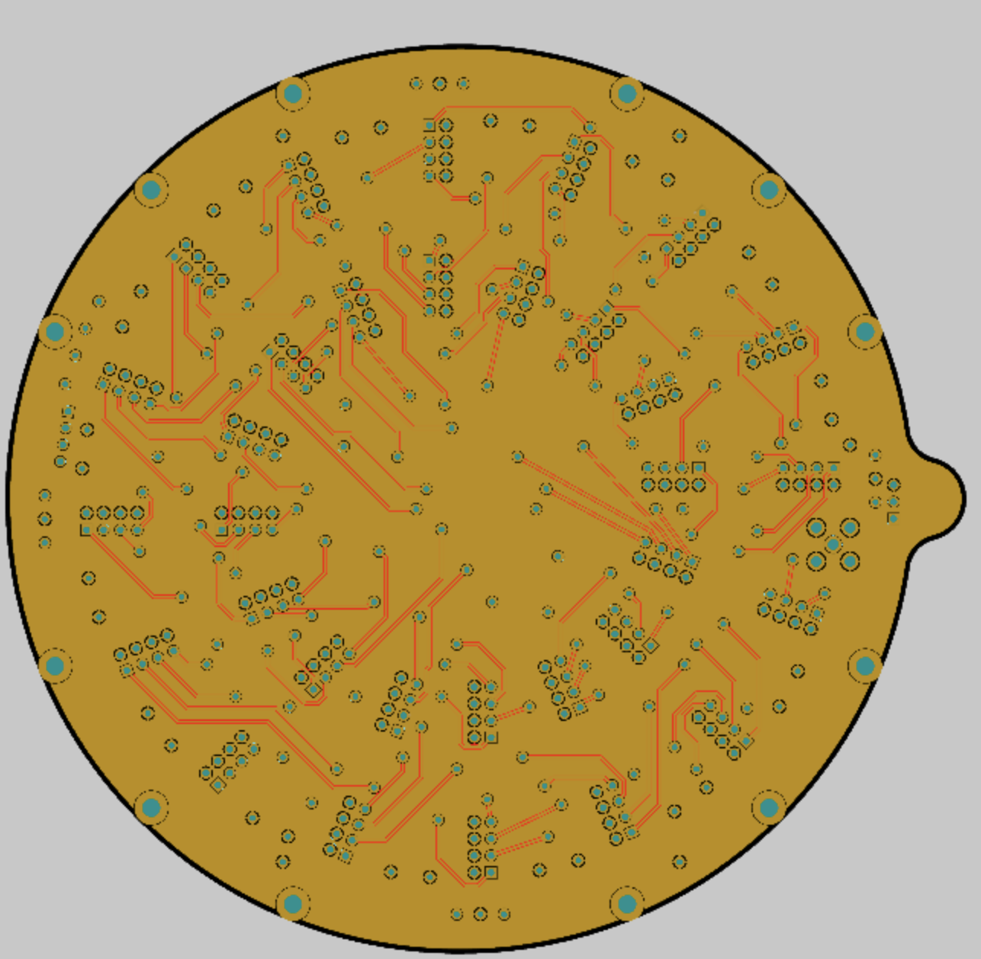
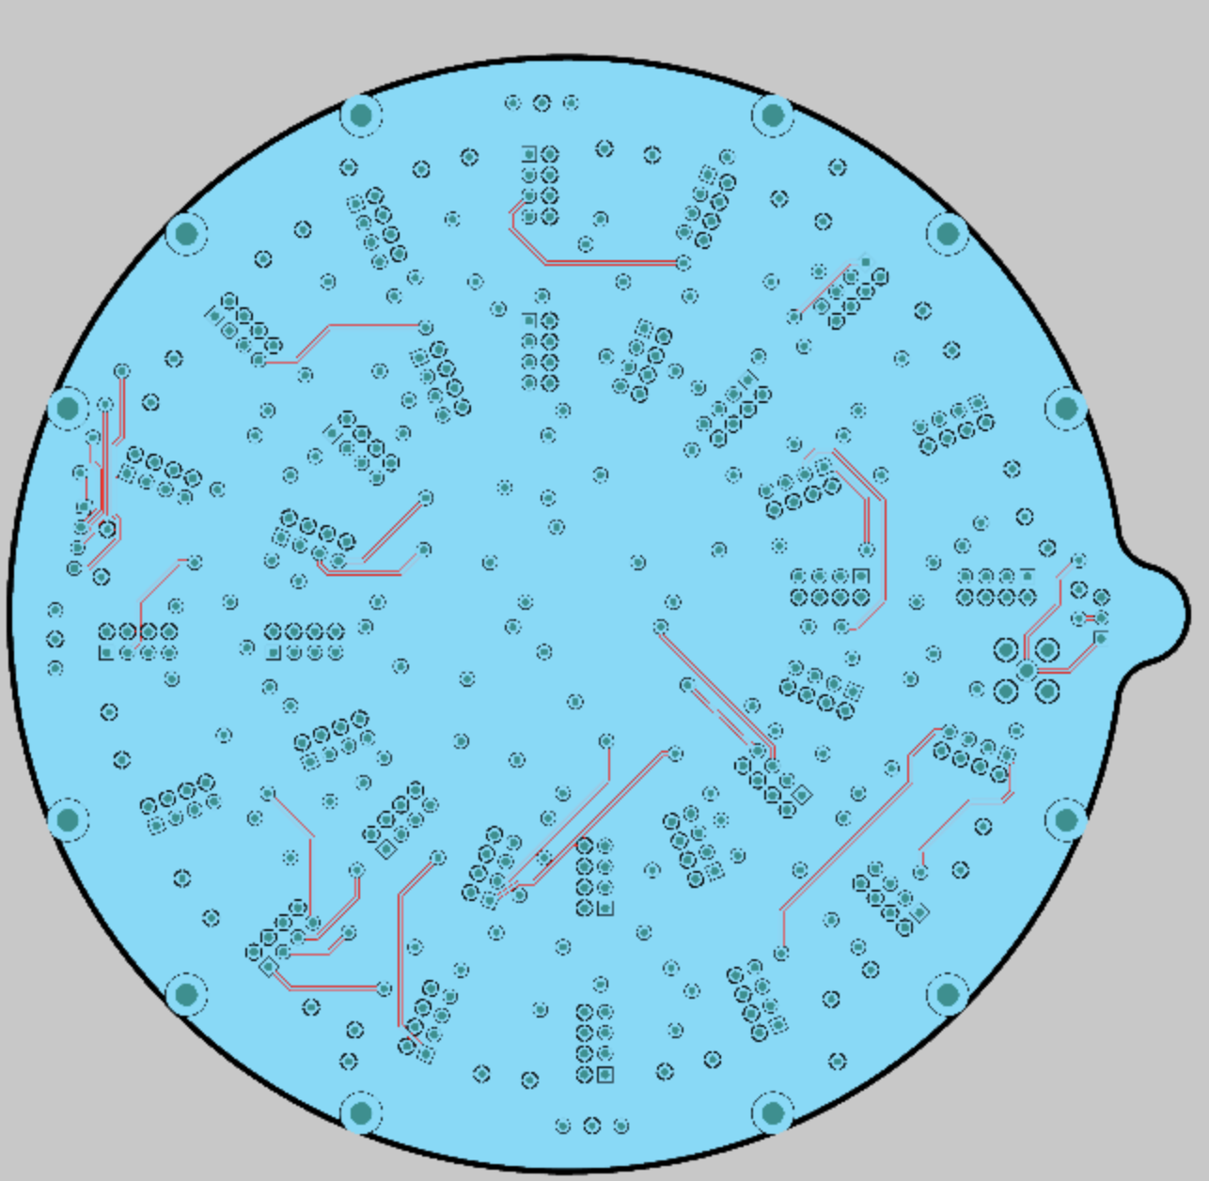
FET Pogo Pin Board Cross Talk Bench Test
Tested Overlapping Traces looking for crosstalk
  1 V output signal saw less than 10 mV crosstalk

Slide 10
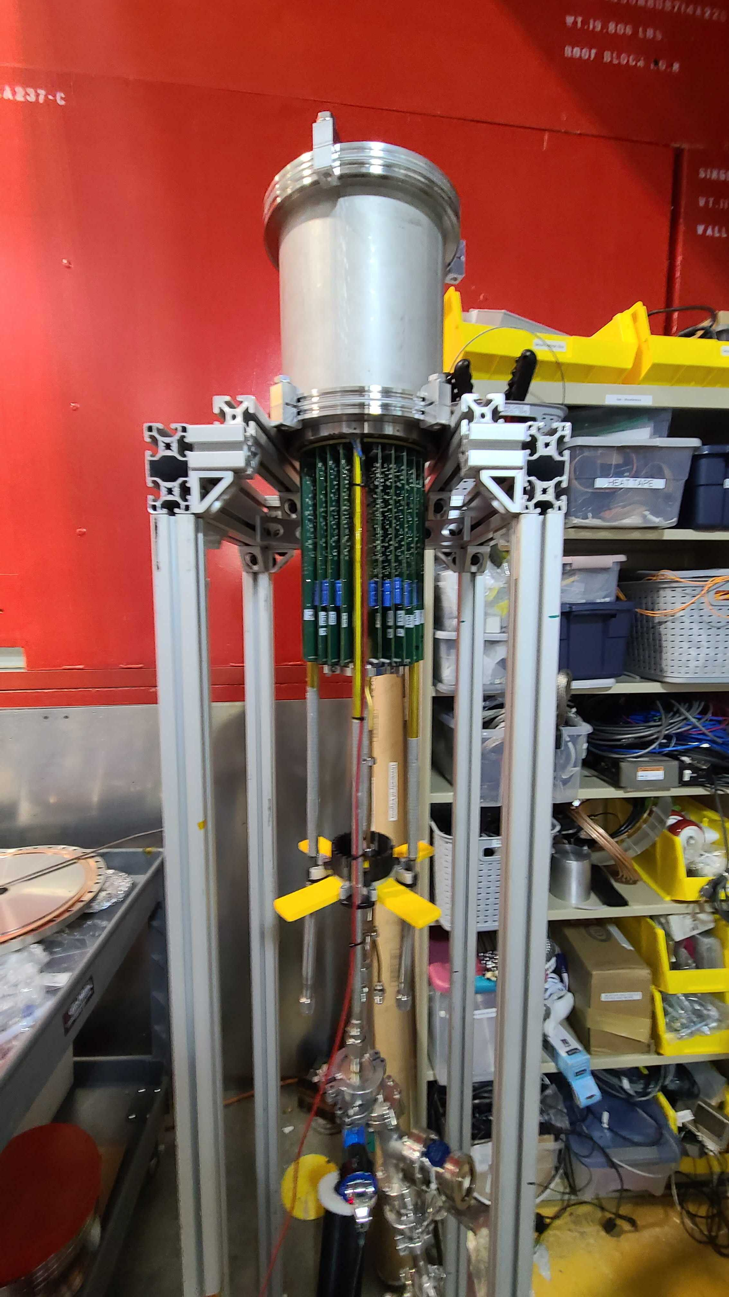
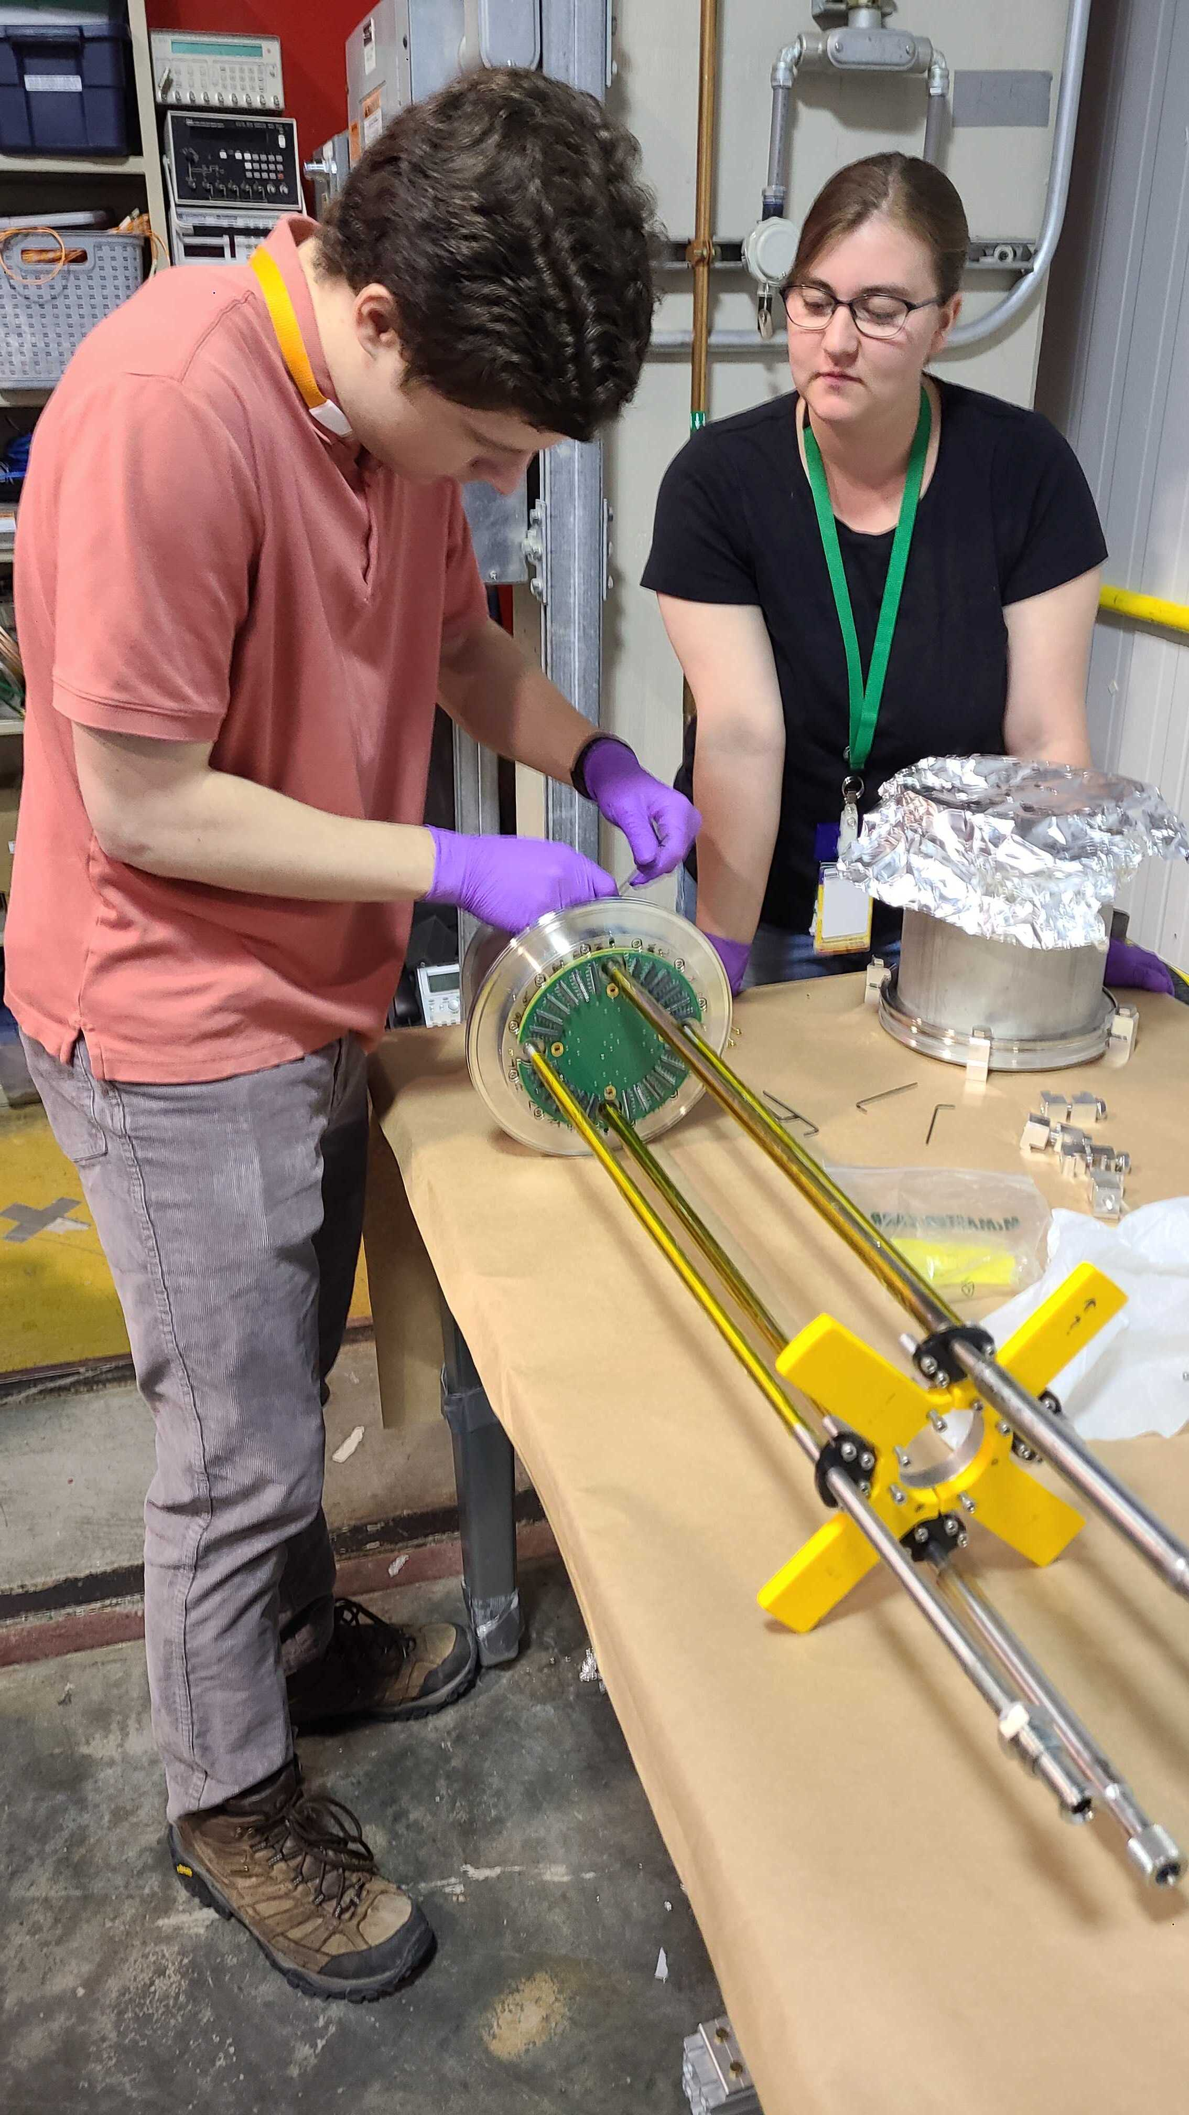
Mini Chamber
Tests of Electronics Changes​
Testing for new Lower Detector​
Testing of New Transition Boards​

Slide 11
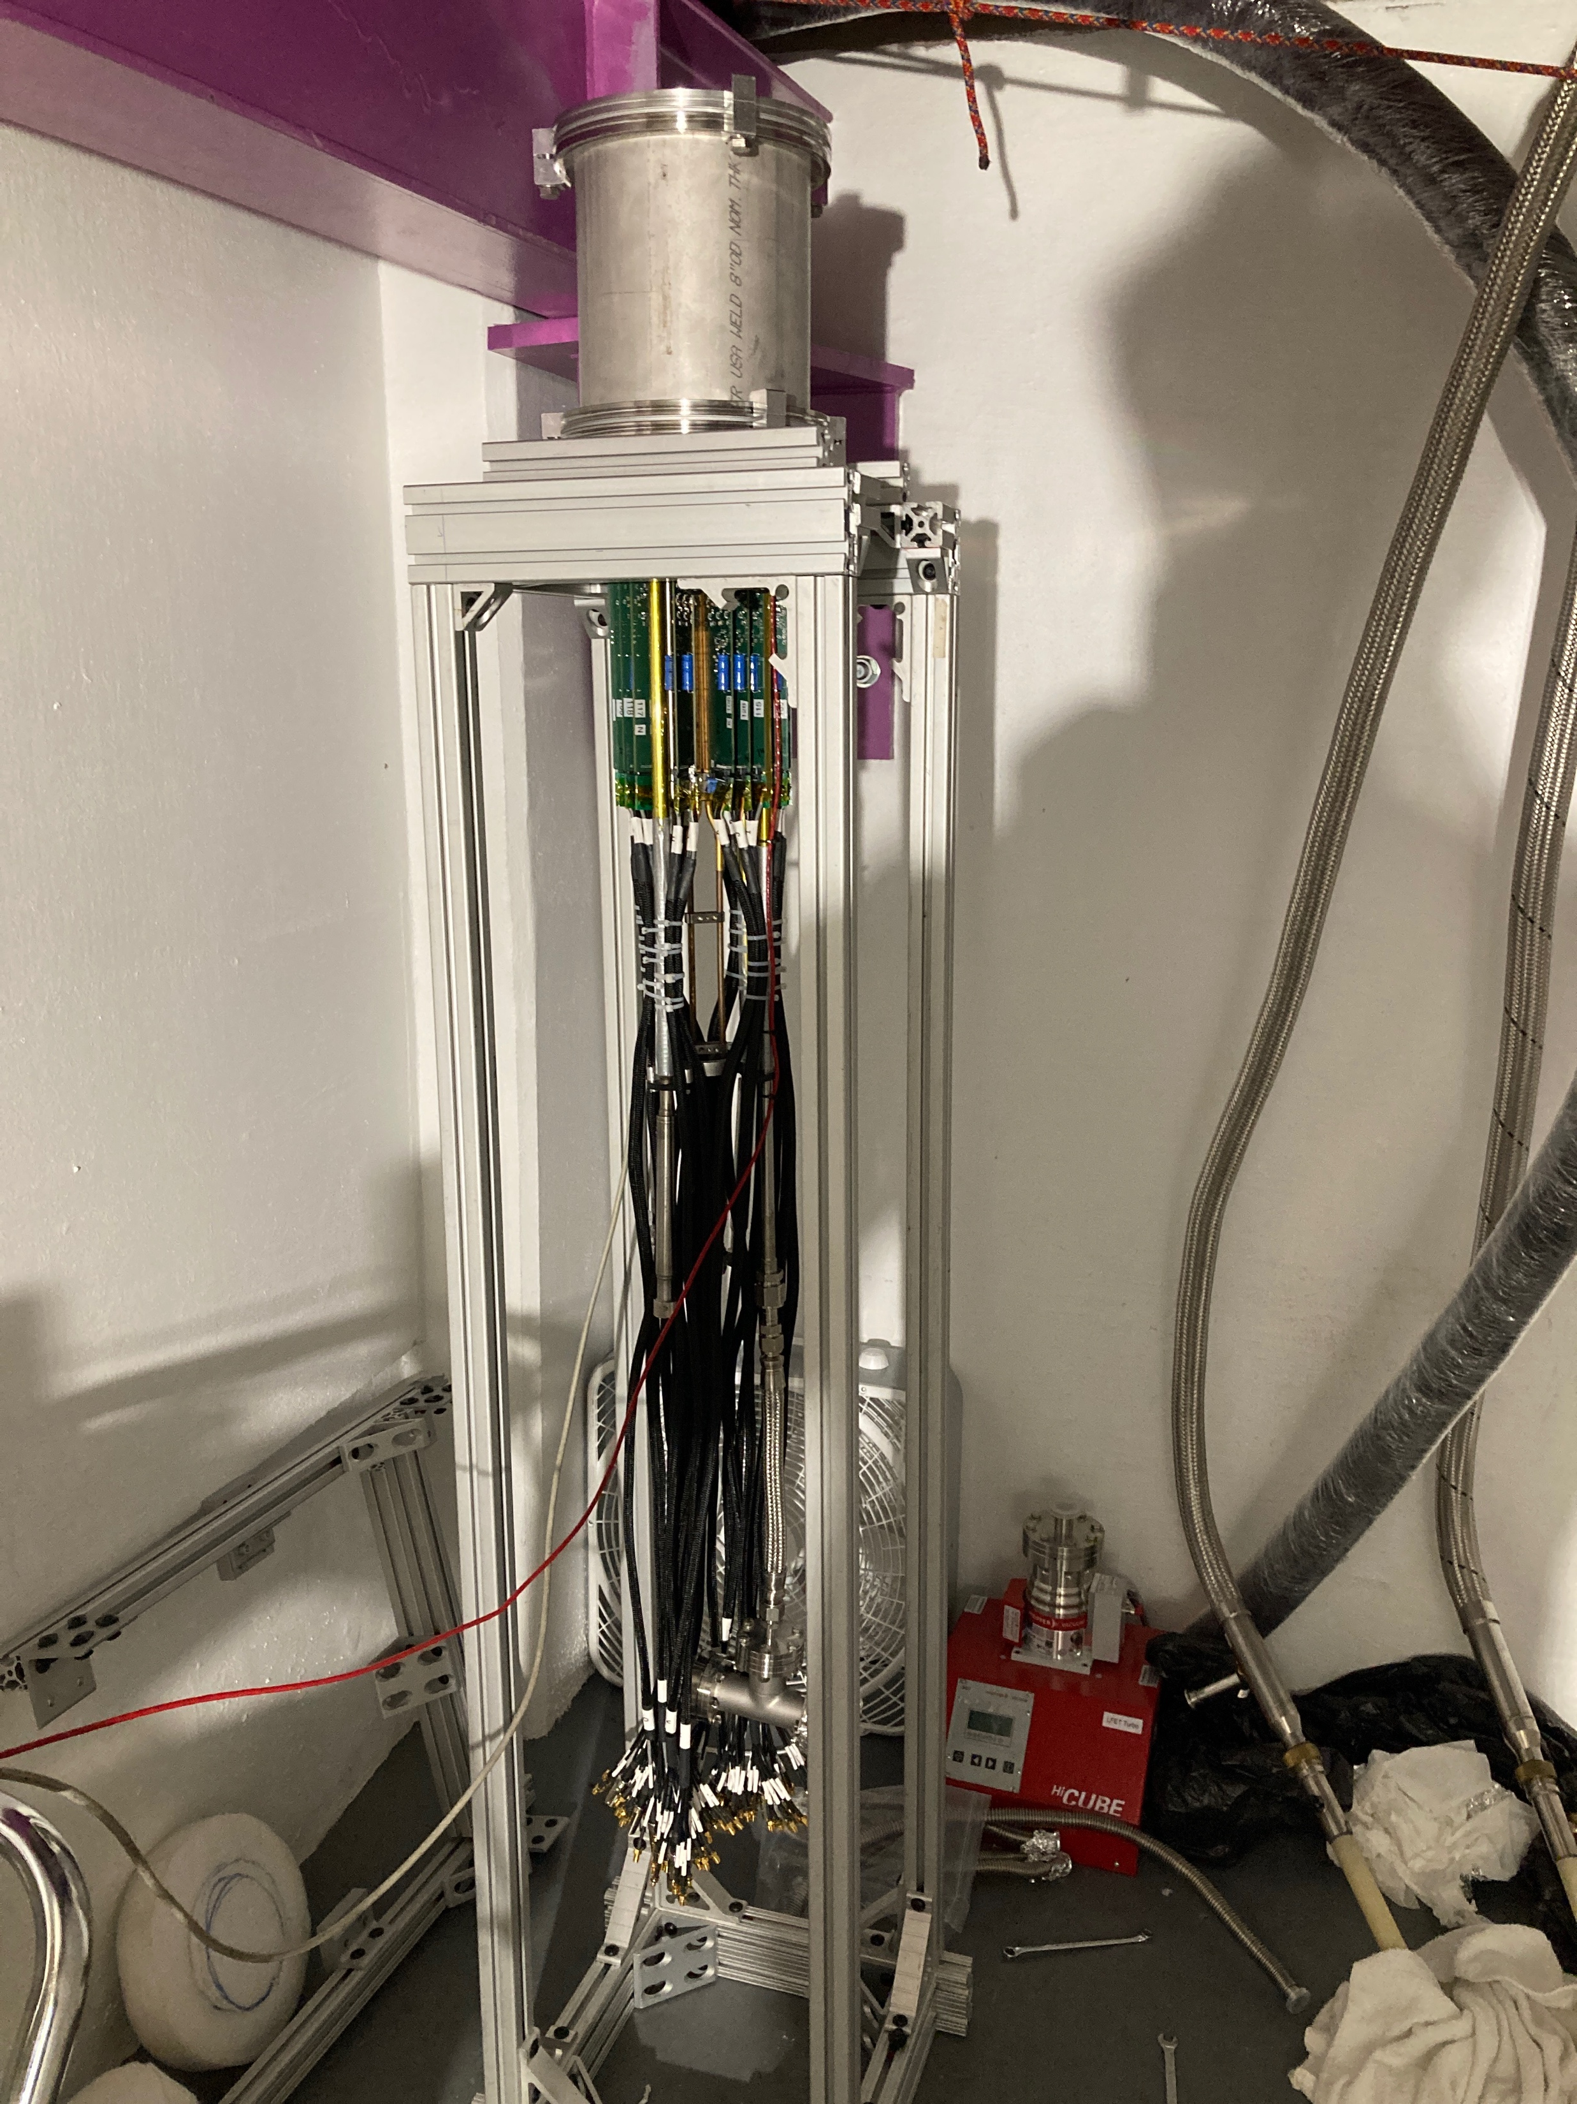
Mini Chamber Test
Warm Vacuum never better than 1 mTorr
Reluctance to put in a low leakage current detector into dirty vacuum led to testing with detectors with high leakage current
Saw 31 out of 127 pixels on Detector “Smudge”

Slide 12
Test Stand Tests with the “Manitoba” Detector
Green
  Working Pixels
Yellow -
  FET card inoperative
Pink
  Preamp inoperative
Blue
  Did not pass detector pogo pin continuity test
Red
  Missing after cooldown
Purple
  Did not pass detector pogo pin continuity test, reappeared after cooldown

Slide 13
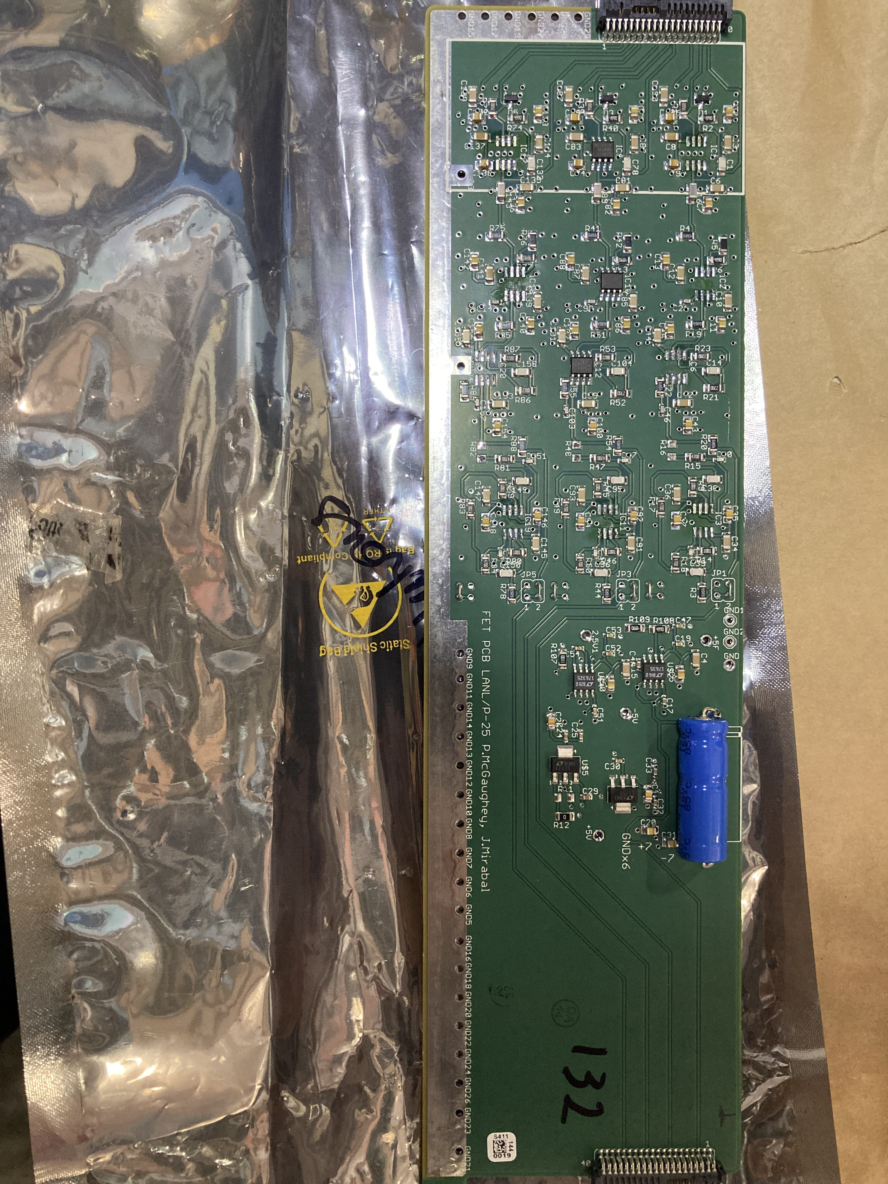
Electronics Modification Stability Test

Slide 14
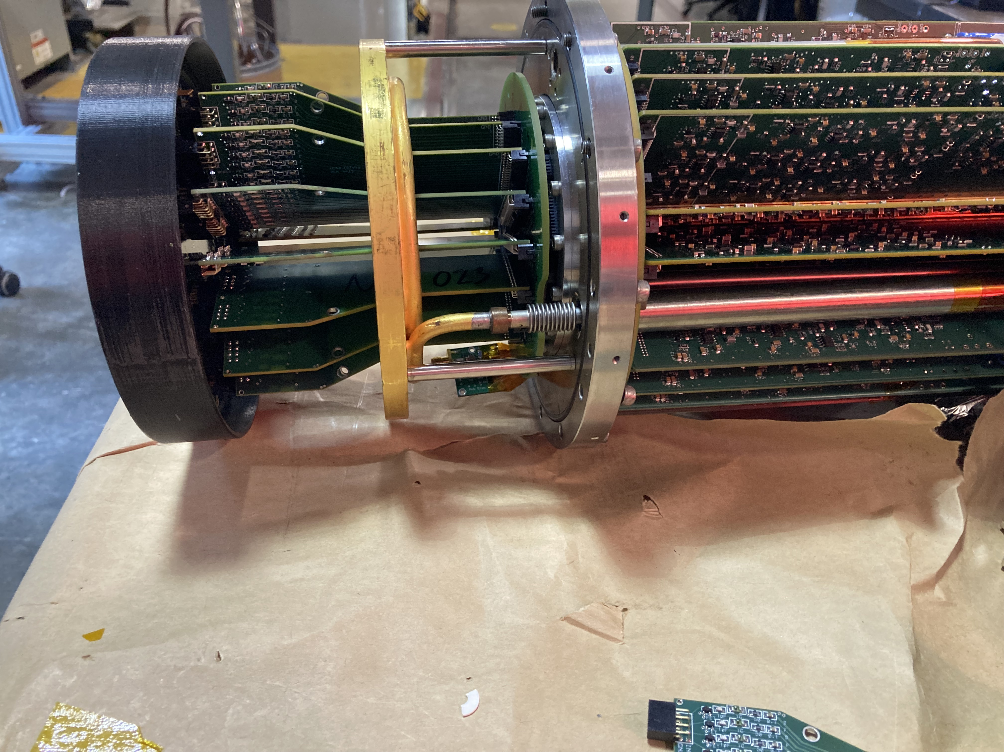
FET Card Removal Bench Test
Removed four FET cards (32 channels) from Electronics system to test stability

Slide 15
Removed Channels
Modified Preamps:
  A,B,D,G,I,J,L,M,P,R,T
  25 Channels removed
Power up Test
  Current Draws
Preamp | A | B | D | G | I | J | L | M | P | R | T
+7 (mA) | 149 | 150 | 147 | 118 | 146 | 200 | 145 | 118 | 145 | 118 | 147
-7 (mA) | 120 | 220 | 120 | 90 | 118 | 120 | 118 | 89 | 125 | 88 | 119
+12 (mA) | 76 | 76 | 71 | 79 | 77 | 76 | 77 | 77 | 76 | 77 | 72
Ch. removed | 2 | 2 | 2 | 3 | 2 | 2 | 2 | 3 | 2 | 3 | 2

Slide 16
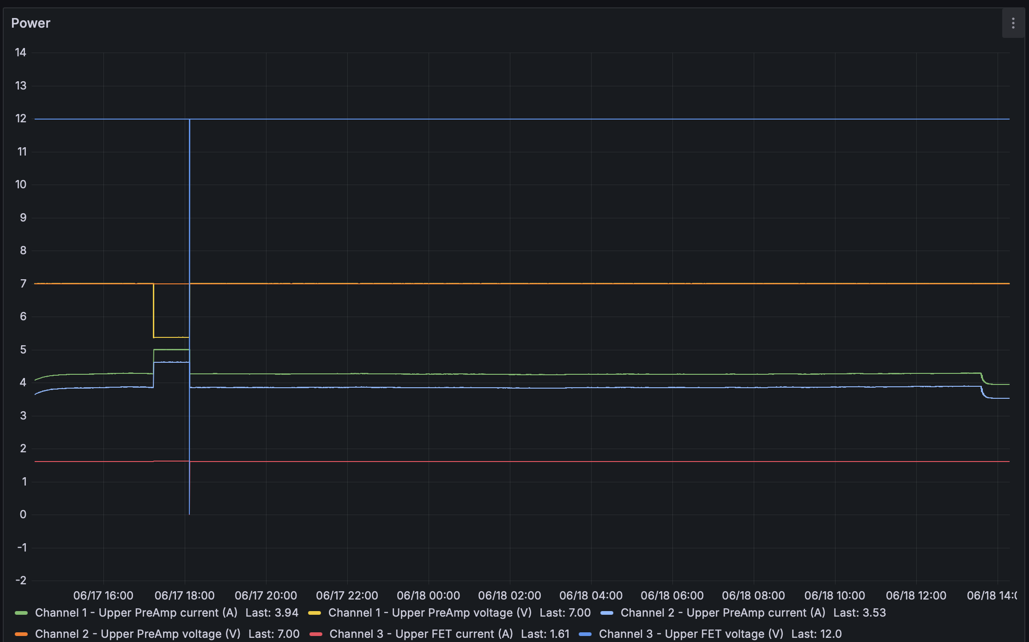
Test Results
FET removal test:
  System oscillated 4 times in 90 minutes
Op-Amp removal test:
  System oscillated once in 24 hours
Bench Test,
  No Detector
  FETs not cooled

Slide 17
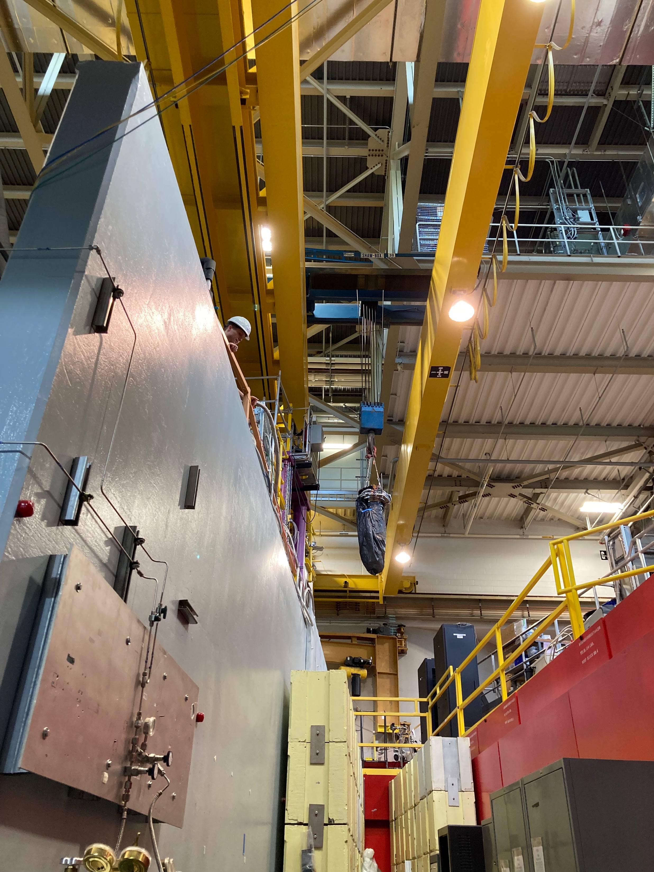
Future Work
Tests of new transition boards
  Continuity test
  Vacuum Test
Cold test 2nd new FET pogo pin
Cold Test of manual outer pixel removal
Install modifications for use in the upcoming beam cycle

Slide 18














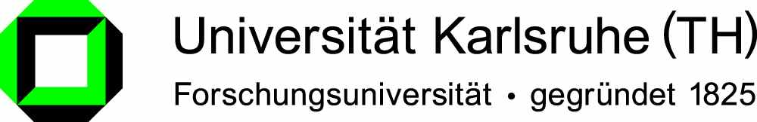

The Nab Collaboration
Main project funding:

