Slide 1
Characterization of Segmented Silicon Detectors for Neutron Beta Decay
By: August Mendelsohn for the Nab Collaboration
Supervisors: Drs. M. Gericke and R. Mammei
April 9th, 2022
Notes:
Good afternoon, my name is August. I am an undergraduate student from the University of Manitoba, working under the supervision of Drs. Michael Gericke and Russell Mammei.
In this talk I will discuss, as the title suggests, the characterization of large-area doped silicon diode detectors for investigating aspects of neutron beta decay.

Slide 2
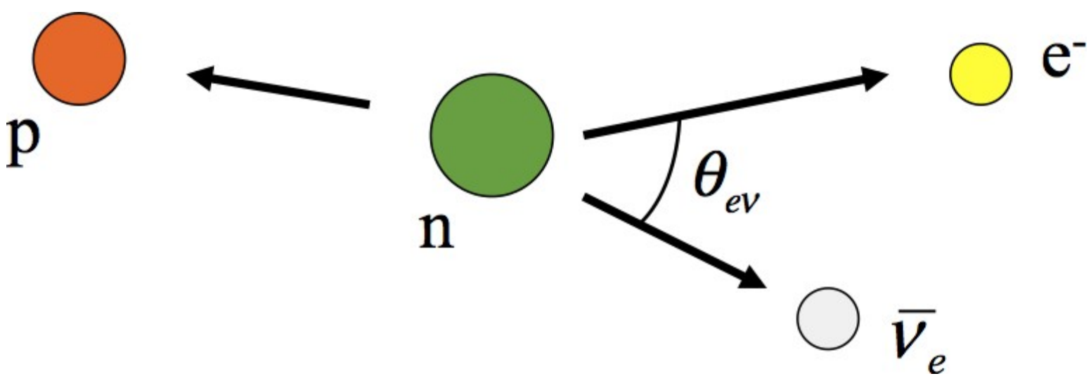
Outline
1) Introduction
Neutron beta decay
The CKM matrix
2) Instrumentation
The Nab experiment
Silicon Diode Detectors
Low-energy proton source @ MB
3) Characterization
Proton spot size study
Detector optimization
Notes:
So, to lay down the framework of this talk, there are three main sections.
The introduction serves to overview the theory of beta decay and its relationship to the boundaries of the standard model.
Then I will discuss the instrumentation of the Neutron-a-b experiment, and our corresponding equipment at the University of Manitoba that allows us to play an important role in this experiment.
All of this will build to the main discussion where I will dive into a study I performed and overview our current research goals.

Slide 3
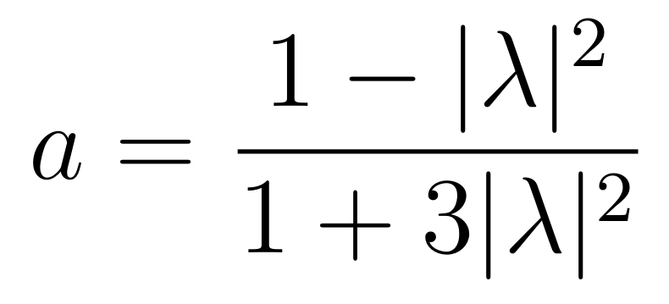
Theory - Neutron Beta Decay
2
J. D. Jackson et. al. Phys. Rev. 106 (1957)
Determine “little-a” from experiment (e-ν momentum correlation)
Extract $λ$ – the mixing of axial vector to vector coupling in the weak interaction
Notes:
In Neutron beta decay, the unpolarized contribution to the neutron triple differential decay rate (at top) depends on “little a” and “little b”.
Little a is the correlation between the electron and anti-electron neutrino momenta and b is known as the Fierz interference term, which dictates the amount of scalar-tensor contribution to an interaction under the weak theory.
Using the momentum of the proton and the energy of the electron, the selection in red can be determined, and thus “little a.”
Note that for determination of “little a” the standard model prediction of little b=0 is applied.
We can then gain access to the ratio of axial vector to vector coupling, denoted lambda, via the expression at bottom right.
This factor is important not only for particle physics, but it is also directly related to the production of neutrinos in a neutron star.

Slide 4
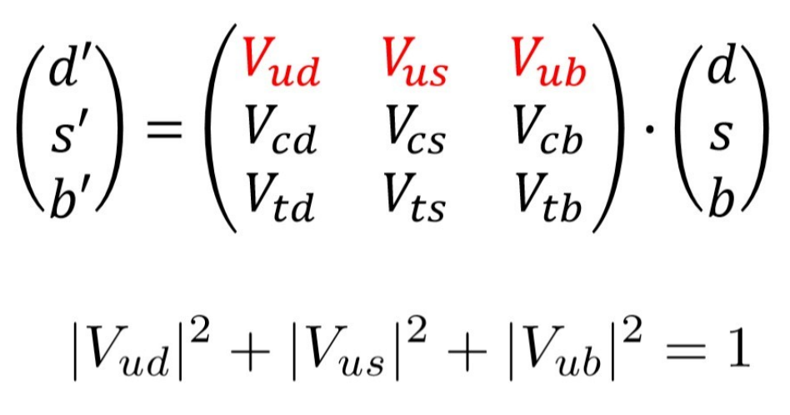
Theory – The CKM Matrix
$λ$ and $τ_{n}$ give rise to $V_{ud}$
CKM matrix unitarity highly dependent on $V_{ud}$
Unitarity of CKM speaks to the number of possible quark generations
$3σ$ away from the expected value of 1
Ideally:
Notes:
If we combine lambda with the neutron lifetime, we can determine V_ud, the 1-1 element of what is known as the CKM matrix.
Some of the most precise determinations of V_ud are through super-allowed 0+ 0+ decays, and the lamda-T_n approach provides a nice independent check of the same value.
But what is the CKM matrix?
It speaks to the transformation of quark generations between the weak interaction basis and the quark mass eigenstate basis.
Just like any other transformation we would like it to be unitary, that is – preserve the number of quarks undergoing transformation.
The sum of squared first row elements allows us to test the unitarity of the matrix (note that V_ud is the most significant contribution ~0.97).
Current measurements of V_ud yield values close to one, but with uncertainties 3 sigma away, meaning that the unitarity is in doubt.
If the CKM matrix turns out to be non-unitary, this would imply the existence of yet-undiscovered quarks.

Slide 5
The Nab Experiment
4
Spalled neutrons spontaneously decay
Time-of-Flight Spectrometer
Measure a and b via electron energy and proton momentum
Uses well-characterized silicon diode detectors
Salas-Bacci et. al., Nuclear Instruments and Methods (2014)
Notes:
The Neutron-a-b (nab) experiment is currently constructing a time-of-flight spectrometer at Oak-Ridge National laboratory’s Fundamental neutron physics beamline with the intention of making the most precise measurement of little a to date, and some of the first measurements of little b.
This spectrometer coerces the beta decay products into the time-of-flight regions (the areas with magnetic field lines).
Where the electron is used as a marker starting a timer. This is then stopped by the proton event trigger.
From this record the proton time-of-flight can be determined, and since the path length and proton mass are well-known, so too can the momentum and in turn little-a.
Integral to the spectrometer are a pair of segmented silicon diode detectors which collect the decay products, registering events with precise timing and (to a lesser degree) position.

Slide 6
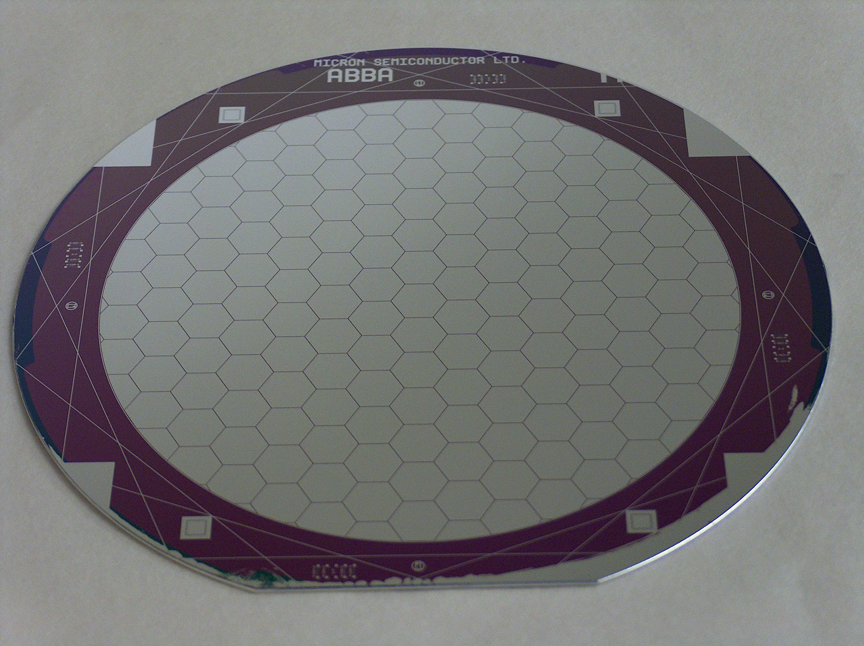
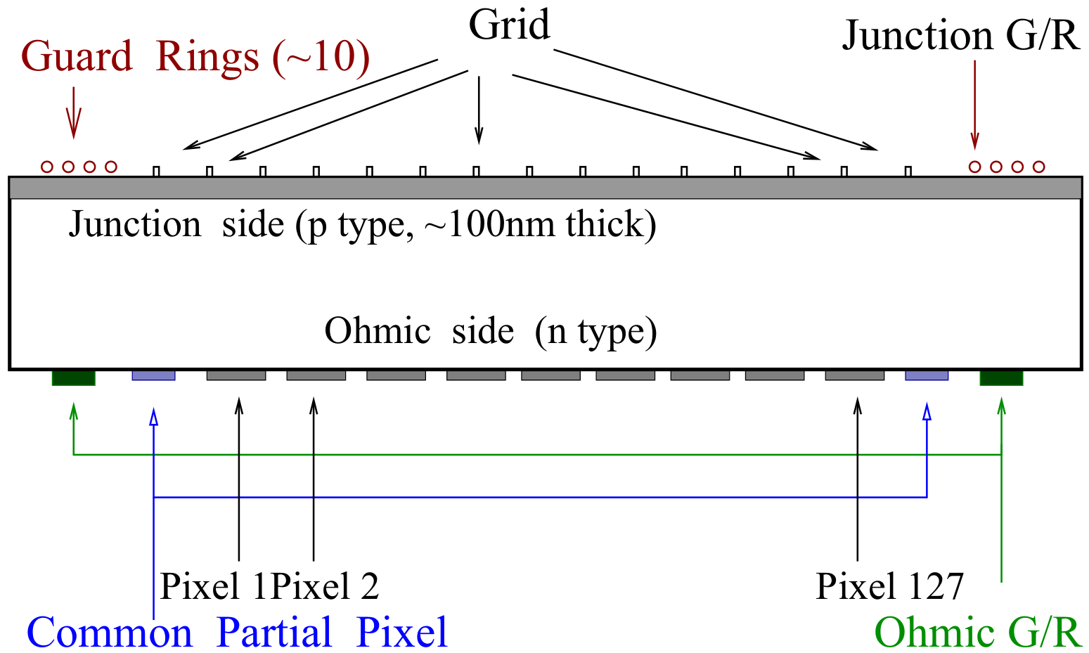
Silicon Diode Detectors
5
Layered silicon semiconductor
Dopants added to increase/decrease charge carriers
Reverse DC Bias applied across the junction
Charged particle lodges in the depleted region
Courtesy of the Nab collaboration
Salas-Bacci et. al., Nuclear Instruments and Methods (2013)
Notes:
The detectors consist of negatively-doped silicon wafers to which a p-type dopant is embedded.
This creates a p-n junction, like a diode.
And when a reverse DC voltage is applied across the faces of the detector (i.e., negative at the top and positive at the bottom in this orientation) the charge carriers are pulled towards the faces, creating a central “layer” depleted of charge carriers.
Then, incident particles will penetrate the now-depleted region, depositing their energy, and exciting the flow of charge carriers.
This results in a pulse that is registered using purpose-built electronics.

Slide 7
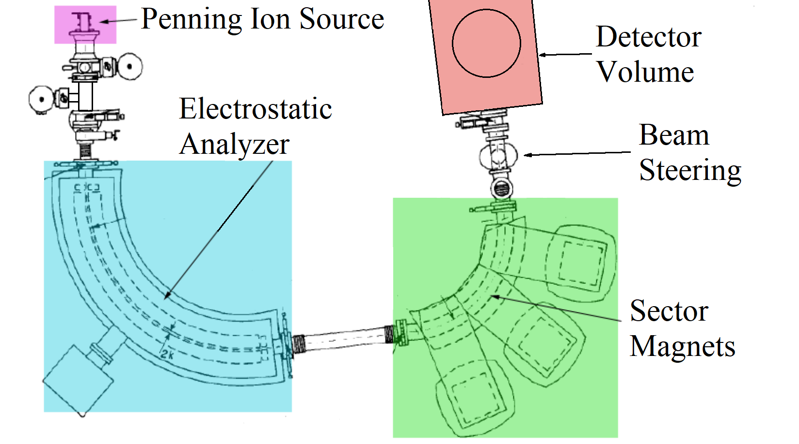
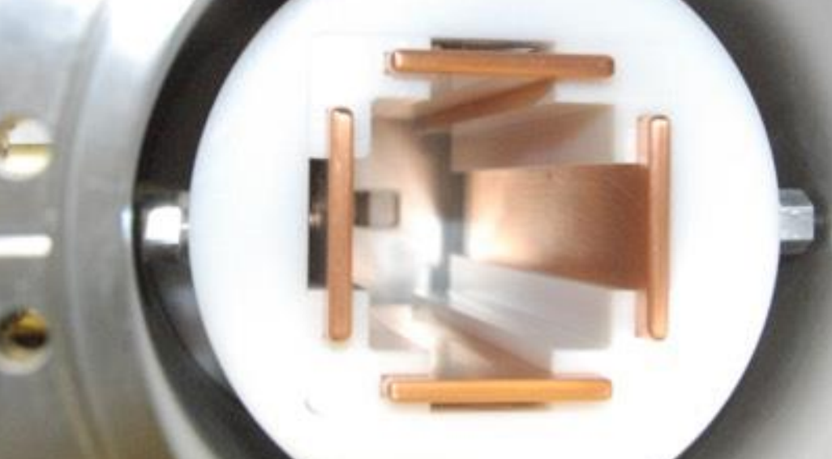
Experimental Setup
6
Manitoba II proton source (ex-mass spec)
Consists of:
Penning Ion Source (H-Ar)
Energy filtering (ESA)
Momentum filtering (Sector Magnets)
Beam steering apparatus
D. Harrison M.Sc Thesis (2013) modified
Courtesy of R. Mammei
Notes:
At the University of Manitoba, the previous Manitoba II mass spectrometer was converted in to a low-energy steerable proton source about ten years ago.
It uses a hydrogen-argon plasma to create protons, which are formed into a beam and then pass through energy and momentum filters (ESA and sector Magnets respectively).
This beam has a cross section of ~1mm after the sector magnets and can be directed around on the surface of the detector, using the electrostatic steerer as seen at bottom right, in order to study the detectors response.
The way that this image is oriented, the protons would come out of the slide, and the electric fields applied to each pair of opposing plates pull the beam in the desired direction.
This steering capability is somewhat unique, setting us apart from other low-energy protons sources.
(source @ university of virginia, can count protons but not steer)

Slide 8
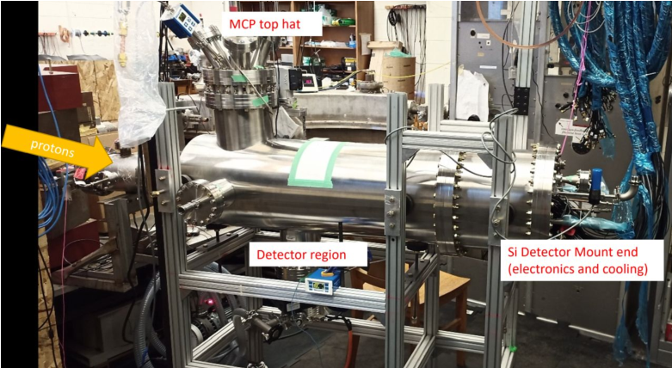
The Detector Mount
Courtesy of R. Mammei
Courtesy of the Nab collaboration
Notes:
Attached directly after the proton beam steerer is the detector mount itself.
Each pixel on the detector has a corresponding FET and amplifier, for a total of 127 channels in total.
These channels are then fed into FPGA oscilloscope cards housed in a NI PXIe crate which collect the waveforms and forward them to the data acquisition software via fiber optic link.
From there the DAQ processes and saves the collected data.
One of our goals is to understand the response the amplifying electronics have to protons.

Slide 9
Proton Spot Size Study
Use edge of pixel to determine beam diameter ($1±0.2$mm)
Erf fit in terms of position
Two Methods
NIM Counter
Dedicated DAQ software
Position information extremely relevant
Pixel Charge-Sharing Study
Much the same as above – now looking at detector with beam
Px
Amplifier
Discriminator
Counter
Spread
sheet
Pulse Gen
Timer
Schematic of the spot size determination using hardware
Notes:
Alright, having discussed the theory and instrumentation, I’ll finally get into the actual work we are performing at the University of Manitoba.
I will highlight the areas that I am more deeply involved with as a selection of our ongoing analysis.
There were two main aspects to this, the first being gaining an understanding of the proton beam itself, and the second being the optimization of the running parameters (Which is still on-going).
It was of interest to find out the proton beam size at the detector and, using the edge of one of the segments, I performed a counting experiment to determine this.
When plotting counts vs position, the result is error function-looking plot, from which the roll-off can be determined.
Two methods were employed, one using a simple discriminator and counter to register the number of counts, move the beam, and repeat the process.
A schematic of the used hardware can be seen at the right.
The second method made use of the dedicated data acquisition software which collects many more aspects of the events beyond which pixel is “lighting up”.
Things like collected noise from individual pixels, energy and power spectra etc.
As one can imagine – the positional information is quite important to make a good estimation of the proton size. This is non-trivial, and I’ll speak more towards that in the next slide.
This experiment can (and indeed needs to) be turned on its head to investigate the amount of charge-sharing between adjacent segments in the detector, to avoid registering a single event more than once.

Slide 10
Statistics for the Counter Method
Created a MATLAB script to fit a cumulative distribution
Assumed displacement was center-to-center distance
Extracted 2*HWHM
$F\left(x\right)=\frac{a}{2}\left[b±erf⁡\left(\frac{x−μ}{\sqrt{2}σ}\right)\right]$
$2∗HWHM=2\sqrt{2\ln{2}}σ$
Corresponds to beam cross-section
Rate vs. Position
Rate vs. Position
Rate $(s^{−1})$
Rate $(s^{−1})$
Rate $(s^{−1})$
Notes:
In the counter method I initially assumed that the movement of the beam was from the center of one pixel to the center of one of its neighbours.
This turns out to be not perfect as you can see. If this were true, the crossover would be centrally located in the bottom-left-hand plot. But I will speak more to that in a second.
From the collected data an error function was used as a fit and the HWHM extracted.
The beam size was then determined to be twice the HHWHM. With a result of ~1mm in diameter.
As I say, the assumption of center-to-center distance is not perfect but note that even if the displacement was from far-edge of one pixel across the boundary and then to far-edge the other pixel, it would mean the beam moved a larger distance yielding a smaller HWHM and thus a smaller beam size, so this estimate errs on the conservative side of things.

Slide 11
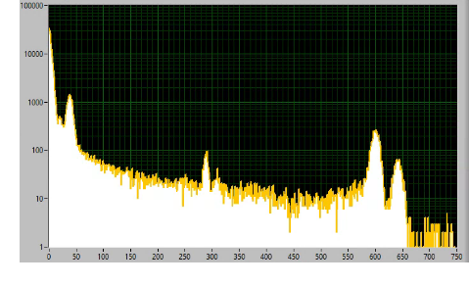
Running Parameter Optimization
Two kinds of detectors:
P-spray and P-stop
Intend to characterize both with 30KeV protons and radiation sources (${Cd}^{109}$ and ${Sn}^{113}$)
Want to reduce typical noise contributions
Thermal (Johnson) noise $∝I_{L}$
Temperature and bias are coupled
$I_{L}∝T^{2}\exp\left(−\frac{E_{g}}{2kT}\right)$
Use of ${LN}_{2}$ to achieve temperatures of 120°K
Shot noise – FET amplifier
$1/f$ (“pink”) noise
Analysis is in-progress
Counts
Trigger Energy (ADC)
Notes:
The overall objective at Manitoba is to determine the detectors optimal running conditions for use in the main experiment.
There are two versions of the detectors, p-spray where the entire face is sprayed with a p-type dopant and p-stop where the face is instead covered in “strips”.
We are concerned with minimizing electrical noise as well as other factors by studying the effects of varying temperature and bias voltage.
The typical noise contributions are present in the system.
One of the largest being Johnson noise, which is produced by thermal excitations of charge carriers across the band gap creating a small leakage current (I_L).
This is combatted by reducing the detector temperature (as seen in this formula here).
We take advantage of this by cooling the detector with liquid nitrogen.
Shot noise from the FET amplifiers directly after the detector, and low-frequency 1/f noise as a function of bias voltage (can be seen in this Sn113 spectrum bottom left).
Data has been collected for the p-spray detector, and analysis has begun, with the intention of repeating the process for p-stop. As I say, while the bias and temperature optimization are arguably the items with highest importance, the analysis is still ongoing.

Slide 12
Thank you!
Notes:
And I’ll wrap it up there. Thank you for your attention, and if you have any questions, please do not hesitate to ask me through the APS secure platform!

