Slide 1


Characterization of Segmented Semiconductor Detectors for Neutron Beta Decay
By: August Mendelsohn for the Nab Collaboration

Slide 2
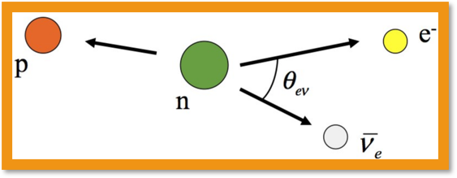
Overview
The Nab Experiment
Unique setup at Manitoba
Calibration/Optimization
Summary/Future Work

Slide 3

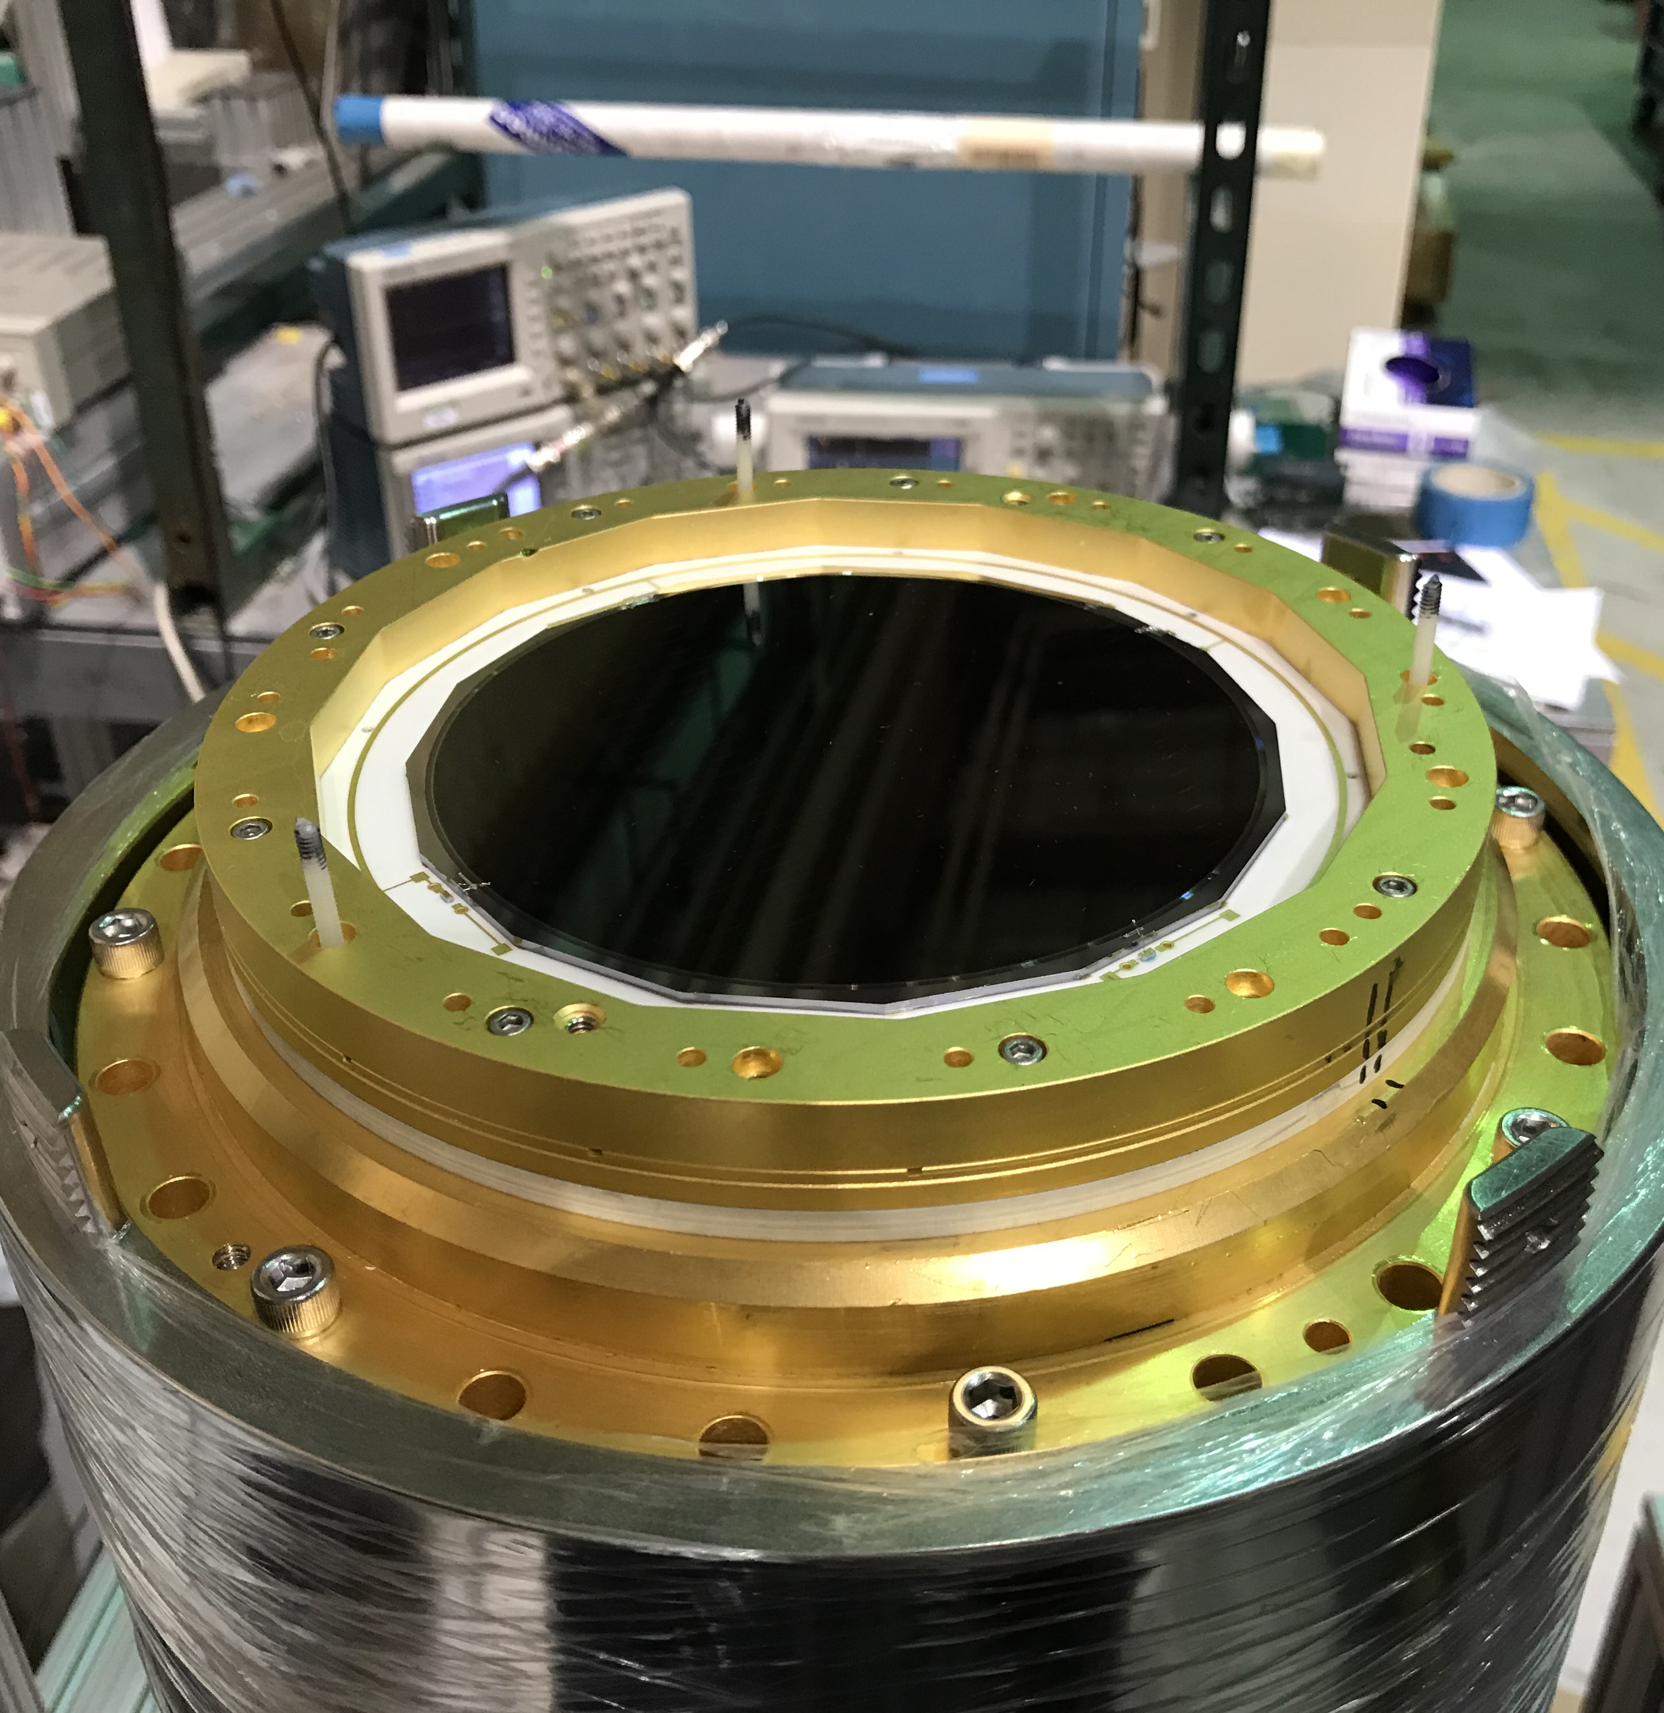
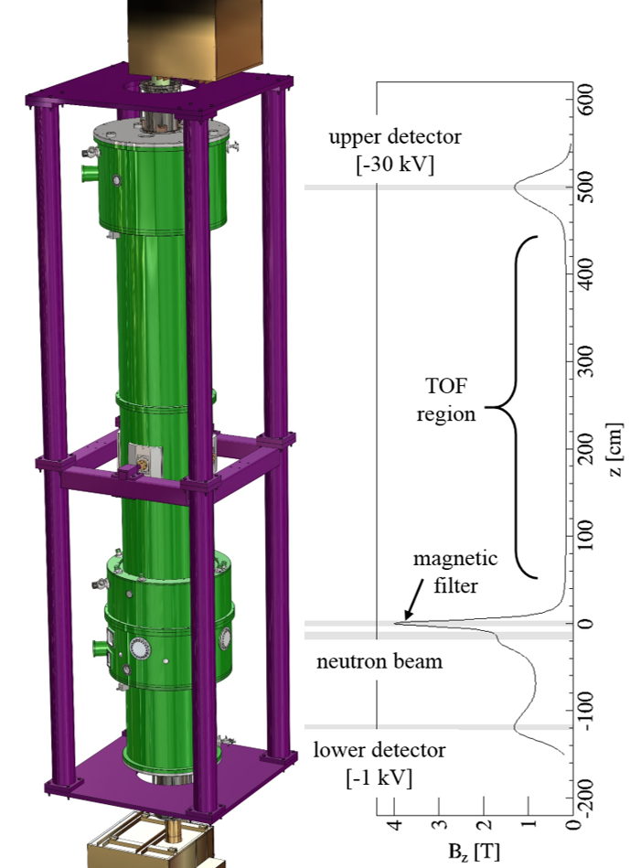
The Nab Experiment and Motivation
Credit: Dr. Leah Broussard
Neutron-a-b
  Beta decay to probe CKM unitarity
  26' ToF spectrometer
  Segmented silicon diode detectors to collect decay products
Motivation
  Calibration of detection electronics
Courtesy of the Nab Collaboration

Slide 4
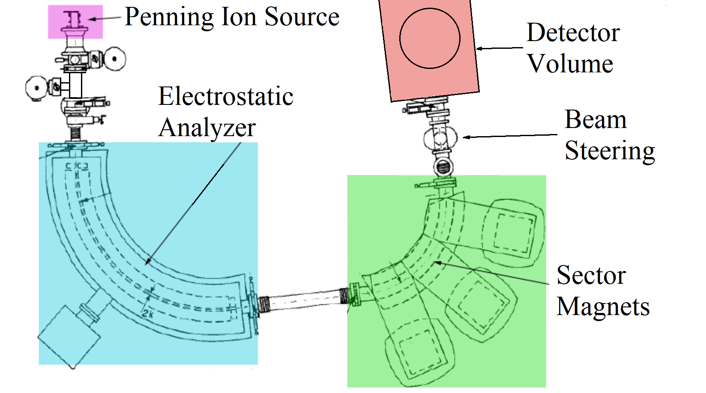
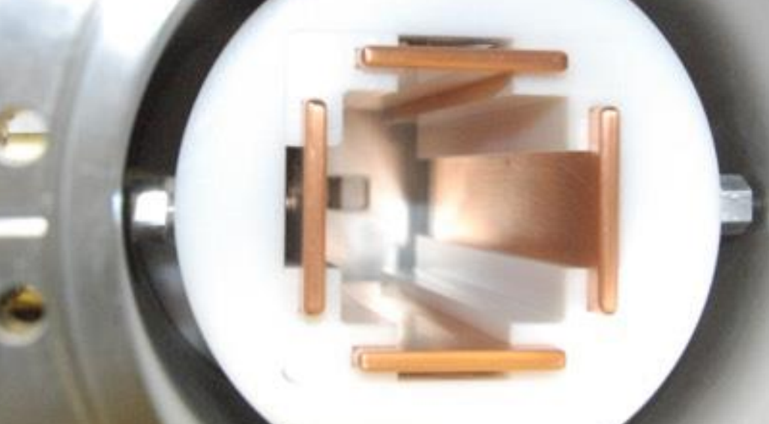
The Manitoba II Proton Source
D. Harrison M.Sc Thesis (2013) modified
Courtesy of R. Mammei

Slide 5
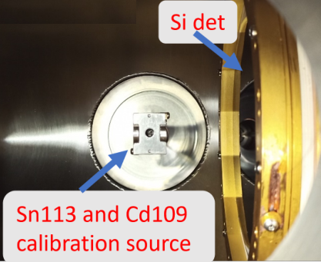
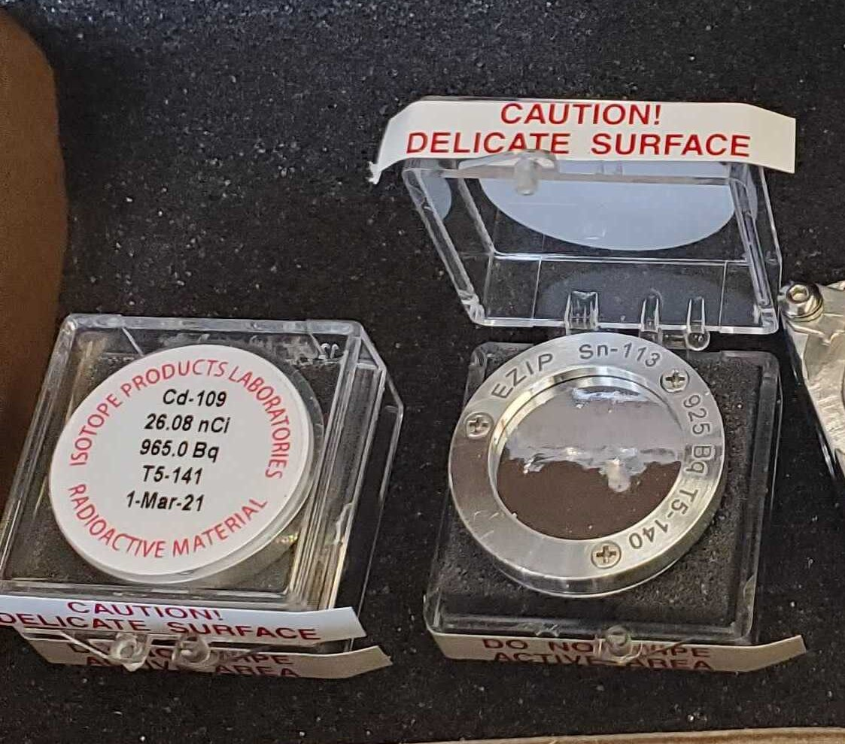
Energy Calibration
  Used 113Sn and 109Cd to calibrate for 30 KeV protons and up to 1Mev electrons

Slide 6
Energy Calibration
Convert between ADC (arb) units to KeV
Using known X-ray and Conversion electron peaks
Corroborate using NIST e-star data to account for losses through mylar foil
Preliminary

Slide 7
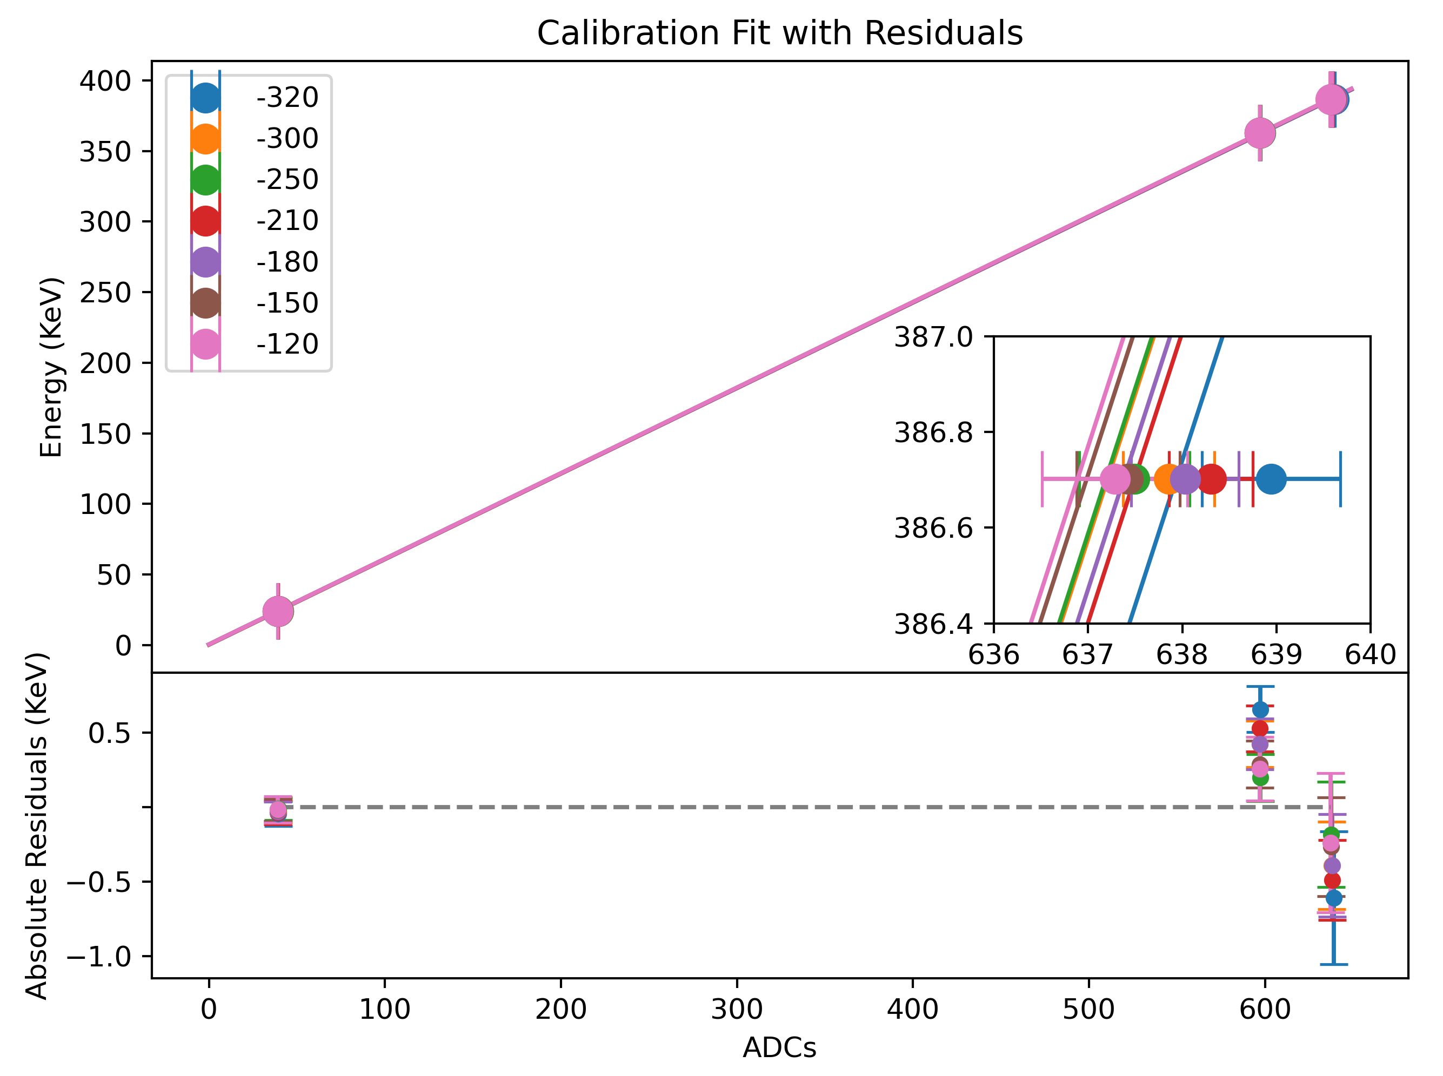
Energy Calibration vs. Detector Bias
Remarkably consistent over a range of 200V
Y-intercept decreases with bias magnitude, slopes remain similar
Further study needed
Preliminary
Approx 0.6KeV/ADC + 0.4KeV

Slide 8
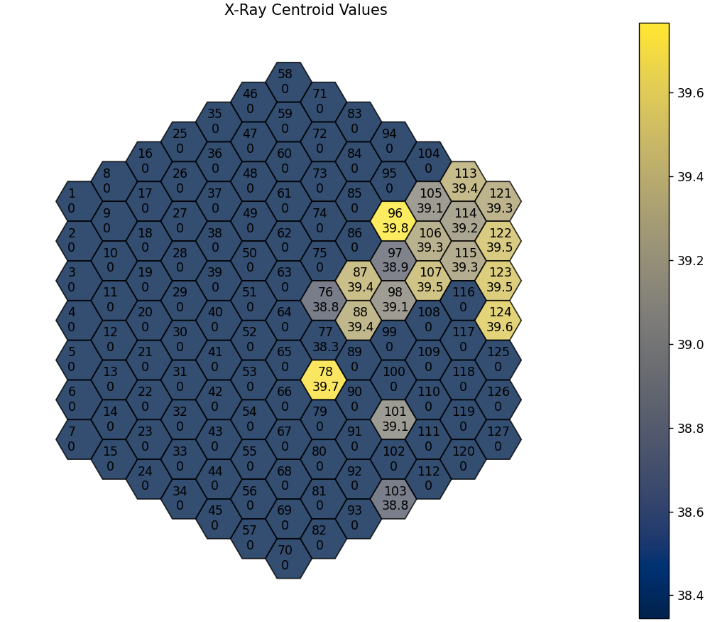
Peak Centroid vs. Detector Pixel
Only powered a subset of pixels
No significant relationship with detector symmetry
May be due to individual gain stages for each pixel
Preliminary

Slide 9
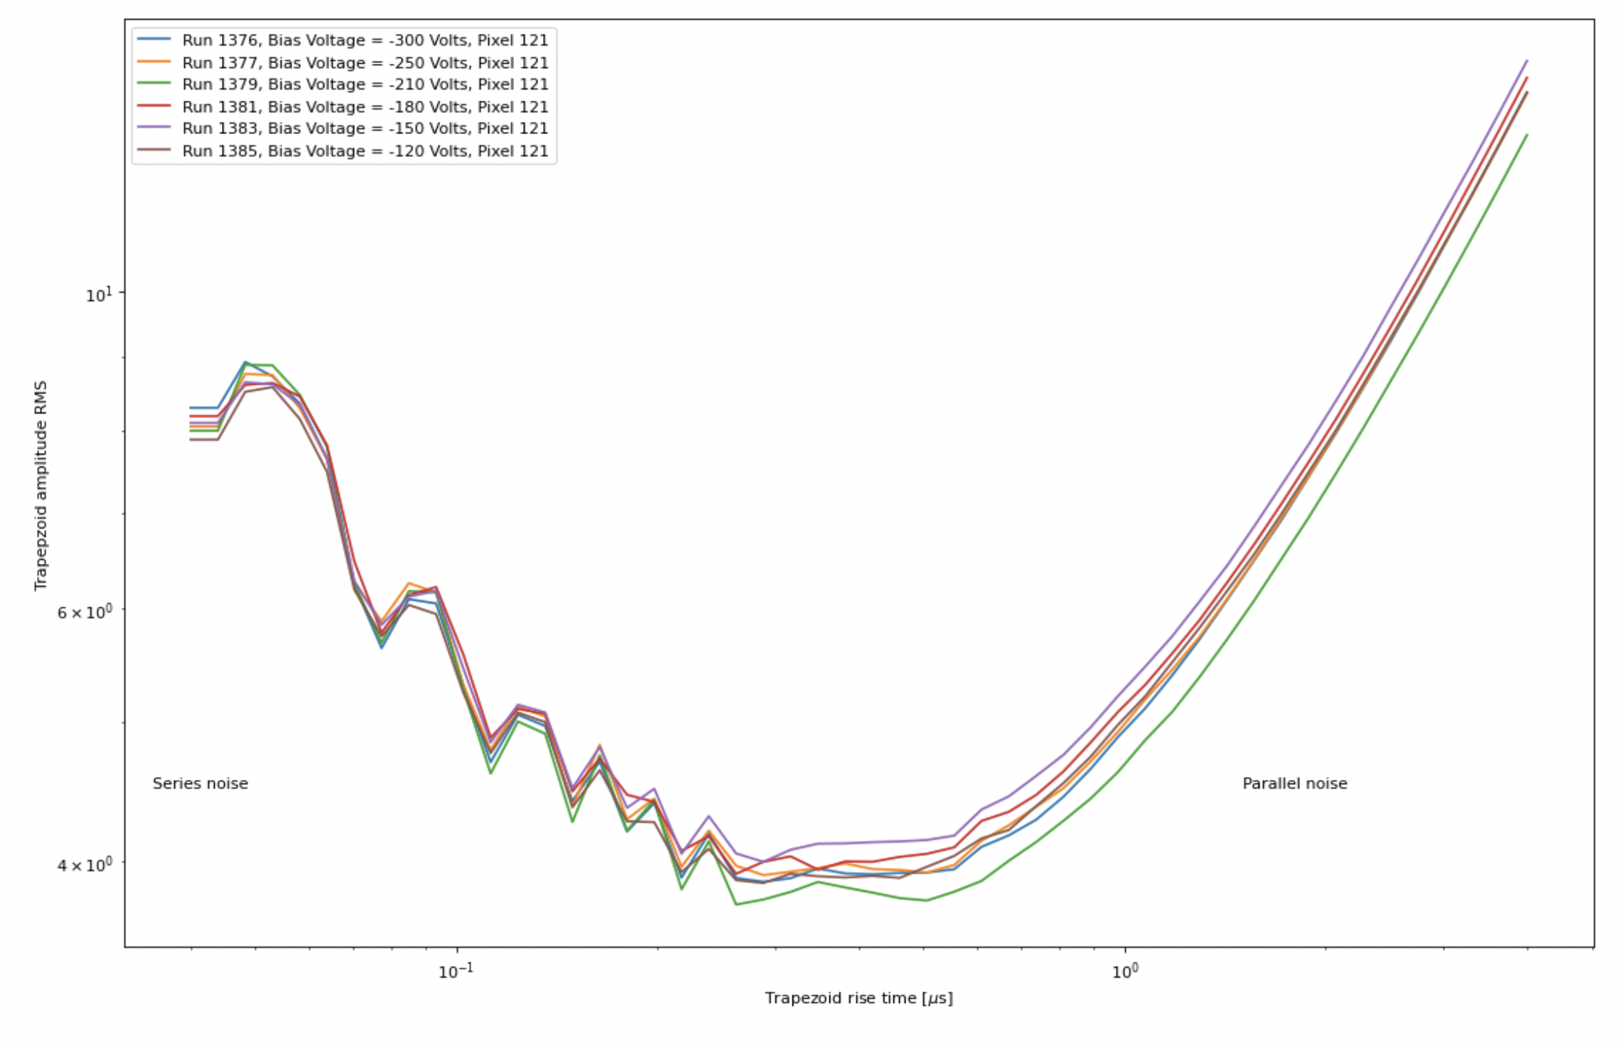
ENC vs Filter Rise Time
Preliminary
Proportional to the FWHM
Used a Pulser to characterize
DAQ uses a double trapezoidal filter to convolve waveforms
Trapezoidal Amplitude RMS
Trapezoidal Filter Rise Time
Credit to Billy Mcray at NCSU for these results

Slide 10
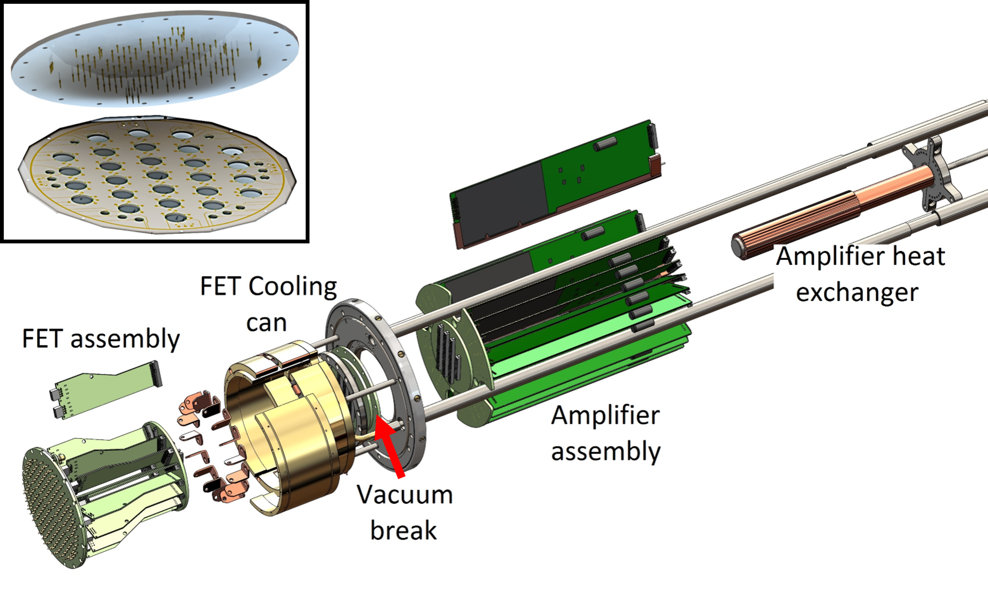
Summary
Characterization with known X-rays and conversion electrons
Calibration is stable with detector bias
Spatial dependance for a given bias voltage is limited
Courtesy of the Nab Collaboration

Slide 11
Concurrent and Future Work
See Session PL: Neutron Physics II: Precision Neutron Decay on Sunday to see further talks on:
  Detector simulations (Leendert Hayen)
  A test stand for the detector systems (Michelle Gervais)
  In-situ calibration (Jin Ha Choi)
  And a few more!
Currently continuing effort to calibrate detectors at ORNL via a custom test stand
Ongoing analysis of the data collected at Manitoba

Slide 12














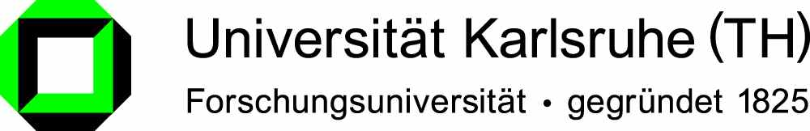


The Nab Collaboration
Main project funding:

Slide 13
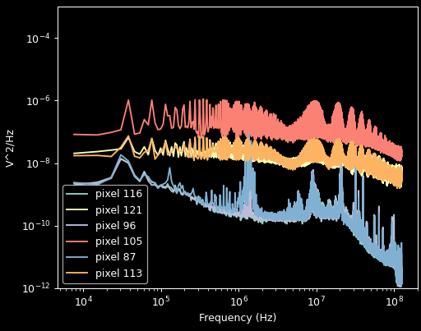
Noise Contributions
Want to reduce typical noise contributions
  Thermal (Johnson) noise
    Temperature and detector bias are coupled
    Use of LN2 to achieve temperatures of 120°K
  Shot noise – FET amplifier

