Slide 1
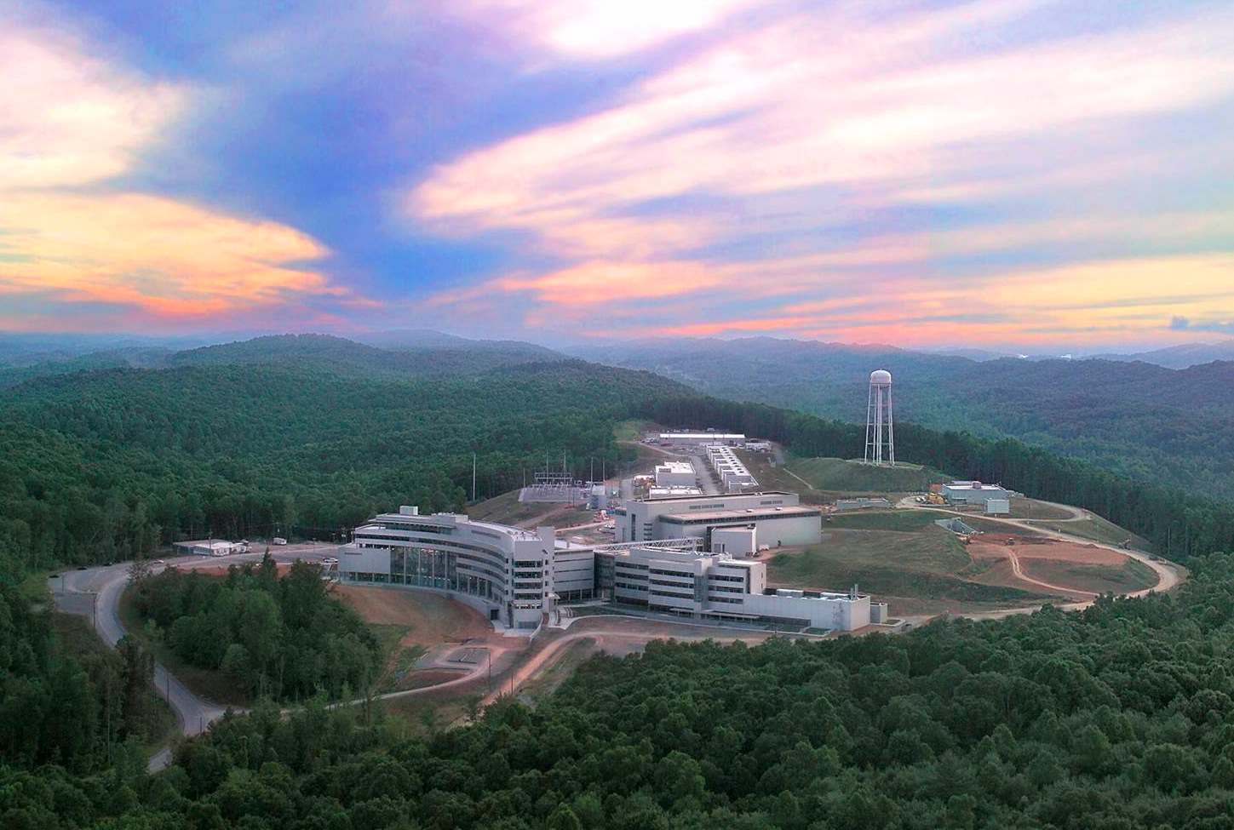
The Nab Experiment
2019-10-17 Christopher Crawford
DNP Fall Meeting, Crystal City, VA University of Kentucky

Slide 2
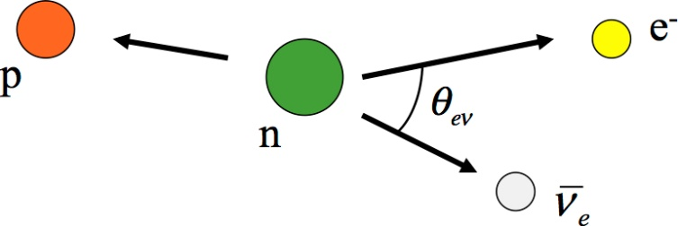
Neutron decay
UCNA Brown (2018)
UCNA (2018)

Slide 3
Notes:
An important feature of the Nab measurement of the electron-neutrino correlation (little ‘a’) is complete enough kinematic coverage to directly measure the angle between the electron and neutrino, which you can access from pe.pn by squaring the conservation of momentum equation. All we need to know are the electron energy which deposits enough energy in the detector to measure, and the proton velocity. We can get the neutrino energy from conservation of momentum. The uncorrelated cross section depends only on the electron energy, so the yield is linear along each vertical line of phase space with a slope of little ‘a’.

Slide 4
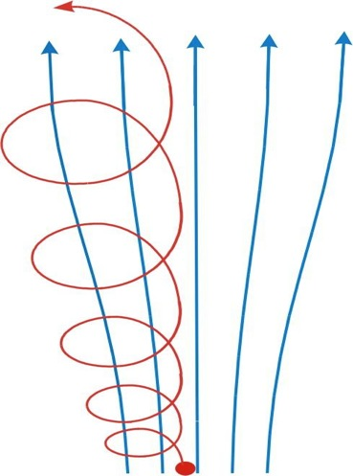
Proton TOF measurement
Magnetic filter and longitudinalization of proton momentum
30 kV
Segmented
Si detector
TOF region
(field r_{B}∙B₀)
Adiabatic conversion
Magnetic Field
magnetic filter
region (field B₀)
Proton Trajectory
decay volume (field r_{B,DV}∙B₀)
5
0 kV
4
Si detector
Neutron
beam
3
B
(on axis)
z
2
Decay
0 kV
1
volume
courtesy S. Baessler
0
2
5
-1
0
1
3
4
z
[m]
Notes:
Because it is so heavy, the proton energy of less than 1 keV is no enough to penetrate the dead layer of the detector. Therefore we have to measure its time-of flight along one arm of the asymmetric large-acceptance magnetic spectrometer. The magnetic field guides both the electron and proton to the two silicon detectors which intersect both ends of all the field lines passing through the decay region. A couple of features are designed to measure the total proton momentum and not just the z-component of its velocity. First there is a magnetic filter to reject protons with large transverse velocity. Protons which make it through the pinch are further lontitudinalized and then accelerated to 30 keV in an electrostatic field just before detection.

Slide 5
Detector response function
TOF vs. p_{p} assuming adiabatic proton spin transport
Edges confirm calibration
Slope of central part used to extract correlation ‘a’
Simulated counts [A.U.]
E_{e} = 300 keV
E_{e} = 500 keV
E_{e} = 700 keV
0
0.002
0.004
0.006
1/t_{p}² [µs⁻²]
courtesy S. Baessler
Notes:
Because of the finite decay region, slightly varying electric and magnetic field profiles, various degrees of longitudinalization, and some nonadiabaticity, there is a detection response function of the proton time-of-flight from its momentum, which must be accounted for. We can fit the edges of proton velocity spectrum at each electron energy to tune our model of this response, and either do a global fit, or restrict ourselves to the linear central region to control systematic errors. Kavish Iman will present a detailed mapping of the magnetic field for Mae Scott to characterize this response function.

Slide 6
Fierz interference term ‘b’
From the shape of the electron energy spectrum
Systematic uncertainties
Electron energy resolution
background
)
5
s
10
t
i
n
u
4
Detector response to decay
electron with E_{e} = 300 keV
.
10
b
r
a
(
3
d
d
10
l
b
= +0.1
l
e
e
i
SM
i
Y
Y
2
10
1
2% of events in tail
(deadlayer,
external bremsstrahlung)
10
1
0
50
100
150
200
250
300
0
2
0
0
4
0
0
6
0
0
8
0
0
detected E_{e} [keV]
E
(
k
e
V
e
)
,
k
i
n
Goal: Δb ~ 3×10⁻³
courtesy S. Baessler
Notes:
The Nab spectrometer was also optimized to measure the Fierz interference term, little ‘b’ by measuring higher proton rates predominantly in the lower detector. In this case we have to resolve a very slight alteration of the electron energy spectrum, and systematic uncertainties involving electron energy calibration and the tail from bremsstrahlung and bouncing in the detector become important. Glenn, Tom Shelton will talk about detector simulations and energy calibrations to control this systematic error. Chris Hays will give a talk on the calibration source insertion system in XX right after this session ends.

Slide 7
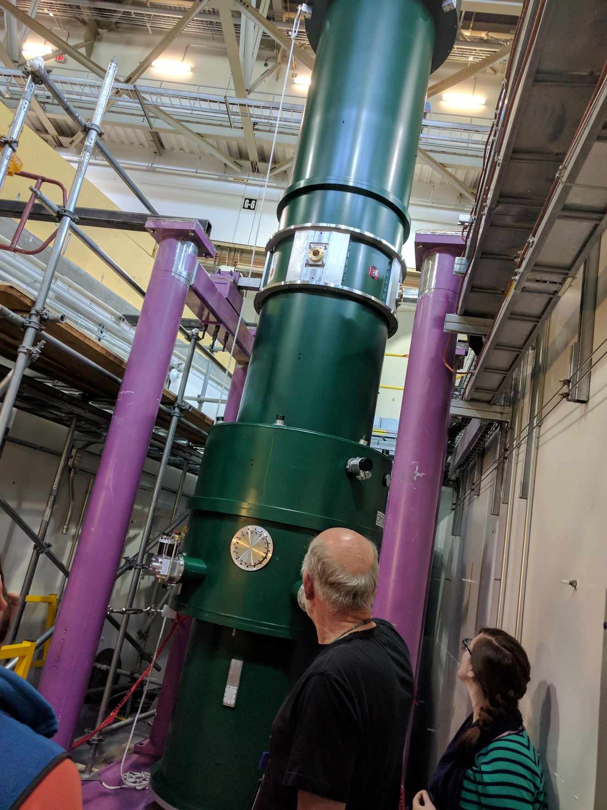
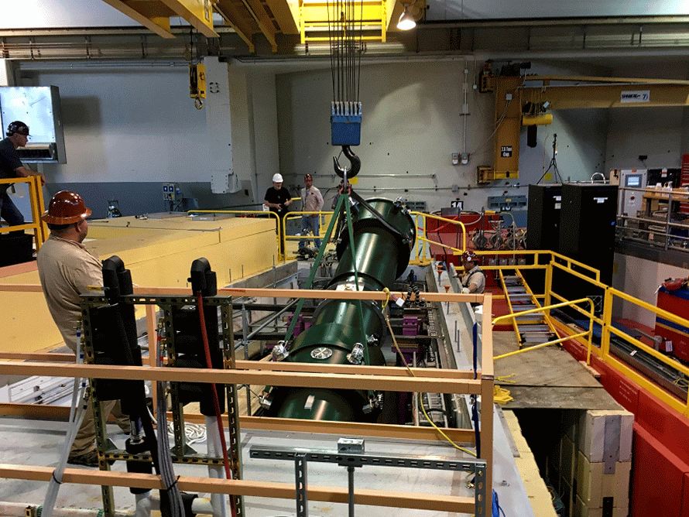
Notes:
Status of the experiment: we received the superconducting magnetic spectrometer last summer?? and it has been installed in the Fundamental Neutron physics beamline at the Spallation Neutron Source at Oak Ridge National Laboratory. The spectrometer is prominently displayed in Mardi Gras colors thanks to Leah Broussard. Chelsea Hendrus is seen here inspecting the newly installed spectrometer, anxious to install her adiabatic neutron spin flipper upstream to control a newly discovered systematic error that arises from correlation of the electron momentum to the polarization of the neutron, the big ‘A’ parameter. XX will present her talk on the unique design of this spin flipper.

Slide 8
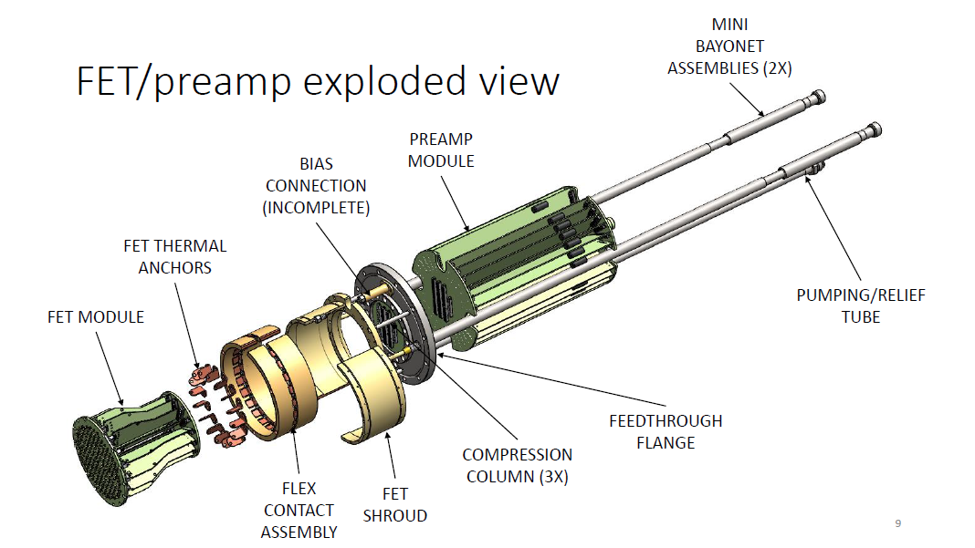
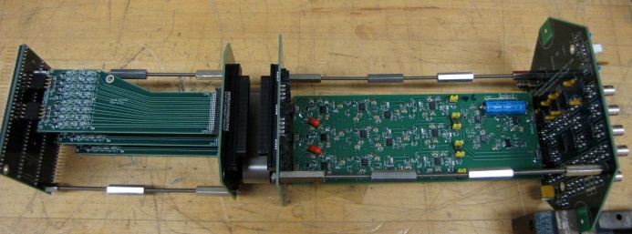
Particle detection
Electronic preamplifier circuit
Notes:
The high voltage electrode which encloses the detector, has also been fabricated and is undergoing testing. It has a special cold chamber for the initial FET and then the preamplifiers out of vacuum. The entire electronics chain including the DAQ system is all housed at -30 kV.

Slide 9
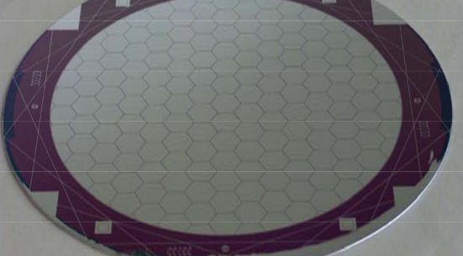
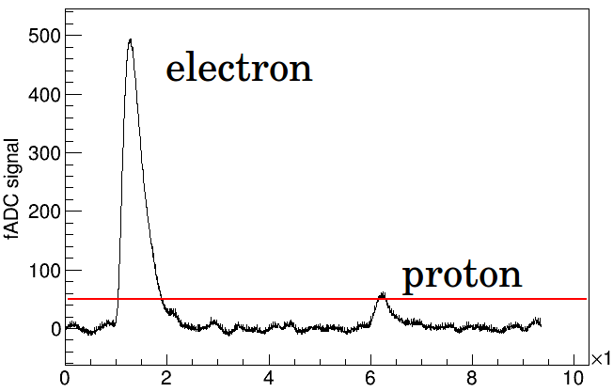
Particle detection
Silicon diode detector
Time (μs)
Notes:
Finally, the electrons and protons are measured in a silicon detector either 1.5 or 2 mm thick in order to capture all of the electron energy. There is a .4% area gold grid etched on the front for fast timing with minimal proton loss. The electronic signals are preamplified and digitized as

Slide 10
Uncertainty Budget
PLANNED statistical uncertainty budget:
PLANNED systematic uncertainty budget:
Experimental parameter | Systematic uncertainty Δa/a
Magnetic field
... curvature at pinch | 5·10⁻⁴
… ratio r_{B} = B_{TOF}/B₀ | 2.5·10⁻⁴
… ratio r_{B,DV} = B_{DV}/B₀ | 3·10⁻⁴
Length of the TOF region | (*)
Electrical potential inhomogeneity:
… in decay volume / filter region | 5·10⁻⁴
… in TOF region | 1·10⁻⁴
Neutron Beam:
… position | 4·10⁻⁴
… profile (including edge effect) | 2.5·10⁻⁴
… Doppler effect | small
Unwanted beam polarization | can be made small
Adiabaticity of proton motion | 1·10⁻⁴
Detector effects:
… Electron energy calibration | (*)
… Electron energy resolution | 5·10⁻⁴
… Proton trigger efficiency | 2.5·10⁻⁴
Residual gas | small
Background | small
Accidental coincidences | small
Sum | 1·10⁻³
lower E_{e} cutoff | none | 100 keV | 100 keV | 300 keV
upper t_{p} cutoff | none | none | 40 μs | 40 μs
Δ_{a} | 2.4/√N | 2.5/√N | 2.5/√N | 2.6/√N
Δ_{a} (E_{cal}, l variable) | 2.5/√N | 2.6/√N | 2.7/√N | 2.7/√N
Δ_{a} (E_{cal}, l variable, inner 70% of data) | 4.1/√N | 4.1/√N | 4.1/√N | 4.1/√N
About 2×10⁹ events can be detected in 6 weeks (Decay volume V = 246 cm³, decay density n_{d} = 20 cm⁻³, 12.7 % of decay protons go to upper detector, 80% duty factor)
→ (Δa/a)_{stat} < 1×10⁻³ can be reached
Compare to Δa/a = 5 % of existing experimental results

Slide 11
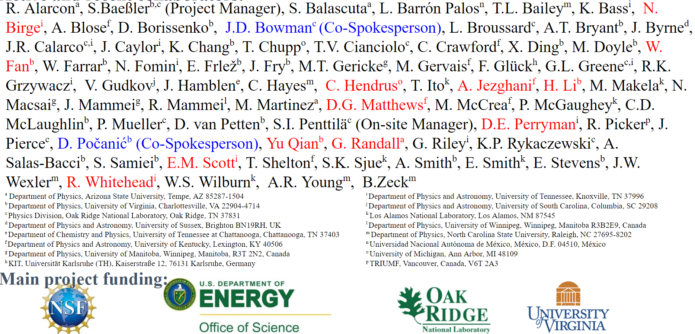
Nab Collaboration

Slide 12
Nab talks in this session
10:42 Mae Scott Magnetometry of the Nab (Grant Riley) Spectrometer
10:54 Chelsea Hendrus Towards Polarimetry for (Kavish Iman) the Nab Experiment
11:06 Glenn Randall Nab Detector Timing Studies
11:18 Tom Shelton Simulating Inside Detector Physics for the Nab Experiment
11:30 David Perryman Pile-up Detection in Silicon Detector Signals via Machine Learning
11:42 David Mathews GPU Based Nearline Analysis for the Nab Experiment
SB 12:18 Chris Hayes Radioactive Source Insertion System for the Nab Experiment

