Slide 1



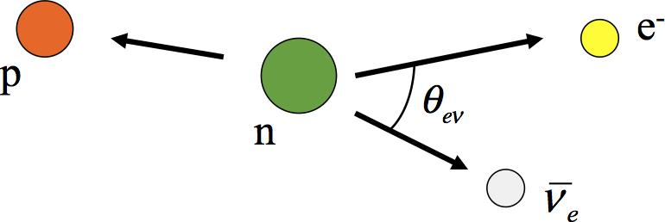
Performance of the Data Acquisition System for the Nab Experiment
Austin Nelsen - University of Kentucky, Oak Ridge National Laboratory
ACNS 2024, 06/26/24 - Fundamental Neutron Physics

Slide 2
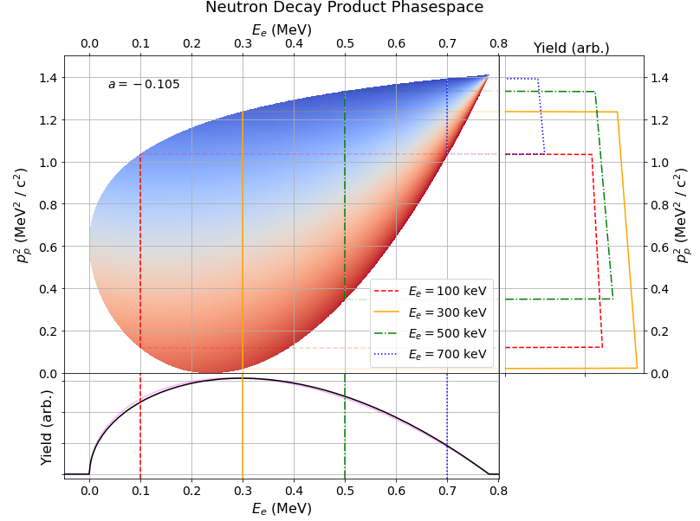
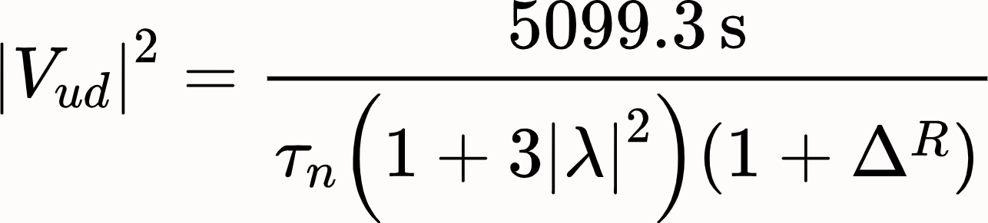
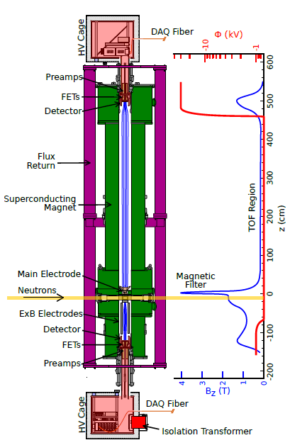
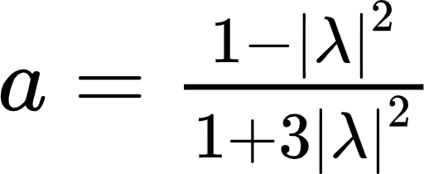
Nab: Using Cold Neutron Decay to Probe CKM Unitarity
Courtesy of Frank Gonzalez.
CKM Unitarity:
Nab’s goal: 𝛥a/a ~ 10⁻³
𝛥b ~ 3×10⁻³ b = 0
Two pixelated silicon detectors will enable measurements:
Electron energy
Proton time-of-flight
Fast data acquisition processes and records events
a is the slope
Shape of e⁻ spectrum gives b
Austin Nelsen
Courtesy of Aaron Jezghani.
Notes:
The Nab experiment will measure both the electron-neutrino momentum correlation coefficient to a precision of 10^(-3) and the Fierz interference term to precision 3 x 10^(-3) via neutron beta decay. This is achieved by measuring both the energy spectrum of produced electrons and the time of flight of produced protons. Of course, these measurements can be used to further resolve the value of V_ud in the CKM matrix and serve as a direct measurement of beyond-the-standard model physics.

Slide 3
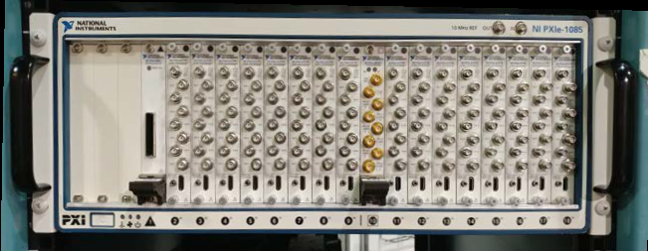
Overview
System Requirements
Data Collection
Timing Synchronization
Commissioning & Performance
Upgrades & Outlook
Austin Nelsen

Slide 4
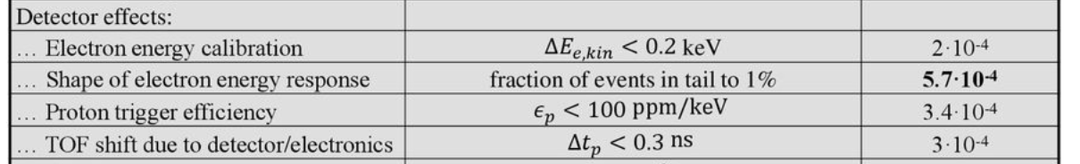
Requirements for the DAQ System
Needed for the experiment:
3 keV energy resolution
Sub 10 ns timing resolution
Multi-pixel logic and readout
Low threshold stability
Very stable timing offset between upper and lower detectors
What this means for the DAQ:
Fast sampling, high resolution ADC
  250 MS/sec + 14 bit ADC
Very stable timing synchronization
  Two chassis offset stable to < 300 ps
Raw trace readout
High throughput hardware and efficient software
256 individual channels!
Operate in -30 kV environment
Proton detection!
Austin Nelsen

Slide 5

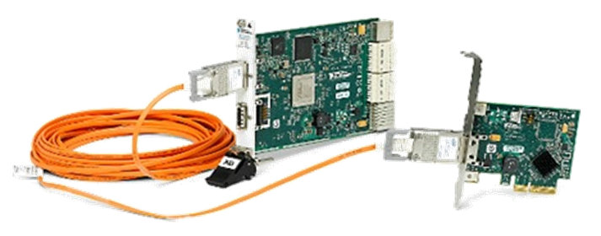
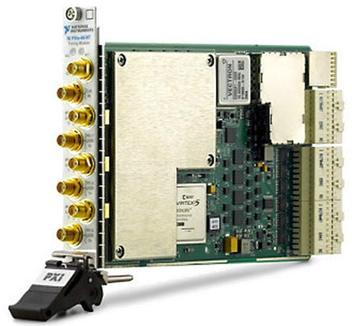
Requirements for the DAQ System
High Precision → High Data Rate
FPGA Programmable Logic
High Voltage → No Copper Cables
Fiber Optic Communication
Timing Bias → Stable Synchronization (across 2 chassis)
Custom Synchronization Routine
Austin Nelsen

Slide 6
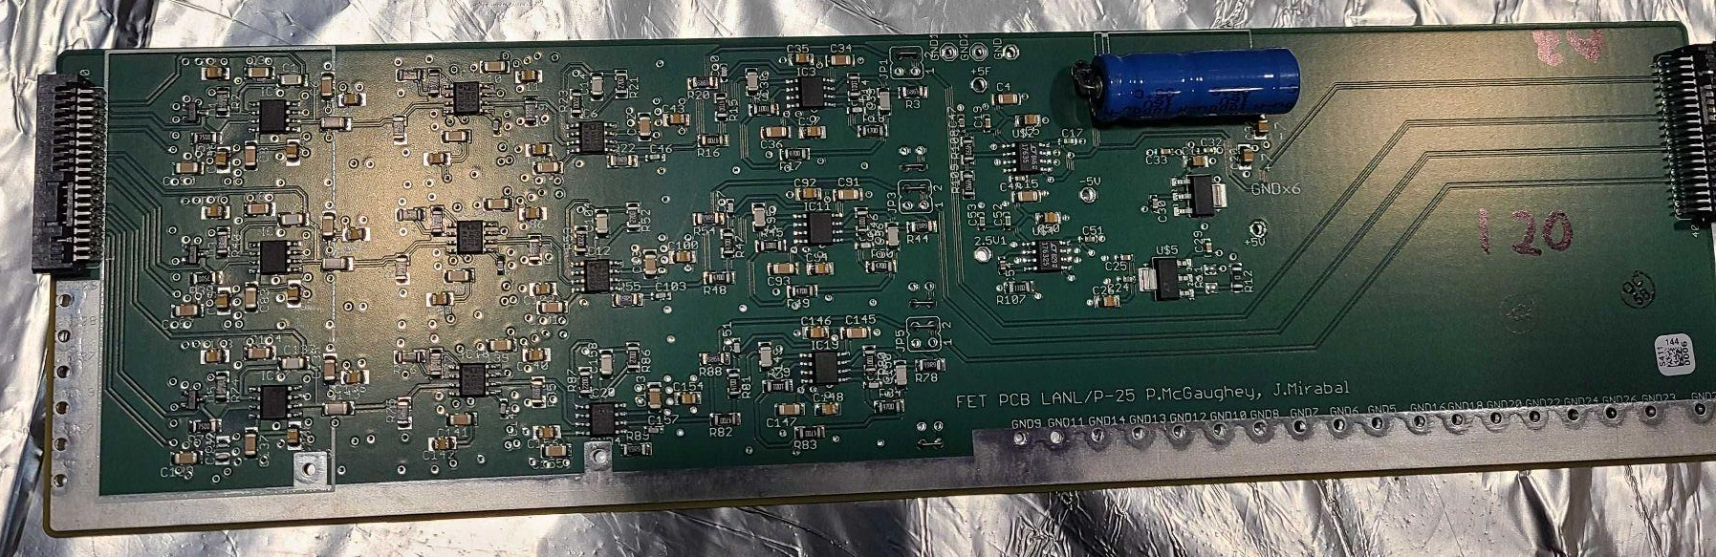
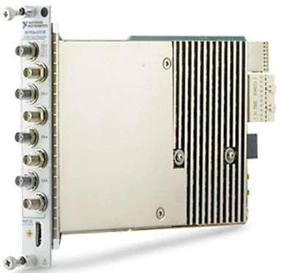
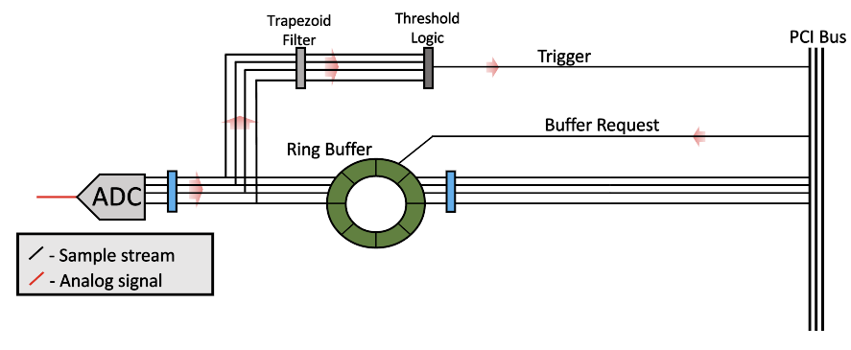
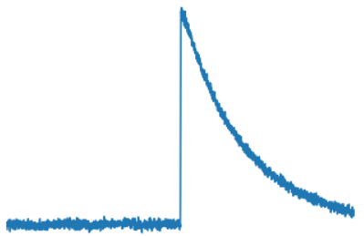
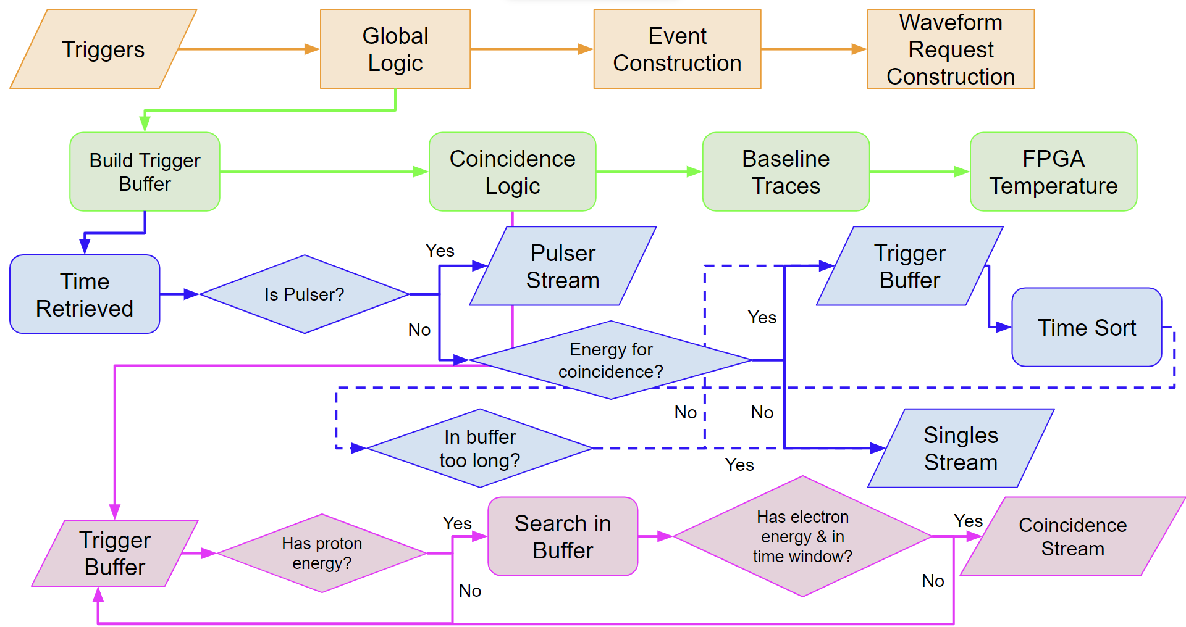
Data Collection: High Level
Raw signals received by ADCs
Copy of sample made*
Filter output goes to logic
Host pulls triggers from FIFO
“L1 Triggers” put into FIFO
Other goes to filter
250 Mega Samples
14-bit digitizer
Triggers used to identify events
Events inform waveform requests
Requests made to ring buffer
One goes to ring buffer
Austin Nelsen
Notes:
*Caveat: the “sample” is actually the average of two samples on account of the DAQ’s clock being half that of the ADC clocks.

Slide 7
Data Collection: Trigger Logic (FPGA)
Double Trapezoid Filter:
Back-to-back single trapezoid filters
  Better noise cancelation
  More accurate timing extraction
Zero-Cross Logic:
Is it an appropriate signal above threshold?
If yes, extract the energy and t₀
Send To Trigger FIFO:
Tuple of t₀, energy, and FPGA#+channel
Forms the L1 trigger datastream
Pulled by the host PC
Energy
t₀
Austin Nelsen

Slide 8
Data Collection: Global Logic (PC)
Organize L1 Triggers
Identify Coincidence Events
Austin Nelsen

Slide 9
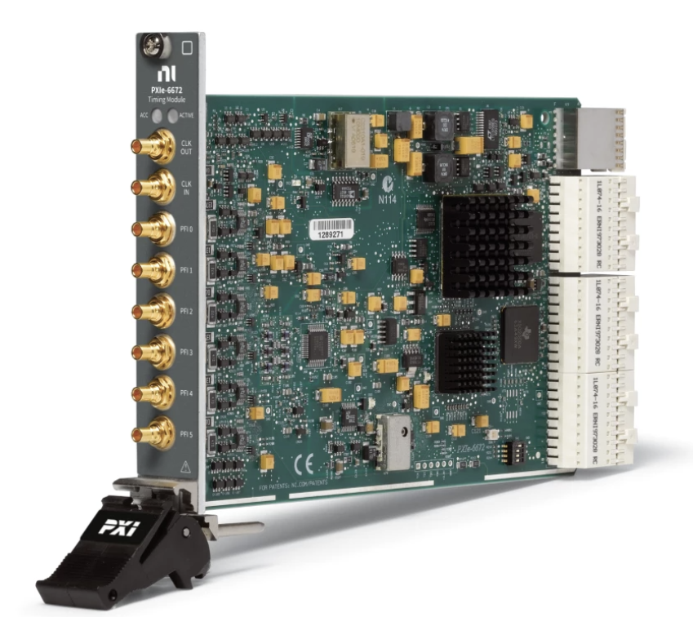
Timing Synchronization
Synchronization Process (Hardware):
6674T (primary) generates highly stable 10 MHz clock
  Onboard oven-controlled crystal oscillator
  Routes clock and triggers in primary chassis and sends it to the secondary
6672 (secondary) collects clock input from primary
  Routes clock triggers and triggers in secondary chassis
NI custom + proprietary software
  Ensures very precise phase locking
Austin Nelsen

Slide 10
Performance
Data Collection:
System-wide: Can handle > 70 thousand triggers per second
Coincidence Logic: Now up to ~30 million triggers per second stable operation
Trigger Interpretation: ~99% of triggers get associated with an event (as of last summer)
Waveform Readout: Up to 700 MB/s of waveform readout (stable)
Timing Synchronization:
Two Chassis Timing Offset: Jitter understood to sub 100 ps level
Austin Nelsen

Slide 11
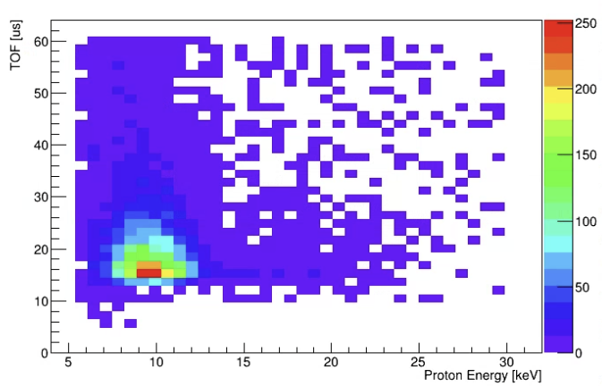
Performance
Nab DAQ Preliminary
Courtesy of Himal Acharya.
First commissioning data!
> 16 million coincidences
  ~ 150 coincidences / second
~ > 99% coincidence detection efficiency
Example proton time-of-flight spectrum
TOF [𝜇s]
0 10 20 30 40 50 60
17 33 50 66 83 100
Proton Energy [ADC]
Austin Nelsen

Slide 12
Recent and Planned Upgrades
Data Collection:
Timing audit - sped up slow areas (PC)
Robust data rate safety checks
Long term:
  Implement ring buffer reorganization
  Loosen coincidence event requirements
  Introduce trigger counting number
Quality of Life:
Run-log and real-time status on Nab slow controls
Revamped data pipeline handling
Stay-tuned for a Nab DAQ paper!
Austin Nelsen

Slide 13















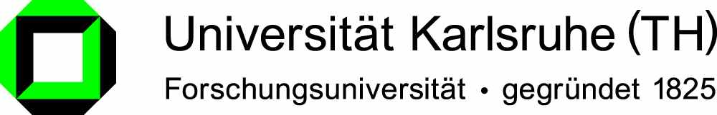


The Nab Collaboration
Main project funding:

Slide 14
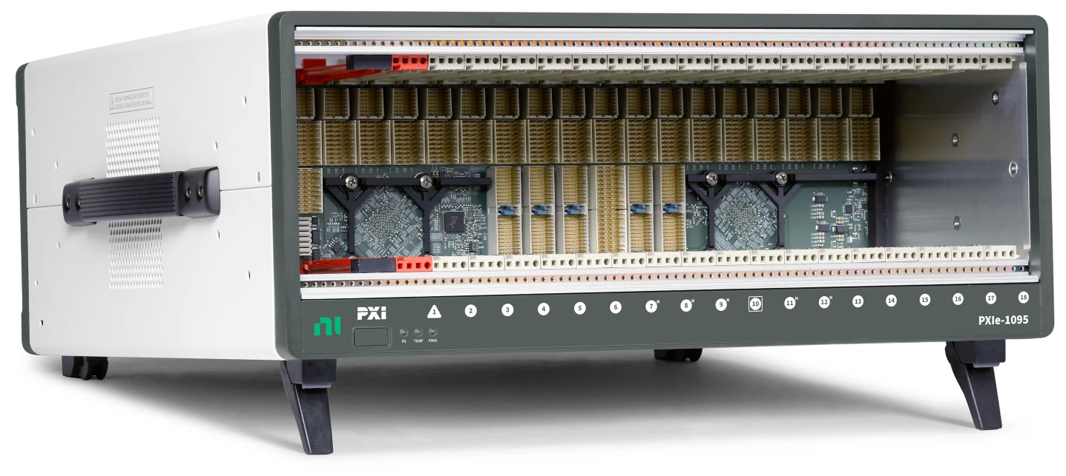
DAQ Hardware Configuration
Slide concept courtesy of Himal Acharya.
PXIe-6674T (primary)
Chassis: NI PXIe-1085/1095
PCIe MXI-Express
PXIe-6672 (secondary)
PXIe-5171R (ADC + FPGA)
Austin Nelsen

Slide 15
“Zero Cross” Logic: Visualized
Energy
Larger than threshold again?
If all three criteria met, trigger rearms!
t₀
Filter finished
In threshold band
Waited one dead time
Trigger Threshold
Filter Output Stream
Zero Cross
Threshold Cross
One filter length
One dead time
Austin Nelsen

Slide 16
Data Collection: Global Logic (PC)
Austin Nelsen

Slide 17
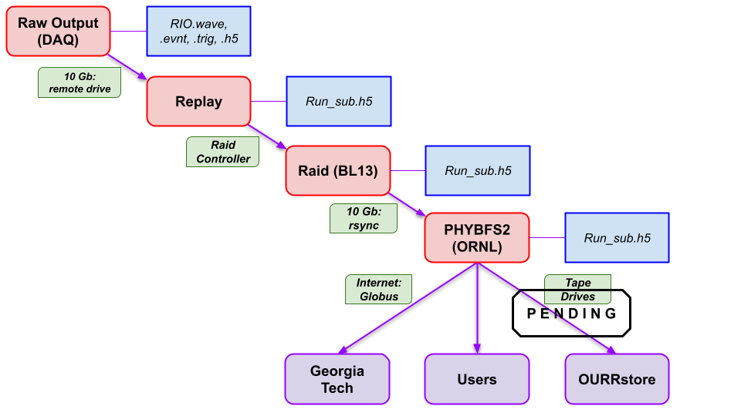
Nab Data Pipeline
Austin Nelsen

Slide 18
Data Collection: High Level (without clutter)
Raw signals received by ADCs
Copy of sample made*
Filter output goes to logic
Host pulls triggers from FIFO
“L1 Triggers” put into FIFO
Triggers used to identify events
Events inform waveform requests
Requests made to ring buffer
Austin Nelsen
Notes:
*Caveat: the “sample” is actually the average of two samples on account of the DAQ’s clock being half that of the ADC clocks.

Slide 19
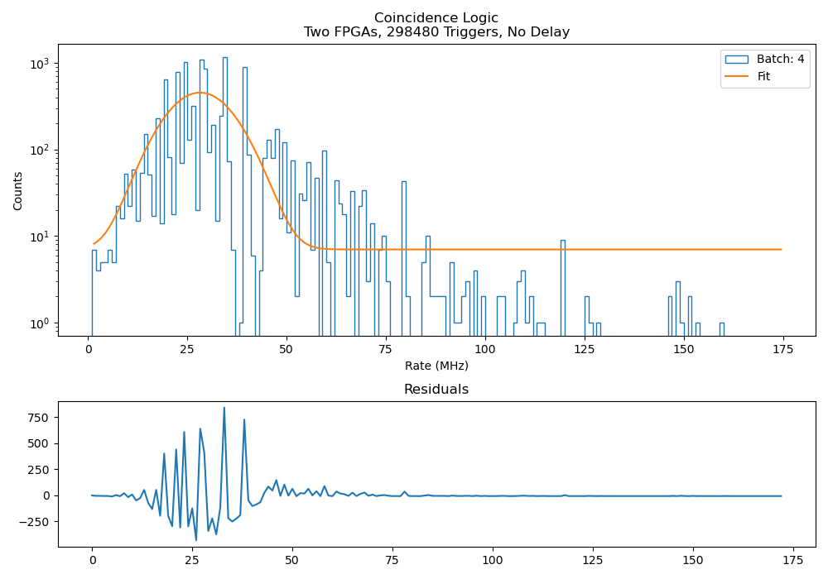
Rough Coincidence Timing Extraction
Proxy for rate at which triggers are pulled from FIFO
Two separate while loops
Austin Nelsen

