Slide 1
Commissioning The Nab Experiment
Frank Gonzalez
APS DNP New Orleans
October 28, 2022

Slide 2
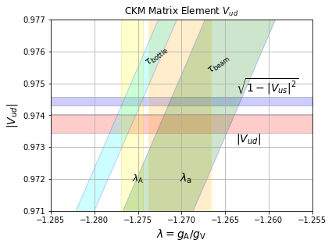
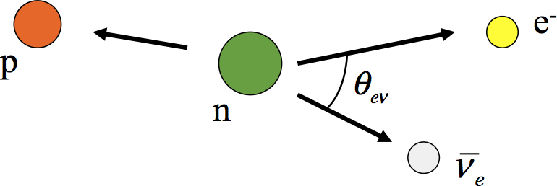
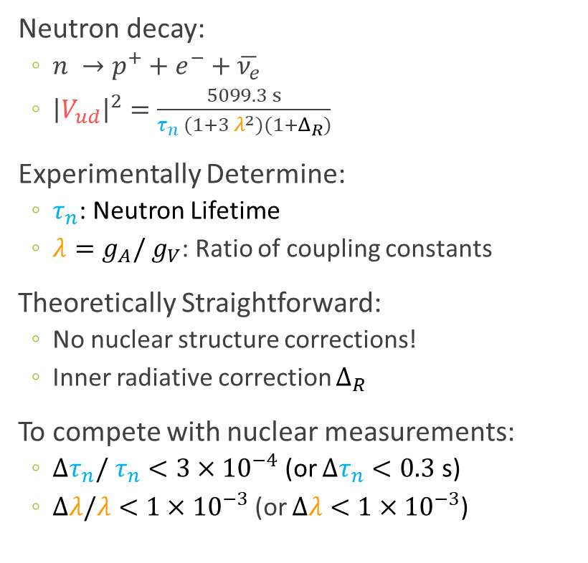
Beta-Decay: Why Use Neutrons?
Neutron decay:
  $n →p^{+}+e^{−}+\overline{ν_{e}}$
  ${\left|V_{ud}\right|}^{2}=\frac{5099.3 s}{τ_{n} (1+3 λ^{2})(1+Δ_{R})}$
Experimentally Determine:
  $τ_{n}$: Neutron Lifetime
  $λ=g_{A}/ g_{V}$: Ratio of coupling constants
Theoretically Straightforward:
  No nuclear structure corrections!
  Inner radiative correction $Δ_{R}$
To compete with nuclear measurements:
  $Δτ_{n}/ τ_{n}<3×{10}^{−4}$ (or $Δτ_{n}<0.3$ s)
  $Δλ/λ<1×{10}^{−3}$ (or $Δλ<1×{10}^{−3}$)
Data from:
Workman, R. L. et al, Particle Data Group (2022)

Slide 3
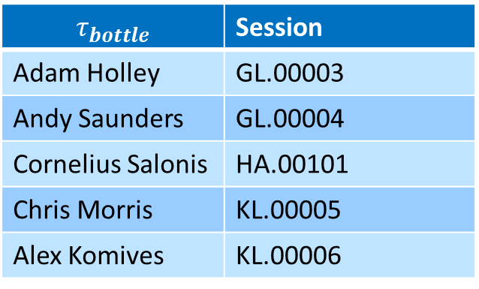

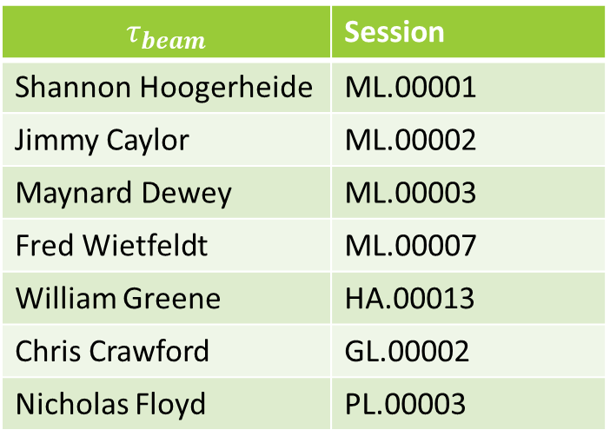
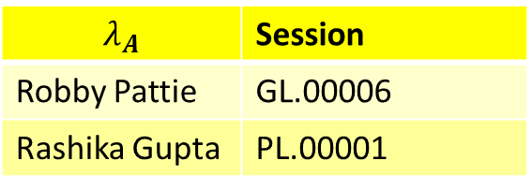
Beta-Decay: Why Use Neutrons?
$$λ_{A}$$ | Session
Robby Pattie | GL.00006
Rashika Gupta | PL.00001
$$τ_{bottle}$$ | Session
Adam Holley | GL.00003
Andy Saunders | GL.00004
Cornelius Salonis | HA.00101
Chris Morris | KL.00005
Alex Komives | KL.00006
Neutron decay:
  $n →p^{+}+e^{−}+\overline{ν_{e}}$
  ${\left|V_{ud}\right|}^{2}=\frac{5099.3 s}{τ_{n} (1+3 λ^{2})(1+Δ_{R})}$
Experimentally Determine:
  $τ_{n}$: Neutron Lifetime
  $λ=g_{A}/ g_{V}$: Ratio of coupling constants
Theoretically Easier:
  No nuclear structure corrections!
  Inner radiative correction $Δ_{R}$
To compete with $0^{+}→0^{+}$ measurements:
  $Δτ_{n}/ τ_{n}<3×{10}^{−4}$ (or $Δτ_{n}<0.3$ s)
  $Δλ/λ<1×{10}^{−3}$ (or $Δλ<1×{10}^{−3}$)
$$τ_{beam}$$ | Session
Shannon Hoogerheide | ML.00001
Jimmy Caylor | ML.00002
Maynard Dewey | ML.00003
Fred Wietfeldt | ML.00007
William Greene | HA.00013
Chris Crawford | GL.00002
Nicholas Floyd | PL.00003
Data from:
Workman, R. L. et al, Particle Data Group (2022)

Slide 4
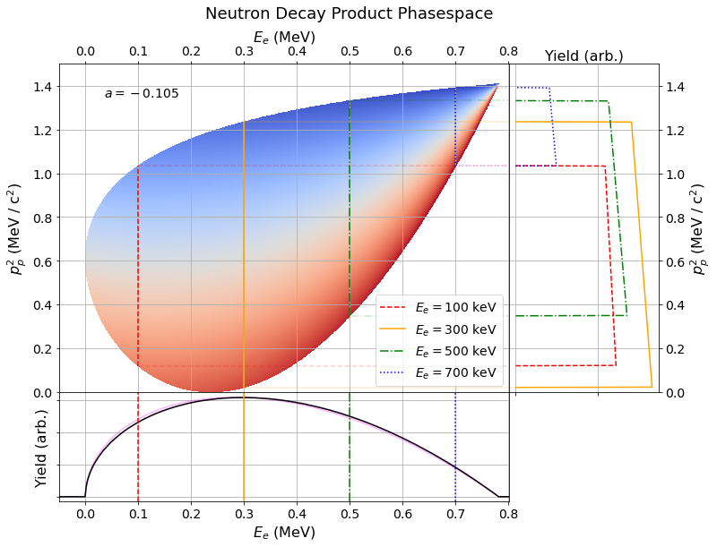
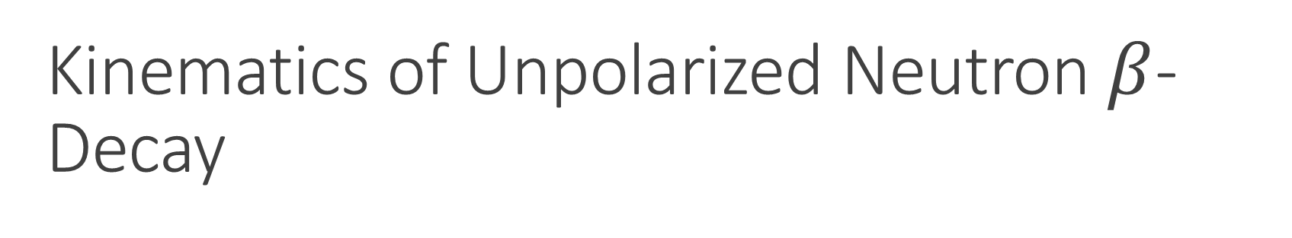
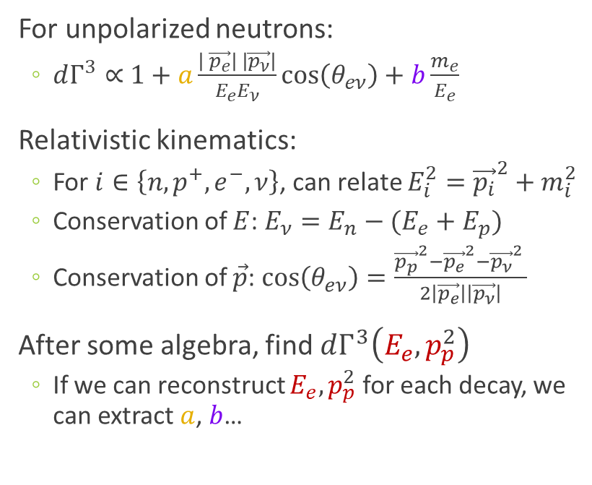
Kinematics of Unpolarized Neutron $β$-Decay
For unpolarized neutrons:
  $dΓ^{3}∝$ $1+a\frac{\left| \vec{p_{e}}\right| \left|\vec{p_{ν}}\right|}{E_{e}E_{ν}}cos\left(θ_{eν}\right)+b\frac{m_{e}}{E_{e}}$
Relativistic kinematics:
  For $i∈\left\{n, p^{+},e^{−},ν\right\}$, can relate $E_{i}^{2}={\vec{p_{i}}}^{2}+m_{i}^{2}$
  Conservation of $E$: $E_{ν}=E_{n}−(E_{e}+E_{p})$
  Conservation of $\vec{p}$: $cos\left(θ_{eν}\right)=\frac{{\vec{p_{p}}}^{2}−{\vec{p_{e}}}^{2}−{\vec{p_{ν}}}^{2} }{2\left|\vec{p_{e}}\right|\left|\vec{p_{ν}}\right|}$
After some algebra, find $dΓ^{3}\left(E_{e}, p_{p}^{2}\right)$
  If we can reconstruct $E_{e}, p_{p}^{2}$ for each decay, we can extract $a$, $b$…

Slide 5

Kinematics of Unpolarized Neutron $β$-Decay
For unpolarized neutrons:
  $dΓ^{3}∝$ $1+a\frac{\left| \vec{p_{e}}\right| \left|\vec{p_{ν}}\right|}{E_{e}E_{ν}}cos\left(θ_{eν}\right)+b\frac{m_{e}}{E_{e}}$
Relativistic kinematics:
  For $i∈\left\{n, p^{+},e^{−},ν\right\}$, can relate $E_{i}^{2}={\vec{p_{i}}}^{2}+m_{i}^{2}$
  Conservation of $E$: $E_{ν}=E_{n}−(E_{e}+E_{p})$
  Conservation of $\vec{p}$: $cos\left(θ_{eν}\right)=\frac{{\vec{p_{p}}}^{2}−{\vec{p_{e}}}^{2}−{\vec{p_{ν}}}^{2} }{2\left|\vec{p_{e}}\right|\left|\vec{p_{ν}}\right|}$
After some algebra, find $dΓ^{3}\left(E_{e}, p_{p}^{2}\right)$
  If we can reconstruct $E_{e}, p_{p}^{2}$ for each decay, we can extract $a$, $b$…
Slopes of trapeziums give $a$

Slide 6
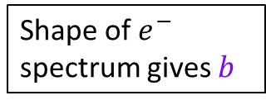
Kinematics of Unpolarized Neutron $β$-Decay
For unpolarized neutrons:
  $dΓ^{3}∝$ $1+a\frac{\left| \vec{p_{e}}\right| \left|\vec{p_{ν}}\right|}{E_{e}E_{ν}}cos\left(θ_{eν}\right)+b\frac{m_{e}}{E_{e}}$
Relativistic kinematics:
  For $i∈\left\{n, p^{+},e^{−},ν\right\}$, can relate $E_{i}^{2}={\vec{p_{i}}}^{2}+m_{i}^{2}$
  Conservation of $E$: $E_{ν}=E_{n}−(E_{e}+E_{p})$
  Conservation of $\vec{p}$: $cos\left(θ_{eν}\right)=\frac{{\vec{p_{p}}}^{2}−{\vec{p_{e}}}^{2}−{\vec{p_{ν}}}^{2} }{2\left|\vec{p_{e}}\right|\left|\vec{p_{ν}}\right|}$
After some algebra, find $dΓ^{3}\left(E_{e}, p_{p}^{2}\right)$
  If we can reconstruct $E_{e}, p_{p}^{2}$ for each decay, we can extract $a$, $b$…
Slopes of trapeziums give $a$
Shape of $e^{−}$ spectrum gives $b$

Slide 7
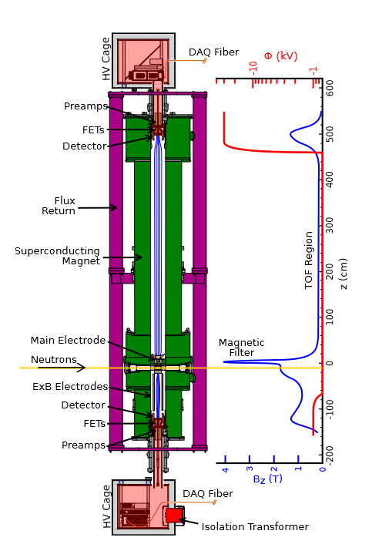


Reconstructing $β$-Decay Product Kinematics
Use an asymmetric (7m high) spectrometer
  Beam of unpolarized cold spallation neutrons
  Expect $1600$ decays/s
Schematic by A. Jezghani, UKY

Slide 8

Reconstructing $β$-Decay Product Kinematics
- 30 kV
Use an asymmetric (7m high) spectrometer
  Beam of unpolarized cold spallation neutrons
  Expect $1600$ decays/s
Magnetic fields guide decay products
  High-field decay filter region
  Low-field time of flight region longitudinalizes momentum
TOF region
(low field)
4 m flight path skipped
magnetic filter
region (field maximum)
0 kV
decay volume
1 m flight path skipped
0-1 kV
Credit S. Baessler, UVA
Schematic by A. Jezghani, UKY
Notes:
Long TOF region improves proton TOF resolution

Slide 9
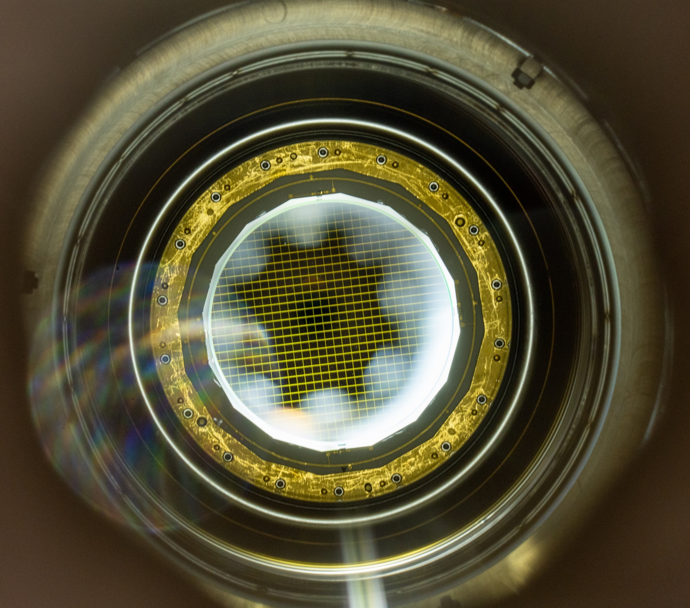
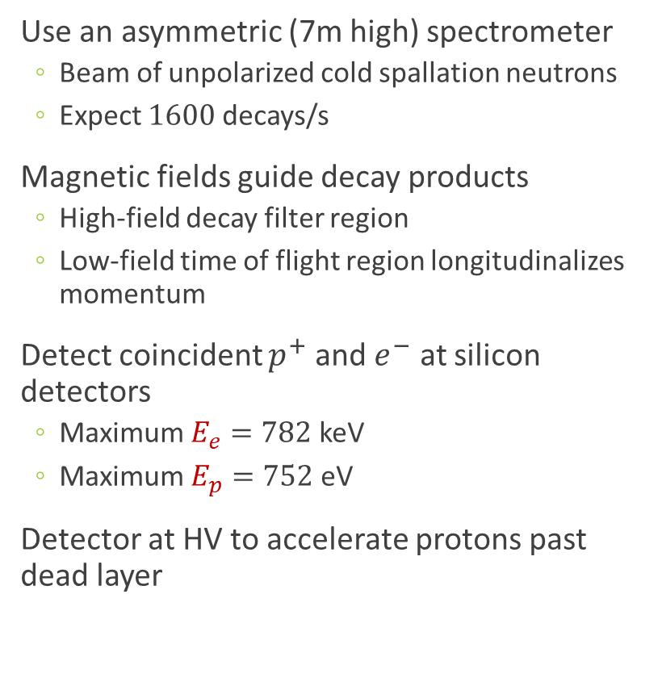
Reconstructing $β$-Decay Product Kinematics
Use an asymmetric (7m high) spectrometer
  Beam of unpolarized cold spallation neutrons
  Expect $1600$ decays/s
Magnetic fields guide decay products
  High-field decay filter region
  Low-field time of flight region longitudinalizes momentum
Detect coincident $p^{+}$ and $e^{−}$ at silicon detectors
  Maximum $E_{e}=782$ keV
  Maximum $E_{p}=752$ eV
Detector at HV to accelerate protons past dead layer
D. Mathews, UKY
Schematic by A. Jezghani, UKY
Notes:
Two detector geometry allows to suppress electron backscattering

Slide 10
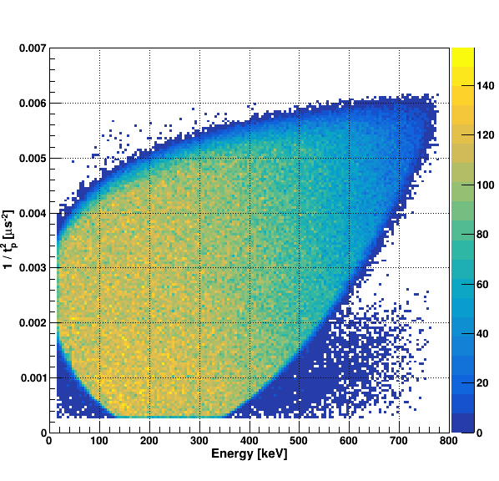
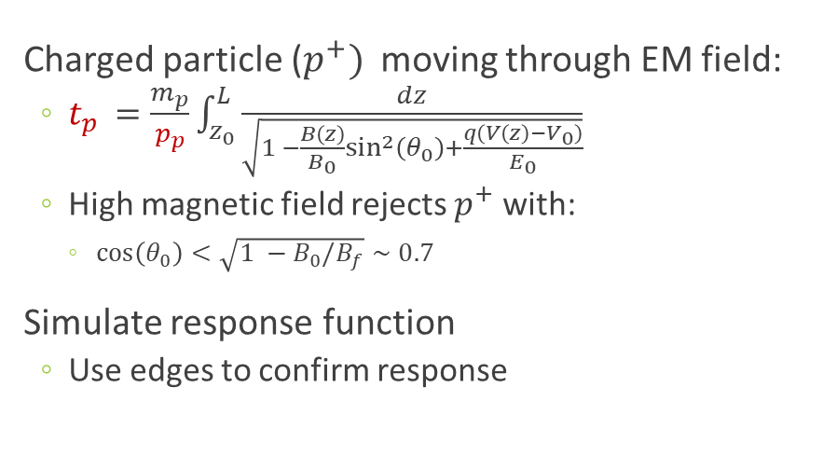

Determining $p_{p}$ from Time of Flight
Charged particle ($p^{+})$ moving through EM field:
  $t_{p }=\frac{m_{p}}{p_{p}}\int_{z_{0}}^{L}{\frac{dz}{\sqrt{1 −\frac{B\left(z\right)}{B_{0}}\sin^{2}\left(θ_{0}\right)+\frac{q\left(V\left(z\right)−V_{0}\right)}{E_{0}}}}}$
  High magnetic field rejects $p^{+}$ with:
    $cos\left(θ_{0}\right)<\sqrt{1 −B_{0}/B_{f}}∼0.7$
Simulate response function
  Use edges to confirm response
Simulated Teardrop
Fry et al. EPJ Web of Conferences 219, 04002 (2019)

Slide 11
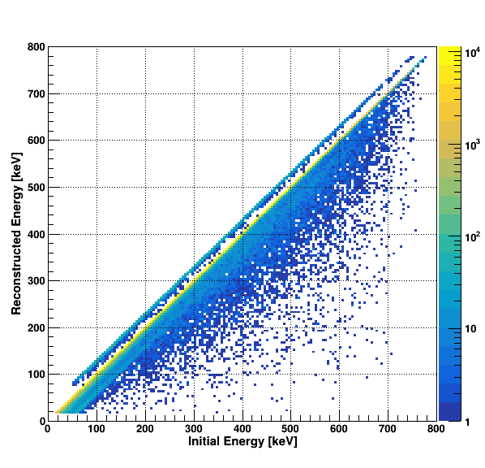
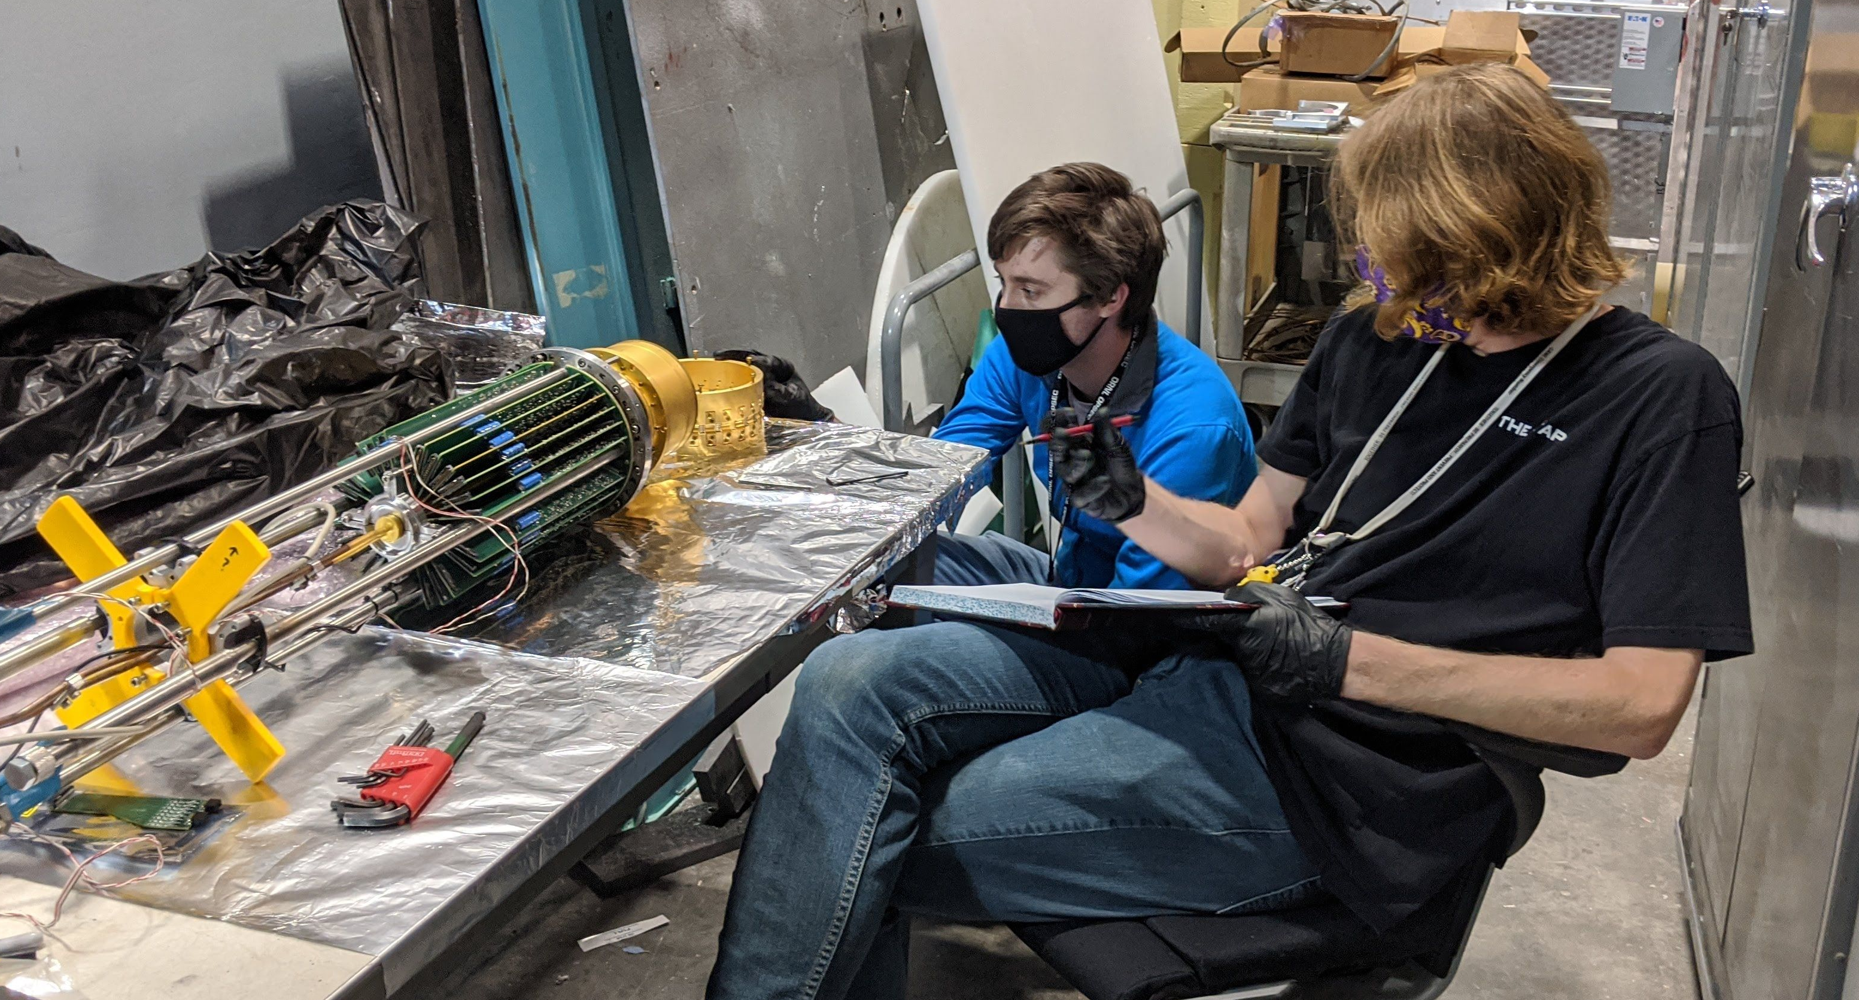

Electron Response Function
Need to understand $E_{e,meas}$ for each $E_{e}$ to 1%
  Fast + Linear electronics response
  Electron bounce history
  Energy loss in detector due to Bremsstrahlung
Simulate detector response and measure with radioactive sources
Simulated Electron Energy
Photo Credit: L. Broussard

Slide 12
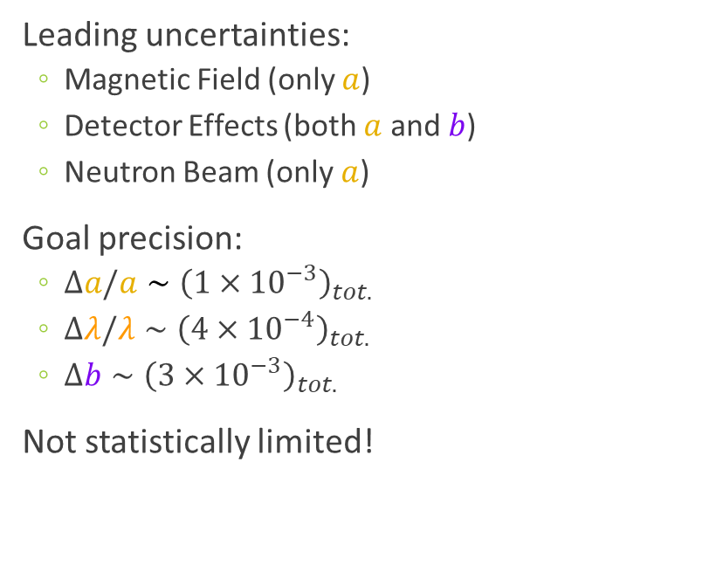
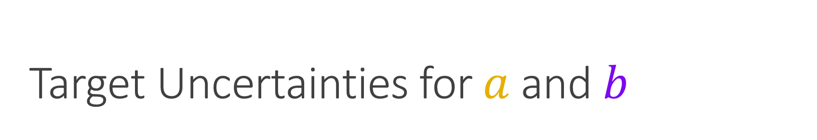
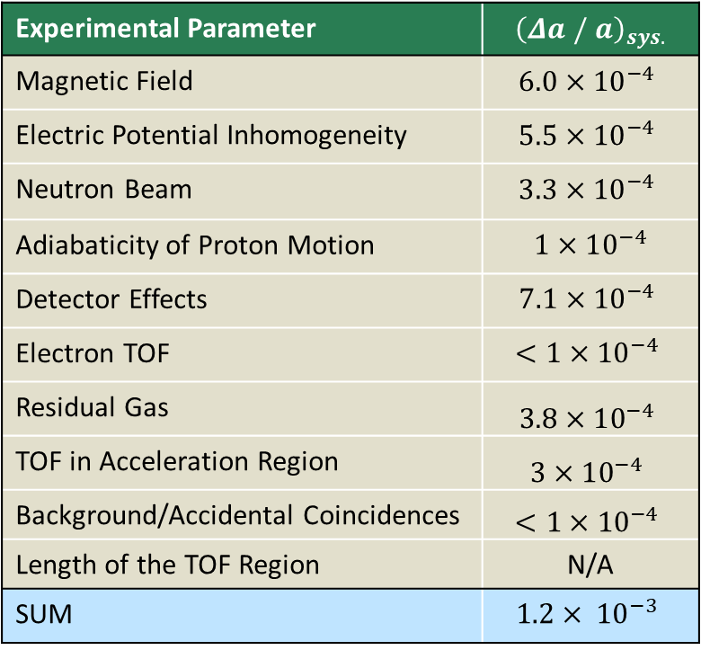
Target Uncertainties for $a$ and $b$
Leading uncertainties:
  Magnetic Field (only $a$)
  Detector Effects (both $a$ and $b$)
  Neutron Beam (only $a$)
Goal precision:
  $Δa/a∼{\left(1×{10}^{−3}\right)}_{tot.}$
  $Δλ/λ∼{\left(4×{10}^{−4}\right)}_{tot.}$
  $Δb∼{\left(3×{10}^{−3}\right)}_{tot.}$
Not statistically limited!
Experimental Parameter | $${\left(Δa / a\right)}_{sys.}$$
Magnetic Field | $$6.0×10^{−4}$$
Electric Potential Inhomogeneity | $$5.5×10^{−4}$$
Neutron Beam | $$3.3×10^{−4}$$
Adiabaticity of Proton Motion | $$1×10^{−4}$$
Detector Effects | $$7.1×{10}^{−4}$$
Electron TOF | $$<1×{10}^{−4}$$
Residual Gas | $$3.8×10^{−4}$$
TOF in Acceleration Region | $$3×10^{−4}$$
Background/Accidental Coincidences | $$<1×{10}^{−4}$$
Length of the TOF Region | N/A
SUM | $$1.2× {10}^{−3}$$

Slide 13
Target Uncertainties for $a$ and $b$
Beam Studies | Session
Sepehr Samiei | GL.00007
Hitesh Rahangdale | PL.00008
Paul Harmston | HA.00021
Leading uncertainties:
  Magnetic Field (only $a$)
  Detector Effects (both $a$ and $b$)
  Neutron Beam (only $a$)
Goal precision:
  $Δa/a∼{\left(1×{10}^{−3}\right)}_{tot.}$
  $Δλ/λ∼{\left(4×{10}^{−4}\right)}_{tot.}$
  $Δb∼{\left(3×{10}^{−3}\right)}_{tot.}$
Not statistically limited!
Experimental Parameter | $${\left(Δa / a\right)}_{sys.}$$
Magnetic Field | $$6.0×10^{−4}$$
Electric Potential Inhomogeneity | $$5.5×10^{−4}$$
Neutron Beam | $$3.3×10^{−4}$$
Adiabaticity of Proton Motion | $$1×10^{−4}$$
Detector Effects | $$7.1×{10}^{−4}$$
Electron TOF | $$<1×{10}^{−4}$$
Residual Gas | $$3.8×10^{−4}$$
TOF in Acceleration Region | $$3×10^{−4}$$
Background/Accidental Coincidences | $$<1×{10}^{−4}$$
Length of the TOF Region | N/A
SUM | $$1.2× {10}^{−3}$$

Slide 14
Target Uncertainties for $a$ and $b$
Beam Studies | Session
Sepehr Samiei | GL.00007
Hitesh Rahangdale | PL.00008
Paul Harmston | HA.00021
Leading uncertainties:
  Magnetic Field (only $a$)
  Detector Effects (both $a$ and $b$)
  Neutron Beam (only $a$)
Goal precision:
  $Δa/a∼{\left(1×{10}^{−3}\right)}_{tot.}$
  $Δλ/λ∼{\left(4×{10}^{−4}\right)}_{tot.}$
  $Δb∼{\left(3×{10}^{−3}\right)}_{tot.}$
Not statistically limited!
Experimental Parameter | $${\left(Δa / a\right)}_{sys.}$$
Magnetic Field | $$6.0×10^{−4}$$
Electric Potential Inhomogeneity | $$5.5×10^{−4}$$
Neutron Beam | $$3.3×10^{−4}$$
Adiabaticity of Proton Motion | $$1×10^{−4}$$
Detector Effects | $$7.1×{10}^{−4}$$
Electron TOF | $$<1×{10}^{−4}$$
Residual Gas | $$3.8×10^{−4}$$
TOF in Acceleration Region | $$3×10^{−4}$$
Background/Accidental Coincidences | $$<1×{10}^{−4}$$
Length of the TOF Region | N/A
SUM | $$1.2× {10}^{−3}$$
Proton Studies | Session
August Mendelsohn | GL.00008
Leendert Hayen | PL.00002

Slide 15

Target Uncertainties for $a$ and $b$
Beam Studies | Session
Sepehr Samiei | GL.00007
Hitesh Rahangdale | PL.00008
Paul Harmston | HA.00021
Leading uncertainties:
  Magnetic Field (only $a$)
  Detector Effects (both $a$ and $b$)
  Neutron Beam (only $a$)
Goal precision:
  $Δa/a=±{\left(1.4×{10}^{−3}\right)}_{tot.}$
  $Δλ/λ=±{\left(4.2×{10}^{−4}\right)}_{tot.}$
  $Δb={±\left(2.2×{10}^{−3}\right)}_{tot.}$
Not statistically limited!
Experimental Parameter | $${\left(Δa / a\right)}_{sys.}$$
Magnetic Field | $$6.0×10^{−4}$$
Electric Potential Inhomogeneity | $$5.5×10^{−4}$$
Neutron Beam | $$3.3×10^{−4}$$
Adiabaticity of Proton Motion | $$1×10^{−4}$$
Detector Effects | $$7.1×{10}^{−4}$$
Electron TOF | $$<1×{10}^{−4}$$
Residual Gas | $$3.8×10^{−4}$$
TOF in Acceleration Region | $$3×10^{−4}$$
Background/Accidental Coincidences | $$<1×{10}^{−4}$$
Length of the TOF Region | N/A
SUM | $$1.2× {10}^{−3}$$
Detector Studies | Session
Jin Ha Choi | PL.00004
Love Christie | PL.00005
Michelle Gervais | PL.00006
Austin Nelsen | PL.00007
Jackson Ricketts | HA.00091
Proton Studies | Session
August Mendelsohn | GL.00008
Leendert Hayen | PL.00002

Slide 16
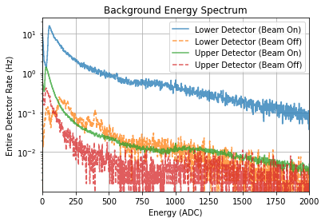
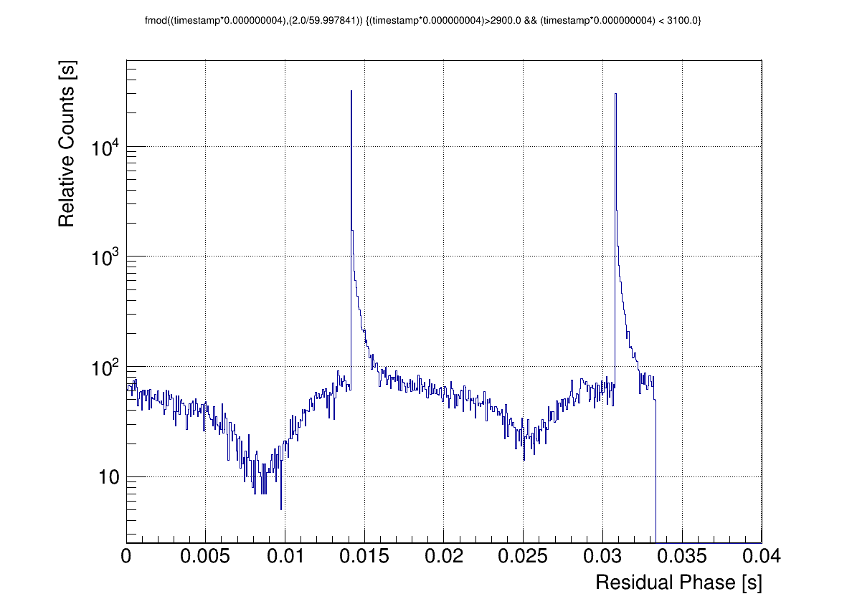
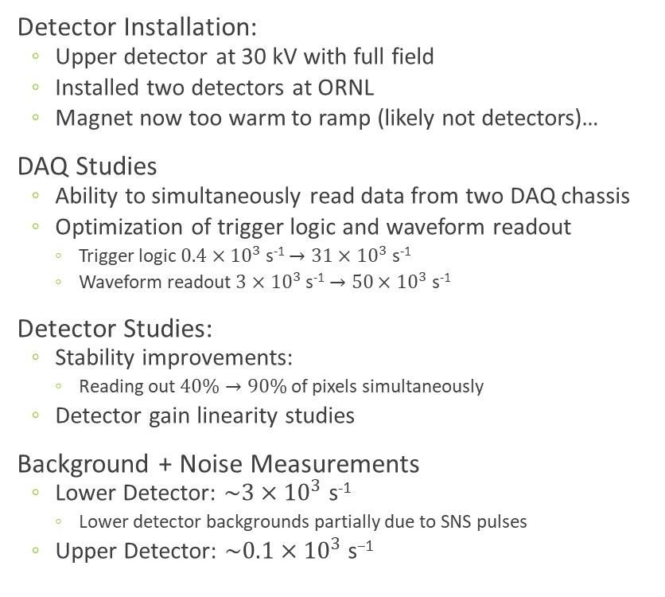
Commissioning Update:
Two detectors at ORNL, Warm Magnet
Detector Installation:
  Upper detector at 30 kV with full field
  Installed two detectors at ORNL
  Magnet now too warm to ramp (likely not detectors)…
DAQ Studies
  Ability to simultaneously read data from two DAQ chassis
  Optimization of trigger logic and waveform readout
    Trigger logic $0.4×{10}^{3}$ s⁻¹ $→31×{10}^{3}$ s⁻¹
    Waveform readout $3$ $×{10}^{3}$ s⁻¹ $→50$ $×{10}^{3}$ s⁻¹
Detector Studies:
  Stability improvements:
    Reading out $40\%→90\%$ of pixels simultaneously
  Detector gain linearity studies
Background + Noise Measurements
  Lower Detector: $\sim 3×{10}^{3}$ s⁻¹
    Lower detector backgrounds partially due to SNS pulses
  Upper Detector: $\sim 0.1×{10}^{3} \text{s}\text{−1}$
Time of Flight (Lower Detector)
Jin Ha Choi (NCSU)

Slide 17














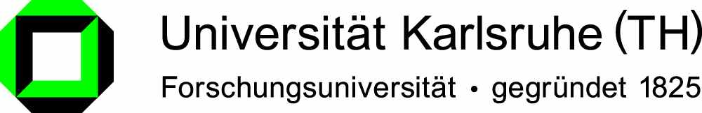



The Nab Collaboration
Nab Collaborating Institutions:
Main Project Funding:

Slide 18
Extra Slides

Slide 19
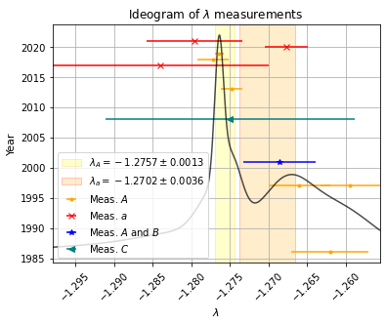

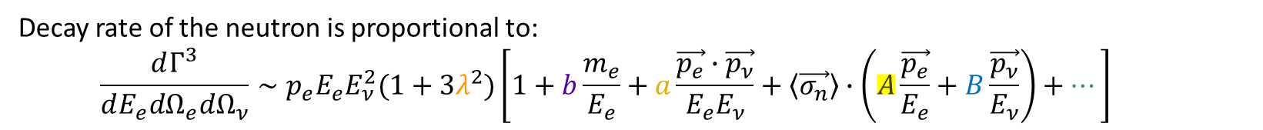
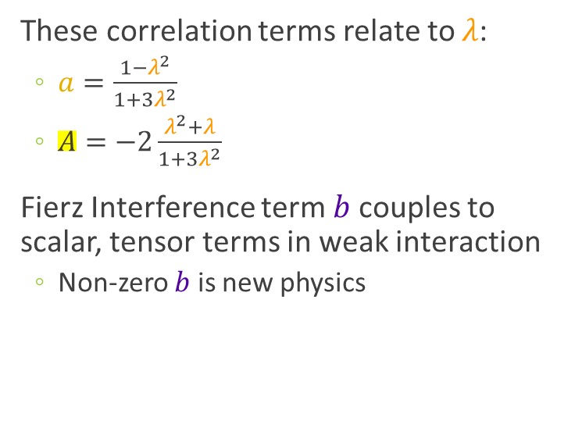

How to Measure $λ$?
Decay rate of the neutron is proportional to:
  $$\frac{dΓ^{3}}{dE_{e}dΩ_{e}dΩ_{ν}}∼p_{e}E_{e}E_{ν}^{2}(1+3λ^{2})\left[1+b\frac{m_{e}}{E_{e}}+a\frac{\vec{p_{e}}∙\vec{p_{ν}}}{E_{e}E_{ν}}+\left\langle \vec{σ_{n}}\right\rangle ∙\left(A\frac{\vec{p_{e}}}{E_{e}}+B\frac{\vec{p_{ν}}}{E_{ν}}\right)+…\right]$$
These correlation terms relate to $λ$:
  $a=\frac{{1−λ}^{2}}{1+3λ^{2}}$
  $A=−2\frac{λ^{2}+λ}{1+3λ^{2}}$
Fierz Interference term $b$ couples to scalar, tensor terms in weak interaction
  Non-zero $b$ is new physics
Data from:
Workman, R. L. et al, Particle Data Group (2022)
Most recent $a$ measurements:
Beck, et al., Phys. Rev. C 101, 055506 (2020)
Hassan et al., Phys. Rev. C 103, 045502 (2021)
Notes:
I’m assuming \lambda is real (no time-reversal symmetry breaking
The Radiative Corrections Hint comes in from: https://arxiv.org/pdf/1110.6448.pdf
The definition of b with scalar/tensor constants comes from:

Slide 20

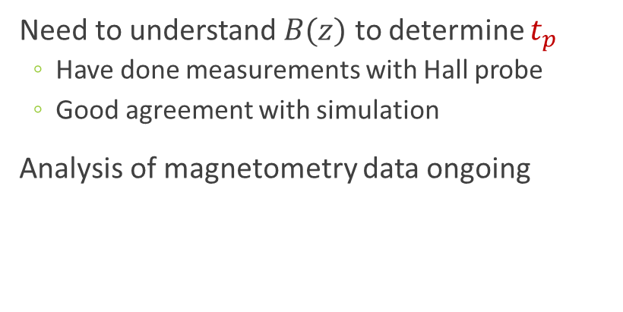





Characterization of Magnetic Field
Need to understand $B(z)$ to determine $t_{p}$
  Have done measurements with Hall probe
  Good agreement with simulation
Analysis of magnetometry data ongoing
$\left|B\right|$ vs. $z$
$γ (2\%$)
$\frac{B_{DV}}{B_{f}}$ ($1\%$)
$$B_{f}$$
Magnetic Field | Target Uncertainty | $${\left(Δa / a\right)}_{sys.}$$
Curvature at Pinch $γ$ | $$Δγ/γ=2\%$$ | $$5.3×10^{−4}$$
Ratio $r_{B,TOF}=B_{TOF}/B_{f}$ | $$(Δr_{B,TOF})/r_{B,TOF} =1\%$$ | $$2.2×10^{−4}$$
Ratio $r_{B,DV}=B_{DV}/B_{f}$ | $$(Δr_{B,DV})/r_{B,DV} =1\%$$ | $$1.8×10^{−4}$$
SUM |  | $$6.0×10^{−4}$$
$\frac{B_{TOF}}{B_{f}}$ ($1\%$)
J. Fry, EKU

Slide 21
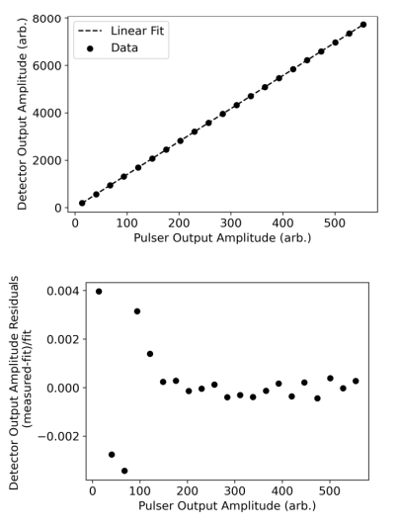

Detector Linearity
Based on SULI student report using the pulser
  Detector linearity
  Nonlinearities at $0.068\%$
Detector Linearity
Eliza Howard (SULI)

Slide 22
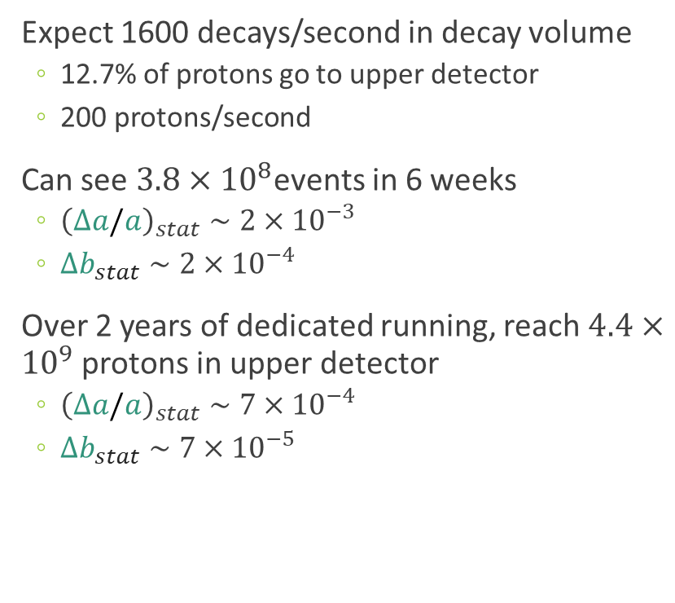
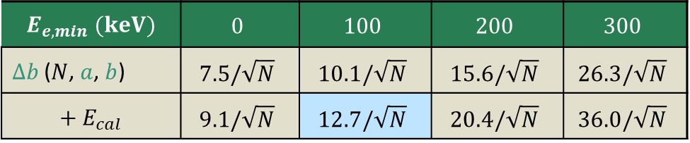
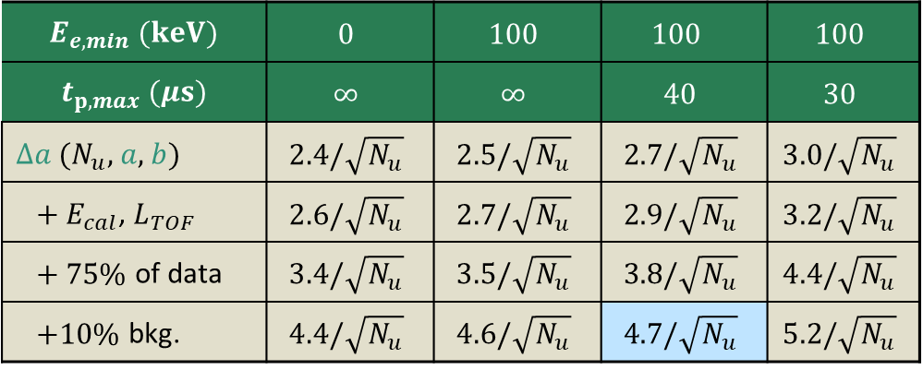
Statistical Reach of Nab
Expect 1600 decays/second in decay volume
  12.7% of protons go to upper detector
  200 protons/second
Can see $3.8×{10}^{8}$events in 6 weeks
  ${\left(Δa/a\right)}_{stat}∼2×{10}^{−3}$
  $Δb_{stat}∼2×{10}^{−4}$
Over 2 years of dedicated running, reach $4.4×{10}^{9}$ protons in upper detector
  ${\left(Δa/a\right)}_{stat}∼7×{10}^{−4}$
  $Δb_{stat}∼7×{10}^{−5}$
$$E_{e,min} (keV)$$ | $$0$$ | $$100$$ | $$100$$ | $$100$$
$$t_{p,max} (μs)$$ | $$∞$$ | $$∞$$ | $$40$$ | $$30$$
$Δa$ ($N_{u}$, $a$, $b$) | $$2.4/\sqrt{N_{u}}$$ | $$2.5/\sqrt{N_{u}}$$ | $$2.7/\sqrt{N_{u}}$$ | $$3.0/\sqrt{N_{u}}$$
$+ E_{cal}$, $L_{TOF}$ | $$2.6/\sqrt{N_{u}}$$ | $$2.7/\sqrt{N_{u}}$$ | $$2.9/\sqrt{N_{u}}$$ | $$3.2/\sqrt{N_{u}}$$
$+ 75\%$ of data | $$3.4/\sqrt{N_{u}}$$ | $$3.5/\sqrt{N_{u}}$$ | $$3.8/\sqrt{N_{u}}$$ | $$4.4/\sqrt{N_{u}}$$
$+10\%$ bkg. | $$4.4/\sqrt{N_{u}}$$ | $$4.6/\sqrt{N_{u}}$$ | $$4.7/\sqrt{N_{u}}$$ | $$5.2/\sqrt{N_{u}}$$
D. Počanić, UVA
$$E_{e,min} (keV)$$ | $$0$$ | $$100$$ | $$200$$ | $$300$$
$Δb$ ($N$, $a$, $b$) | $$7.5/\sqrt{N}$$ | $$10.1/\sqrt{N}$$ | $$15.6/\sqrt{N}$$ | $$26.3/\sqrt{N}$$
$$+ E_{cal}$$ | $$9.1/\sqrt{N}$$ | $$12.7/\sqrt{N}$$ | $$20.4/\sqrt{N}$$ | $$36.0/\sqrt{N}$$
H. Li, UVA
Notes:
1.4 MW beam at SNS
246 cm³ decay volume
1600 decays/s in spectrometer
12.7% of protons go to upper detector

Slide 23
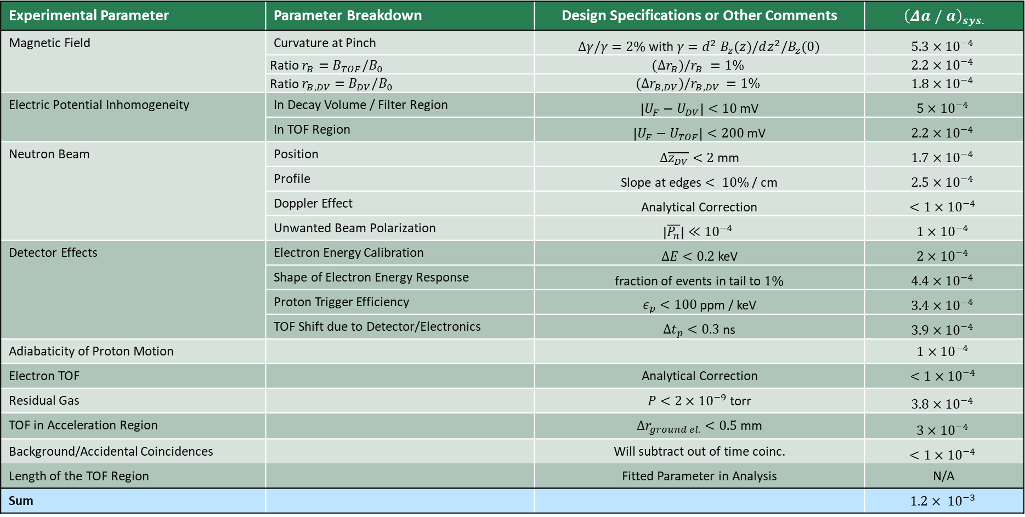
Full Systematics Budget $a$
Experimental Parameter | Parameter Breakdown | Design Specifications or Other Comments | $${\left(Δa / a\right)}_{sys.}$$
Magnetic Field | Curvature at Pinch | $Δγ/γ=2\%$ with $γ=d^{2} B_{z}(z)/dz^{2}/B_{z}(0)$ | $$5.3×10^{−4}$$
 | Ratio $r_{B}=B_{TOF}/B_{0}$ | $$(Δr_{B})/r_{B} =1\%$$ | $$2.2×10^{−4}$$
 | Ratio $r_{B,DV}=B_{DV}/B_{0}$ | $$(Δr_{B,DV})/r_{B,DV} =1\%$$ | $$1.8×10^{−4}$$
Electric Potential Inhomogeneity | In Decay Volume / Filter Region | $\left|U_{F}−U_{DV}\right|<10$mV | $$5×10^{−4}$$
 | In TOF Region | $\left|U_{F}−U_{TOF}\right|<200$ mV | $$2.2×10^{−4}$$
Neutron Beam | Position | $Δ\overline{z_{DV}}<2$ mm | $$1.7×{10}^{−4}$$
 | Profile | Slope at edges $< 10\%$ / cm | $$2.5×{10}^{−4}$$
 | Doppler Effect | Analytical Correction | $$<1×{10}^{−4}$$
 | Unwanted Beam Polarization | $$\left|\overline{P_{n}}\right|≪{10}^{−4}$$ | $$1×{10}^{−4}$$
Detector Effects | Electron Energy Calibration | $ΔE<0.2$ keV | $$2×{10}^{−4}$$
 | Shape of Electron Energy Response | fraction of events in tail to $1\%$ | $$4.4×{10}^{−4}$$
 | Proton Trigger Efficiency | $ε_{p}<100$ ppm / keV | $$3.4×{10}^{−4}$$
 | TOF Shift due to Detector/Electronics | $Δt_{p}<0.3$ ns | $$3.9×{10}^{−4}$$
Adiabaticity of Proton Motion |  |  | $$1×10^{−4}$$
Electron TOF |  | Analytical Correction | $$<1×{10}^{−4}$$
Residual Gas |  | $P<2×{10}^{−9}$ torr | $$3.8×10^{−4}$$
TOF in Acceleration Region |  | ${Δr}_{ground el.}<0.5$ mm | $$3×10^{−4}$$
Background/Accidental Coincidences |  | Will subtract out of time coinc. | $$<1×{10}^{−4}$$
Length of the TOF Region |  | Fitted Parameter in Analysis | N/A
Sum |  |  | $$1.2× {10}^{−3}$$

Slide 24
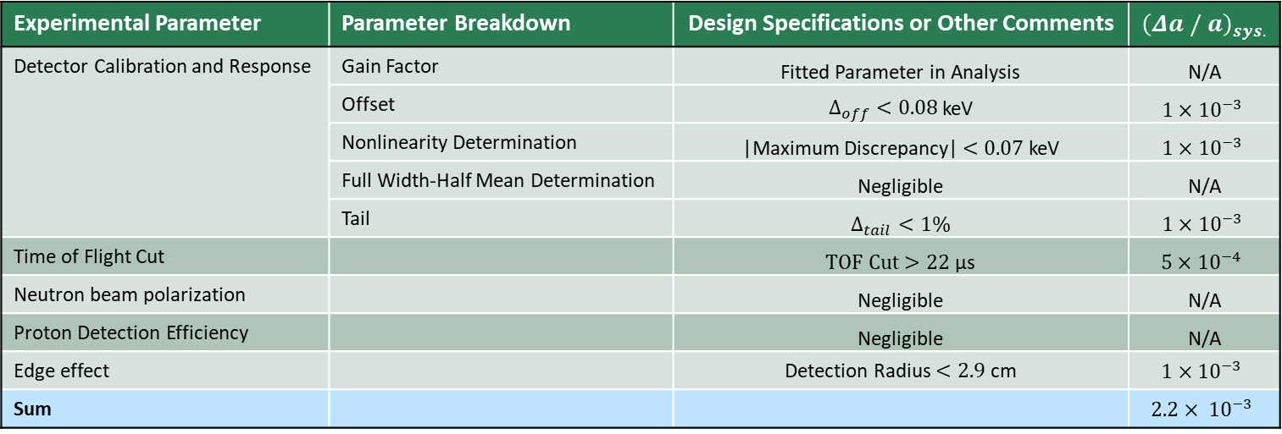

Systematic Reach for $b$
Experimental Parameter | Parameter Breakdown | Design Specifications or Other Comments | $${\left(Δa / a\right)}_{sys.}$$
Detector Calibration and Response | Gain Factor | Fitted Parameter in Analysis | N/A
 | Offset | $Δ_{off}<0.08$ keV | $$1×{10}^{−3}$$
 | Nonlinearity Determination | |Maximum Discrepancy| $<0.07$ keV | $$1×{10}^{−3}$$
 | Full Width-Half Mean Determination | Negligible | N/A
 | Tail | $Δ_{tail}<1\%$ | $$1×{10}^{−3}$$
Time of Flight Cut |  | $TOF Cut>22$ µs | $$5×10^{−4}$$
Neutron beam polarization |  | Negligible | N/A
Proton Detection Efficiency |  | Negligible | N/A
Edge effect |  | Detection Radius $<2.9$ cm | $$1×{10}^{−3}$$
Sum |  |  | $$2.2× {10}^{−3}$$
PhD Thesis H. Li, UVA

