Slide 1

GPU Based Nearline Waveform Analysis System
David Mathews for the Nab Experiment
Department of Physics and Astronomy
University of Kentucky
1

Slide 2
Introduction
What is Nearline?
Realtime
Better resolution than DAQ/Online Analysis
Data Rate
Coincidence Event Rate: ~250 Hz
Singles Rate (scaled): <250 Hz
Waveform Rate: ~ 10kHz or ~ 100 MB/s
Experimental Requirements
Energy Resolution: < 3keV
Timing Bias: < 300ps
Analog Signal
DAQ System
Nearline Analysis
Storage and Offline Analysis
2

Slide 3
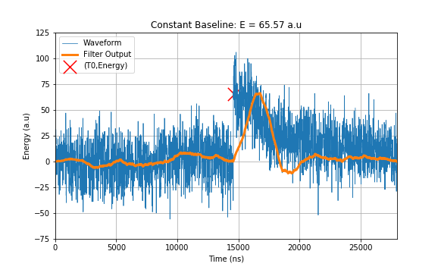
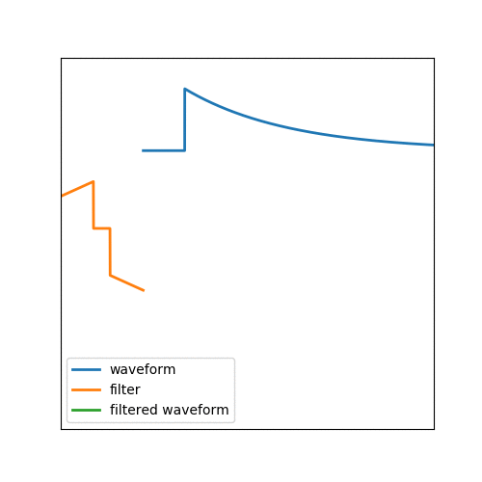
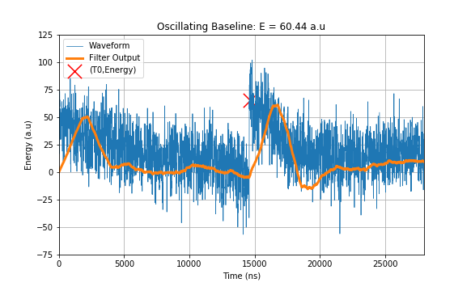
The Standard: Trapezoidal Filter
3

Slide 4
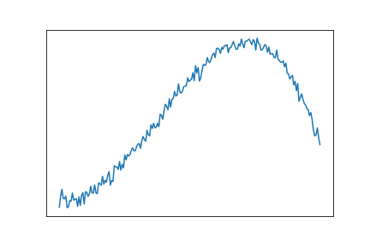
Data: y
Linear Fitting with the Pseudo-Inverse
4

Slide 5
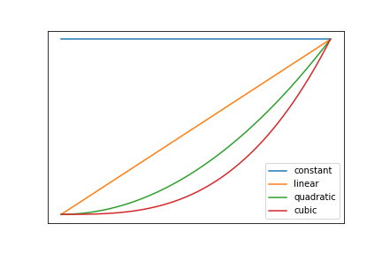
Data: y
Fit Functions: A
Linear Fitting with the Pseudo-Inverse
5

Slide 6

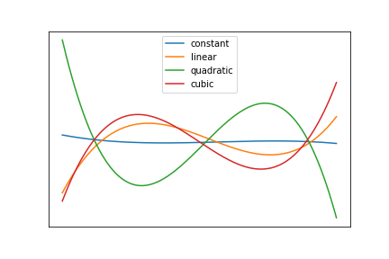
Data: y
Fit Functions: A
Linear Fitting with the Pseudo-Inverse
Pseudoinverse Fit Functions
6

Slide 7

Data: y
Fit Functions: A
Linear Fitting with the Pseudo-Inverse
Pseudoinverse Fit Functions
Calculate Fit Parameters
7

Slide 8
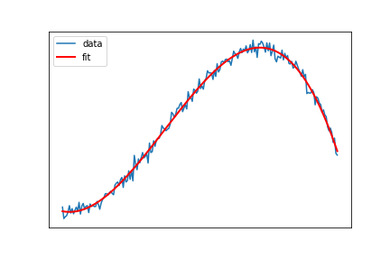
Data: y
Fit Functions: A
Linear Fitting with the Pseudo-Inverse
Pseudoinverse Fit Functions
Calculate Fit Parameters
Fit using Parameters
8

Slide 9
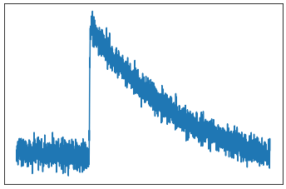
Non-Linear Fitting: One Non-Linear Parameter:
Data:
9

Slide 10
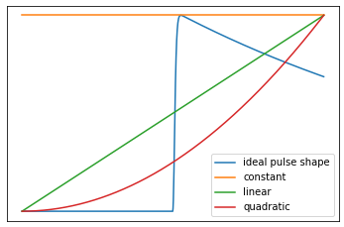
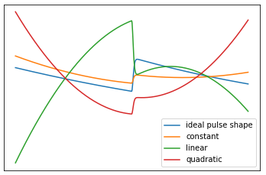
Non-Linear Fitting: One Non-Linear Parameter:
Data:
Fit Functions:
Pseudoinverse Fit Functions
10

Slide 11

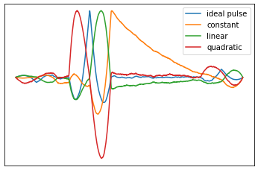
Non-Linear Fitting: One Non-Linear Parameter:
Data:
Fit Functions:
Pseudoinverse Fit Functions
Calculate Fit Parameters:
11

Slide 12

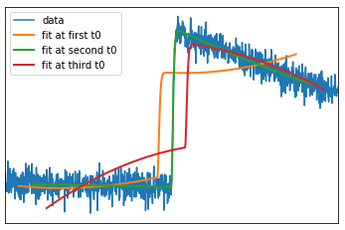
Non-Linear Fitting: One Non-Linear Parameter:
Data:
Fit Functions:
Pseudoinverse Fit Functions
Calculate Fit Parameters:
Fit using Parameters
12

Slide 13

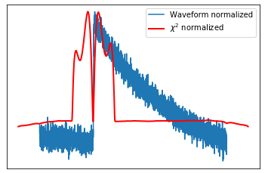
Non-Linear Fitting: One Non-Linear Parameter:
Data:
Fit Functions:
Pseudoinverse Fit Functions
Calculate Fit Parameters:
Fit using Parameters
Find Best Fit with
13

Slide 14

GPU Implementation (UPDATE RATES)
Convolution: cuFFT
Matrix Multiplication: cuBLAS
Test: 14 us waveforms
Algorithm | CPU (~Hz) | GPU (~Hz)
Trapezoidal Filter | 300 | 86,000
Fitting: 3 Basis | 200 | 36,000
Fitting: 6 Basis | 190 | 31,000
Fitting: 9 Basis | 170 | 24,000
14

Slide 15

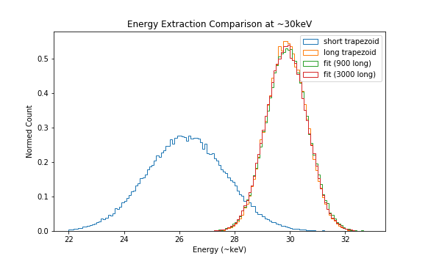
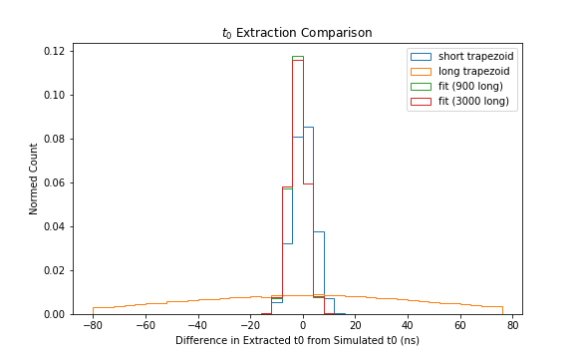
How well does this work? It Depends
Testing Method
Used Average Pulse Shape at ~30 keV
Superimposed realistic noise: RMS~ 3 keV
Fit with pulse shape, constant, and linear
Results
 | Short Trapezoid | Long Trapezoid | Short Fit | Long Fit
Energy
Timing
15

Slide 16
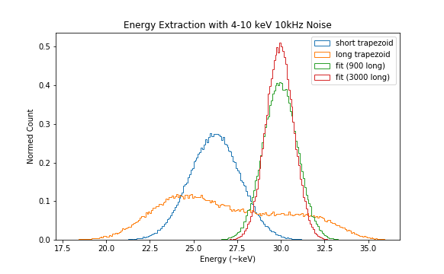
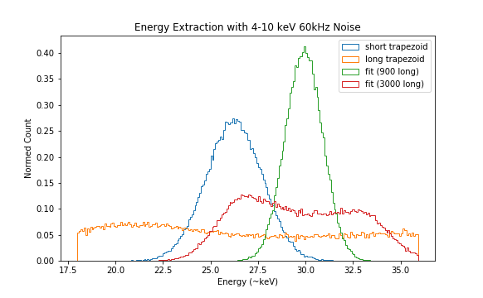
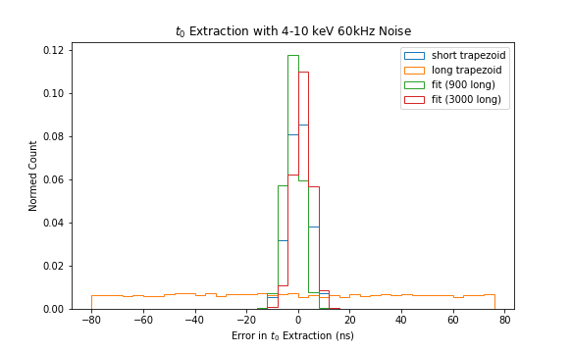
Baseline Oscillations
16

Slide 17
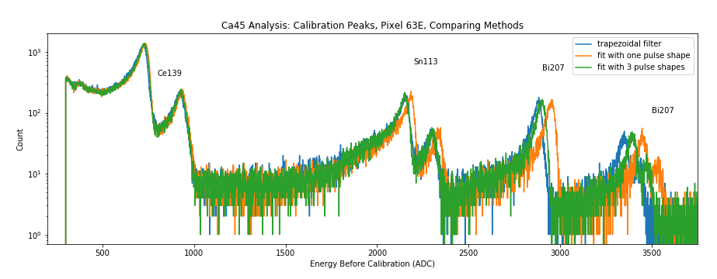
Multiple Pulse-Shape Fitting
17

Slide 18
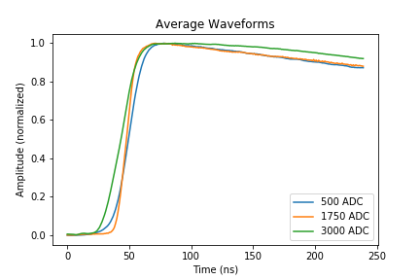
Multiple Pulse-Shape Fitting
17

Slide 19
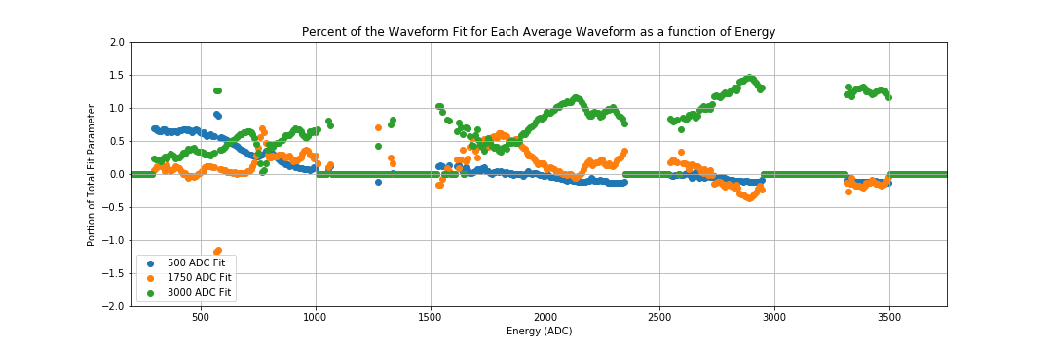
Multiple Pulse-Shape Fitting
17

Slide 20
Closing Remarks
Conclusion
Obtained 3keV Precision Goal
Real Time
Future Work
Sub-timebin timing extraction and understand bias
Use Simulated Pulse Shapes
Tom's simulation work for different event types
Implement Weighting
18

Slide 21




The Nab collaboration
Active and recent collaborators:
R. Alarconª, S.Baeßler^{b,c} (Project Manager), S. Balascutaª, L. Barrón Palos^{n}, T.L. Bailey^{m}, K. Bass^{i}, N. Birge^{i}, A. Blose^{f}, D. Borissenko^{b}, J.D. Bowman^{c} (Co-Spokesperson), L. Broussard^{c}, A.T. Bryant^{b}, J. Byrne^{d}, J.R. Calarco^{c,i}, J. Caylor^{i}, K. Chang^{b}, T. Chuppº, T.V. Cianciolo^{c}, C. Crawford^{f}, X. Ding^{b}, M. Doyle^{b}, W. Fan^{b}, W. Farrar^{b}, N. Fomin^{i}, E. Frlež^{b}, J. Fry^{b}, M.T. Gericke^{g}, M. Gervais^{f}, F. Glück^{h}, G.L. Greene^{c,i}, R.K. Grzywacz^{i}, V. Gudkov^{j}, J. Hamblen^{e}, C. Hayes^{m}, C. Hendrusº, T. Ito^{k}, A. Jezghani^{f}, H. Li^{b}, M. Makela^{k}, N. Macsai^{g}, J. Mammei^{g}, R. Mammei^{l}, M. Martinezª, D.G. Mathews^{f}, M. McCrea^{f}, P. McGaughey^{k}, C.D. McLaughlin^{b}, P. Mueller^{c}, D. van Petten^{b}, S.I. Penttilä^{c} (On-site Manager), D.E. Perryman^{i}, R. Picker^{p}, J. Pierce^{c}, D. Počanić^{b} (Co-Spokesperson), Yu Qian^{b}, G. Randallª, G. Riley^{i}, K.P. Rykaczewski^{c}, A. Salas-Bacci^{b}, S. Samiei^{b}, E.M. Scott^{i}, T. Shelton^{f}, S.K. Sjue^{k}, A. Smith^{b}, E. Smith^{k}, E. Stevens^{b}, J.W. Wexler^{m}, R. Whitehead^{i}, W.S. Wilburn^{k}, A.R. Young^{m}, B.Zeck^{m}
ª Department of Physics, Arizona State University, Tempe, AZ 85287-1504 ^{b} Department of Physics, University of Virginia, Charlottesville, VA 22904-4714 ^{c} Physics Division, Oak Ridge National Laboratory, Oak Ridge, TN 37831 ^{d} Department of Physics and Astronomy, University of Sussex, Brighton BN19RH, UK ^{e} Department of Chemistry and Physics, University of Tennessee at Chattanooga, Chattanooga, TN 37403 ^{f} Department of Physics and Astronomy, University of Kentucky, Lexington, KY 40506 ^{g} Department of Physics, University of Manitoba, Winnipeg, Manitoba, R3T 2N2, Canada ^{h} KIT, Universität Karlsruhe (TH), Kaiserstraße 12, 76131 Karlsruhe, Germany | ^{i} Department of Physics and Astronomy, University of Tennessee, Knoxville, TN 37996 ^{j} Department of Physics and Astronomy, University of South Carolina, Columbia, SC 29208 ^{k} Los Alamos National Laboratory, Los Alamos, NM 87545 ^{l} Department of Physics, University of Winnipeg, Winnipeg, Manitoba R3B2E9, Canada ^{m} Department of Physics, North Carolina State University, Raleigh, NC 27695-8202 ^{n} Universidad Nacional Autónoma de México, México, D.F. 04510, México º University of Michigan, Ann Arbor, MI 48109 ^{p} TRIUMF, Vancouver, Canada, V6T 2A3
Main project funding:

