Slide 1
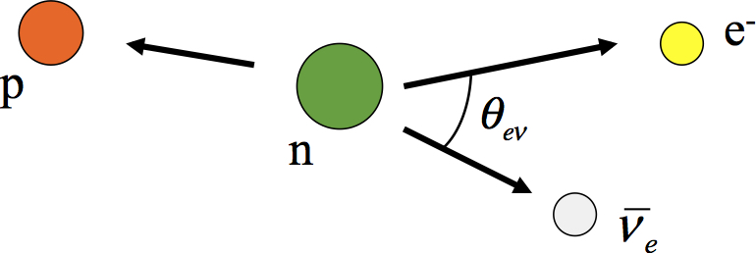
A Precision Measurement of Zero Beam Polarization for the Nab Experiment at the SNS
Chelsea Hendrus
For the Nab Collaboration
April 11, 2022

Slide 2
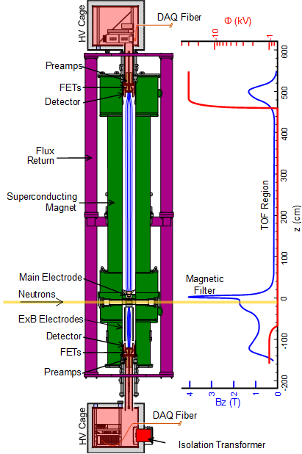
The Nab Experiment
The Nab Spectrometer and Detectors
Experimental Goal:
$$\frac{∆a}{a}=0.1\%$$
$$a=−0.1044±0.0008$$
$$∆b=3×{10}^{−3}$$
$$b=0.017±0.020$$
These parameters contribute to our understanding of Standard Model puzzles
CKM Unitarity, Quark Mixing V_{ud}
$λ=\frac{G_{A}}{G_{V}}$
Neutron Lifetime
A measurement of $b$ also helps probe Non-Standard Model Physics
P.A. Zyla et al. (Particle Data Group), Prog. Theor. Exp. Phys. 2020, 083C01 (2020) and 2021 update
Image: A. Jezghani

Slide 3
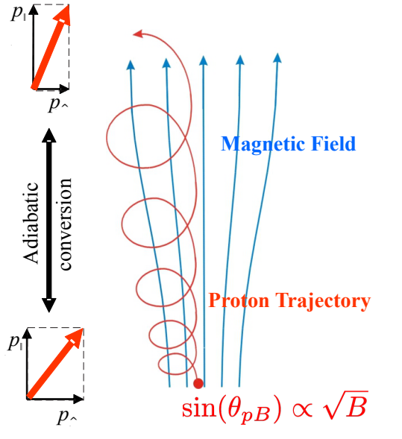
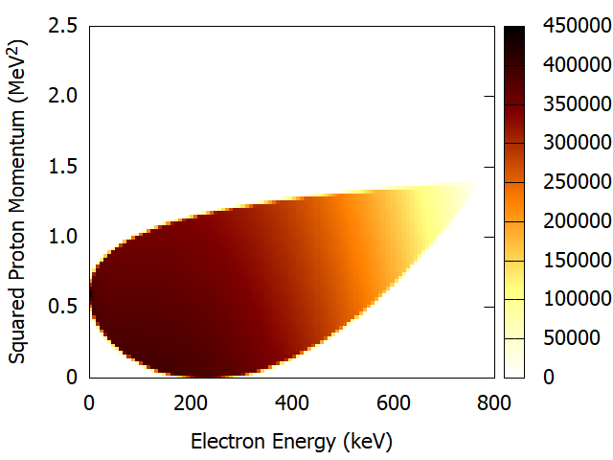
The Nab Experiment
The Nab Spectrometer and Detectors
The Measurement:
Measure Electron energy via lower silicon detectors
Measure proton momentum via Time-of-Flight through Spectrometer field
$$t_{p}=\frac{m_{p}}{p_{p}}\int_{z_{0}}^{l}{\frac{∂z}{\sqrt{1−\frac{B\left(z\right)}{B_{0}}\sin^{2}{θ_{p,0}}+\frac{q(V\left(z\right)−V_{0}}{E_{p,0}}}}}$$
Images: J.Fry, A. Jezghani

Slide 4
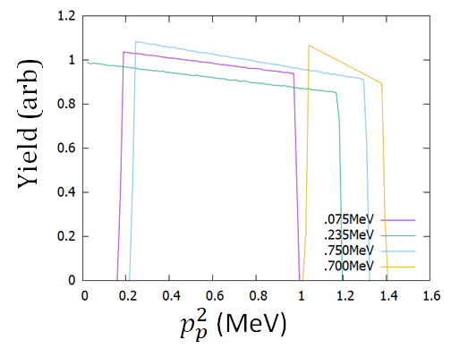
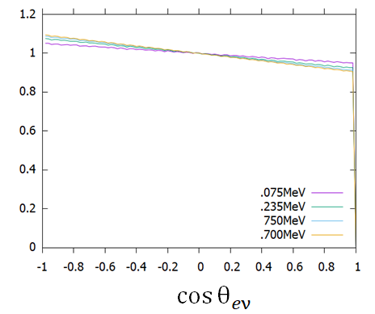
The Nab Experiment
Phase spaces of the unpolarized part:
Neglect time reversal terms, and average the polarized terms over the events the detector sees we get:
To Meet Our Experimental Goal we must verify that that the beam polarization is:
$$\frac{Δa}{a}=\frac{B\left\langle cosθ_{e}\right\rangle \left|\left\langle σ_{n}\right\rangle \right|}{β_{e}a}≈{10}^{−4}$$

Slide 5
Polarimetry for the Nab Experiment
Neutron Polarizer
The Cross section between ³He and neutrons is spin dependent
They only interact in the singlet state!
Transmission of Neutrons through Unpolarized ³He
Transmission!
$$T_{0}=Ne^{−nlσ_{0}\frac{λ}{λ_{0}}}$$
Transmission of Polarized Neutrons through Polarized ³He
Absorption!
$$T_{}=Ne^{−nlσ_{0}\frac{λ}{λ_{0}}}\left(\cosh\left(nlσ_{0}\frac{λ}{λ_{0}}P_{He}\right)+P_{n}\sinh\left(nlσ_{0}\frac{λ}{λ_{0}}P_{He}\right) \right)$$

Slide 6
Polarimetry for the Nab Experiment
Adiabatic Fast Passage (AFP) Spin Flipping
Flipping the spin using a resonant field
B₀ is a static field in the lab frame, B₁ oscillates with some frequency, ω.
In the rotating frame, the magnetic moment sees an effective B_{eff}, and B₀, modulated by the larmor frequency and ω.
Change in B_{eff} must be slower than the Larmor Precession Frequency
B₀
ω/γ
B₀
B₀
B_{eff}
ω/γ
μ
μ
B_{eff}
B₁
B₁
B₁
ω/γ
B_{eff}
μ

Slide 7
Polarimetry for the Nab Experiment
Measuring A Polarization
If we flip a spin, that spin gets multiplied a factor that depends of the efficiency of the flipping device
$$P→\left(1−2ε\right)P$$
Then, we can take transmission ratios and compare them to measure the neutron polarization
We need 3 measurements to get a Polarization:
Neutron Beam through Unpolarized ³He –T₀
Neutron Beam through Polarized ³He – T₊
Neutron Beam through Polarized ³He, flipping something T₋
³He
Analyzer
AFP Neutron Spin Flipper
Normalizing
Monitor
Analyzing
Monitor

Slide 8
Polarimetry for the Nab Experiment
Measuring A Polarization by Flipping Neutrons
If we assume that our ³He polarization is the same between measurements, we can compare ratios of transmission measurements
$$R_{+}=\frac{T_{+}}{T_{0}}$$
$$R_{−}=\frac{T_{−}}{T_{0}}$$
$$P_{n}=\frac{R_{+}−R_{−}}{\sqrt{{\left[\left(2ε_{n}−1\right)R_{+}+R_{−}\right]}^{2}−4ε_{n}^{2}}}$$
³He
Analyzer
AFP Neutron Spin Flipper
Normalizing
Monitor
Analyzing
Monitor

Slide 9
Polarimetry for the Nab Experiment
Measuring our Spin Flipper Efficiency
We need to understand our Spin Flipper Efficiency. We can’t do that on a beam where we expect a small polarization, so we will add a 3He Polarizer to our setup
We will need 4 measurements this time:
Beam through polarized ³He – T₊₊
Flipped beam through polarized ³He – T₋₊
Beam through polarized, flipped ³He T₊₋
Flipped beam through polarized, flipped ³He T₋₋
³He
Polarizer
³He
Analyzer
AFP Neutron Spin Flipper
Normalizing
Monitor
Analyzing
Monitor

Slide 10
Polarimetry for the Nab Experiment
Measuring our Spin Flipper Efficiency
If we assume that the polarization of the polarizer and the analyzer are the same between measurements, we can take transmission ratios
$$ε_{n}=\frac{1}{2}\left(1−\frac{\frac{T_{−−}−T_{− +}}{T_{−−}+T_{− +}}}{\frac{T_{+ −}−T_{++}}{T_{+ −}+T_{++}}}\right)$$
When we understand our Spin Flipper Efficiency, we can run Nab in “Spin Flipper Mode,” where we run the Spin Flipper half-time during data collection, to cancel out an average polarization
³He
Polarizer
³He
Analyzer
AFP Neutron Spin Flipper
Normalizing
Monitor
Analyzing
Monitor

Slide 11
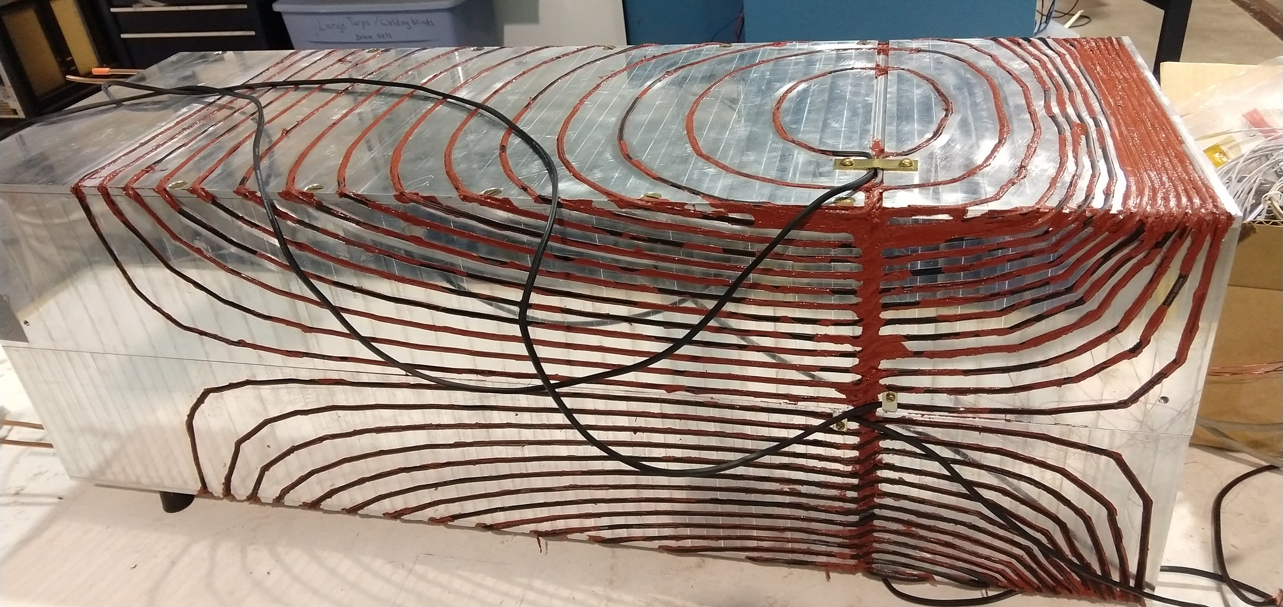
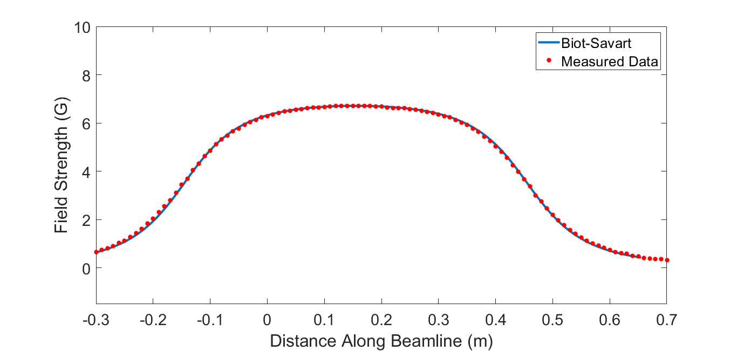
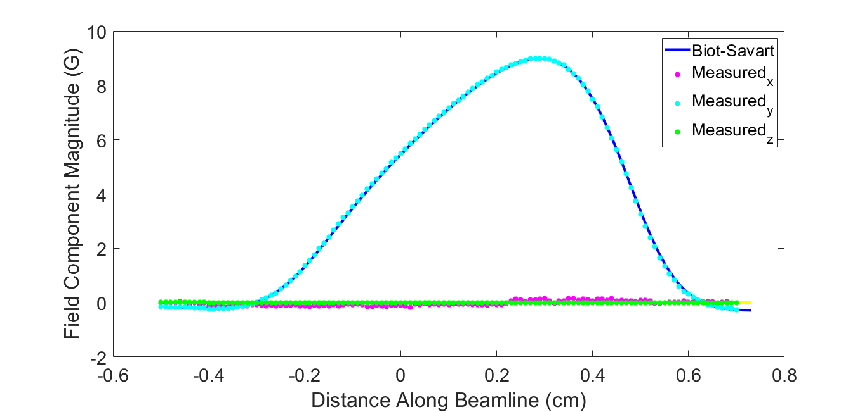
Equipment for Polarimetry
An Adiabatic Fast Passage Spin Flipper
RF Solenoid
Static Gradient Field

Slide 12
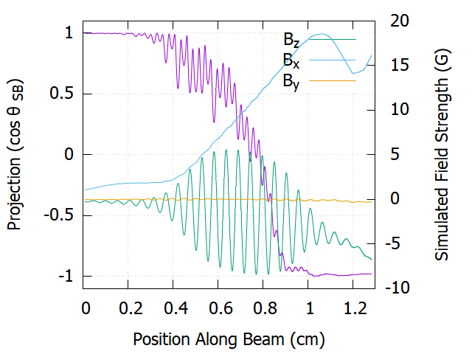
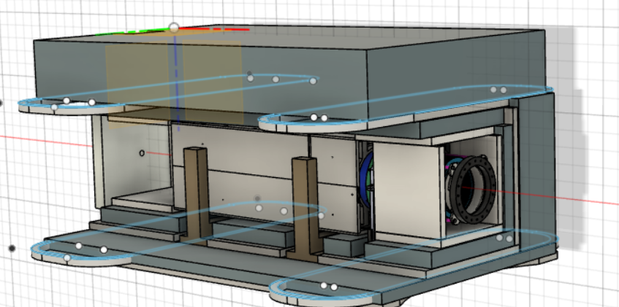
Equipment for Polarimetry
An Adiabatic Fast Passage Spin Flipper
We can integrate Bloch’s Equations, sampling the field at different points in time as the neutron travels through it.
Simulations like this help us predict how well our Spin Flipper will function in different fields, so that we can also include the effects of the spectrometer field, and learn how to compensate for those with auxiliary coils:
The cosine of the angle plotted here is the angle between the spin and the field in the lab frame (purple)

Slide 13
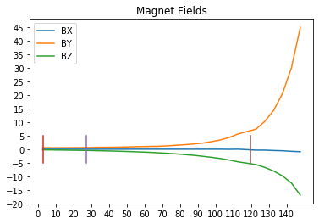
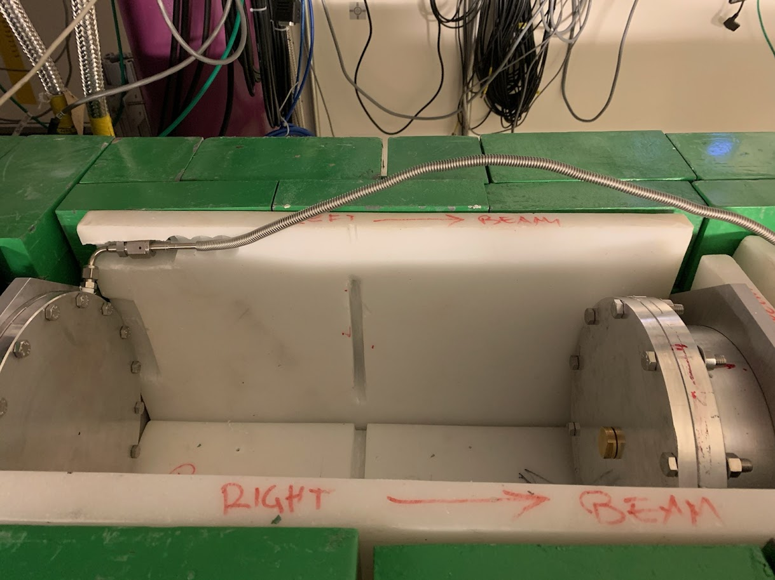
Equipment for Polarimetry
³He Holding Fields
We need our ³He Polarization to be consistent across our measurement, but it will decay as the ³He atoms move about in the cell and experience different field gradients.
We want to minimize our field gradients to prolong ³He polarization lifetime.
Problem:
The fields from our spectrometer produce gradients in these regions
We have very limited space inside the shielding to produce the holding fields we need and control these gradients
$$\frac{1}{T_{1}}∝\frac{{\left|∇B_{x}\right|}^{2}+{\left|∇B_{y}\right|}^{2}}{B^{2}}$$
Spectrometer Field Along Beamline
Field Strength(G)
Spectrometer→
Position along beam(cm)

Slide 14
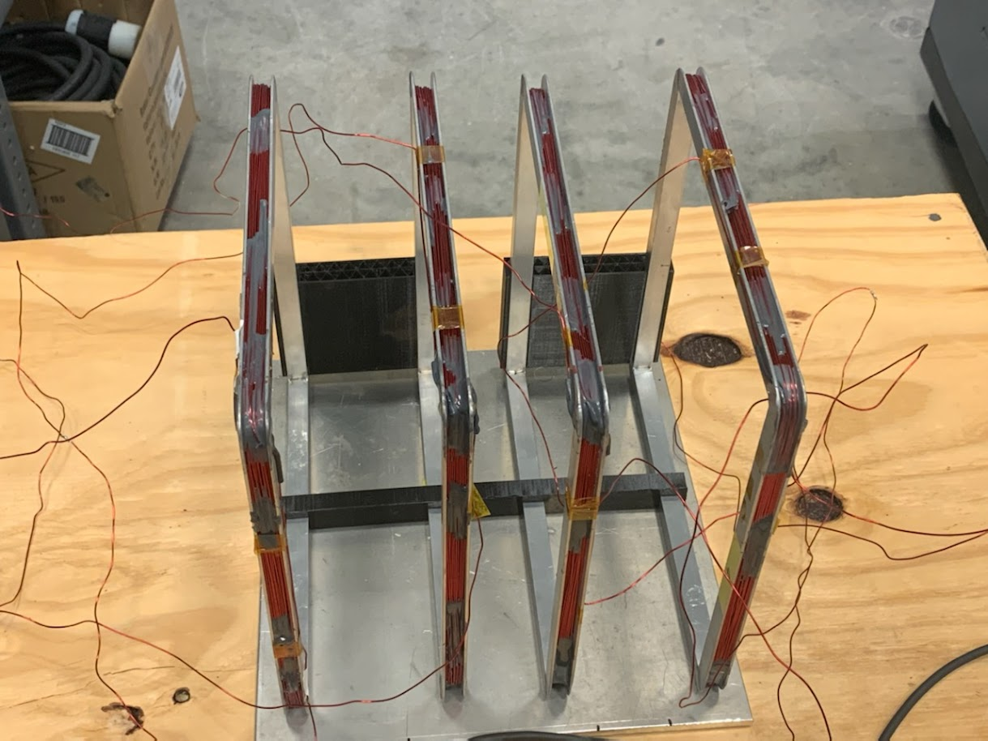
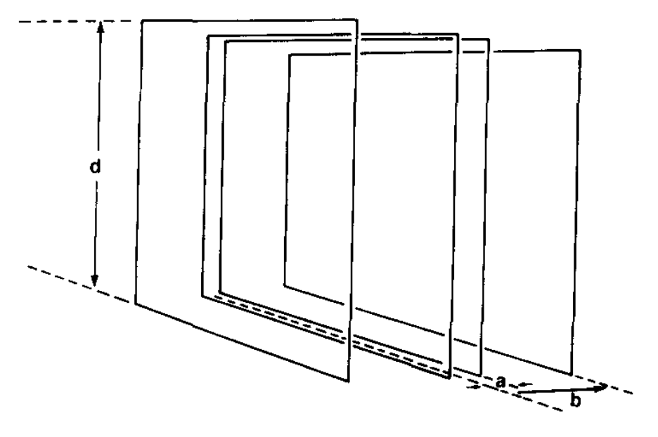
Equipment for Polarimetry
³He Holding Fields
What We Designed:
2 sets of Merritt Coils
Solution: Merritt Coils
 | Upstream Coil | Downstream Coil
Size (d) | 200mm | 220mm
a (distance between center and inner pair) | 25.6mm | 28.2mm
b (distance between center and outer pair) | 101.1mm | 111.2mm
Inner Pair Turns | 11 | 36
Outer Pair turns | 26 | 85
Current for 10G at center | 4.285A | 1.44A
Simulated Relative Gradient over 10cm cube at center | 5.09x10⁻⁶ | 2.93x10⁻⁶
Review of Scientific Instruments 54, 879 (1983); https://doi.org/10.1063/1.1137480

Slide 15
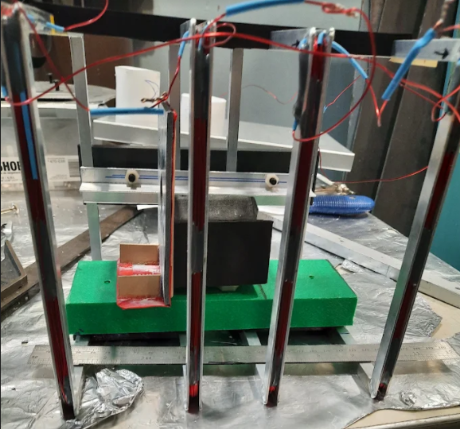
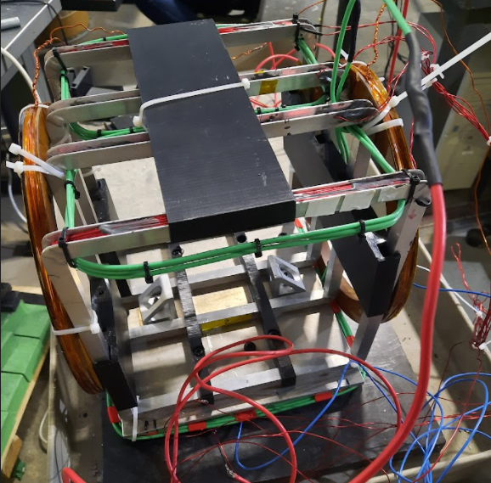
Equipment for Polarimetry
³He Holding Fields
Compensation for Spectrometer (green)
Solution: Merritt Coils
AFP Sweep Coils (brown)
Upstream Merritt Coil
³He Cell Scotty
Measured lifetime on Beamline: 44.3 +- 7.7 hrs
This cell is smaller and further away from the spectrometer. we get an OK lifetime
Downstream Merritt Coil
³He Cell Hedy Lamar
Measured lifetime on Beamline:In Progress (Requires further tuning)
Lifetime in Lab: 49+- 10.4 h
This cell is larger and closer to spectrometer the spectrometer, which makes the lifetime shorter.

Slide 16
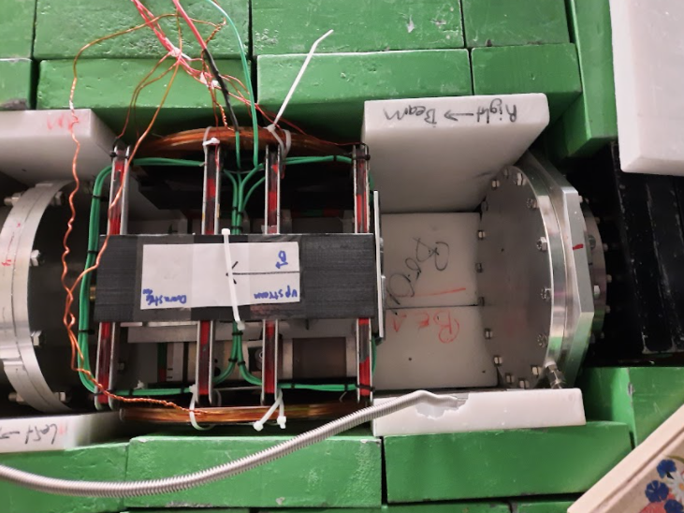
Polarimetry
Estimate ³He lifetime ~30hrs in full fields:
% of Helium polarization lost during:
1 neutron pulse (1/60s): 1.157e-05
60 neutron pulses (1s): 0.0006944
600 neutron pulses (10s): 0.006944
3600 neutron pulses (60s): 0.0416
We will fit neutron data for the ³He polarization in situ. We can attempt to match or group data with similar ³He polarizations.
FID data is often noisy, and only yields a relative polarization measurement
We should be able to compare measurements that are over a minute apart, and still not be able to resolve the change in polarization. This also sets the time over which we want to think about flipping our systems, and canceling drifts:
We will monitor temperatures of various devices, and currents to watch for drifts that may affect the efficiency of the Spin Flipper.
We will also monitor the incoming neutron beam with an upstream monitor to normalize and correct for fluctuations in beam power.

Slide 17
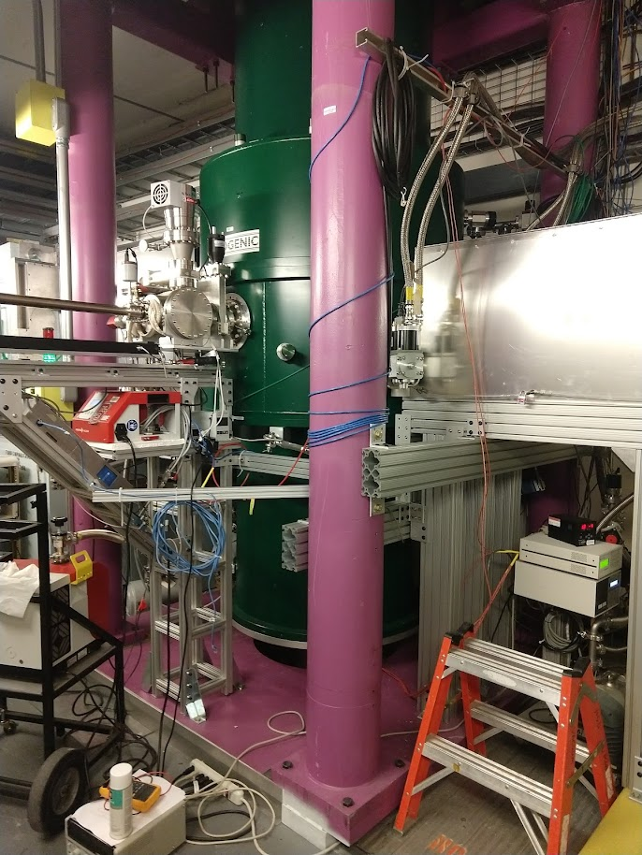
Polarimetry : June 2022
What’s Next? Neutrons!
DS Merritt Coil needs further tuning.
Mu-Metal shielding for Merritt Coils to reduce effects of outside fields
New neutron monitor needs calibrated
Need to measure thickness of ³He cells
Fit neutron spectra through unpolarized cells
Take Data!

Slide 18
The Nab Collaboration
R. Alarconª, A. Atencio^{k}, S.Baeßler^{b,c} (Project Manager), S. Balascuta, L. Barrón Palos^{n}, T.L. Bailey^{m}, K. Bass^{i}, N. Birge^{i,k}, A. Blose^{f}, D. Borissenko^{b}, M. Bowler^{b}, J.D. Bowman^{c} (Co-Spokesperson), L. Broussard^{c}, A.T. Bryant^{b}, J. Byrne^{d}, J.R. Calarco^{c,i}, J. Choi^{m}, J. Caylor^{i}, L. Christie^{i}, T. Chuppº, T.V. Cianciolo^{c}, C.B. Crawford^{f}, M. Cruz^{i}, X. Ding^{b}, George Dodson^{s}, W. Fan^{b}, W. Farrar^{b}, N. Fomin^{i}, E. Frlež^{b}, J. Fry^{q}, M.T. Gericke^{g}, M. Gervais^{f}, C. Gilbert^{c}, F. Glück^{h}, R. Godri^{i}, F. Gonzalez^{c}, G.L. Greene^{c,i}, R.K. Grzywacz^{i}, V. Gudkov^{j}, J. Hamblen^{e}, L. Hayen^{m}, C. Hayes^{m}, C. Hendrusº, K. Imam^{i}, T. Ito^{k}, A. Jezghani^{f}, H. Li^{b}, M. Makela^{k}, N. Macsai^{g}, J. Mammei^{g}, R. Mammei^{l}, M. Martinezª, D.G. Mathews^{f}, M. McCrea^{f}, P. McGaughey^{k}, C.D. McLaughlin^{b}, J. Mirabal-Martinez^{k}, P.E. Mueller^{c}, A. Nelsen^{f}, I. Novikov^{p}, D. van Petten^{b}, S.I. Penttilä^{c} (On-site Manager), D.E. Perryman^{i}, J. Pierce^{r}, D. Počanić^{b} (Co-Spokesperson), H. Presley^{i} , Yu Qian^{b},
H. Rahangdale^{i}, J. Ramsey^{c}, G. Randallª, G. Riley^{i,k}, K.P. Rykaczewski^{c}, A. Salas-Bacci^{b}, S. Samiei^{b}, A. Saunders^{c}, E.M. Scott^{i}, T. Shelton^{f}, S.K. Sjue^{k}, A. Smith^{b}, E. Smith^{k}, E. Stevens^{b}, L. Tinius^{b} , J. Thomison^{c}, J.W. Wexler^{m}, R. Whitehead^{i}, W.S. Wilburn^{k}, A.R. Young^{m}, B.Zeck^{m}, M. Zemke^{i}
Main Project Funding:

Slide 19
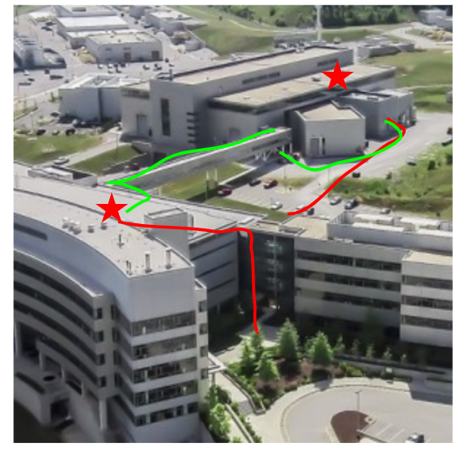
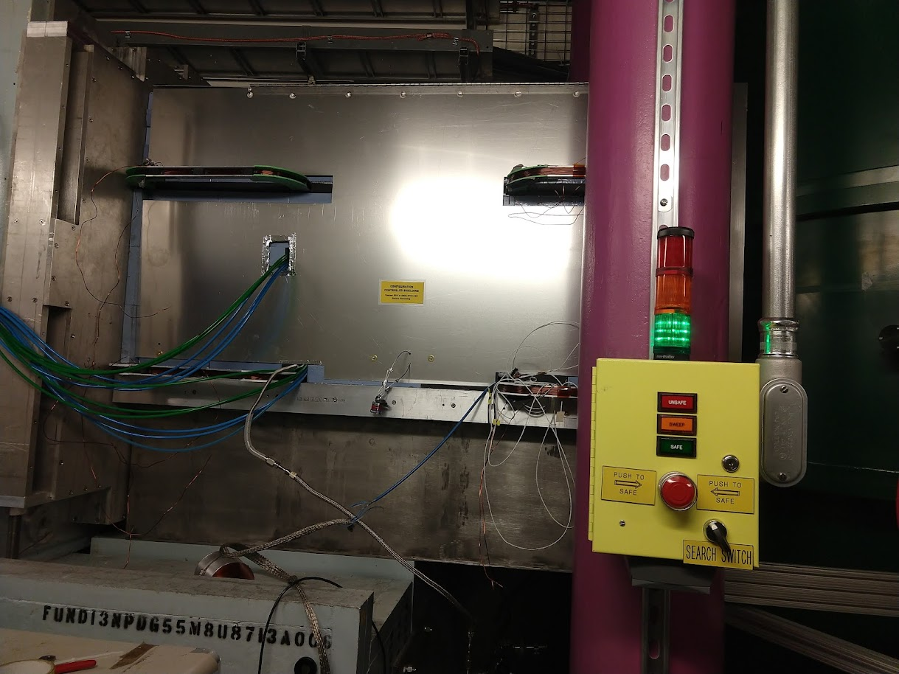
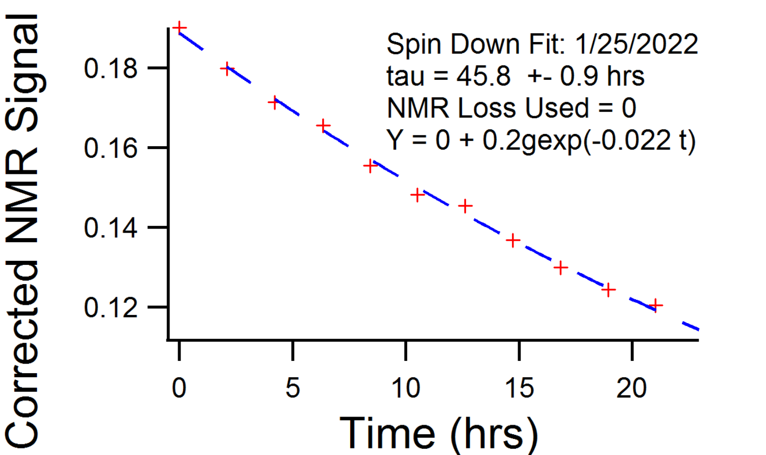
Equipment for Polarimetry
Measuring ³He Polarization Lifetime
Polarize ³He cell using Spin Exchange Optical Pumping
Transfer Cell to environment
We lose some polarization in this process
Measure relative polarization using Free Induction Decay (FID) over various timing intervals (hrs)
Use the amplitude of the FID signals to examine the decay of polarization over time

Slide 20
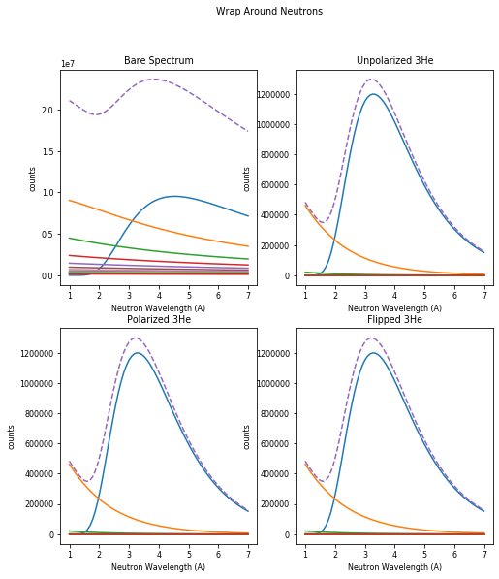
Polarimetry
Simulated Wrap Around Neutrons
Our DAQ takes “frames” of data at a rate of 60Hz
This coincides with the neutron pulses from the SNS
Neutron pulses overlap
We have concerns about the Choppers imparting or modifying the polarization of the beam, so we will need to be able to examine the overlapping specra from the monitor.
We can fit for spectrum parameters and reconstruct a single pulse
We will monitor temperatures of various devices, and currents to watch for drifts that may affect the efficiency of the Spin Flipper.
We will also monitor the incoming neutron beam with an upstream monitor to normalize and correct for fluctuations in beam power.

Slide 21
Polarimetry for the Nab Experiment
Measuring A Polarization by Flipping ³He
Flipping the ³He yields a more complicated analysis, but might be more easily achievable
We can measure our flipping efficiency independently of the Neutrons using FID signals from the ³He
Efficiencies of 92-99% have been recorded in the lab
$$CTR=\frac{T_{+}−T_{−}}{T_{+}+T_{−}}=\tanh{cP_{H}ε_{H}λ}\frac{\sinh{cP_{H}λ\left(1−ε_{H}\right)}−P_{n}\cosh{cP_{H}λ\left(1−ε_{H}\right)}}{\cosh{cP_{H}λ\left(1−ε_{H}\right)+P_{n}}\sinh{cP_{H}λ\left(1−ε_{H}\right)}}$$
If ε_{H} ≈1 this becomes
$$CTR=\frac{T_{+}−T_{−}}{T_{+}+T_{−}}=P_{n}tanh{cP_{H}λ}$$
³He
Analyzer
AFP Neutron Spin Flipper
Normalizing
Monitor
Analyzing
Monitor

Slide 22
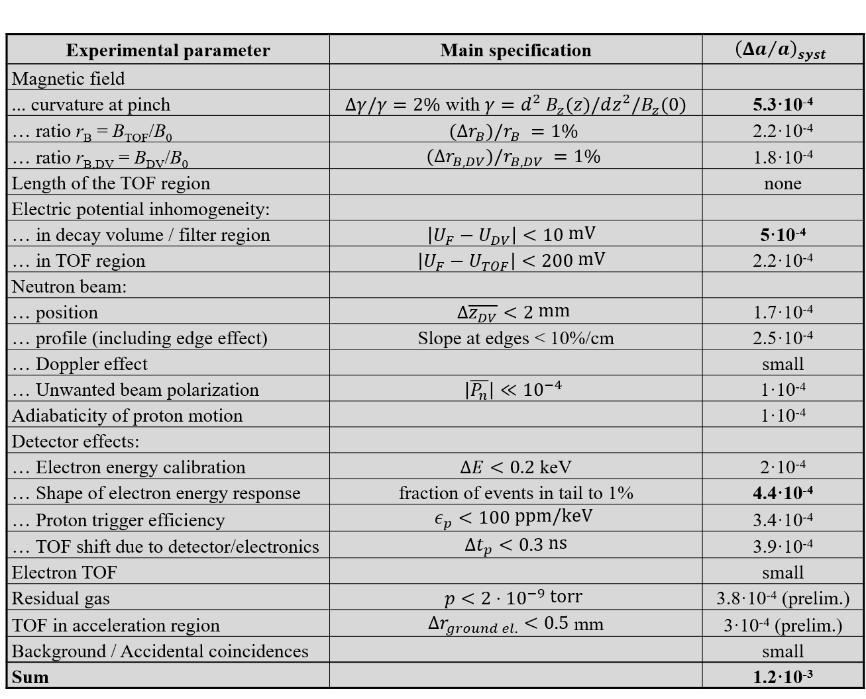
The Nab Experiment
Systematic Uncertainties
P_{n}<2∙10⁻⁵

